Slide 1
Author Identification in Online Text
Guide : Mohd. Ahsan Chishti
Co Guide : Asim
Kishan Kumar Mishra
Mayank Kumar Gupta

Slide 2
Introduction
Introduction
Authorship Identification is the task of identifying who wrote a
given piece of text from a given set of candidate authors .
From Machine Learning perspective it can be viewed as multiclass
single label classification problem.
With the rapid growth of Internet, focus has shifted to author
identification in online text.
Online texts are much harder to classify as the content is less.

Slide 3
Problem statement
Given a set of documents each labeled with its author name, learn a function which can identify the author of an unlabelled document.
author1
author2
author1
author2
author1
author2
Training data
learning
?
author1
Hypothesis function

Slide 4
Literature survey
Year | People invloved | Dataset | Work done | Features used | Method of classification
1887 | Corwin Mendenhall | Works of Shakespeare and Bacon. | Classified the works of Shakespeare and Bacon | Frequency of different word lengths. | Manual
1964 | Mosteller and Wallace | A series of political papers known as Federalist papers. | Resolved the authorship dispute between madison and Hamilton regarding federalist papers. | Frequency of function words. | Bayesian probability
1987 | Burrows | Federalist papers. | Showed the capability of function words in discriminating authors. | 50 most frequent function words. | Principal Component Analysis.

Slide 5
Year | People invloved | Dataset | Work done | Features used | Method of classification | Conclusion
2001 | Corney | E-mail | Author identification in email. | Multiple features. | Support Vector Machines. | Structural features provide significant improvement in accuracy.
2006 | Rong Zheng | English and chinese message boards. | Comparison of stylometric features on english vs chinese language | Multiple features. | SVM, Neural networks, Decision trees | SVM performed better than other algos.
2010 | Marcia Fissette | fok.nl a dutch message board | Comparison of unigram and bigram approach including and excluding smileys. | Unigrams Bigrams Smileys | Support Vector Machines. | Unigrams are better than bigrams. Including smileys improve accuracy.

Slide 6
Motivation
Much of the work in the field of Author Identification has been done on classification of texts written in English.
No work has been done on classification of Hindi texts.
Our aim is to classify texts written in Hindi.

Slide 7
Flowchart
start
Collect data
Low level feature extraction
Normalize features
Change
Feature selection
No
High level feature extraction
Satisfied with accuracy
Yes
Apply machine learning algorithm
stop

Slide 8
Bag of words
Different authors use different words
Difference in word usage can be used to identify authors

Slide 9
Function words
Functions words express grammatical relationship between other words.
Conjunctions
Pronouns
Prepositions

Slide 10
Function words
No function words list available for Hindi
If x is a function word → x occurs frequently
If x occurs frequently → x is a function word
Fails when authors write on the same topic. The topic itself becomes a frequent word but not a function word.
Yet it holds most of the times. So frequent words can approximate function words.

Slide 11
Function words
How to get frequent words
A word is frequent if it occurs in more than a specified percentage £ of total number of documents.
£=0.9
Total documents=100
Then the word must appear in
Fails when authors write on the same topic. The topic itself becomes a frequent word but not a function word.
Yet it holds most of the times. So frequent words can approximate function words.

Slide 12
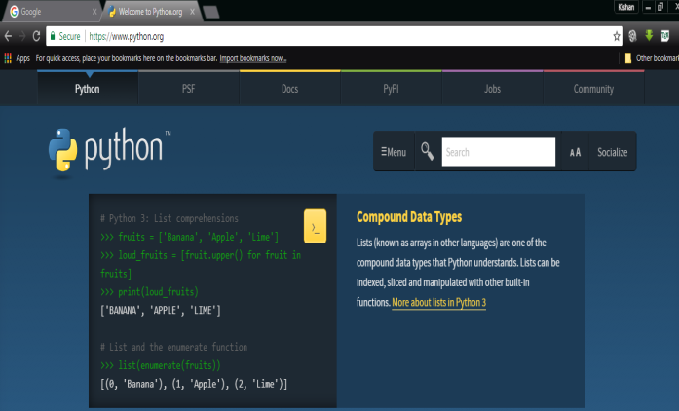
Web Scraping libraries
Urllib2 :
Used to fetch a web page
BeautifulSoup :
Used to extract content out of a web page
<!doctype html>
<html>
<head>
</head>
<title>
Python introduction
</title>
<body>
….
</body>
</html>
<!doctype html>
<html>
<head>
</head>
<title>
Python introduction
</title>
<body>
….
</body>
</html>
Python is a programming language that lets you work quickly and integrate systems more effectively
BeautifulSoup(Page)
Page=Urllib2.urlopen(“python.org”)
HTML Source code
HTML Source code
Web page
Content

Slide 13
Pandas
This library provides data manipulation and analysis functionality.
Main Structures:
Dataframe
DataFrame is a 2-dimensional labeled data much like a SQL table.
Series
Series is a one-dimensional labeled array capable of holding
any data type

Slide 14
Sklearn
This library provides implementations of Machine learning algorithms.
It provides algorithms for :
Classification
Regression
Dimensionality reduction
Clustering
Data preprocessing

Slide 15
NLTK
This library is specifically developed for Natural Language Processing.
It provides various tools such as:
Tokeniser
Parser
Part of Speech Tagger

Slide 16
Timeline of project

Slide 17
THANK YOU

