Slide 1




Next Gen Employability Program
Full Stack Web Development with AI Tools
Team Details – NG_CP_Team_419
Name: Mayank Kishan Mathur
Name: Ashutosh Singh Negi
Name: Nikhil Shardul Haq Jha
Name: Ashutosh Ranjan
Name: Milind Parashar
College: Inderprastha Engineering College, Ghaziabad

Slide 2

The content is curated from online/offline resources and used for educational purpose only.
Notes:
Speaker would be briefing the students that this content has been prepared for the educational purpose only and is referred from multiple sites which are cited in the last.​​
---------------------------------------------------​​
A disclaimer is a statement or notice that is intended to clarify, limit, or provide information about the scope, limitations, or potential risks associated with certain actions, information, products, services, or content. ​​
​​
​

Slide 3

Project Title
MEDIBRIDGE:HOSPITAL MANAGEMENT SYSTEM
Notes:
In this slide speaker will be introducing the program and its outcomes. The speaker will introduce himself in brief

Slide 4

Table of Contents
Introduction
Problem Statement
Proposed Solution
Key Features
Technology Stack
System Flowchart
Core Modules
Security Measures
Conclusion and Future work
References
Notes:
This slide, The speaker will talk about the content that we will be covering in this session as follows:
Introduction
Importance of UI/UX in industry
History and Definitions of UI and UX
Key Differences between UI/UX
Use Cases
Significance in Web Development
Use Cases
Visual Design Principles
Design process
Color theory and psychology
Typography and readability
Layout and Spacing
Responsive design basics
Usability and Accessibility
Usability Aspects
Web Content Accessibility Guidelines (WCAG)
Inclusive design practices
Consistency
User Experience
User-Centered Design
User research methods
Interactive Elements and Feedback
Mini Case Study
Discussing a popular UI/UX design
Hands-On
Introduction to Figma for UI/UX design

Slide 5
Introduction
MediBridge is an online healthcare platform that brings patients and doctors together in one easy-to-use system. It allows patients to book appointments online and access personalized dashboards, while doctors can manage consultations efficiently. The platform also includes an ML-based self-diagnosis feature that helps patients understand possible health conditions and find suitable doctors quickly. With direct redirection from diagnosis to appointment booking, MediBridge reduces waiting time and makes healthcare more accessible and convenient.
Notes:
This slide, The speaker will talk about the content that we will be covering in this session as follows:
Introduction
Importance of UI/UX in industry
History and Definitions of UI and UX
Key Differences between UI/UX
Use Cases
Significance in Web Development
Use Cases
Visual Design Principles
Design process
Color theory and psychology
Typography and readability
Layout and Spacing
Responsive design basics
Usability and Accessibility
Usability Aspects
Web Content Accessibility Guidelines (WCAG)
Inclusive design practices
Consistency
User Experience
User-Centered Design
User research methods
Interactive Elements and Feedback
Mini Case Study
Discussing a popular UI/UX design
Hands-On
Introduction to Figma for UI/UX design

Slide 6
Problem Statement
Traditional hospital systems suffer from:
Long waiting times for doctor consultations
Lack of preliminary guidance for patients before booking appointments
Manual and inefficient appointment management
No intelligent support to guide patients to the correct medical specialist
Poor digital coordination between patients and doctors
Notes:
This slide, The speaker will talk about the content that we will be covering in this session as follows:
Introduction
Importance of UI/UX in industry
History and Definitions of UI and UX
Key Differences between UI/UX
Use Cases
Significance in Web Development
Use Cases
Visual Design Principles
Design process
Color theory and psychology
Typography and readability
Layout and Spacing
Responsive design basics
Usability and Accessibility
Usability Aspects
Web Content Accessibility Guidelines (WCAG)
Inclusive design practices
Consistency
User Experience
User-Centered Design
User research methods
Interactive Elements and Feedback
Mini Case Study
Discussing a popular UI/UX design
Hands-On
Introduction to Figma for UI/UX design

Slide 7
Proposed Solution
MediBridge provides an integrated digital healthcare platform with:
Online patient and doctor Portals
Appointment scheduling and tracking
A Self-Diagnosis portal using Machine Learning
Automatic doctor recommendation based on predicted specialization
Seamless redirection to appointment booking with pre-filled details
Notes:
This slide, The speaker will talk about the content that we will be covering in this session as follows:
Introduction
Importance of UI/UX in industry
History and Definitions of UI and UX
Key Differences between UI/UX
Use Cases
Significance in Web Development
Use Cases
Visual Design Principles
Design process
Color theory and psychology
Typography and readability
Layout and Spacing
Responsive design basics
Usability and Accessibility
Usability Aspects
Web Content Accessibility Guidelines (WCAG)
Inclusive design practices
Consistency
User Experience
User-Centered Design
User research methods
Interactive Elements and Feedback
Mini Case Study
Discussing a popular UI/UX design
Hands-On
Introduction to Figma for UI/UX design

Slide 8
Key Features
Secure patient and doctor login with role-based dashboards.
Online appointment booking and status tracking.
ML-based self-diagnosis using symptom selection.
Automatic doctor recommendation based on specialization.
Doctor availability and appointment management.

Slide 9
Technology Stack
Frontend – HTML, CSS, Bootstrap, JavaScript.
Backend – Python, Django.
Authentication & Security – Django built-in authentication system.
Machine Learning – Scikit-learn, Joblib.
Database – SQLite3 (development).
Tools – VS Code, Git, Django ORM.

Slide 10
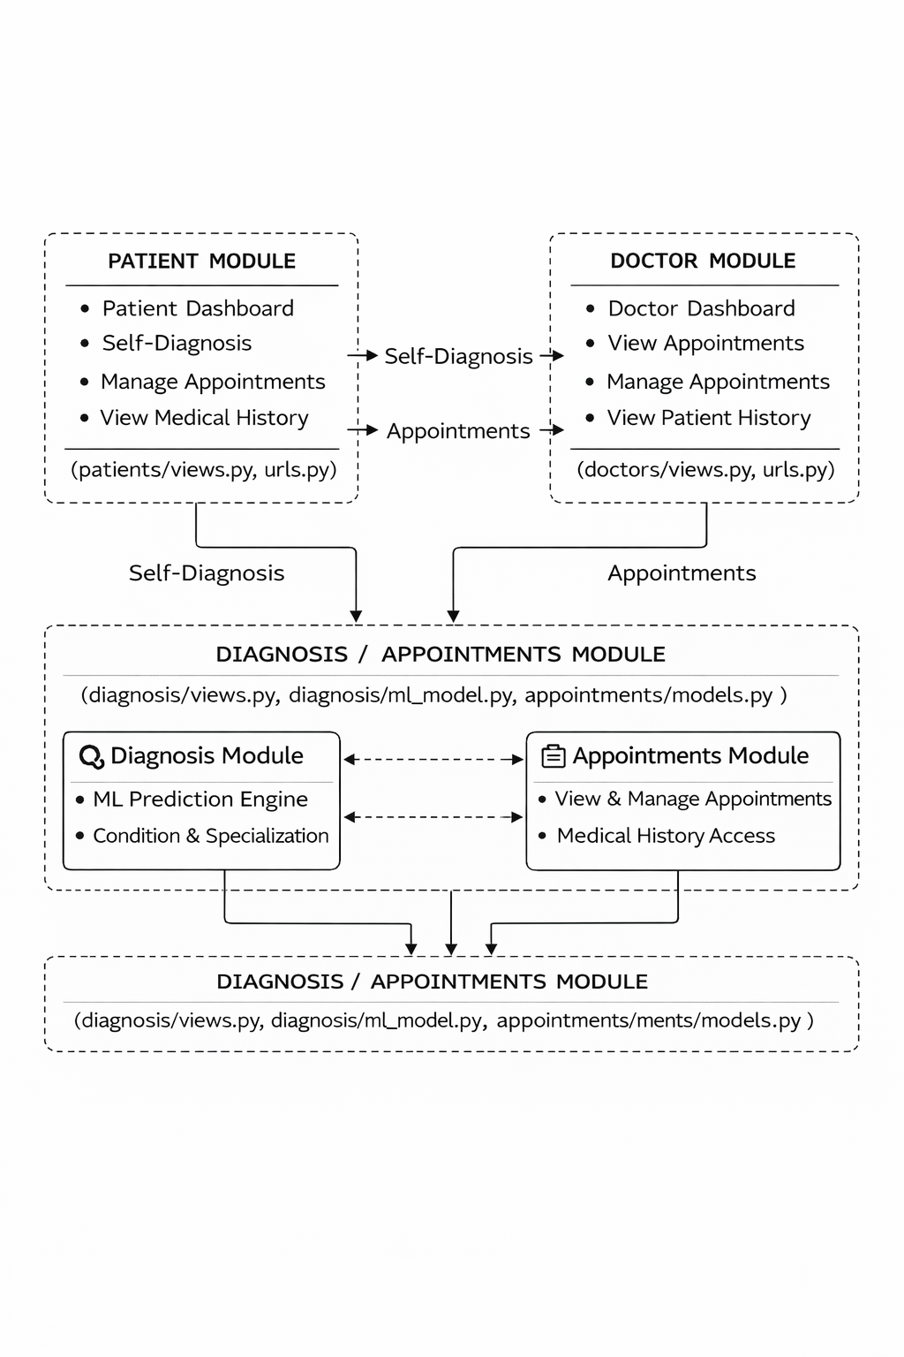
System Flowchart

Slide 11
Core Modules
Patient Module: Registration and login, patient dashboard , self-diagnosis access.
Doctor Module: Doctor registration and login, doctor dashboard, appointment viewing and status handling, and availability management.
Appointment Module: Appointment booking, doctor selection, and appointment status tracking.
Diagnosis Module (ML Module): Symptom selection (Yes/No), machine-learning based condition prediction, specialization mapping, confidence scoring.

Slide 12
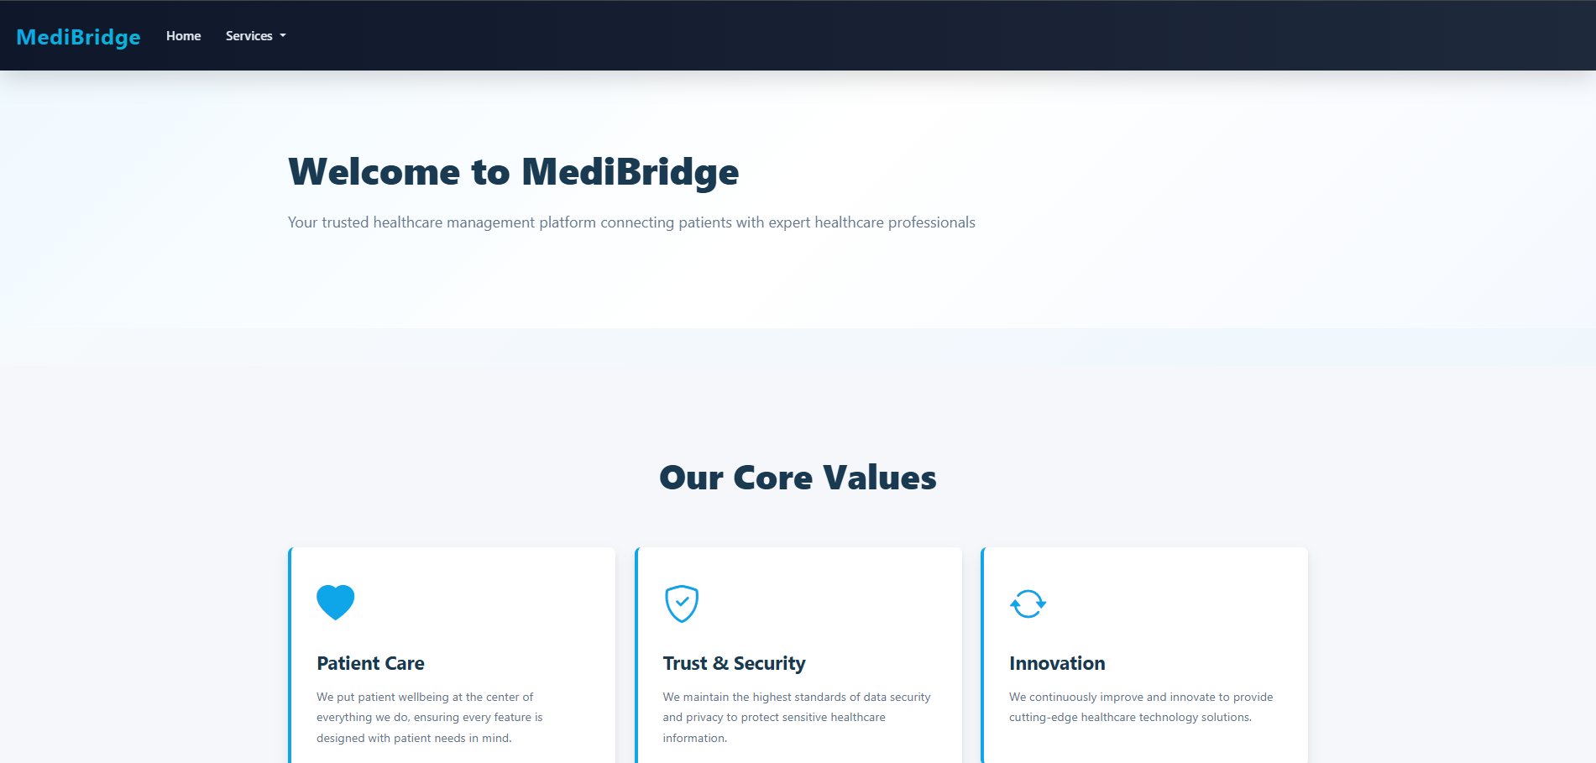
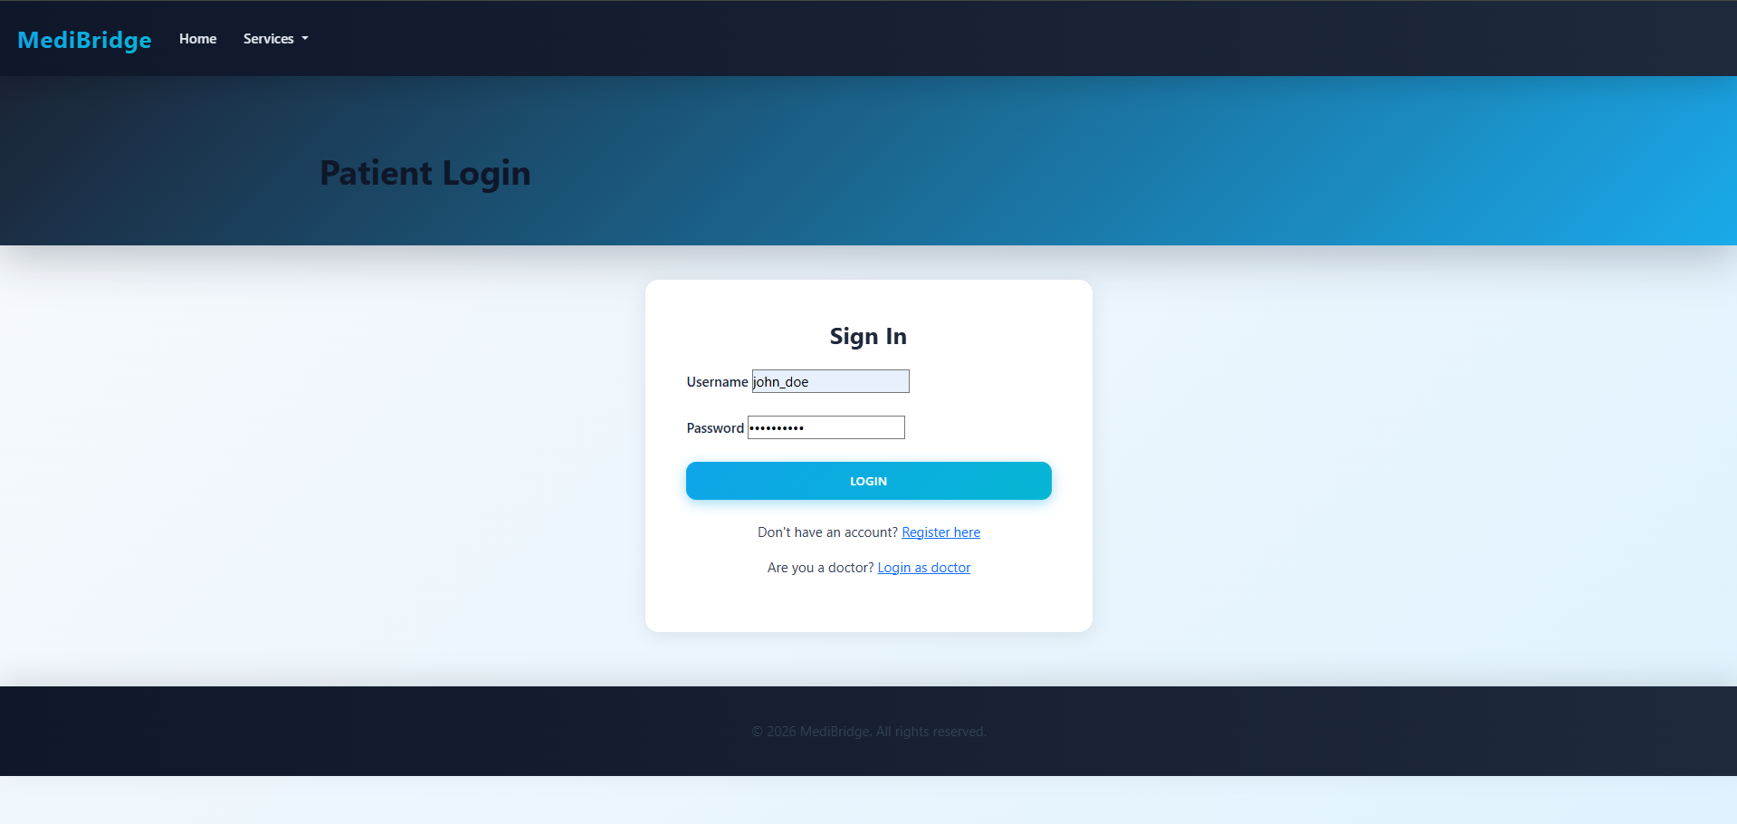

Slide 13
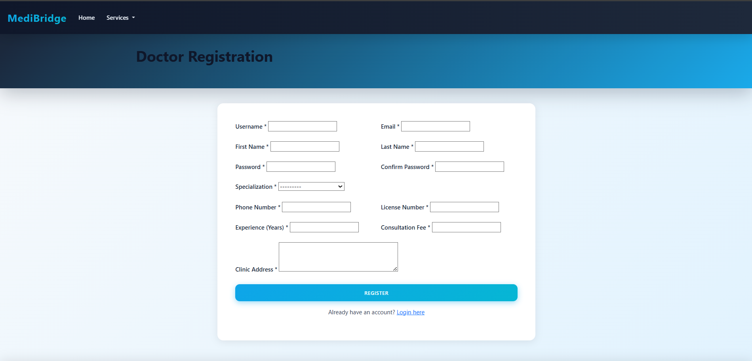
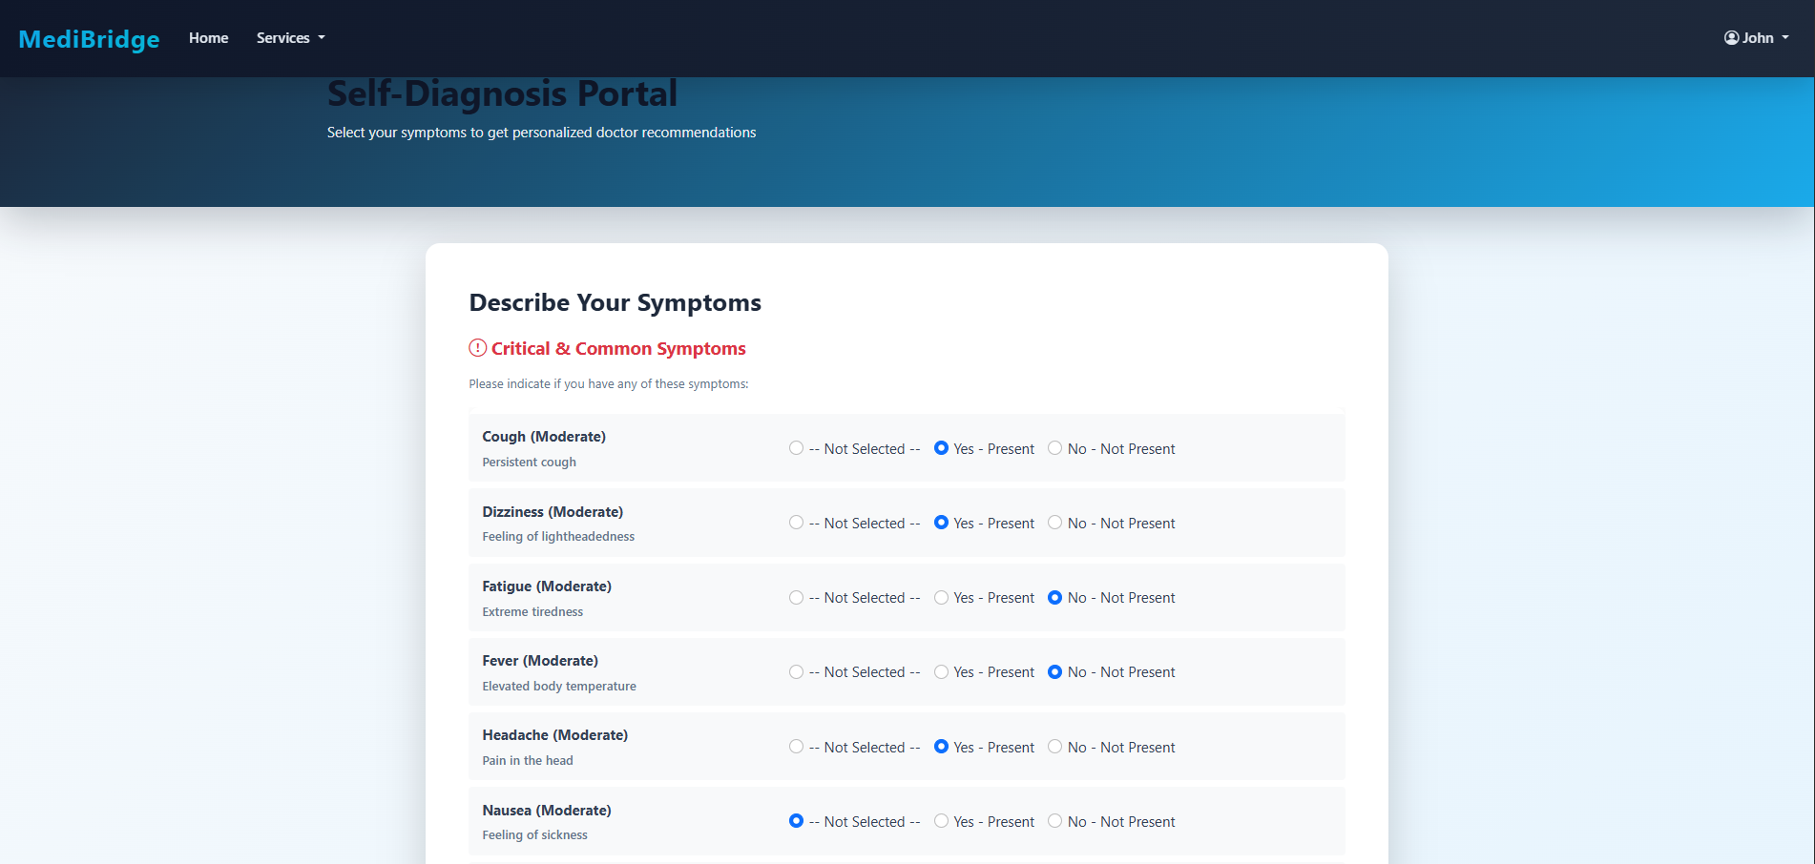

Slide 14
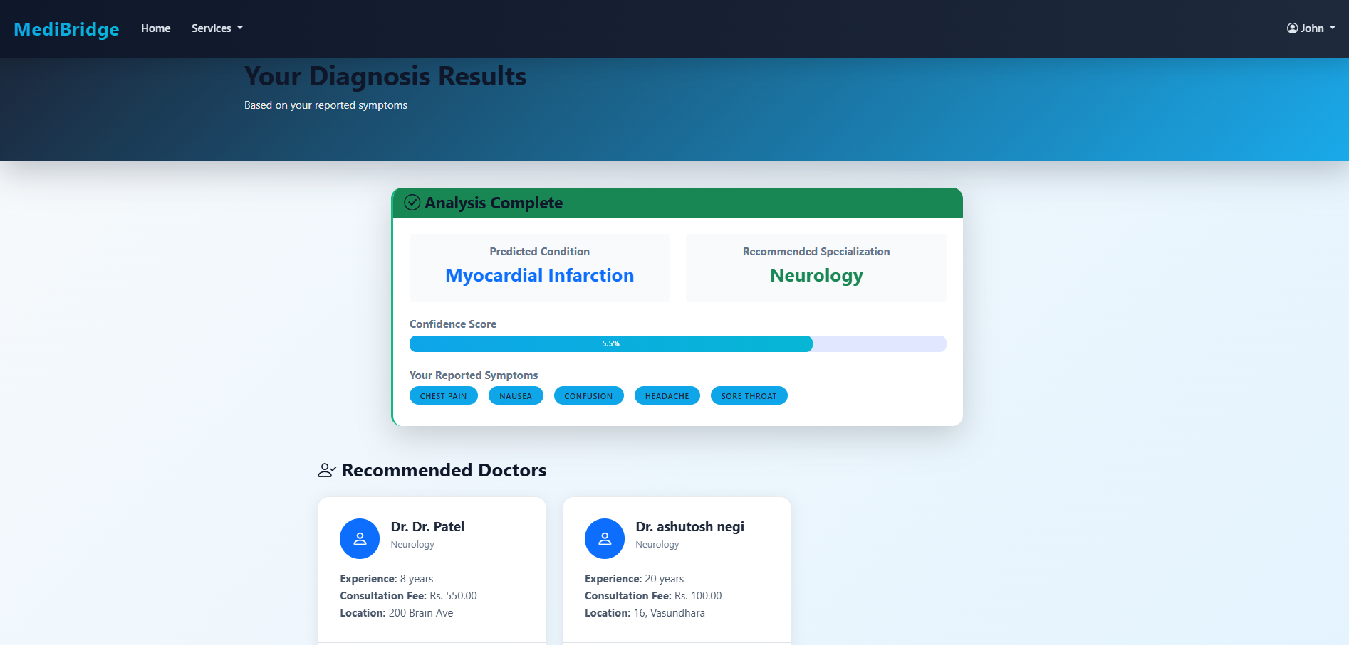
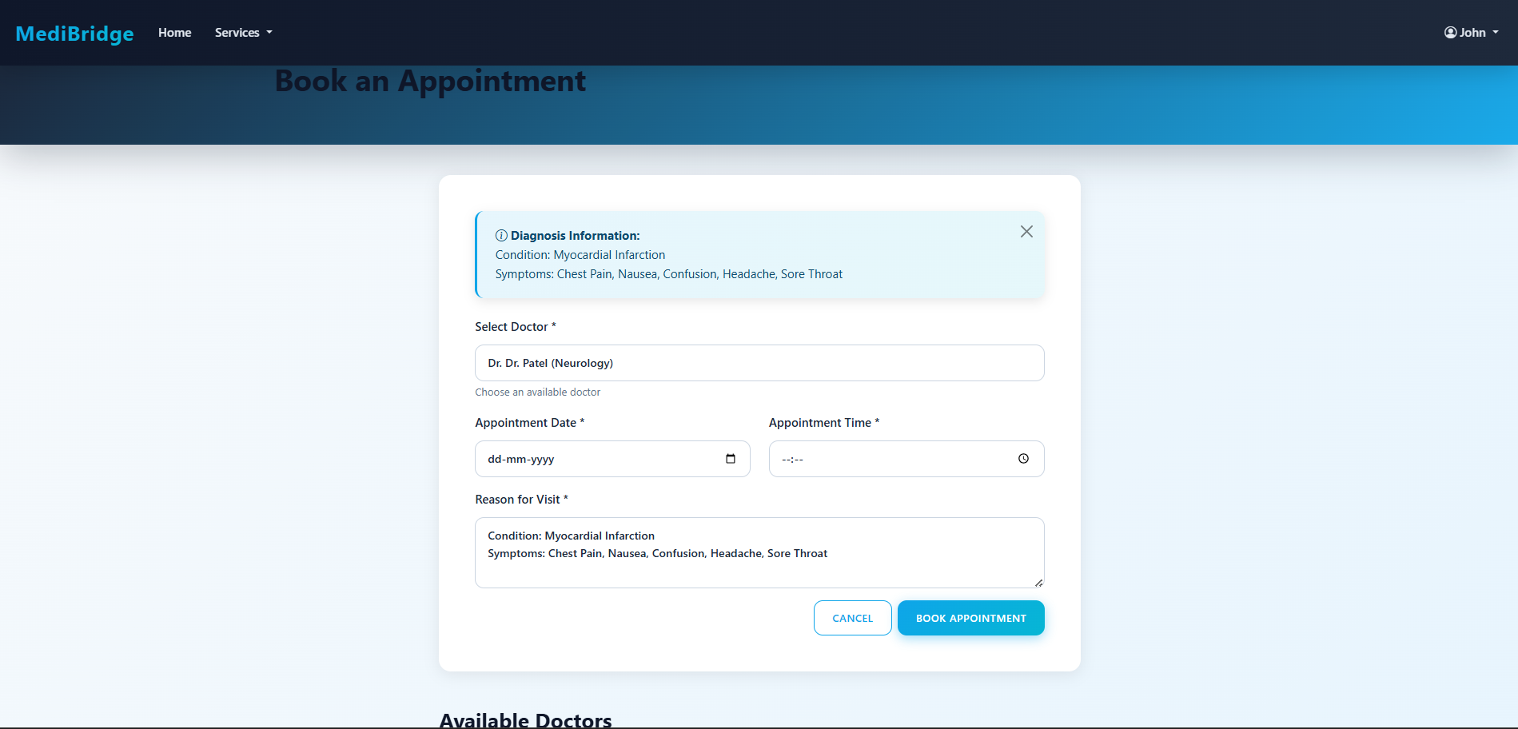

Slide 15

Security Measures
Django authentication system
Role-based access (patient / doctor)
Session-based login
CSRF protection for all forms
Input validation using Django forms
Access control for dashboards
Server-side data processing only
No direct database exposure

Slide 16
Conclusion
MediBridge integrates appointment management, doctor availability control, and a machine-learning based self-diagnosis and recommendation system into a single healthcare platform. It enables a smooth flow from symptom analysis to doctor selection and booking, helping patients reach the right specialist faster while improving overall hospital efficiency.
Future work
In the future, the system can be enhanced using real medical datasets and more advanced models, along with features such as a mobile application, multilingual support, video consultations, real-time scheduling, hospital system integration, online payments, and digital prescriptions.

Slide 17
References
https://www.udemy.com/course/hospital-management-system-using-django
https://phpgurukul.com/hospital-management-system-using-python-django-and-mysql
https://github.com/sumitkumar1503/hospitalmanagement
https://www.scribd.com/document/875329232/100613941398
https://www.researchgate.net/publication/384423677_Hospital_Management_System_Using_PYTHON_DJANGO
Notes:
This slide, The speaker will talk about the content that we will be covering in this session as follows:
Introduction
Importance of UI/UX in industry
History and Definitions of UI and UX
Key Differences between UI/UX
Use Cases
Significance in Web Development
Use Cases
Visual Design Principles
Design process
Color theory and psychology
Typography and readability
Layout and Spacing
Responsive design basics
Usability and Accessibility
Usability Aspects
Web Content Accessibility Guidelines (WCAG)
Inclusive design practices
Consistency
User Experience
User-Centered Design
User research methods
Interactive Elements and Feedback
Mini Case Study
Discussing a popular UI/UX design
Hands-On
Introduction to Figma for UI/UX design

