Slide 1
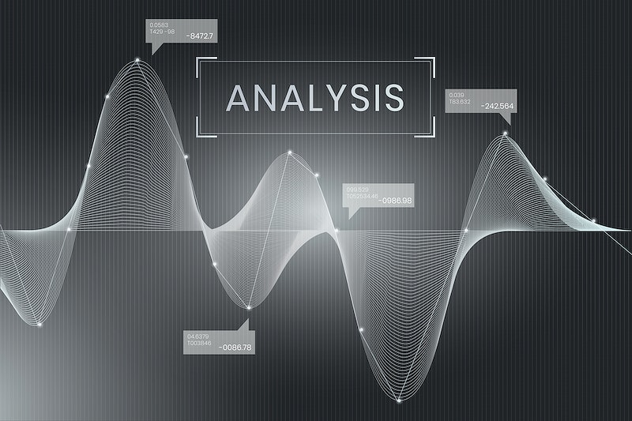
Unlocking Investment Insights:
A Data Analyst's In-Depth Exploration of Moody's Stock Performance (1994-2023)"
Mayank Koundal
Notes:
Line spacing + Page numbers

Slide 2
Agenda
01. Introduction
02. Data Pre-Processing
03. Visualising Columns
04. Trading Volume
05. Line Plots
06. Correlation Matrix
07. Daily Returns
08. Moving Averages
09. Time Series Decomposition
10. Results

Slide 3



Introduction
Moody's Corporation is a credit rating agency that provides research, analytics, and advisory services to investors, institutions, and governments. Analyzing its stock data can help understand the company's financial performance, risk factors, and market trends.
This report showcases the EDA performed on the historical stock data of Moody's Corporation and serves as a portfolio piece for a data analyst.

Slide 4
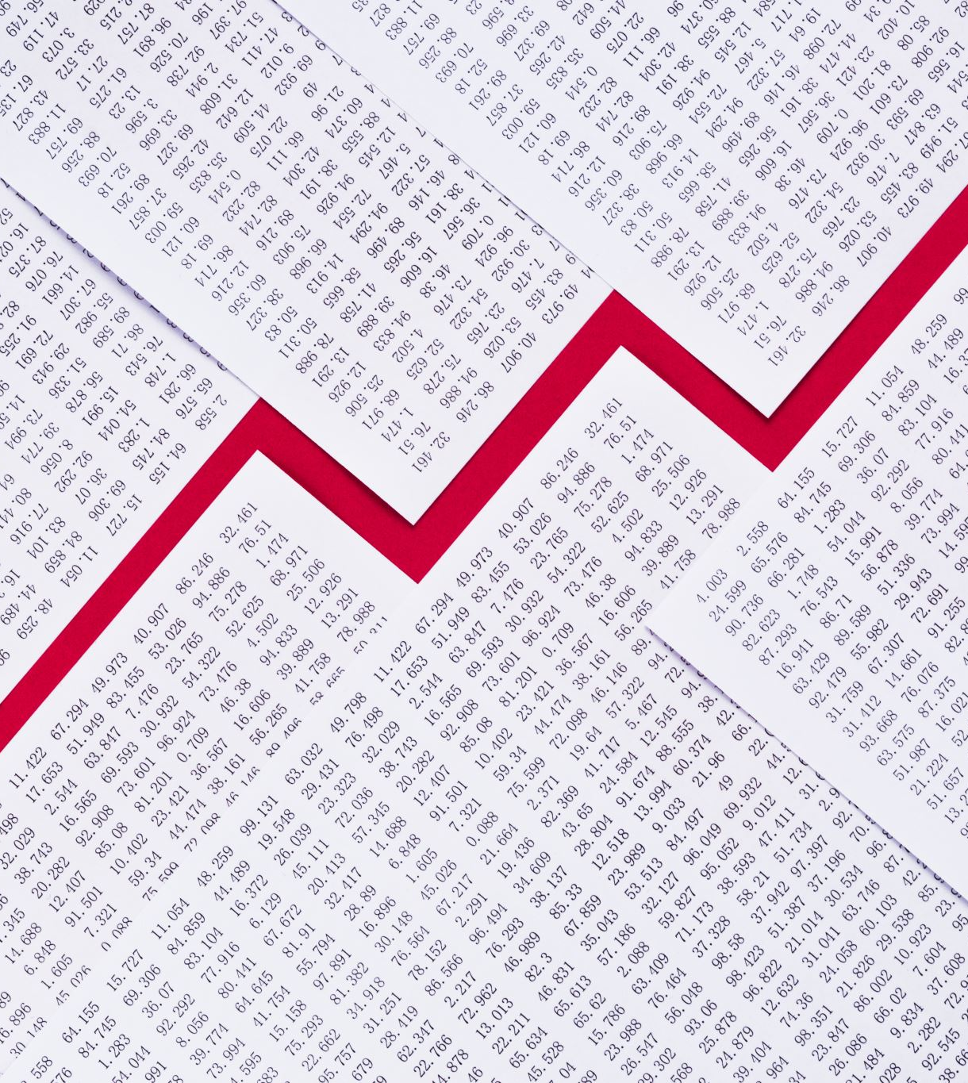
Data Pre-processing
The data preprocessing involved the following steps:
Reading the CSV file containing the stock data
Converting the 'Date' column to a datetime object and setting it as the index
Checking for missing values and handling them if necessary
Extracting day names from the datetime index
Creating additional features like daily return and moving averages (SMA_50 and SMA_200)

Slide 5
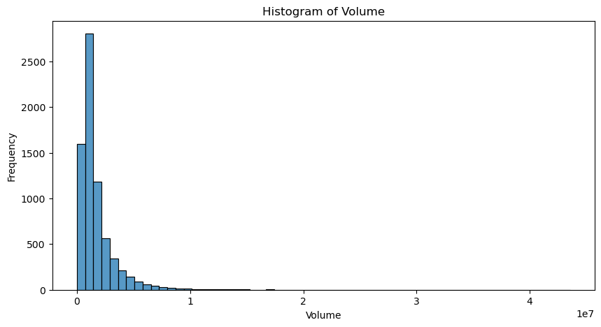
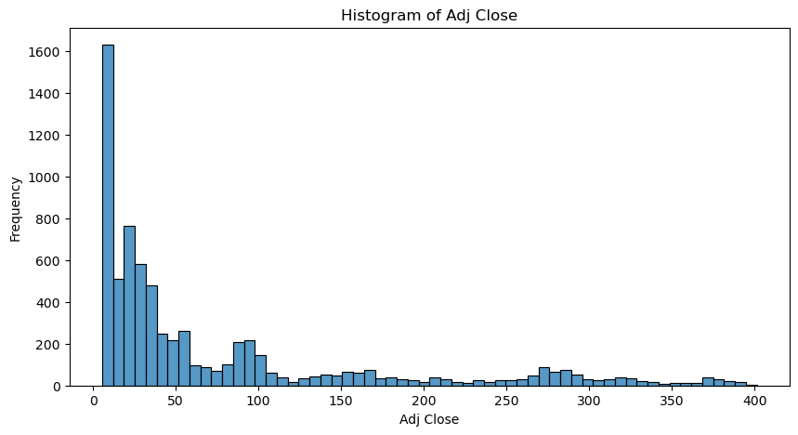
VISUALISING COLUMNS
DAILY ADJUSTED CLOSING

Slide 6
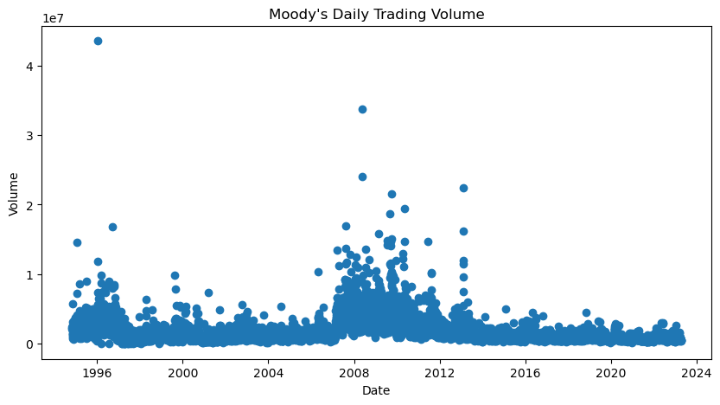
Scatter Plot for daily trading volume

Slide 7
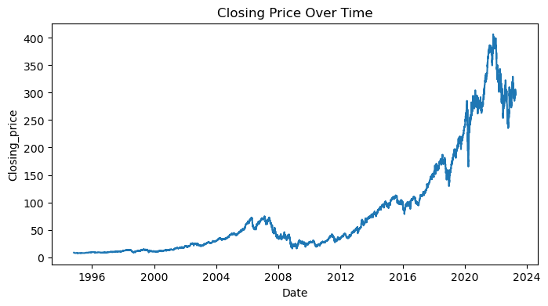
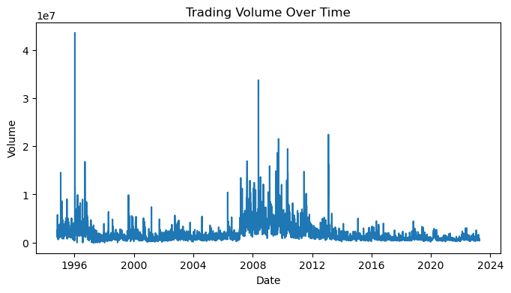
LINE PLOTS

Slide 8
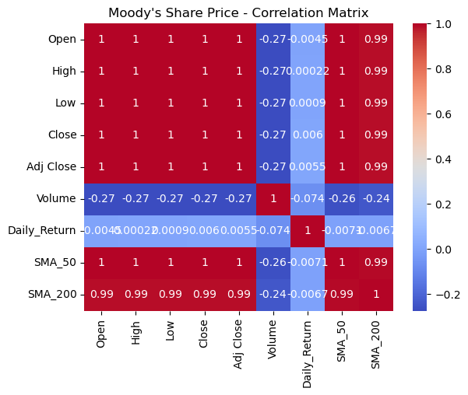
CORRELATION MATRIX
VISUALIZING THE CORRELATION BETWEEN COLUMNS

Slide 9
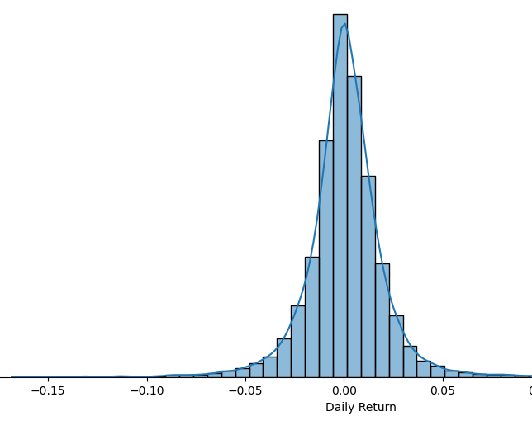
DISTIRBUTION FOR DAILY RETURNS

Slide 10
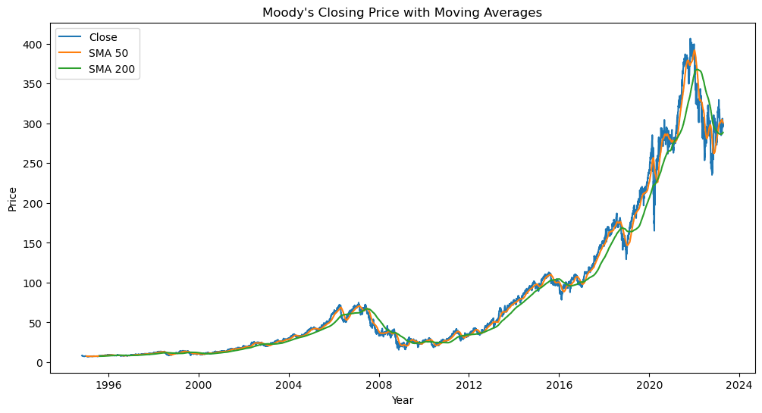
CLOSING PRICE WITH MOVING AVERAGES (SMA_50 AND SMA_200)

Slide 11
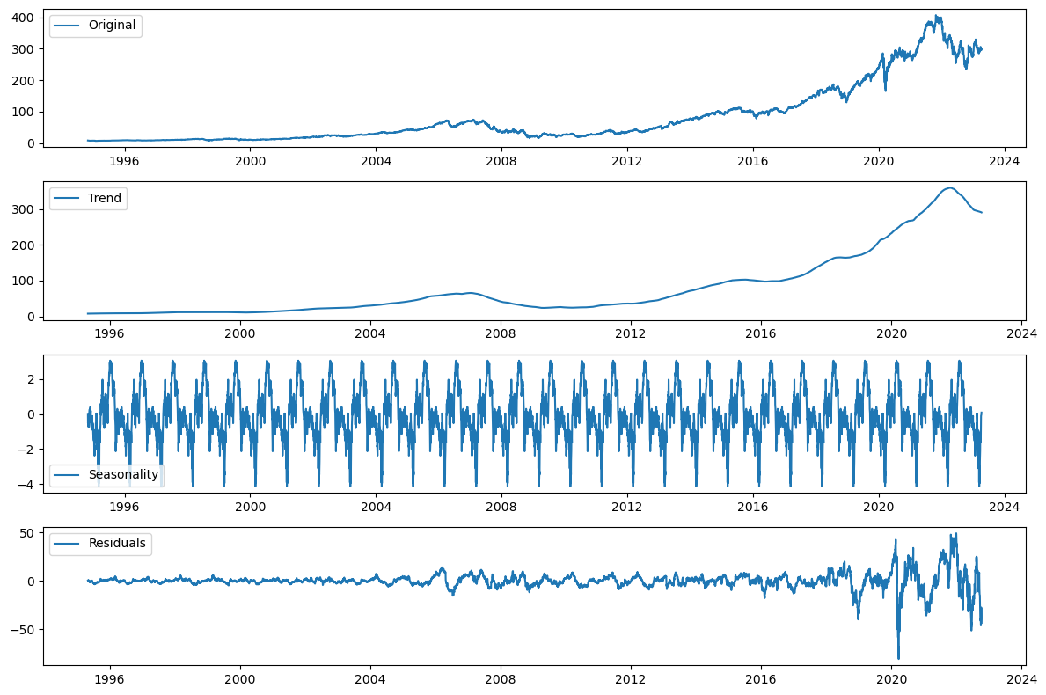
Time Series Decomposition
The time series decomposition was performed using the 'seasonal_decompose' function from the 'statsmodels' library with an additive model and a period of 252 days (approximate number of trading days in a year). The decomposition resulted in the following components:
Trend
Seasonality
Residuals

Slide 12
SUMMARY
Which attributes exhibit correlation, and what is the nature of their relationships?
In the dataset, the columns 'Open', 'High', 'Low', 'Close', and 'Adj Close' exhibit a strong correlation of 1 with each other, indicating a near-perfect positive relationship. On the other hand, the 'Volume' column has a comparatively weaker correlation of 0.27 with these other columns, suggesting a more limited degree of association between trading volume and the other attributes.
How has the stock liquidity varied over time ?
Stock liquidity is often linked to trading volume. High volumes imply greater liquidity, facilitating easier buying or selling without significant price impacts. In contrast, low volumes suggest lower liquidity and larger price fluctuations. Moody's stock initially had higher trading volumes, which began to decrease over time. The 2007-2011 period was favorable with higher-than-average volumes, indicating enhanced liquidity. However, since 2012, volumes have decreased with yearly fluctuations, suggesting changes in stock liquidity over time.

Slide 13
SUMMARY
How do the short-term (50-day) and long-term (200-day) moving averages relate to the stock price?
The visualization of the closing price with the 50-day (short-term) and 200-day (long-term) moving averages (SMA_50 and SMA_200) offers insights into potential buy or sell signals based on the crossover points of these moving averages. Specifically, when the short-term moving average crosses above the long-term moving average, it may indicate a buying signal, whereas a cross below the long-term moving average may suggest a selling signal. The crossover of these moving averages serves as a strong indication for making investment decisions.
Are there any other identifiable patterns?
The residual plot is primarily flat with minor fluctuations, indicating that trend and seasonality components capture most data structure, leaving random noise as residuals. However, large spikes from 2021 to 2023 suggest unexplained events or factors. These spikes may be due to company-specific events or broader market influences. To understand these spikes, it's recommended to investigate relevant news articles, financial reports, or information sources during that period. This context can help identify contributing factors, providing valuable insights for future analysis and predictions.

Slide 14
SUMMARY
Are there any specific events which need further investigation ?
The scatter plot for trading volume over time reveals several significant spikes, notably one around 1996 and a few more between 2007 and 2011. The period from 2007 to 2011 appears to be favorable for Moody's stock in terms of volume traded, suggesting increased market activity during that time. However, the large spike observed around 1996 could potentially be an outlier and may warrant further investigation and research to better understand the underlying factors or events driving this unusual trading volume.
Does the stock exhibit any seasonal patterns?
The seasonality plot exhibits constant dips, suggesting the presence of underlying factors or events that cause these recurring patterns in stock prices. In order to better understand the reasons behind these dips, further investigation is needed, which may involve examining the stock's historical performance, company events, or external factors that might have influenced the stock price during those periods. Recognizing and understanding these patterns can provide valuable insights for future analysis and predictions.

Slide 15
Summary
What is the overall trend exhibited by the stock?
The dataset mainly indicates an upward trend in the stock prices however there is a significant dip between 2007 to 2011. Earlier we noticed that this period was favorable in terms of volume traded. Our correlation matrix also showed a weak correlation of 0.27 with stock prices. If there is a large volume of shares being bought or sold, it could indicate that institutional investors are accumulating or distributing shares. Accumulation typically leads to an increase in stock prices, while distribution can cause prices to decline. High trading volume can also confirm an existing price trend. If a stock is trending upward and the trading volume increases, it may reinforce the bullish sentiment and push the stock price higher. Conversely, if a stock is trending downward and the trading volume increases, it could signal a continuation of the bearish trend and lead to lower prices.

Slide 16


Closing
05
Thanks to your commitment and strong work ethic, we know next year will be even better than the last.
We look forward to working together.
Ana
sales@contoso.com

