Slide 1
MAVEN

Slide 2
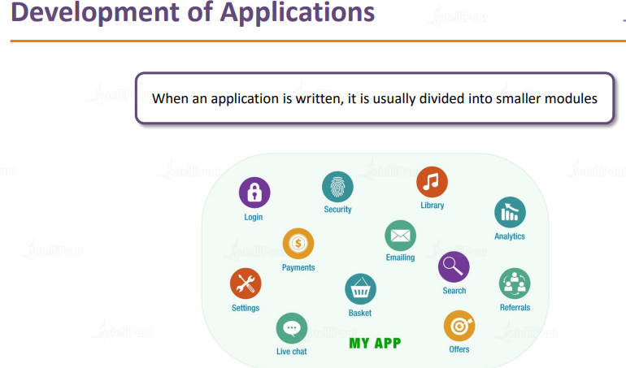
How a application is developed

Slide 3
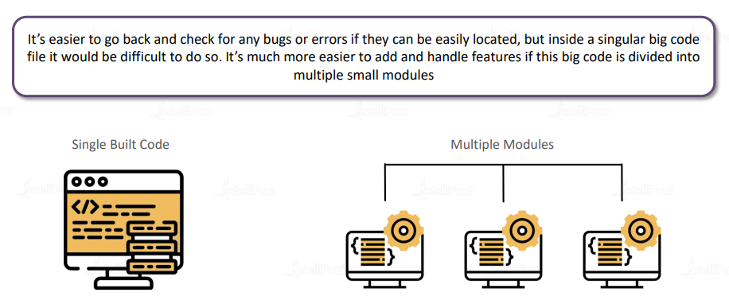
Why are they divided in smaller module

Slide 4
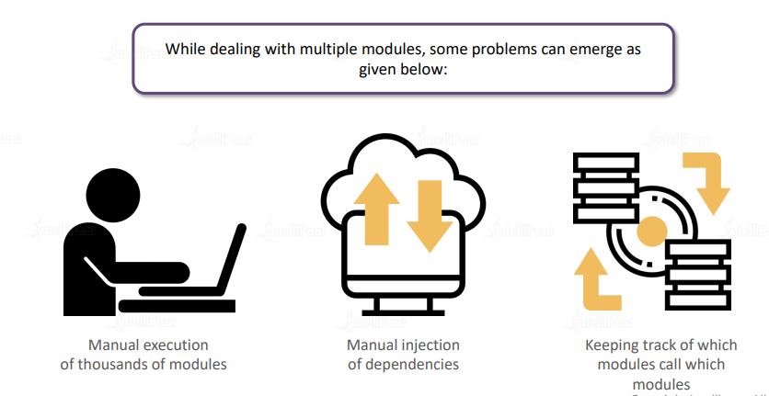
Difficulty with multiple module

Slide 5
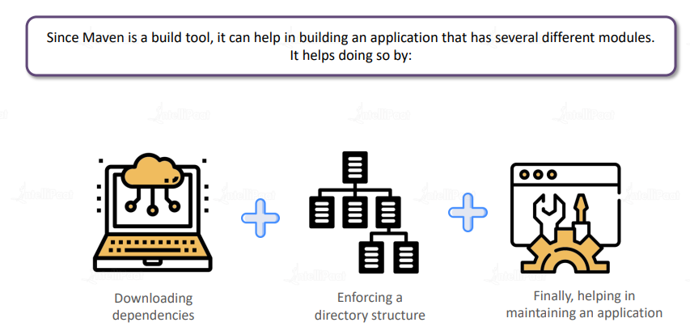
MAVEN Is helpful

Slide 6
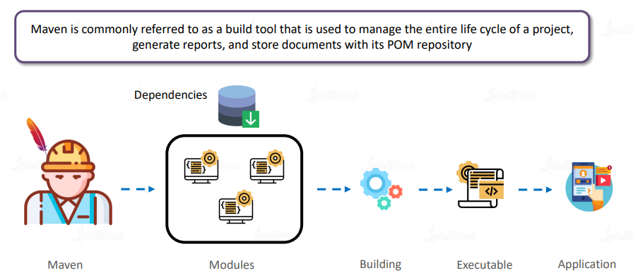
What is MAVEN

