Slide 1
Comparison of Classifiers for Detection of True Complex Variants
Mayank Mahajan
December 2, 2015

Slide 2
Goal
Find a consistent way to identify DNA subsequences called complex variants

Slide 3
Outline
Background
Overview
Results
Methods
Future Work
Acknowledgements

Slide 4
Background
Complex variants
Multi-allelic variation
≥ 1 indel
Health effects
Features

Slide 5
Overview
Feature Extraction
Dimensionality Reduction
Attribute Selection
Classification and Validation

Slide 6
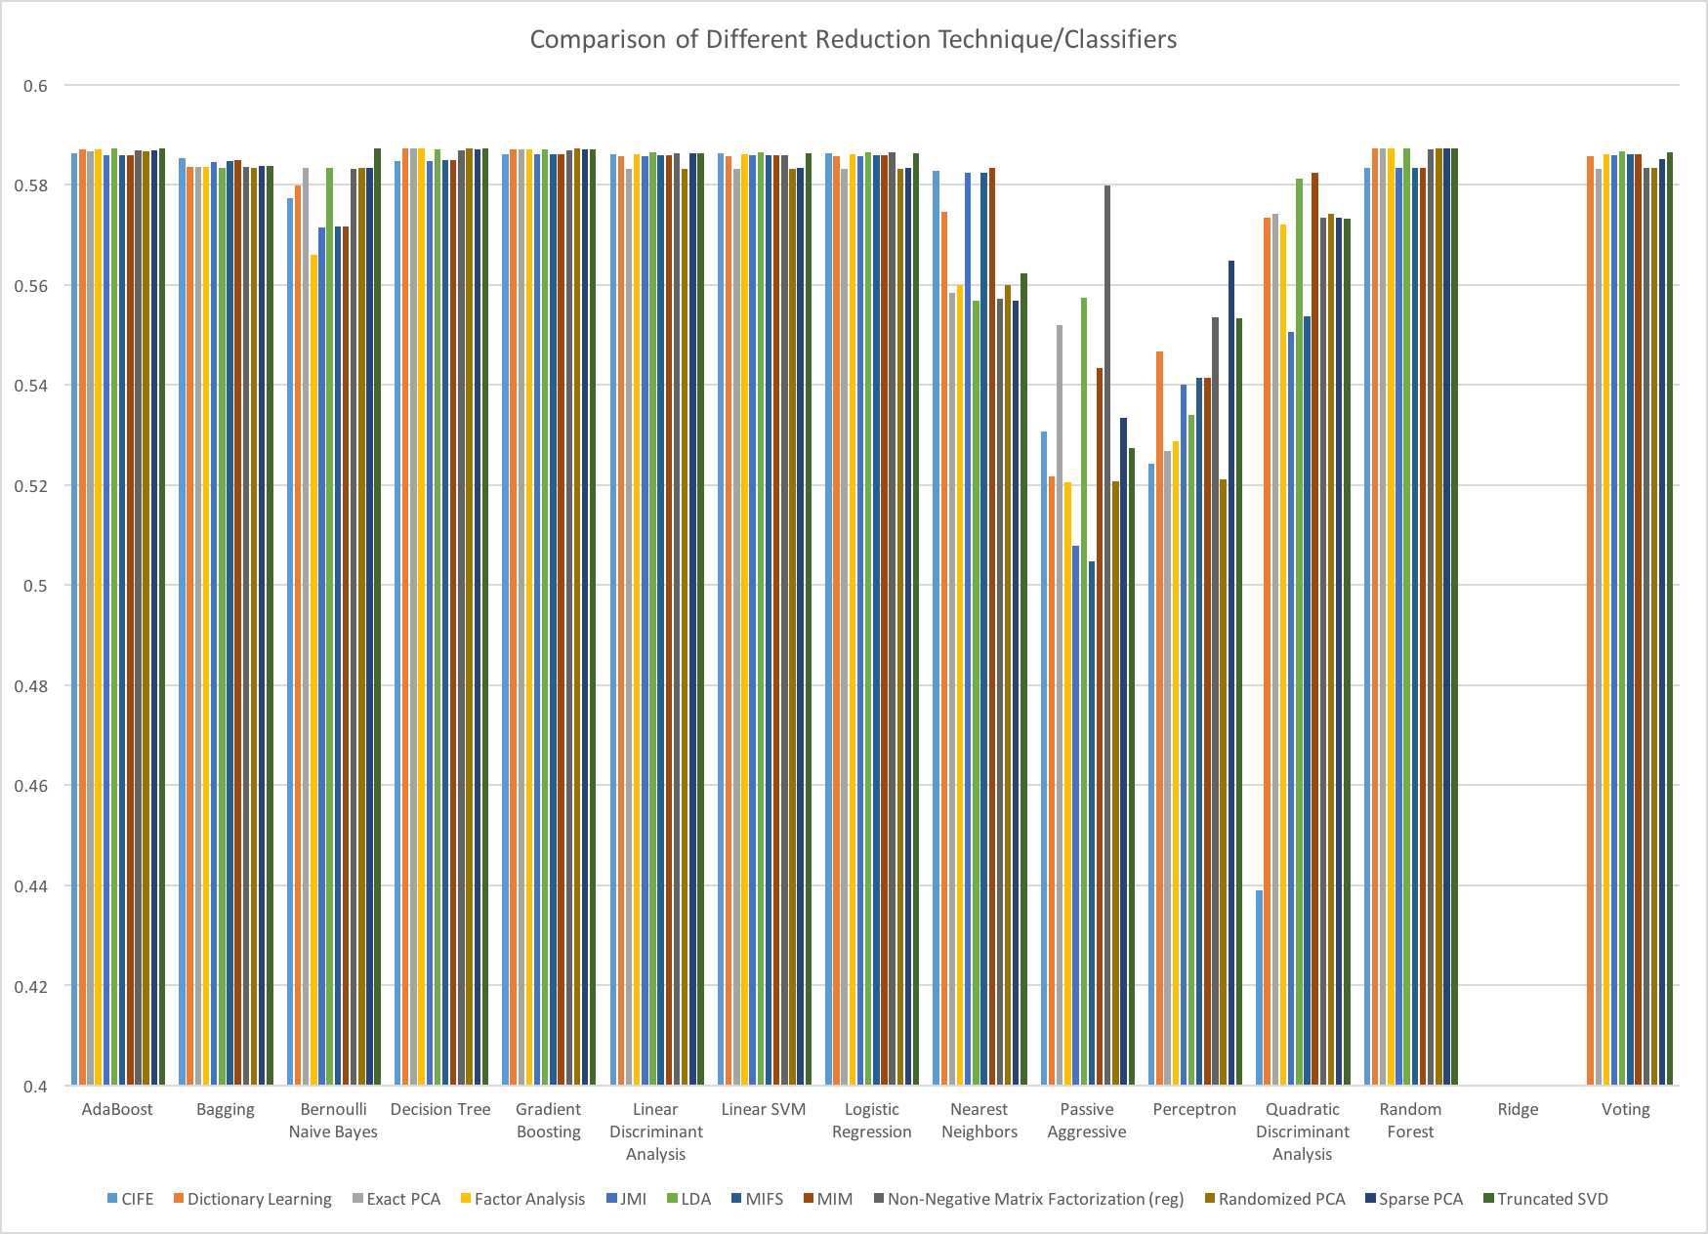
*Not pictured: Ridge classifiers (mean = -.056)

Slide 7
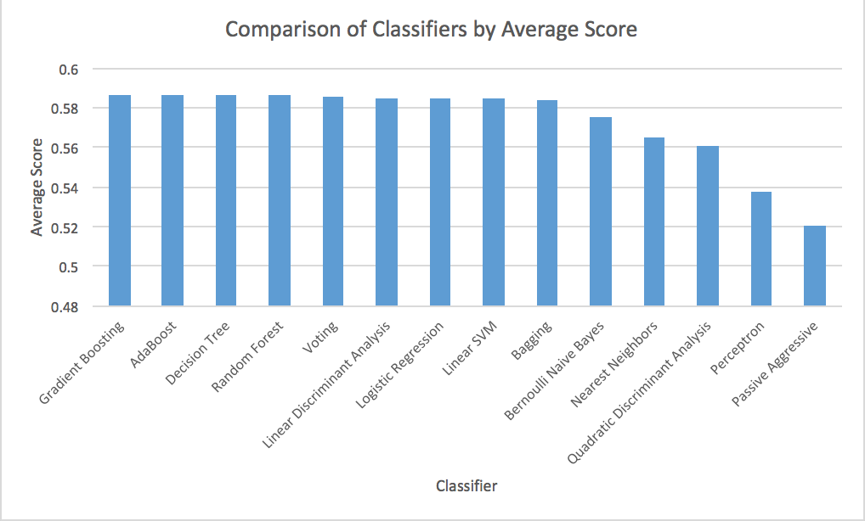
*Not pictured: Ridge classifiers (mean = -.056)

Slide 8
* Not pictured: Bagging, AdaBoost, Gradient Boosting, QDA, Voting Nearest Neighbors

Slide 9
Analysis
Average performance is 57.3% accuracy (not including ridge classifier runs)
Best: AdaBoost, Gradient Boosting
Worst: Perceptron, Passive Aggressive, and QDA
Quick + accurate classifiers: BNB, Decision Trees, Random Forest
Overall not much variation in accuracy at top end

Slide 10
Methods
Dimensionality Reduction: Scikit and PyFeast
Attribute Selection: Not used
Classifiers: Scikit
Validation: We used 10-fold cross-validation for all tests
Data
710,000 samples (> 120 MB) from Complete Genome Pipeline
42 features (ChromHMM)
Reference file: Pipeline.py

Slide 11
Methods (cont.)
Full pipeline file was split into 4 parts for simultaneous execution
Splits were based on % of features to retain and whether PyFeast or SciKit classifiers would be used
Uploaded the files onto Sharif’s computer and began running on Saturday, 11/29
About 260 / ~1000 runs have been completed

Slide 12
Future Work
More, different features
Sticking to best, quickest classifiers

Slide 13
Acknowledgements
Sharif
Itsik
Aman

Slide 14
About Me
Junior undergraduate studying computer science
First semester of university research
Course background: Machine Learning with Daniel Hsu, Natural Language Processing with Michael Collins
Advised by Md. Sharif Is Bhuyan

Slide 15
Questions?

Slide 16
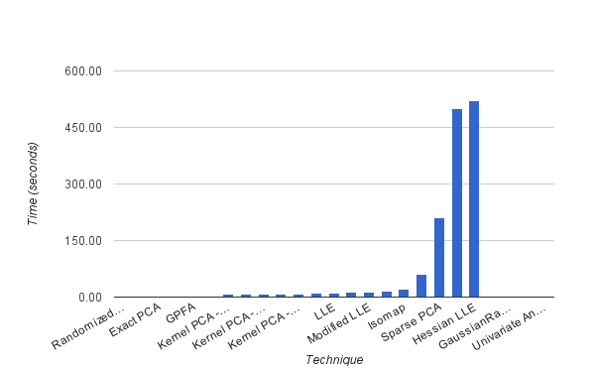
Step 1: Dimensionality Reduction
Tested 21 dimensionality reduction methods and measured how long they took for different % reductions
Methods were obtained from scikit-learn
Used example data without labels
Reference file: dim_red.py

Slide 17
Dimensionality Reduction (continued)
Also looked at using the FEAST Toolbox, which has some dimensionality reductions implemented in C
Played around with MATLAB package for the FEAST library, led to segfaults
Actually contacted creator of FEAST about the issue, took too long and was not worth following
Sharif suggested trying PyFeast, which is a Python wrapper for FEAST, which we ended up using later

Slide 18
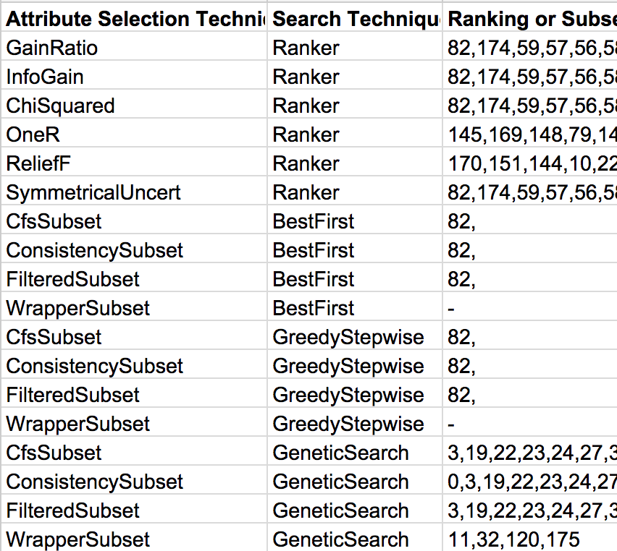
Step 2. Attribute Selection
Looked >20 attribute search and scoring methods to discern the most informative features
Employed the Weka software and JavaML, both of which contain many ML methods written in Java.
Wrote Java programs that allow you to input a search method, a scoring method, and an optional classifier to test your data
Reference files: JavaML.java, WekaClassify.java, WekaClassifierTest.java, AttributeSelection.java, AttributeSelectionTest.java

Slide 19
Step 3. Classifiers
Ended up not using Weka and JavaML methods because they were hard to combine with other parts of the classification process
Scikit implemented many methods that ran as well as Weka/JavaML, and were favored because they were a Python library saving us from having to grab data in Java and pass it to Python or vice versa.

Slide 20
Classifiers (continued)
Sharif provided a list of classifiers to use for this specific project
Different classes, including SVMs, Kernel PCAs, Nearest Neighbors, and LLEs were included in the comparison
All were taken from scikit, which was very easy to integrate into the final file

Slide 21
Step 4. Integration
Dimensionality Reduction: Scikit and PyFeast
Attribute Selection: Not used
Classifiers: Scikit
Validation: We used 10-fold cross-validation for all tests
Data used: 710,000 samples (> 120 MB) with 42 features each
All data marked with positive (contains variant), or negative (does not contain variant)
Reference file: Pipeline.py

