Slide 1
Axion Industrial — Predictive Operations
INDUSTRIAL IOT · PREDICTIVE OPERATIONS
AXION
INDUSTRIAL
Predict failures before they cost you. Connect any plant, see every signal, and turn it into action — automatically.
Notes:
COVER OPTION — original CSS reeded-glass. Three cover options; keep the one you like. Axion Industrial: predictive operations for manufacturers.

Slide 2
Axion Industrial — Predictive Operations
02
01 — THE PROBLEM
Every hour a line goes down, the cost compounds — in scrap, idle labor, missed orders and overtime recovery.
$260K
23
days of production lost to unplanned stoppages, per plant, per year.
70%
of failures give warning signs the floor never sees in time.
Average cost of one hour of unplanned downtime on a tier-one line.
Notes:
The core number: $260K per hour of unplanned downtime. Unplanned stoppages are the single largest controllable cost on the floor.

Slide 3
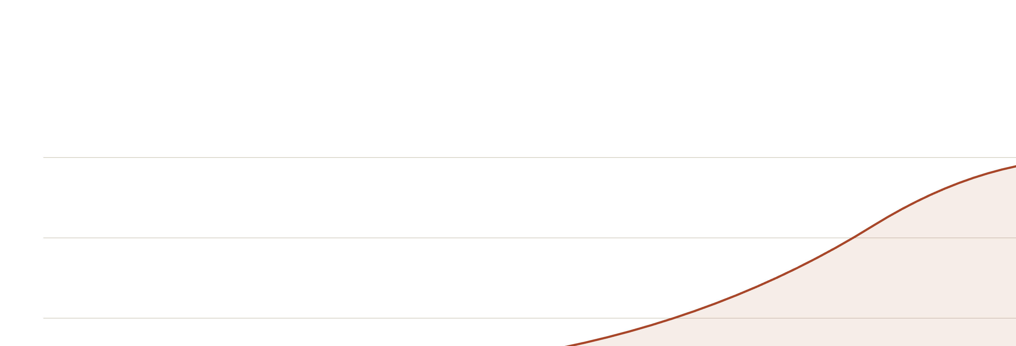
Axion Industrial — Predictive Operations
03
01 — THE PROBLEM
COST COMPOUNDS WITH EVERY MINUTE OF DELAY
Catch a bearing fault at the whisper and it is a $400 part. Catch it at the scream and it is a $260K line stop.
Cost of intervention →
Notes:
The longer a fault goes undetected, the steeper the cost curve. Reactive maintenance lives on the right side of this curve.

Slide 4
Axion Industrial — Predictive Operations
04
02 — THE PLATFORM
CONNECT. PREDICT. ACT.
01
02
03
CONNECT
PREDICT
ACT
Drop an Axion edge gateway on the line. It speaks to any PLC, drive or sensor — Modbus, OPC-UA, EtherNet/IP — no rip-and-replace.
Edge-AI models learn each asset's normal and flag the anomaly — bearing wear, misalignment, thermal drift — weeks before it stops the line.
A predicted failure writes a work order straight into your CMMS — with the part, the procedure and the window to fix it on your terms.
Notes:
Three moves: connect any equipment, predict failures with edge AI, act automatically through your CMMS.

Slide 5

Axion Industrial — Predictive Operations
05
02 — THE PLATFORM
FROM SIGNAL TO ACTION
One closed loop, measured in minutes — not the weeks a manual inspection round takes.
Vibration, temp, current, acoustics
Edge model scores the signal
Time-to-failure, ranked by risk
Auto work-order to your CMMS
Notes:
The signal-to-action loop: sensor data, edge inference, a ranked prediction, and an automated work order — closed loop, minutes not weeks.

Slide 6
Axion Industrial — Predictive Operations
06
03 — THE PROOF
WHAT IT RETURNS
Measured over twelve months at a tier-one automotive supplier running 38 stamping and weld lines.
−38%
+22%
$14M
unplanned downtime across the monitored lines.
overall equipment effectiveness (OEE).
in avoided losses per year — a 6-month payback .
Notes:
Proof at a tier-one automotive supplier: 38% less downtime, 22% OEE gain, six-month payback, fourteen million dollars a year.

Slide 7
Axion Industrial — Predictive Operations
07
04 — THE ROLLOUT
LIVE IN 12 WEEKS
WEEKS 1–2
WEEKS 3–5
WEEKS 6–9
WEEKS 10–12
CONNECT
BASELINE
PREDICT
SCALE
Gateways installed on priority lines; data flowing to the Axion edge.
Models learn each asset's normal signature and alarm thresholds.
Predictions live; work orders auto-routed into your CMMS.
Roll out plant-wide; handoff to your reliability team.
Notes:
Live in 12 weeks across four phases: connect, baseline, predict, scale. Low lift on your team.

Slide 8
Axion Industrial — Predictive Operations
08
05 — INVESTMENT
PRICING THAT SCALES WITH YOUR FLOOR
RECOMMENDED
STARTER
ENTERPRISE
GROWTH
Single line, one plant
Fleet of plants
$3.5K
Multi-line plant
CUSTOM
$12K
per line / month
volume & SLA based
per plant / month
Edge gateway + sensors Anomaly detection Email & dashboard alerts
Everything in Growth On-prem / private cloud SSO, audit & 99.9% SLA Dedicated solutions team
Everything in Starter Failure prediction + RUL Auto work-orders to CMMS Reliability success manager
Notes:
Three tiers: Starter, Growth, Enterprise. Growth is the recommended tier for a multi-line plant.

Slide 9
Axion Industrial — Predictive Operations
09
06 — WHY AXION
BUILT FOR THE PLANT FLOOR
240+
9M+
Vendor-neutral. Any PLC, any sensor, any CMMS — we sit on top of what you already run.
plants running Axion today
assets under live monitoring
Edge-first. Inference runs on the line, so prediction survives a network outage.
14D
94%
Proven at scale. Deployed across heavy industry, not a pilot looking for a reference.
median warning before failure
prediction precision on critical assets
Notes:
Why us: built for the plant floor, vendor-neutral, edge-first, proven at scale. 240+ plants.

Slide 10
Axion Industrial — Predictive Operations
LET'S GET STARTED
STOP PAYING FOR DOWNTIME YOU CAN PREDICT
Book a 30-minute scoping call. We'll model your downtime cost and design a 12-week pilot on your most critical line.
sales@axionindustrial.io
+1 (312) 555-0142
axionindustrial.io
Notes:
The ask: a 30-minute scoping call. We'll model your downtime cost and a 12-week pilot on one line.

Slide 11
Axion Industrial — Predictive Operations
11
APPENDIX — ABOUT
ABOUT AXION INDUSTRIAL
Axion Industrial builds predictive-operations software for manufacturers. We connect the equipment you already run, predict failures at the edge, and turn each prediction into an automated work order — so reliability teams act on the signal instead of the breakdown.
FOUNDED
2019 · Chicago, Illinois
FOOTPRINT
240+ plants · 11 countries
SECTORS
Automotive · Metals · Food & beverage · CPG
Illustrative example. "Axion Industrial" is a fictional company; all figures, customers and results shown are hypothetical and for demonstration purposes only.
Notes:
About Axion and the illustrative disclaimer. Figures are illustrative for this fictional company.

