Slide 1
MERIDIAN
©
NYSE: MRDN
THIRD QUARTER 2026 · EARNINGS & INVESTOR PRESENTATION
Q3.
Results & review
Meridian Financial Group · reporting for the three months ended September 30, 2026.
Investor Relations investor.meridianfg.com
Notes:
Open with composure. Q3 was a quarter of disciplined, compounding progress — revenue and EPS both up, margins expanding, capital strong. We'll walk highlights, the segments, the balance sheet, and our outlook.

Slide 2
MERIDIAN
©
QUARTER HIGHLIGHTS
Q3 2026 · NYSE: MRDN
02
A quarter of disciplined, compounding progress.
$1.40B
$1.68
16.2%
54.8%
TOTAL REVENUE
DILUTED EPS
ROTCE
EFFICIENCY RATIO
▲ 8.6% YoY
▲ 18.3% YoY
▲ 180 bps YoY
▼ 210 bps YoY
Q3 2026 EARNINGS
02 →
Notes:
Four numbers tell the quarter: revenue $1.40B up 8.6%, diluted EPS $1.68 up 18.3%, ROTCE 16.2%, and the efficiency ratio down to 54.8%. Earnings grew faster than revenue — operating leverage is real.

Slide 3
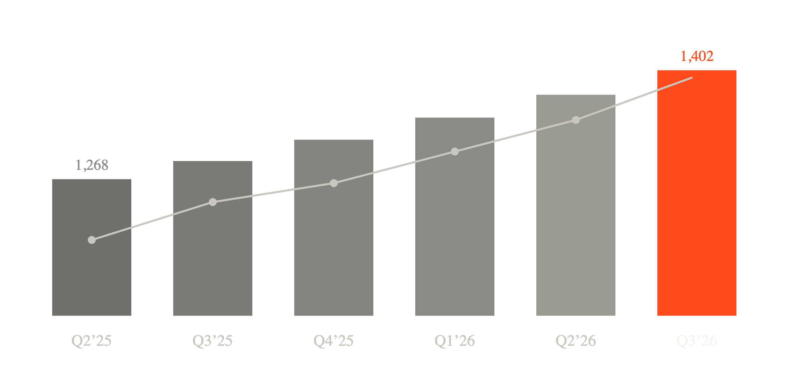
MERIDIAN
©
REVENUE & EPS
Q3 2026 · NYSE: MRDN
03 — TOP & BOTTOM LINE
Revenue and earnings per share
$1.40B
NET REVENUE ($M) · BARS
DILUTED EPS ($) · LINE
NET REVENUE, Q3 2026
+8.6% YoY · +2.2% QoQ
$1.68
DILUTED EPS, Q3 2026
+18.3% YoY · $1.42 a year ago
Q3 2026 EARNINGS
03 →
Notes:
Six straight quarters of revenue growth, now $1.40B. EPS has compounded faster — $1.42 to $1.68 — helped by margin expansion, expense discipline, and buybacks reducing the share count.

Slide 4
MERIDIAN
©
SEGMENTS
Q3 2026 · NYSE: MRDN
04 — LINES OF BUSINESS
Segment performance
SEGMENT
NET REVENUE ($M)
Q3 2026
YOY
Consumer Banking
612
+6.4%
Commercial Banking
438
+9.1%
Wealth Management
244
+12.7%
Capital Markets
108
+3.2%
TOTAL NET REVENUE
1,402
+8.6%
Q3 2026 EARNINGS
04 →
Notes:
Growth was broad-based. Consumer and Commercial are the engines by size; Wealth Management is the fastest grower at nearly 13%, on net new assets and higher fee income. Capital Markets was steady in a quieter quarter.

Slide 5
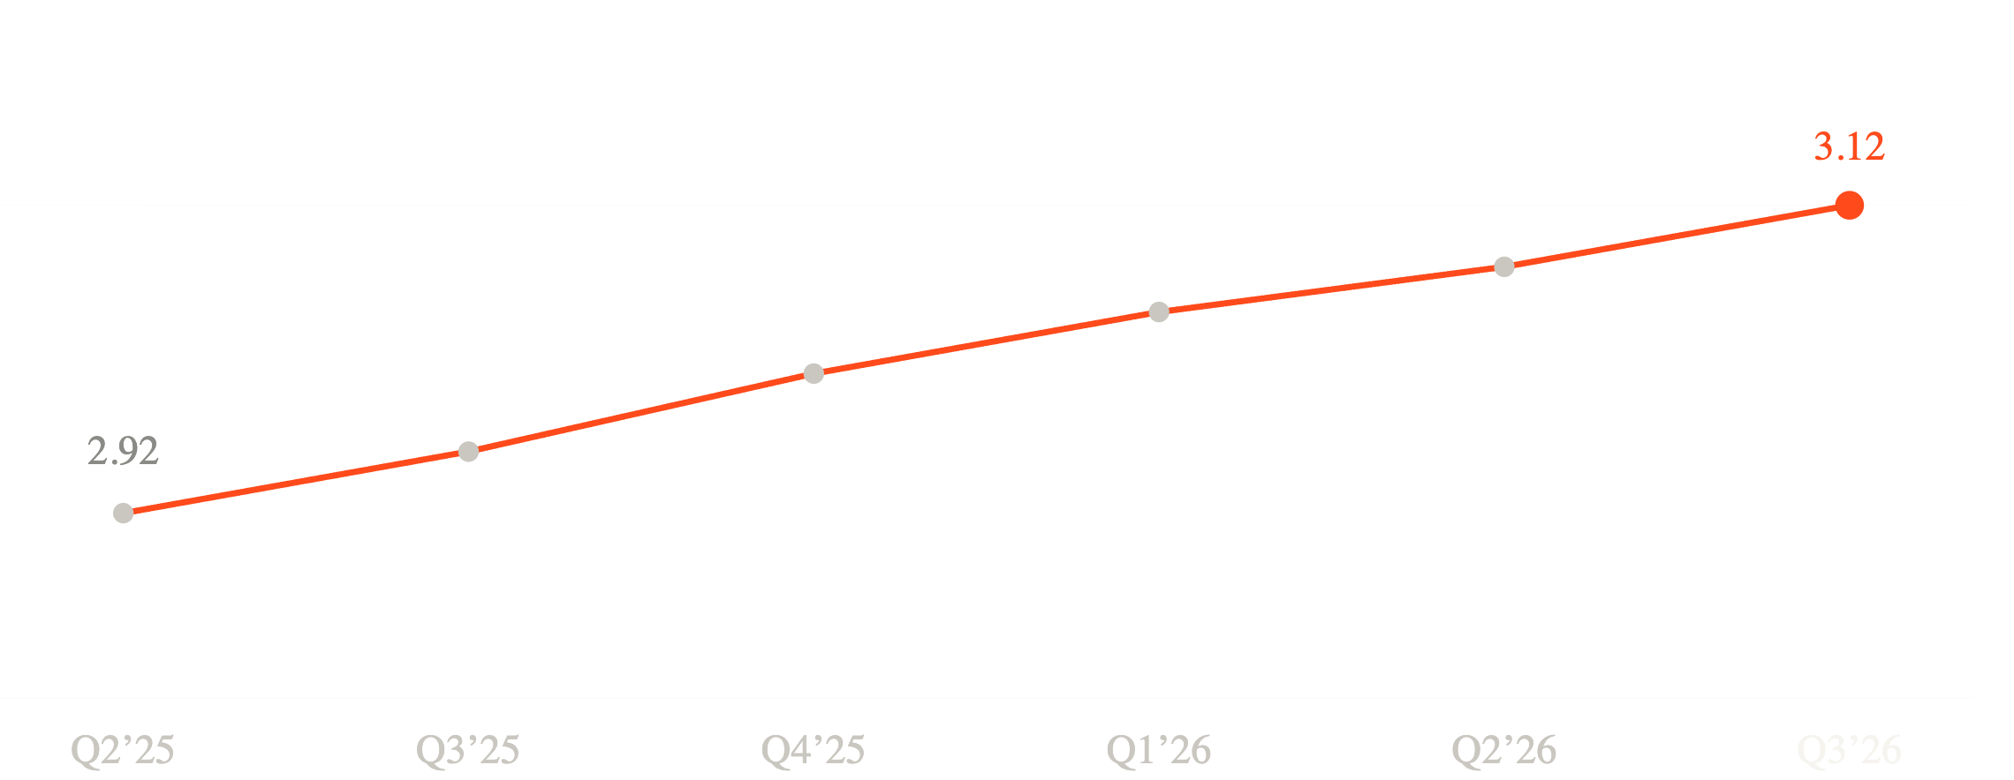
MERIDIAN
©
MARGIN & EFFICIENCY
Q3 2026 · NYSE: MRDN
05 — PROFITABILITY
Net interest margin & efficiency
3.12%
NET INTEREST MARGIN (%) · TRAILING SIX QUARTERS
NET INTEREST MARGIN
+20 bps YoY · +4 bps QoQ
54.8%
EFFICIENCY RATIO
improved from 56.9% a year ago
Q3 2026 EARNINGS
05 →
Notes:
Net interest margin expanded again to 3.12%, up 20 basis points YoY, as assets repriced ahead of funding. Combined with expense discipline, the efficiency ratio improved to 54.8% — every revenue dollar is working harder.

Slide 6
MERIDIAN
©
BALANCE SHEET
Q3 2026 · NYSE: MRDN
06 — STRENGTH & LIQUIDITY
Balance-sheet strength
12.4%
$214.3B
Total assets
Total deposits
$168.2B
COMMON EQUITY TIER 1 RATIO
$141.8B
Comfortably above the 8.0% regulatory minimum, with a 240 bps buffer to our internal target.
Total loans, net
Liquidity coverage ratio
128%
Non-performing loans
0.71%
Q3 2026 EARNINGS
06 →
Notes:
The foundation is strong. CET1 of 12.4% sits well above the 8.0% regulatory minimum, liquidity coverage is 128%, and credit quality is benign with non-performing loans at just 0.71%. We have ample capacity to keep investing and returning capital.

Slide 7
MERIDIAN
©
GUIDANCE
Q3 2026 · NYSE: MRDN
07 — FULL-YEAR 2026 OUTLOOK
Guidance
Reaffirmed for the full year ending December 31, 2026. Figures reflect management’s current expectations and are subject to the risk factors that follow.
Revenue growth
7–9%
Net interest margin
3.10–3.20%
Efficiency ratio
< 55%
Return on tangible common equity
15–16%
CET1 ratio
> 12%
Q3 2026 EARNINGS
07 →
Notes:
For the full year we're holding revenue growth of 7 to 9%, NIM in the low 3.10s to 3.20%, an efficiency ratio below 55%, and ROTCE of 15 to 16%. The shape of the year is steady, disciplined compounding.

Slide 8
MERIDIAN
©
CAPITAL RETURN
Q3 2026 · NYSE: MRDN
08 — DIVIDEND & BUYBACK
Returning capital with discipline
$0.48
62%
TOTAL PAYOUT RATIO
QUARTERLY DIVIDEND PER SHARE
3.1%
Raised 9% · 14th consecutive annual increase
DIVIDEND YIELD
$1.46B
$420M
CAPITAL RETURNED, YTD
−2.8%
SHARES REPURCHASED IN Q3
DILUTED SHARES, YOY
5.1M shares retired · $1.5B authorization, $640M remaining
Q3 2026 EARNINGS
08 →
Notes:
We raised the quarterly dividend 9% to $0.48 and repurchased $420M of stock in the quarter, retiring 5.1M shares. Total payout was 62% — returning capital while keeping the balance sheet fortress-strong.

Slide 9
MERIDIAN
©
RISK FACTORS
Q3 2026 · NYSE: MRDN
09 — WHAT WE ARE WATCHING
Risk factors
01
Interest-rate environment
Margins remain sensitive to the pace and path of central-bank policy and the shape of the yield curve.
02
Credit quality
A weaker macroeconomic backdrop could lift provisions for credit losses above current expectations.
03
Regulatory change
Evolving capital, liquidity and consumer rules may affect the pace at which we deploy excess capital.
04
Deposit competition
Funding costs could rise faster than asset repricing if competition for deposits intensifies.
05
Technology & operational risk
Cybersecurity and third-party dependencies require continued investment to manage effectively.
Q3 2026 EARNINGS
09 →
Notes:
A brief, honest word on what we're watching: rates, credit, regulation, deposit competition, and operational risk. None change the thesis, but all warrant discipline.

Slide 10
MERIDIAN
©
Q3 2026 · NYSE: MRDN
10 — OUTLOOK
Disciplined growth that compounds.
We enter the next cycle from a position of strength — expanding margins, a fortress balance sheet, and capital returned with discipline.
Q3 2026 EARNINGS
10 →
Notes:
The one line to remember. We enter the next cycle from a position of strength — disciplined growth that compounds. Thank you; we'll take questions.

Slide 11
MERIDIAN
©
APPENDIX & CONTACT
Q3 2026 · NYSE: MRDN
11 — INFORMATION
Appendix & contact
INVESTOR RELATIONS
IMPORTANT DISCLOSURES
Eleanor V. Hartwell
Forward-looking statements. This presentation contains forward-looking statements within the meaning of applicable securities laws. Such statements involve known and unknown risks and uncertainties, and actual results may differ materially. Meridian undertakes no obligation to update them except as required by law.
Head of Investor Relations
investor@meridianfg.com +1 212 555 0148 1 Harbour Plaza, New York, NY 10004
Non-GAAP measures. ROTCE, the efficiency ratio and tangible book value are non-GAAP measures. Reconciliations to the most directly comparable GAAP measures appear in the supplementary financial package.
Earnings call replay and the supplementary financial package are available at investor.meridianfg.com.
Illustrative figures. Meridian Financial Group and all financial data shown are fictional and presented for illustrative and design purposes only. Nothing herein is an offer to sell or a solicitation to buy any security.
Q3 2026 EARNINGS
11 →
Notes:
Contact for Investor Relations, plus the required non-GAAP and forward-looking notes. All figures here are illustrative and fictional.

