Slide 1
CSE563 Assignment Instructions
To be Submitted to Google Classroom by February 26

Slide 2
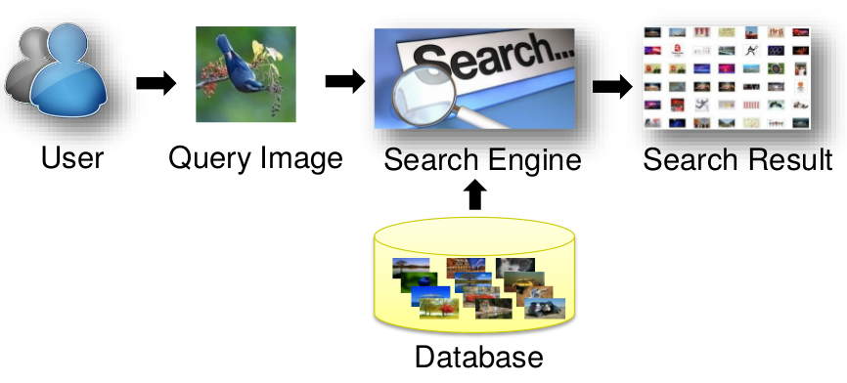
Task: Image Search
Given a query image, rank images in database according to relevancy.

Slide 3
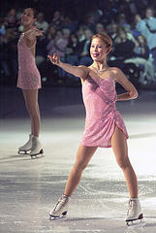
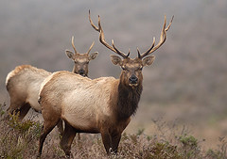
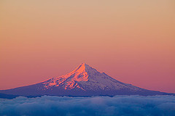
Dataset
A subset of images from NUS-WIDE dataset
Originally from Flickr
1050 images in database: data/images/*.jpg
81 query images: data/queries/*.jpg
Cover a wide range of categories
Ground truth: data/relevant.txt
Each row is the relevant image names for a query image
…

Slide 4
Combining multiple vectors for searching
Given an image query, similarity matching using concept vector and feature vector (see lecture)
Can try different weight combination
Return the top k matches (or k nearest neighbors)

Slide 5
References
Lecture Notes
Tat-Seng Chua, Jinhui Tang, Richang Hong, Haojie Li, Zhiping Luo, and Yan-Tao Zheng. "NUS-WIDE: A Real-World Web Image Database from National University of Singapore", ACM International Conference on Image and Video Retrieval. Greece. Jul. 8-10, 2009
https://www.tensorflow.org/tutorials/image_recognition

