Slide 1

Upstream Token Auth – Kong Plugin
Mayank Murari
&
Siddharth Saikumar
KONG HACKATHON

Slide 2
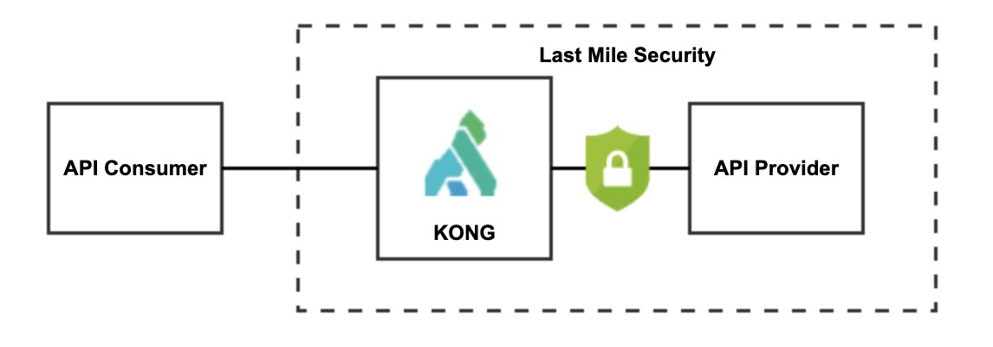
Last mile security
Authentication between KONG and the API Providers.
Upstream Authentication
Dynamic token-based authentication at the upstream
IDP Token generation and API provider token verification
KONG HACKATHON

Slide 3
Upstream Token Auth – Plugin Config
Parameter | Type | Required | Description
token_url | String | ✅ | Defines the upstream token endpoint, provide the complete end point Ex : "https://api.twitter.com/oauth/authorize"
parameters | String | ✅ | Defines the input to the upstream token API. Multiple key value pairs can be enabled , key:value pair separated by a comma. These parameters will form the request payload for the Token API call. Ex : key1:value1,key2:value2
requesttype | String | ❌ | Defines the request content-type expected by the Authorization server. Supported types : "json" , "formparam". Default formparam'
responsetype | String | ❌ | Defines the response content-type expected from the Authorization server. Supported types : "json" , "text"
tokentype | String | ❌ | Defines the type of token return by the Authorization Server Ex : "access_token" or "Bearer "
tokenexpiry | Number | ❌ | Defines the token expiry time in seconds Ex : 900
headers | String | ❌ | Defines the additional custom headers required by upstream token API. Multiple headername value pairs can be enabled , headername:value pair separated by a comma. These headers will be added to the request payload for the Token API call. Ex : headername1:value1,headername2:value2
tokenpath | String | ❌ | This parameter defines the jsonpath of the token ,in the Authorization server response. Can be used only if the responsetype is "json" Ex : "responseObject.accessToken"
KONG HACKATHON

Slide 4




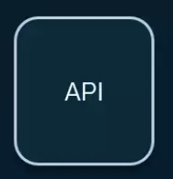

Upstream Token Auth – Request Flow
{
"token_type": "Bearer",
"access_token": ”anfnaofaogi",
}
<900
API Consumer
{
”client_id": client1,
”client_secret": ”password1”,
“grant_type”: “client_credentials”
}
{ "name" : "my_username2",
"first-name" : "My2",
"last-name" : "Username2”}
Header – Bearer anfnaofaogi
{ "name" : "my_username2",
"first-name" : "My2",
"last-name" : "Username2”}
Header – Bearer anfnaofaogi
{ "name" : "my_username",
"first-name" : "My",
"last-name" : "Username”}
{ "name" : "my_username",
"first-name" : "My",
"last-name" : "Username”}
Upstream Token Auth
API Provider
Plugin Schema
config.tokentype="Bearer ”
config.requesttype=json
config.responsetype=json
config.tokenexpiry=900
KONG HACKATHON

Slide 5
Upstream Token Auth – Custom Access Token Flow
{
”token” : {
"token_type": "Bearer",
"access_token":”anfnaofaogi”
}
}
API Consumer
{
”client_id": client1,
”client_secret": ”password1”,
“grant_type”: “client_credentials”
}
Header – access_token anfnaofaogi
{ "name" : "my_username",
"first-name" : "My",
"last-name" : "Username”}
{ "name" : "my_username",
"first-name" : "My",
"last-name" : "Username”}
Upstream Token Auth
API Provider
Plugin Schema
config.tokentype=”access_token”
config.requesttype=json
config.responsetype=json
config.tokenpath=token.access_token
KONG HACKATHON

Slide 6

DEMO
KONG HACKATHON

Slide 7
Upstream Token Auth
THANK
YOU
KONG HACKATHON

