Slide 1
Project Presentation of CO-OP Project at Industry (Module-2) (22CS421)
On
Smart Vessel Closure with RGB Hydration Alerts
Supervised By
Ashish Kumar
Department of Computer Science and Engineering,
Chitkara University, Punjab
Lalit Kumar Yadav (2210991848)
Mayank Sharma (2210991909)
Shivansh Garg (2210992321)

Slide 2
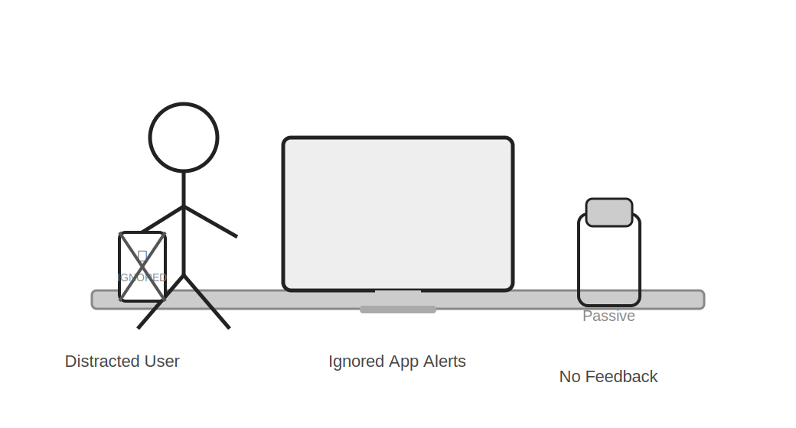
Introduction
Many people forget to drink water in daily life.
This leads to dehydration and health problems.
Existing solutions like apps are often ignored.
Normal water bottles do not give any reminder.
So, we need a smart and simple solution.
2

Slide 3
Problem Statement
People are busy and forget to drink water.
Thirst is not a reliable indicator.
Mobile notifications are ignored easily.
Bottles are passive and give no alerts.
3

Slide 4
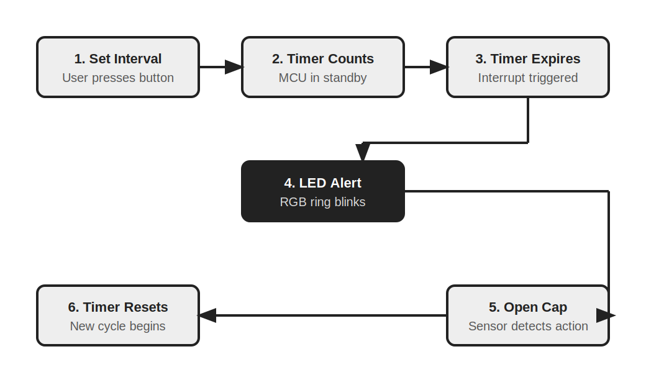
Proposed Solution
A smart bottle cap with timer and LED alerts.
It reminds users to drink water at regular intervals.
Uses RGB light for clear visual alerts.
Works without any mobile app.
4

Slide 5
How it works
User sets a time interval on the cap.
Timer starts counting.
When time ends, LED light starts blinking.
User opens the cap to drink water.
System detects action and resets automatically.
5

Slide 6
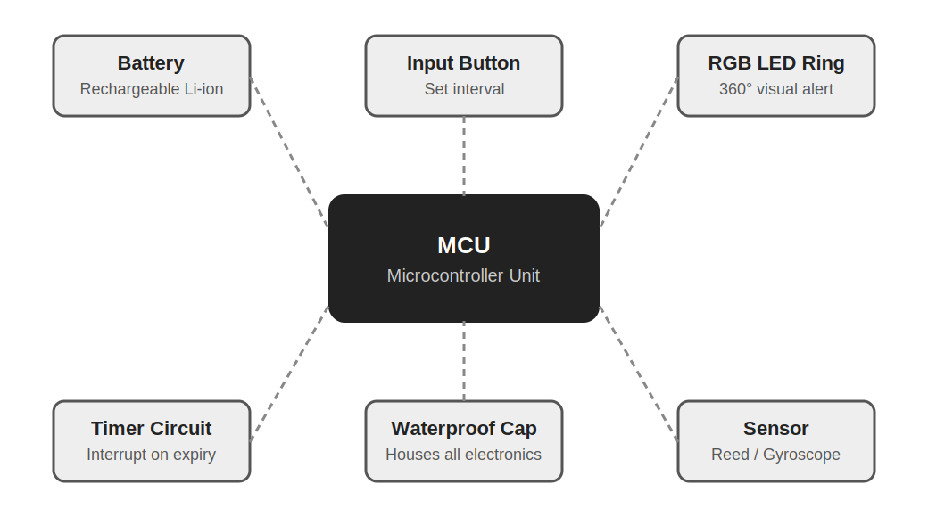
Components Used
Microcontroller (MCU)
Rechargeable battery
RGB LED ring
Timer circuit
Sensor (reed switch / gyro)
Button or touch input
6

Slide 7
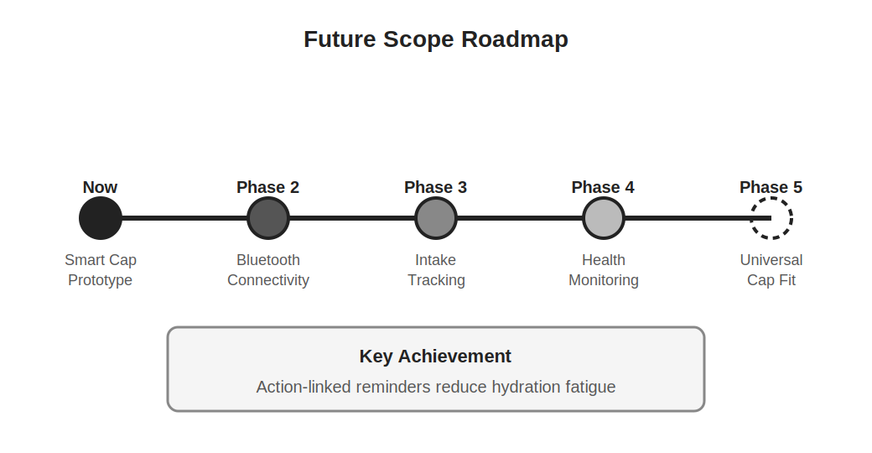
Conclusion
This system solves dehydration problem effectively.
It gives physical and visual reminders.
It is simple, affordable, and practical.
Can be used by all age groups.
7

Slide 8
Thank You
8

