Slide 1
CUSTOMER ANALYTICS / 2026
Customer Shopping
Behaviour Analysis
How Python, PostgreSQL and Power BI turn 3,900 purchase records into business insight.

Slide 2





01 — WORKFLOW
One dataset supports a full analytics workflow
Inspect & prepare
Query & measure
Communicate
Python
PostgreSQL
Power BI
FOCUS
FOCUS
FOCUS
The same records move from preparation to query to communication.
Revenue, products, discounts
Subscriptions, shipping, ratings
Customer segments
3,900 customer purchase records · 18 original fields
Customer Shopping Behaviour Analysis
2

Slide 3




02 — BUSINESS QUESTIONS
The business need is to explain behaviour, not just store transactions
Revenue groups
Product performance
Which customer groups contribute to revenue?
Which products and categories perform best?
Spend relationships
Decision discipline
How do discounts, subscriptions and shipping relate to spend?
How should the business act without confusing correlation with causation?
Customer Shopping Behaviour Analysis
3

Slide 4
03 — DATASET PROFILE
The dataset is broad enough for segmentation, but not for trends or profit
18–70
USD 20–100
25
AGE RANGE
PURCHASE AMOUNT RANGE
DISTINCT PRODUCTS
4
50
37
CATEGORIES
CUSTOMER LOCATIONS
MISSING REVIEW RATINGS
3,900 records · no transaction timestamps, costs or margins.
Customer Shopping Behaviour Analysis
4

Slide 5
04 — PREPARATION LAYER
The preparation layer makes the analysis repeatable
Load and inspect the CSV with Pandas
Standardize fields such as customer_id and purchase_amount
Create an age_group feature and document its boundaries
Load the cleaned dataset into PostgreSQL
Validate row counts, field types and missing ratings before analysis
Customer Shopping Behaviour Analysis
5

Slide 6
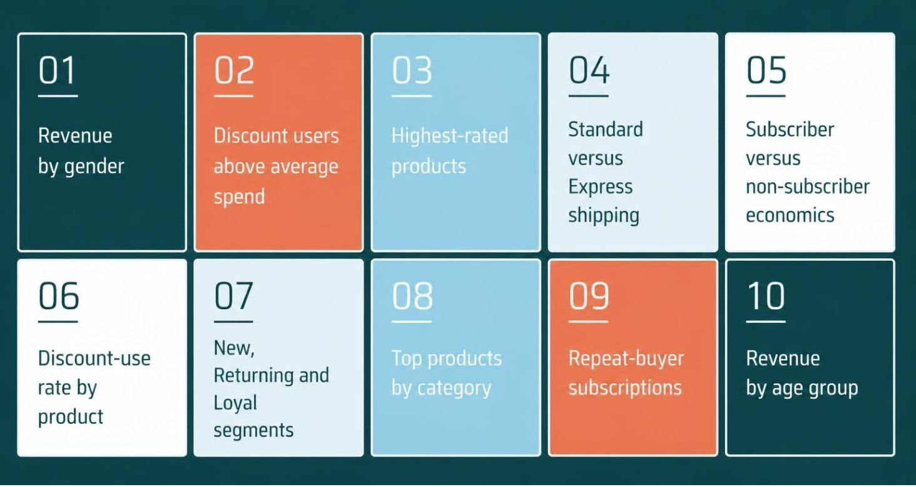
05 — SQL ANALYSIS
Ten SQL questions translate business needs into measurable analysis
Methods include aggregation, subqueries, conditional logic, CTEs and window functions.
Customer Shopping Behaviour Analysis
6

Slide 7



06 — DECISION LAYER
The dashboard is the decision layer
Power BI makes the approved questions explorable, then keeps verification visible.
Headline measures
Explorable patterns
Open validation work
Show revenue, record count, average purchase amount and average rating.
Make demographic, product, subscription, discount, shipping and age-group patterns explorable.
Confirm the PBIX measures, visuals and filters before presenting findings as verified results.
Customer Shopping Behaviour Analysis
7

Slide 8
07 — INTERPRETATION
The analysis can inform action, but not causal claims
These are decision areas enabled by the analysis, not proven intervention effects.
Merchandising
Customer experience
Focus on products and categories with stronger purchase frequency.
Investigate lower-rated products.
Loyalty and subscriptions
Promotions and operations
Compare segment size, spend and revenue.
Review discount, shipping and payment patterns.
Customer Shopping Behaviour Analysis
8

Slide 9
08 — LIMITATIONS
Three limitations matter most for interpretation
Coverage
Economics
No transaction timestamp: no reliable time-series or cohort analysis
Previous purchases are not a complete transaction history
No costs or margins: purchase amount is not profit
Inference
History
Observational records: comparisons do not establish causality
Previous purchases are not a complete transaction history
Customer Shopping Behaviour Analysis
9

Slide 10
Separate and document
Test the pipeline
Separate cleaning code from the notebook and document age-group boundaries.
Add duplicate, null, range and cross-system reconciliation checks.
09 — NEXT RELEASE
The next release should strengthen validation and reproducibility
Harden the queries
Expand the evidence
Apply item_rank <= 3 in the category ranking query; add rates, denominators and rating counts.
Add dates, costs, acquisition, campaign and inventory data for deeper analysis.
Customer Shopping Behaviour Analysis
10

