Slide 1
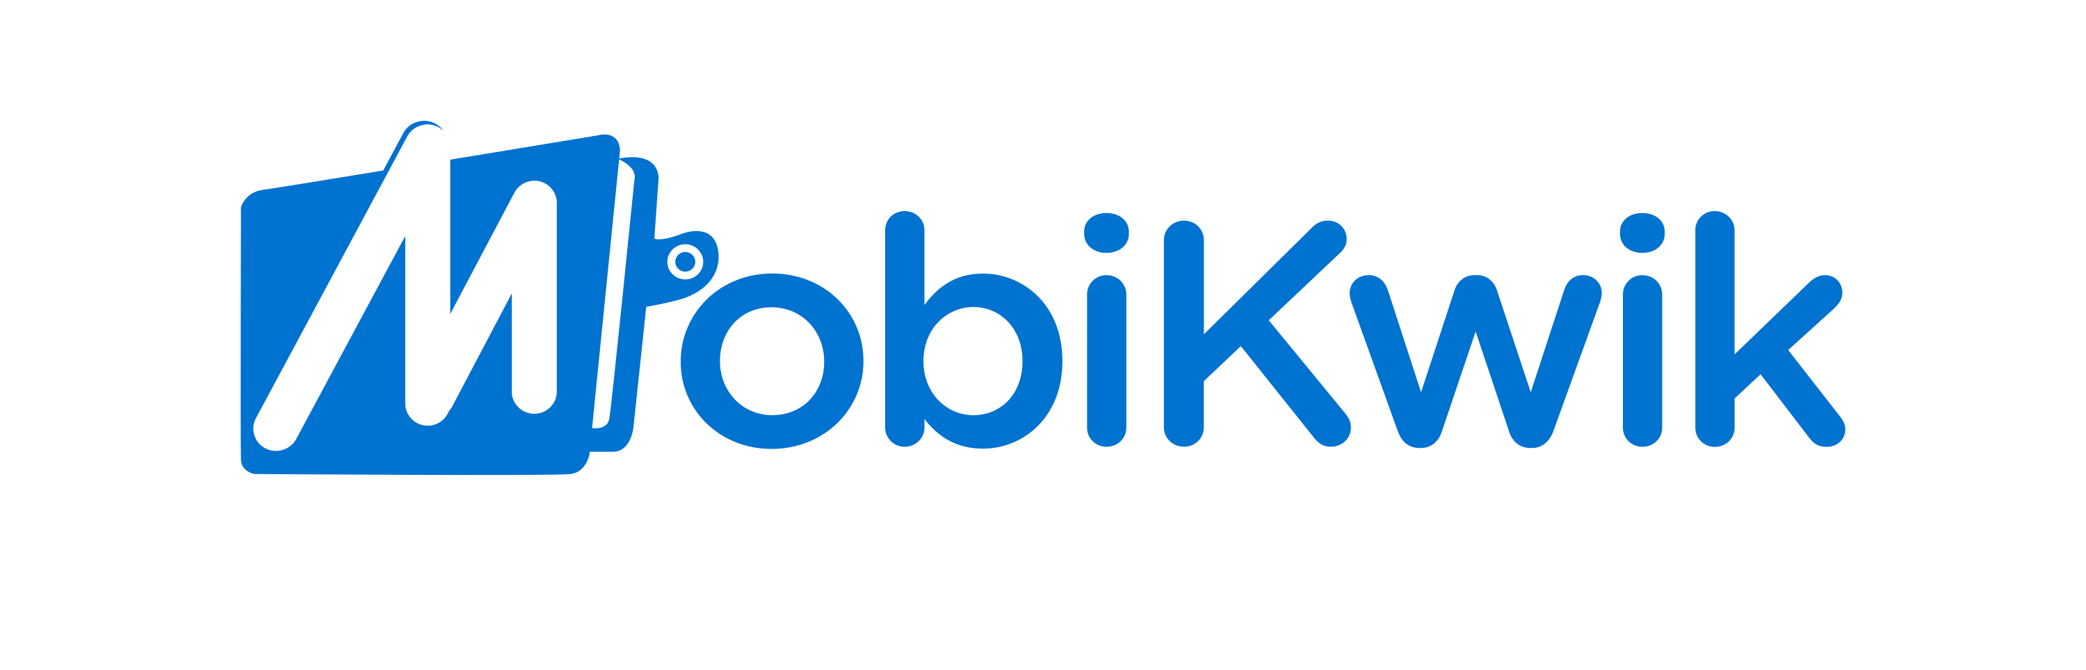
MVP: Save now, Pay Later
Mayank Kumar

Slide 2




INTRODUCTION
Save now, Pay later
Concept:
Save now, Pay later (SNPL) incentivizes saving for high-ticket purchases
Involves saving through platforms which might invest those savings in instruments like low-risk mutual funds to get better returns than savings accounts and fixed deposits
It improves affordability of high ticket purchases for individuals who cannot afford those purchases through down payments
How is it different from Buy Now, Pay Later
Easier for customers as there is no dependence on credit behaviour
Safer for companies, as they are not taking chances with customers with no defined credit behaviour
Develops a habit for saving instead of purchasing on credit
Has dependence on investment instruments, but as these instruments are chosen by the platforms being used, customer does not have to worry about choosing
Current players in the Indian market
Company | Model | Returns
Multipl | Money invested in low risk, good returns mutual funds. Gamification in the form of challenges, levels and milestones. | Upto 25%
Tortoise | Deposits are kept with the brand/merchant you are saving for, in the form of advance payments towards your purchase | 10%
Hubble | Saved money can be transferred to virtual co- branded cards and the card can be used for purchases made from those brands | 10%
EasyPlan | Investment through low-risk ICICI Prudential funds | 10-12%

Slide 3


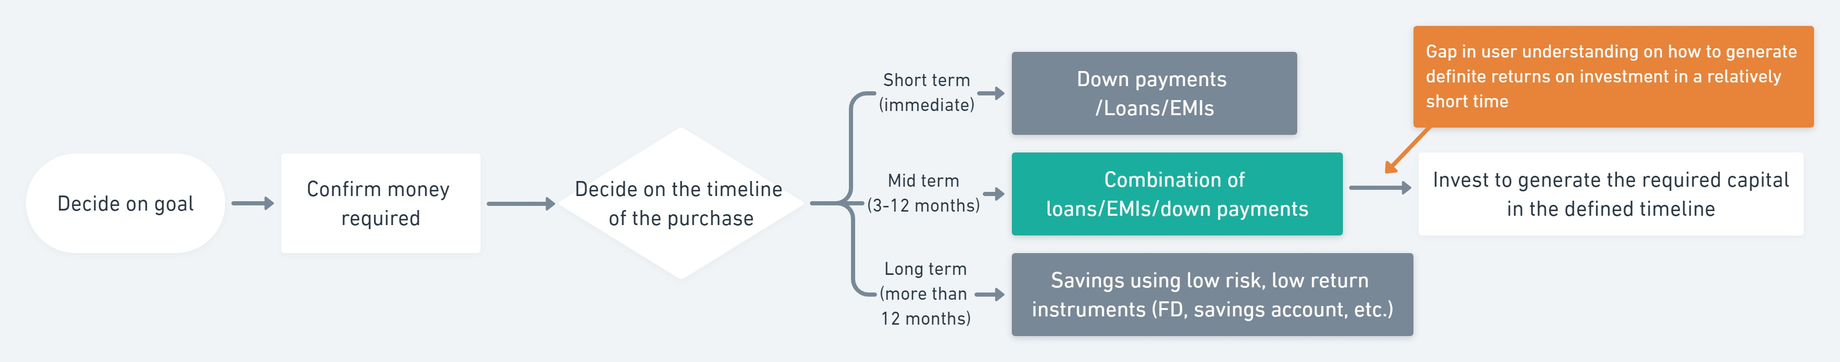
USERS
Following are the prominent user personas relevant to us:
Rishabh, age 22, bachelor
Lives in Noida, recently started working as a software engineer
Wants to become financially independent and buy the things that he wants with his own money
Is new to the world of investments and has limited knowledge on personal finance
Pain points:
Wants to buy a motorbike within a year, but his salary will not add up to the amount necessary
Is ready to save a part of his salary every month, but does not know where to invest to get assured returns to be able to afford a motorbike.
Irshad, age 48, owner of a flat in Lucknow
Lives in Mumbai with his family of 4. Runs a small business
Believes in traditional saving methods and doesn’t believe in quick returns on
investments made
Has been saving up for his daughter’s marriage (plans to get it done in the next 3 years) for a long time but due to COVID, his business is suffering and might need additional monetary inputs from the marriage fund
Pain points:
Doesn’t want to break daughter’s savings fund, but also needs to inject money
into his business quickly to save it from closing
There is an unmet need to educate users on the possibilities of goal-based savings through investment into low-risk, good returns instruments
Analysis of MobiKwik’s current offerings:
Xtra: Xtra is a Peer-to-Peer investment instrument that offers users the opportunity to earn upto 12% p.a. (12.99% for Xtra Plus with a 3-month lock-in) by lending directly to creditworthy borrowers. This is done via an RBI-regulated peer to peer investing platform, Lendbox
To mitigate risk and diversify the investments, money is split into smaller chunks and distributed to different borrowers with varying creditworthiness
Zip EMI: This is a feature which is unlocked if a ZIP BNPL user shows good credit behaviour on the MobiKwik platform. Users get pre- approved loans which they can then pay back in easy EMIs.
The loan limits are not as big as those provided through banks, but still be used to finance big ticket purchases upto the value of INR 2,00,000
User journey for general big ticket (> ₹ 1 lakh) purchases:

Slide 4
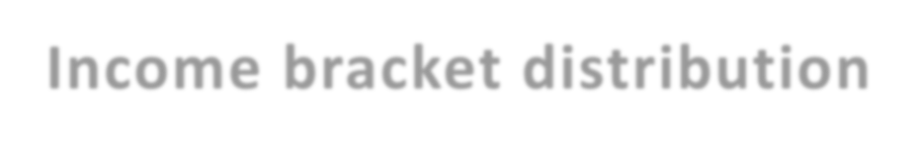



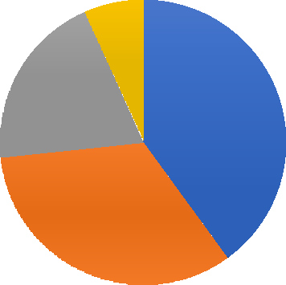


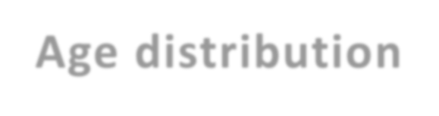



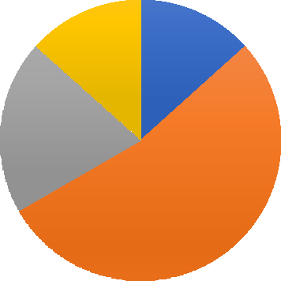


USER RESEARCH AND DEFINING THE PROBLEM
Pretext: We have established that there is a gap in user understanding about investment instruments of low risk, good returns
Hypotheses: (in context of big ticket purchases of value exceeding ₹ 1 lakh)
For immediate purchases, people prefer down payments/loans
For long terms purchases, people prefer saving instruments that are low risk, but yield low returns
People in lower income brackets need a larger timeline as they use traditional saving methods up money to make big ticket purchases
Survey results [15 total respondents, 4 user interviews]: Survey Link
Income bracket distribution
1
Observation | Insight
For people in the income bracket 0-50000, to generate money for big ticket purchases: 67% people would need 12-18 months 33% people would need 18-24 months | There is a huge scope of reducing their timeline of big ticket purchases through appropriate investments
For people in the income bracket 0-50000, to make a big-ticket purchase in the next 3-12 months: 50% would opt for FDs/saving accounts 33% would opt for loans | Interest additions to the total amount spent can be reduced
For people in upper salary brackets, 100% would be willing to opt for a financing option that would result in lower/no interest payments and a shorter purchase timeline | There is a huge scope of reducing their timeline of big ticket purchases through appropriate investments. Interest additions to the total amount spent can also be reduced
3
6
5
0-50000
50001-100000 100001-150000
Age distribution
2 2
>150000
3
8
18-24 25-34 35-44 45-60 >60
JOBS TO BE DONE:
When I want to make a big ticket purchase in a mid-term timeframe (3 - 12 months), but am not sure how to finance it, help me find a way to generate the
required amount, so that I don’t exceed my spending capacity, but am still able to complete the purchase successfully.

Slide 5
SOLUTION: MVP for Zip SNPL
Assumption: All the required permissions from SEBI and other financial regulators are already taken and approved
Problem to solve | Suggested feature
Pop-up on home page | Every time user opens the app, they should be made aware of the introduction of the new SNPL feature to enable discovery and promote usage
Goal setting and tracking | Users should start with naming their goals to give it a meaning and to be able to track it.
Money to be generated | This is the only known parameter for the user. They will be given the option to enter the amount they want to generate for their goal
Time window | This can be set by the user to a value that they feel comfortable with. With the adjustment of time window, the per month investment required will change accordingly.
Frequency of investment | Users should be given an option to establish an SIP, to suit their ability to invest. This option will help users to set the investment frequency to a time period that they feel comfortable with
Investment calculation | We will have capital generation using 2 existing instruments provided by MobiKwik: EXra and Zip EMI. The per month investment required will depend on: The credit limit allotted to the user on ZIP EMI The percentage of credit limit consumption that the user is ready to do The investment method opted by user on Xtra (Flexi or Plus) The user defined time window in which the capital is to be generated The frequency at which the user is comfortable to invest
View goals | User can track all the goals and the amount accumulated till date on each of those. They also will have the option to cancel the goal and get the accumulated money back into their account

Slide 6
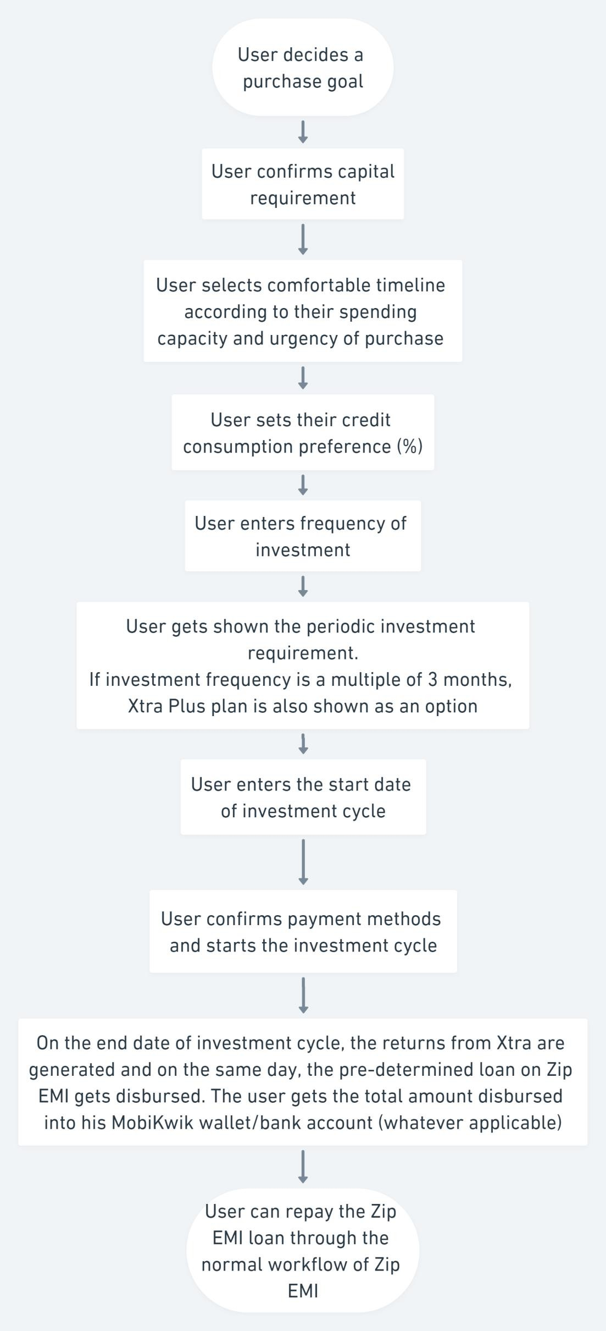
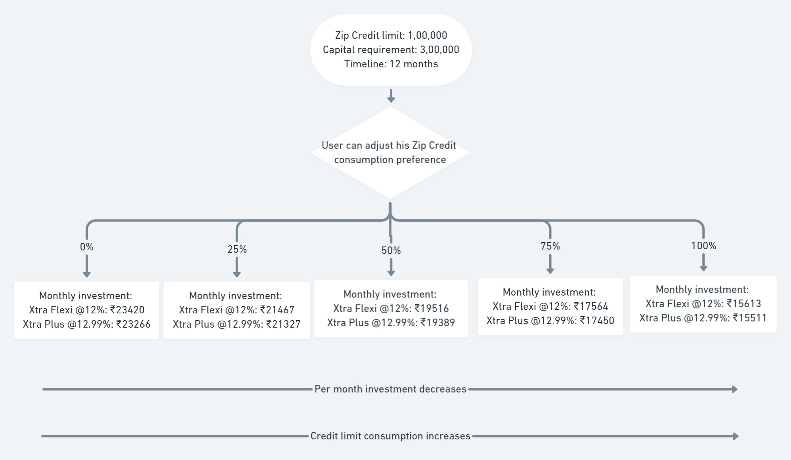
USER FLOW DESIGN FOR Zip SNPL
Why will user opt for SNPL, instead of just Xtra or just Zip EMI?
If user requires amount that is greater than their Zip EMI credit limit
If user wants to save up his credit limit for other purchases and can wait for a longer period to make purchase

Slide 7
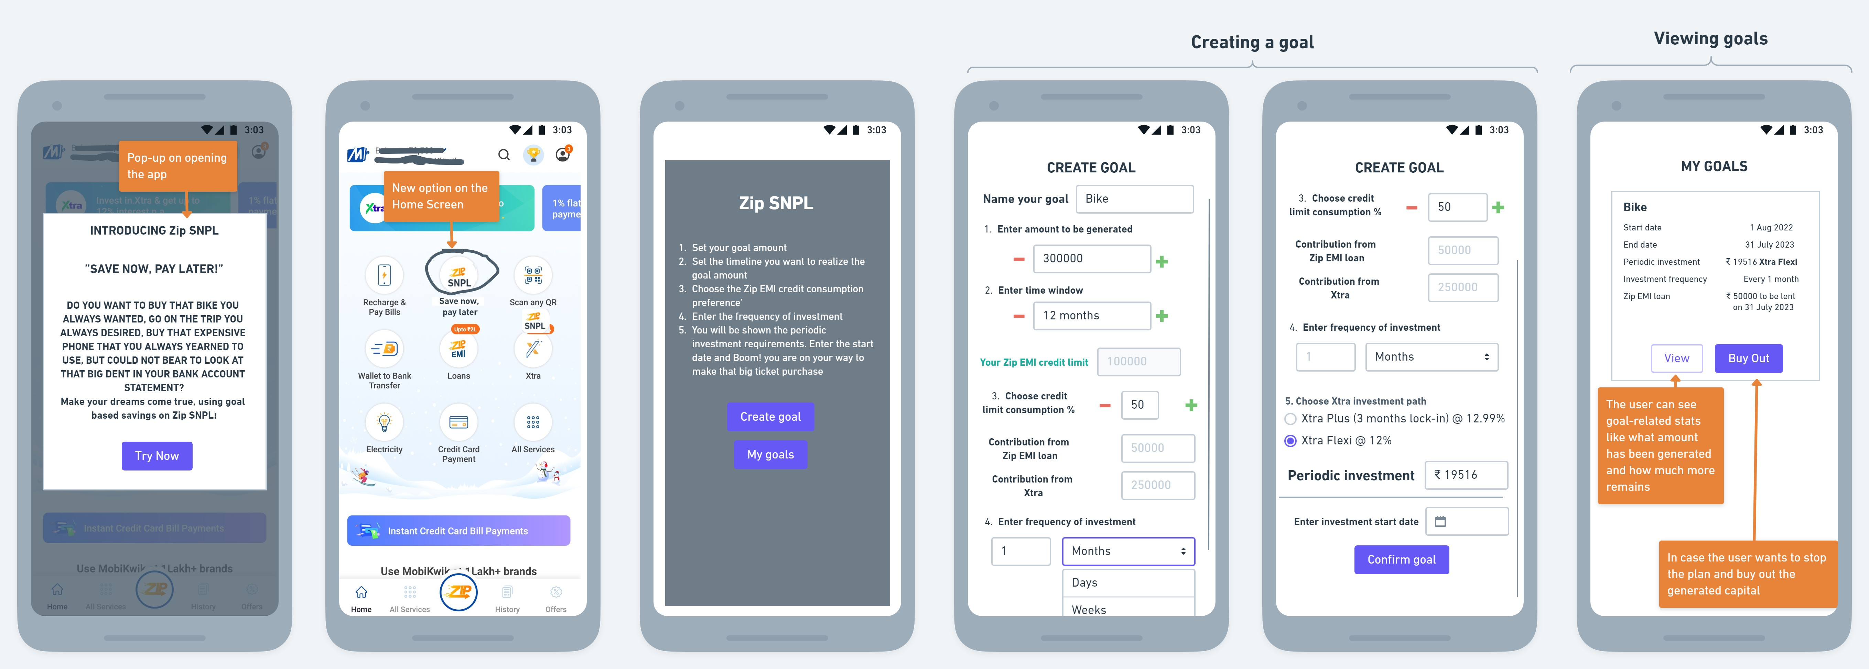
WIREFRAMES

Slide 8



METRICS
North Star metric: Total investment amount done through Zip SNPL
Category | Primary Metric | Desired movement | Remarks
Discovery/ Adoption | CTR of SNPL option present on home page # of SNPL goals set every week |  | Will denote the ease of discovery and interest in offering Will denote the adoption rate of Zip SNPL
Engagement | DAU, MAU Avg. number of goals set per user Avg. monthly investment amount per user |  | Will denote user traction with the new offering Will denote the user trust in the ability of the offering to reach their goals Will denote the user trust in the security of their money invested on the platform
Retention | % users making repeated SNPL goals % SNPL subscribers cancelling goals before end of declared investment period |  | Will denote that the customer had a satisfactory experience and wants to continue the association Will denote customers cancelling their goal due to multiple reasons: cohorts can be made in this data to find out what % cancellation was due to dissatisfied customers
Health | Avg. load time of available options |  | Lower load time will result in lower bounce rates due to bad experience
Satisfaction | % of SNPL customers with complaints monthly NPS score of SNPL customers |  | This will denote the change in complaints rate, hence the improvements in our offerings Will denote the satisfaction rate of SNPL customers
Revenue | Profit generated through SNPL business Avg. commission rate per lending partner |  | Will denote the profit rate we are able to achieve as a function of the revenue generated from the SNPL business Will denote the relative profitability we draw from our various lending partners
Additionally, I will track some secondary metrics like cannibalism of Xtra and Zip EMI customers by Zip SNPL (% of regular users of either of these offerings moving to SNPL and stopping the use of Xtra/Zip EMI)

Slide 9
SECOND ORDER THINKING AND FUTURE SCOPE
Pitfalls | Mitigation
Periodic investment requirements for many cases may turn out to be much higher than the spending capacity of the individual and the user might default after a few initial rounds of investment | The Zip EMI credit limit for each user is generated on the basis of their credit behaviour analysis. The same analysis can be used to decide if the periodic investment requirement for an individual opting for Zip SNPL is much higher than their spending capacity and might throw a warning to the user to increase the time window or decrease the amount to be generated. If the user still decides to go with the original parameters, such cases can be tracked internally
Future scope
Tie up with brands for extra discounts [Impact: High, Risks: Medium]
A given percentage of the amount can be co-invested by the company that the user decides to set up a goal for. The capital generated at the end of the investment period can be given to the user in the form of virtual cards that works only for that platform. Another way to ensure that the user uses the money on the platform that he co-invested with is to give cashbacks or additional offers when the user actually makes the purchase on the platform that he co- invested with. This co-investment method will give the user more incentive to use SNPL to finance their purchases.
Diversification of investment instruments [Impact: High, Risks: High]
To generate capital at varying rates of return, the investment instruments can be expanded from Xtra and Zip EMI loan to include mutual funds and other suitable funds that could provide a higher rate of return. The caveat is that the risks could increase too. Hence a lot of research will go into which instruments should be chosen.
Display user metrics related to their Goals [Impact: Medium, Risks: Low]
User can track multiple aggregate metrics related to completed and uncompleted goals like amount left to be generated, monthly milestones, ROI, savings, average investment amount, etc. Users can be allotted badges on the basis of achievements on these statistics, which can increase engagement

Slide 10
Thank you!

