Slide 1



IMPROVING RAPIDO
Mayank Kumar linkedin.com/in/mayankkumar mayank.pm11@gmail.com

Slide 2
Company background and problem statement
Rapido is an auto and bike ride-hailing platform, currently running operations in more than 100 cities in India. Founded in 2015, the company’s 1.5 million captains (driver-partners) serve more than 15 million registered customers with their services, accumulating well over 50 million rides and a total of over 250 million kilometers.
Rapido is in its growth phase and it operating in a market where Ola and Uber are dominant players.
Thorough customer research has provided insights that users constantly switch between Uber, Ola, and Rapido while booking an auto, and finalizing the booking which provides the perfect combination of price and expected time of arrival at their doorstep.
We wish to launch 2-3 new features in the current app, which can reduce the switching of users, and make sure they stick to our app.

Slide 3
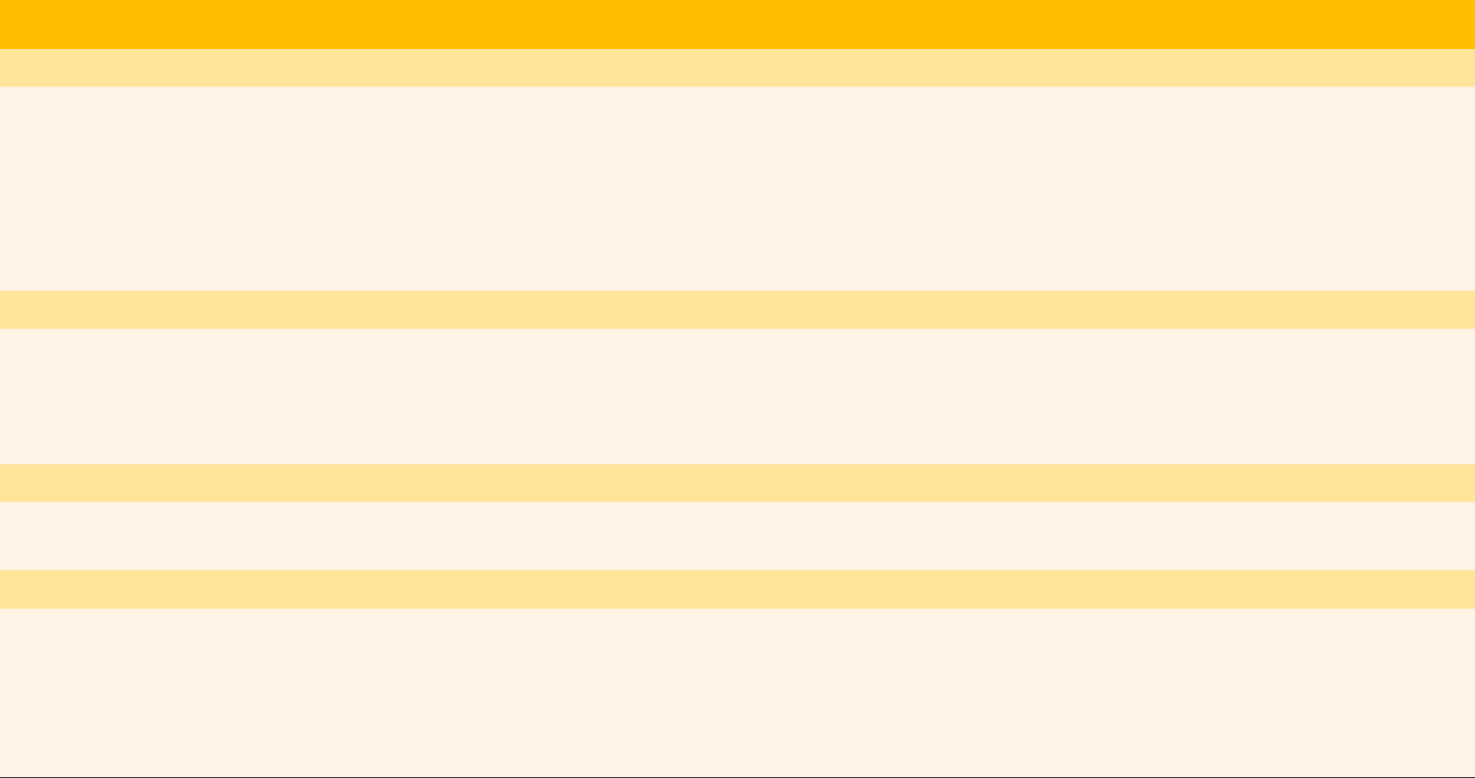




Competition benchmarking
Features | Uber | Ola | Rapido
CUSTOMER EXPERIENCE
Multiple languages | N | N | Y
Linkage through google maps | N | N | N
Use without internet | N | N | N
Use without location | Y | N | Y
Booking for someone else | Y | Y | N
Multiple stops | Y | Y | IN SOME CITIES
PAYMENTS
Postpaid feature (payment on credit) | N | Y | N
Wallet | Y | Y | Y
Change payment mode after booking | N | N | Y
Monthly passes | N | Y | Y
DRIVERS
Frequency of payouts | WEEKLY | DAILY | DAILY
Incentives on number of rides offered | Y | Y | Y
ADDITIONAL SERVICES
Delivery services | Y | N | Y
Insured rides | Y | Y | Y
Additional insurance services | N | Y | N
Payment services (integration with other apps) | N | Y | N
Package delivery services | Y | N | Y

Slide 4



User personas: Riders
User 1: Rishabh
26, Fresh MBA graduate, posted in a tier 2 city
Travels daily from his rented flat to his work place and back. Finds it cumbersome booking an auto everyday
Has to do market visits as part of his work, which takes him to new locations most of the days
Doesn’t know most of the places he travels to, and finds it challenging to direct drivers to his location as he doesn’t know the landmarks in a new place
Solution: Provide regular scheduled services and share live location
User 2: Divya
24, works for an IT company and lives in a flat alone
Has her grandparents visit her occasionally from the other part of town
She wants them to safely travel to and from her place
Solution: Book for others
User 3: Ram Nikunj
Divya’s grandfather, 72, retired from government service
Lives with his wife, and has his granddaughter living in other part of town whom he wants to visit frequently without bothering her
Is not a tech-wizard, but is eager to learn and likes to do things by himself.
Has trouble understanding if he has to pay cash at the end of the ride or if payment will be taken online
Solution: Simplifying the UI, Introduce pay later option

Slide 5


User personas: Drivers
User 1: Sunder Lal
Lives in a tier 2 city, has been doing well for himself as a Rapido/Uber/Ola driver for the past 2 months
Has shifted to a new city, so doesn’t know its localities that well.
Complains that it is difficult to locate riders when picking them up, especially older generation
Solution: Riders can share live location to drivers for easier reachability
User 2: Harish
Has been driving Rapido/Uber/Ola auto for 4 years
Complains about no help from the companies to drivers in conflict resolution. Solutions are always biased towards riders
Solution: Dedicated customer service line for drivers in order to sort out their problems on priority without the need to raise tickets first.

Slide 6
Possible feature additions
Feature (Riders) | Details | Problems targeted
Share live location with driver | Option for users to share their live locations with the driver before starting the trip. | Riders who are unaware of their surroundings can be found by drivers in case they have wandered away from the pickup point or are unable to be present at the designated pickup point. Drivers in general are more aware of the localities and can reach the rider easily in case they have their live locations accessible
Pay later option | Option for users to make payment before next ride instead of the current limit of within 2 minutes of ending the current ride To avoid accumulation of debt on the company, there can be a limit to the ride amount that is eligible for the pay later option, which can later be increased on good credit behaviour | In case of online payments, when user is in a hurry or is unable to receive network in their phones, they should have the option to pay later, before being able to book their next ride. This feature can be expanded later to credit based payment like Ola PostPaid
Book for others | Option to book ride for riders who do not have the mobile app | Helps people who do not have the mobile app or are unable to book the ride by themselves. E.g. for older people or for people who cannot access the internet due to some reason
UI simplification | Simplify the UI during and at the end of the rides to make it cleaner and easier to use | Will avoid information overload, help less tech friendly people to operate the app and make them more likely to use our services
Rapido Regular | Schedule regular services between fixed source and destinations at fixed timings | Will avoid the hassle of making new bookings everyday as the app will do that for you everyday at the specified time between the given locations. There can be an option to update timings or locations within a specified window, if required
Feature (Drivers) | Details | Problems targeted
Dedicated customer service | There will be a different customer service team for taking care of driver concerns Or the current team will take driver concerns on priority without the need for them raising tickets | Drivers will feel valued and will reassure them that their concerns are as important to us as the riders

Slide 7
Analysis of solutions proposed
Feature | Reach (0-10000) | Impact (1-5) | Confidence (1-5) | Effort (1-5) | Final score | Success metrics
Share live location with driver | 6000 | 2 | 3 | 1 | 36000 | Turnaround time to reach rider
Pay later option | 8000 | 5 | 4 | 4 | 40000 | NPS, App downloads, Churn, MAU/DAU
Book for others | 8000 | 3 | 3 | 3 | 24000 | NPS, App downloads, MAU/DAU
UI simplification | 10000 | 2 | 3 | 2 | 20000 | NPS, App downloads, Churn
Rapido Regular | 5000 | 4 | 5 | 4 | 25000 | NPS, App downloads, MAU/DAU
Dedicated customer service for drivers | 5000 | 4 | 2 | 4 | 10000 | Increase in Rapido captain workforce, NPS (drivers), App downloads

Slide 8
Solutions to be implemented
Rapido Regular
“A user opting for regular service on a fixed route should not have to worry about finding a new ride every time”
Examples are:
Students going to tuition/school
Working professional commuting to and from home and office
Define MVP:
New menu item: Define details like source, destination, start date and time and frequency
The payment option can only be Rapido Wallet.
PostPaid wallet can also be added later if the company starts a PostPaid option later
Ride details like source, destination and time can only be edited until 15 minutes before the next scheduled ride
Alert for low wallet balance, so that the user can continue uninterrupted services. This alert is triggered by the wallet balance falling below the amount payable for the next scheduled ride
Share live location
“A driver or rider who is unfamiliar with their surroundings should be able to find their rides easily”
Examples are:
Person trying to find their cab in a crowded place
Rapido captain trying to navigate to the pickup point in a location full of alleys and small parallel streets
Define MVP:
Add a new widget to the ride navigation screen to give the rider the option to share their location with the Rapido captain
Alert to the Rapido captain that the rider’s location has been shared. Marker will be added to his in-app map that will show the pickup location as well as current location of rider
Pay Later
“In a cashless environment, a rider who is in a hurry or is unable to receive network enough to make a payment on the spot should have the chance to make the payment later”
Examples are:
Work professional heading to their office
People visiting locations where they are unable to get network or make online payment
Define MVP:
Starting with a decided limit (e.g.: ₹ 100), the riders whose total payable amount falls below this limit should be shown the option of making the payment later. But this payment should necessarily be made before the user can book his next ride.
User should be shown alert on the book a ride page that he has to make the payment in order to make the next booking
Good credit behaviour (timely payments of previous bookings should be rewarded with increase in credit limit of the user)

Slide 9
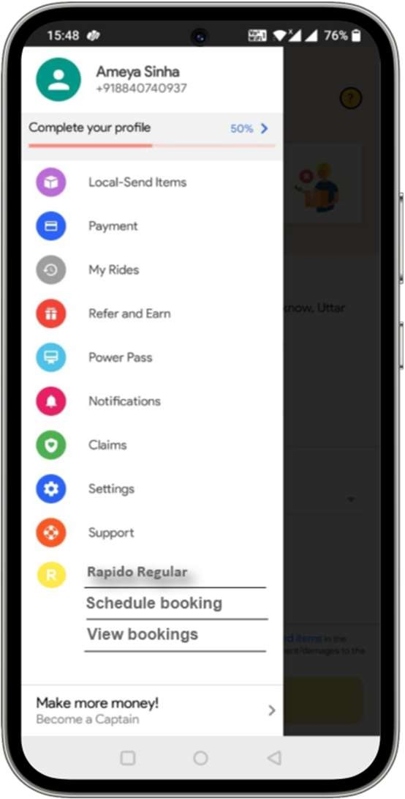
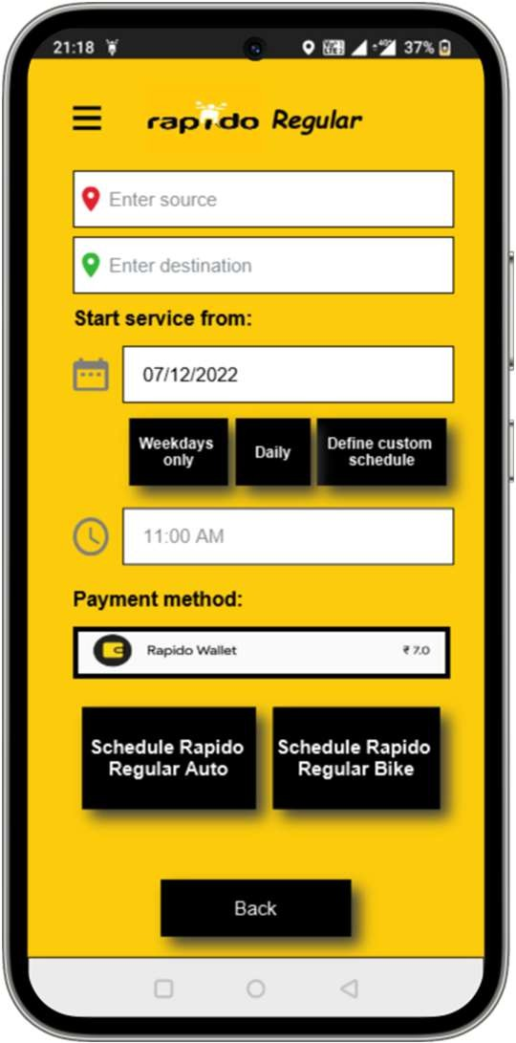
Wireframes - Rapido Regular
Payment method will be limited to Rapido wallet in order to not bug the rider after every ride
New Menu item to schedule booking and view current bookings
Rapido Regular Schedule booking page

Slide 10
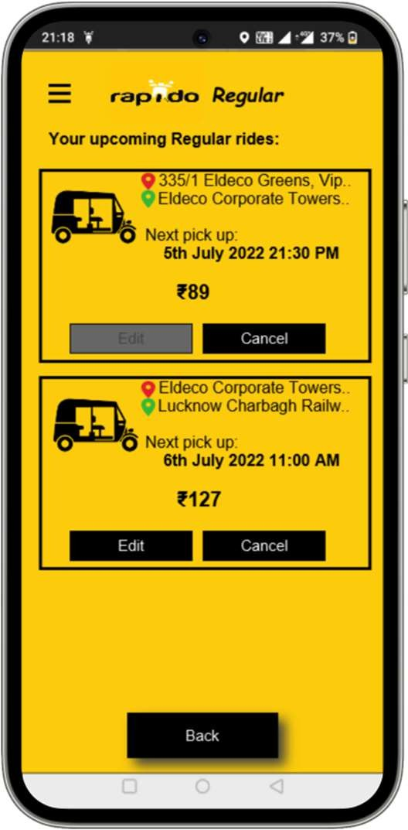
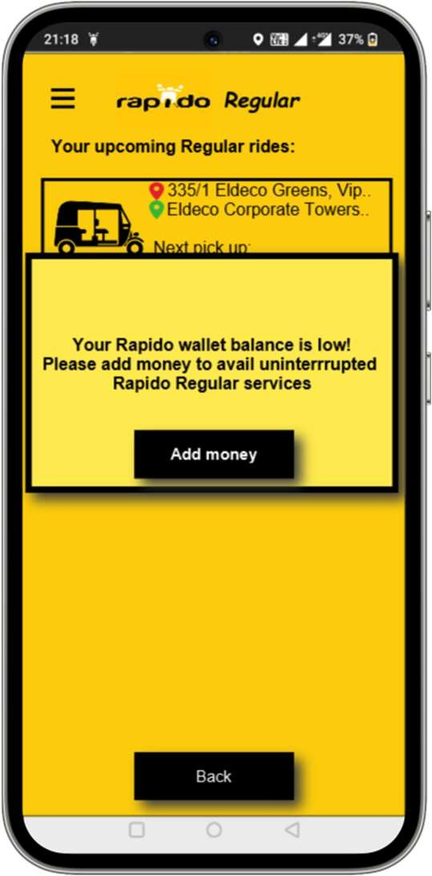
Wireframes - Rapido Regular
Edit option not available if the ride is scheduled in the next 15 minutes. This is because the app will run the Fetch ride process on the backend 15 minutes before the designated pickup time. In such cases only cancel is available.
The alert for low wallet balance pops up by the triggering of the event: Wallet balance is lower than the total amount payable for the next scheduled ride
Rapido Regular View bookings page
Rapido Regular wallet balance alert

Slide 11
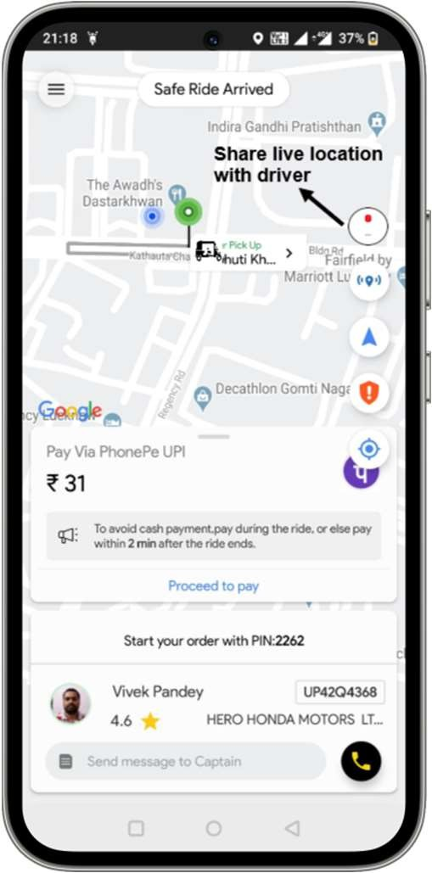
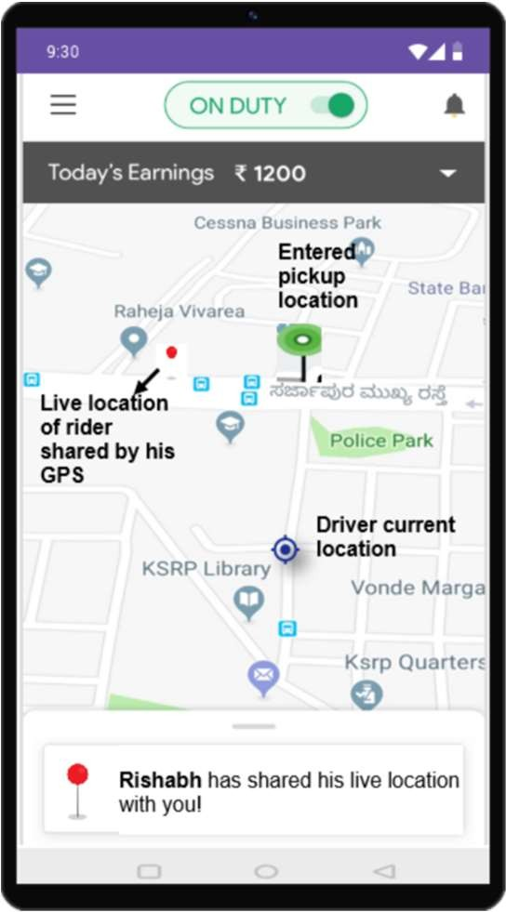
Wireframes – Share live location
Widget added for rider to share his live location to the driver
Widget added to current booking screen
Driver alert and rider live location shared

Slide 12
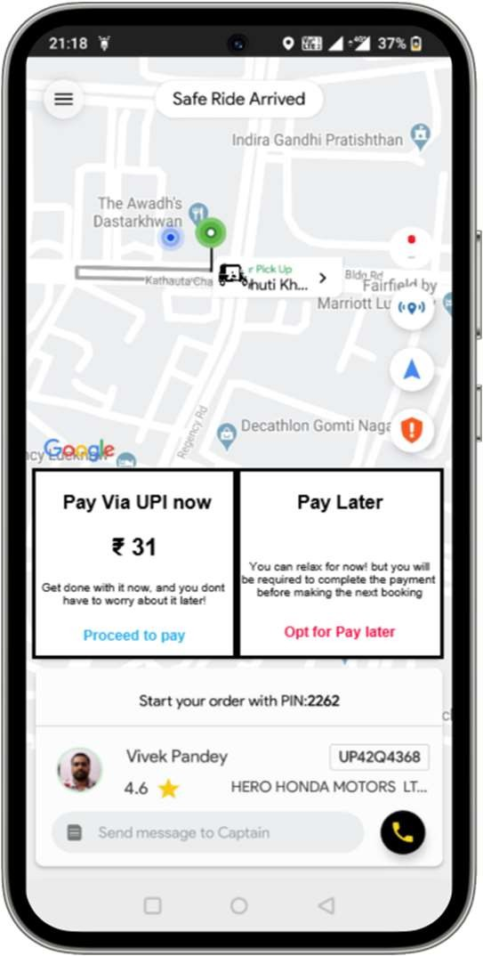
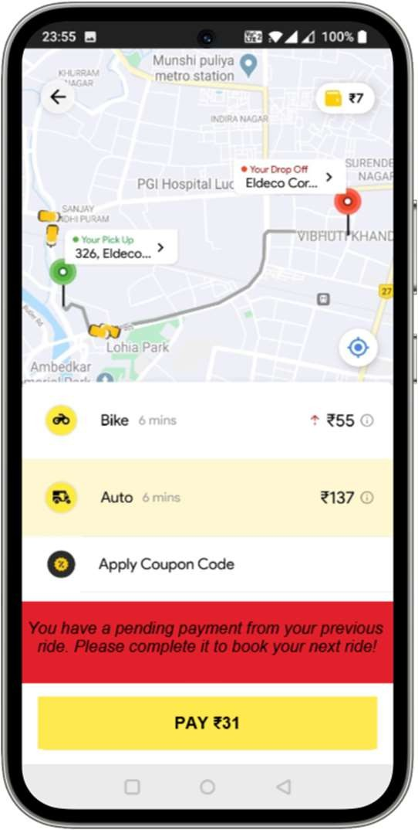
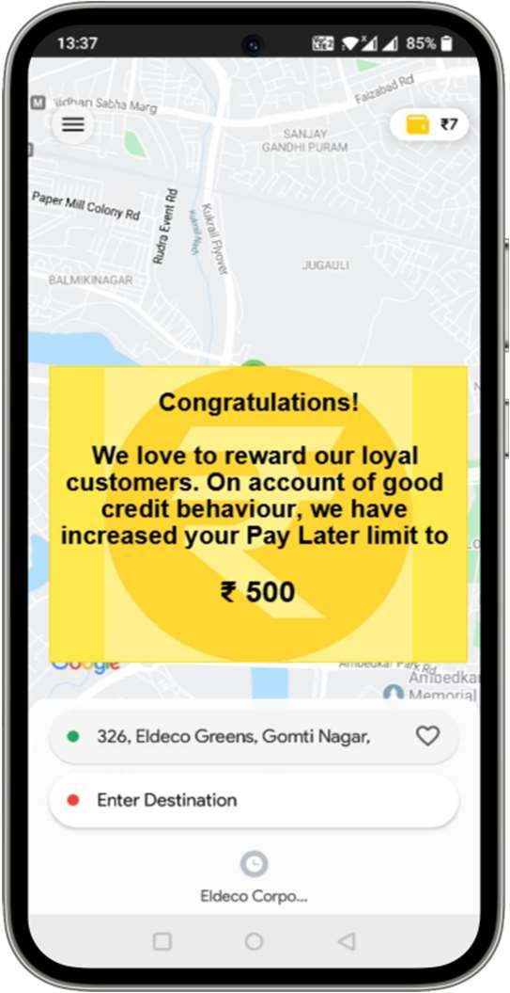
Wireframe – Pay later option
Pay later option shown to eligible users
Mandatory payment to be made before booking next ride
Alert for increase in credit limit of user

Slide 13
Success metrics
Turnaround time to reach the rider: % reduction in the time taken by the Rapido captains to reach the rider for pickup
Daily and monthly average users (DAU/MAU): % increase in the number of users engaging with the application
Net promoter score (NPS): % increase in Play store/App store reviews
App downloads: % increase in app downloads will indicate an increase both in the number of captains and riders
Churn rate: % reduction in the users who are not engaging with our services. This can be tracked at various points of the user journey. For example, searching but not booking, Booking but cancelling, etc.

Slide 14

Go-to market plan
Market research to identify suitable markets for testing new features and response of users
Incorporating the suggested features in user stories and add to product backlog
Pull the stories into sprints and perform the initial development/
QA
Receive and implement feedback in consequent sprints
Beta testing
(Unit/System testing)
Release new features in identified markets
Track metrics
The features to be incorporated would be better suited to an AGILE development framework, where there are subsequent iterations of development and incorporation of user feedback and it will be easier to add newer features. E.g.: integration of PostPaid feature into Rapido Regular if the company moved towards it

Slide 15

Thank you!
Mayank Kumar
linkedin.com/in/mayankkumar mayank.pm11@gmail.com

