Slide 1

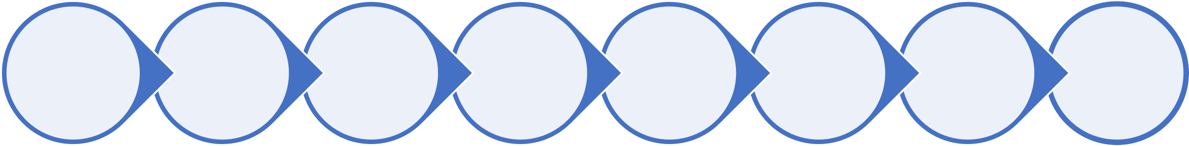
Problem statement and approach
Design a control tower that gives a birds eye view of how are the ground operations for any sample from patient to lab.
Data(not actual):
Redcliffe Lab gets 10,000 orders in a month. Current Process:
No sample wise tracking available.
My approach to this problem:
Map current customer journey
Pain points identification and prioritization
Possible features and prioritization
Possible pitfalls and mitigation
Company overview
Decide upon the objective
Workflow and Mockups
Metrics identification

Slide 2
Redcliffe labs overview
Redcliffe labs cater to all diagnostic needs of people. They have built a comprehensive portfolio approach both with routine and specialized test menus with advanced testing labs all over India
VISION: Most Trusted and Affordable Diagnostics platform for Bharat - Empowering Health, Impacting Lives.
Stakeholders:
User: The user of our interfaces (app/website) who books the
tests
Patient: The person who is to be tested, the one whose sample is collected. This person may or may not be different from the user
Pathology collector: The person assigned to visit the patient’s address to collect samples and transport them to the pathology lab in a safe manner, following the required protocols
Pathologist: The person who carries out the tests on the received samples
Lab admins: The person who updates the activities of the labs in the Lab Information Management System (LIMS)
Impact differentiators
Technology integration
Use of technology to ensure robustness
Accessible to all
Accessibility to remotest parts of
the country
Robust interfaces
Seamless customer journeys
Objective
The bird’s eye view would be an incredible asset for the patient/user to track the status of their provided sample as it would support the ‘robust interfaces’ impact differentiator of Redcliffe labs by filling in a significant gap of the user journey. Hence our objective will be to build a control tower which will enable the user to track the status of their tests, end-to-end from a single interface

Slide 3







Current customer journey
Information of pathology collector/visit received
Tests are conducted: might include multiple tests
Data is analysed and result is created
Results uploaded and made available to patient
Booking of tests
Visit takes place/sample collected
Sample reaches the lab
The user will book | The booking | The pathology | As soon as the | The designated | The data is | The generated
his tests and | details are visible | collector visits the | samples are | pathologists will | analysed and the | report in shared
provide details | on the app and | specified address | received, the lab | conduct the | required report is | with the user
pertaining to the | website. The user | in the specified | admin will update | required tests and | generated and is | through the
name, age, gender | is intimated about | time slot and | the details about | note the relevant | again updated in | appropriate
of the patients. | the designated | collects the | the samples | data. This data will | the LIMS | communication
The preferred slot | pathology | required samples. | received (number, | be collected and |  | channel
for sample | collector and the | He/She marks | types of samples, | updated in the
collection and the | confirmed time | them | time of receipt, | LIMS
address of | slot of sample | appropriately and | designated tests to
collection is | collection | then packs them | be performed,
provided before a |  | securely in | etc.) in the LIMS
payment is done |  | optimum
to confirm the |  | conditions to take
booking |  | them to the lab.

Slide 4
Pain points
Pain point | Detail | Urgency to be solved | Frequency
Process knowledge | Patients have little to no information about how the entire process of sample collection will take place for different tests (e.g.: number of samples, place where sample will be drawn from, best practices to follow before a phlebotomy, etc.). It would put them at ease to know the process which will be followed and the environment to maintain for smooth collection of sample | Medium to high | Medium to high
Current status of sample | Once the sample is handed over to the phlebotomist, the patient faces a black box in terms of where the sample might be currently, how the sample is being treated, ETA for result generation and receipt. The ability to know the live status of the sample would introduce transparency in the process | High | High
Cancel/reschedule the test | These options are currently available through the booking flow, once a tracking system is built for patients, it would make it easier for the patients to access these options through the tracking flow directly | Low | Medium
Knowledge about key benchmarks | Most of the samples need specific temperature and storage conditions in which they need to be delivered/stored/processed. The patient might need to know if the best practices are being followed while handling their samples | Low to Medium | Low
I will prioritize pain points with urgency to be solved and frequency above medium to tackle in order to build our control tower.
This is done so that our problem to solve is not very general with multiple things to take care of at the same time.

Slide 5



Designing the control tower: Features
As soon as a new test is booked through the app/website, the tracking workflow will be triggered.
The patient will receive a link to track their sample collection process from after the booking till the receipt of their reports
This workflow will also be available as a new option in the app/website
Feature | Details | Impact | Effort | Score
Booking details | A unique user ID will be generated. This will help identify the case for the patient throughout the workflow Each booked test will have a unique test ID generated. This will help identify each test separately and to map the samples/patients against each ID clearly Patient details such as service booked, payment status, contact details, etc. will be reflected as a confirmation of the data entered by the patient while booking the service Details of collection date and time will also be visible for the user | 9 | 6 | 1.50
Collection details | Details of the pathology collector (name/contact details) will be visible to the user as soon as it is finalised on the back end | 3 | 3 | 1.00
Process Overview | The tests booked by an individual will have a standard process summary mapped against them in the database. These summaries will be made available to the patient for each test ID, so that the patient can have access to: summary of the test steps, the number and types of samples that will be collected from them and the best practices to follow before, during and after the collection | 8 | 4 | 2.00
Sample tracker | Once the sample reaches the lab, the time of receipt is updated in the Laboratory Information Management System (LIMS), which will be fetched into the tracker as well. The start and end time of each test being performed will be updated in the tracker through the LIMS | 10 | 7 | 1.43
Discarding of samples | Patients to be made aware about the environment friendly disposal of their samples by following appropriate procedures. This can also be read from the updates in the LIMS | 4 | 3 | 1.33

Slide 6
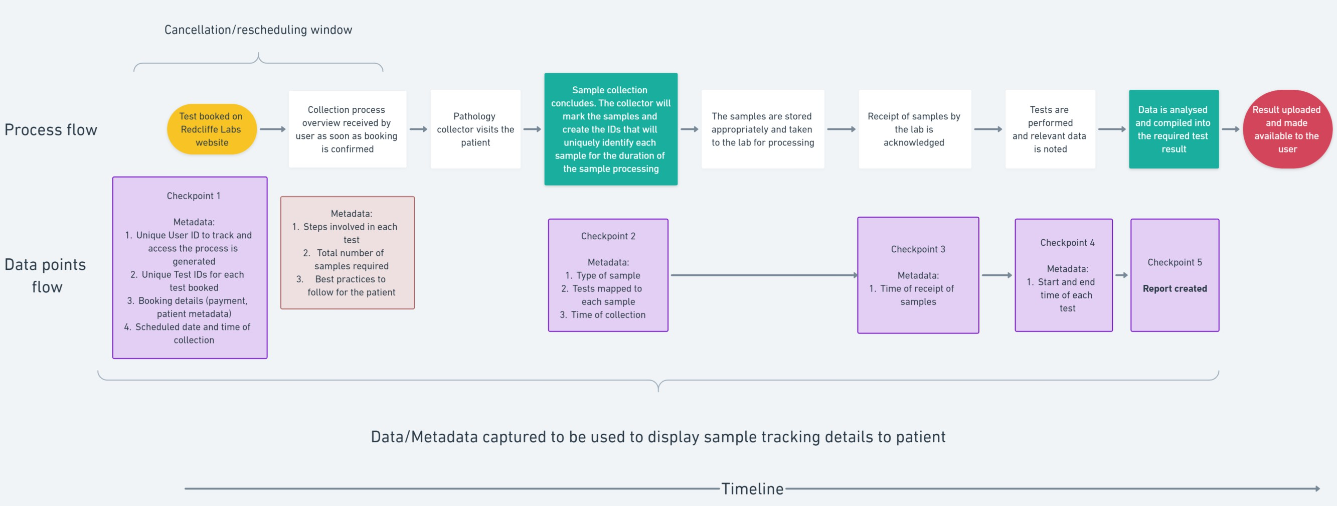
Designing the control tower: Workflow
Note: Purple boxes display the check points that the customer will be made aware of during the tracking of their samples Brown box data will be stored in the database beforehand and will be fetched as per the case

Slide 7
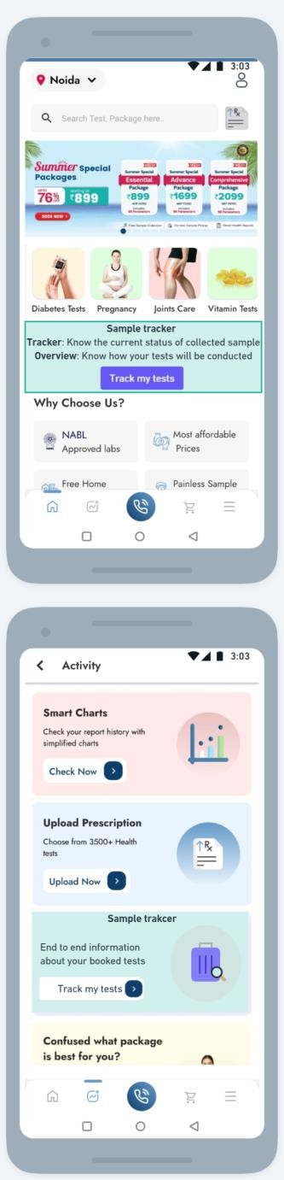
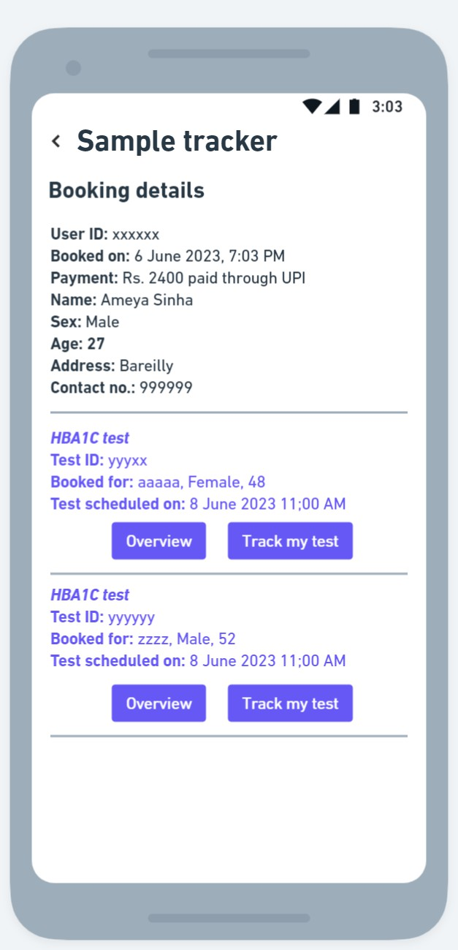
Designing the control tower: Mockups
The first screen for a logged in user with active booked tests will be the booking details followed by the test- specific details of all chosen tests under the user’s booking/
Accessing the control tower will be possible from the activity tab in the mobile app. To generate awareness, there will be a banner on the home page (default section of the app) with a button to access the control tower.
Each test will have its unique ID and details of patients that they are scheduled for. Each test will also include 2 options:
Overview: This will give access to the process overview of that test, including the steps involved, best practices for patients, etc.
Track my test: This opens the tracking section where the current status of the booking and sample is visible to the user

Slide 8
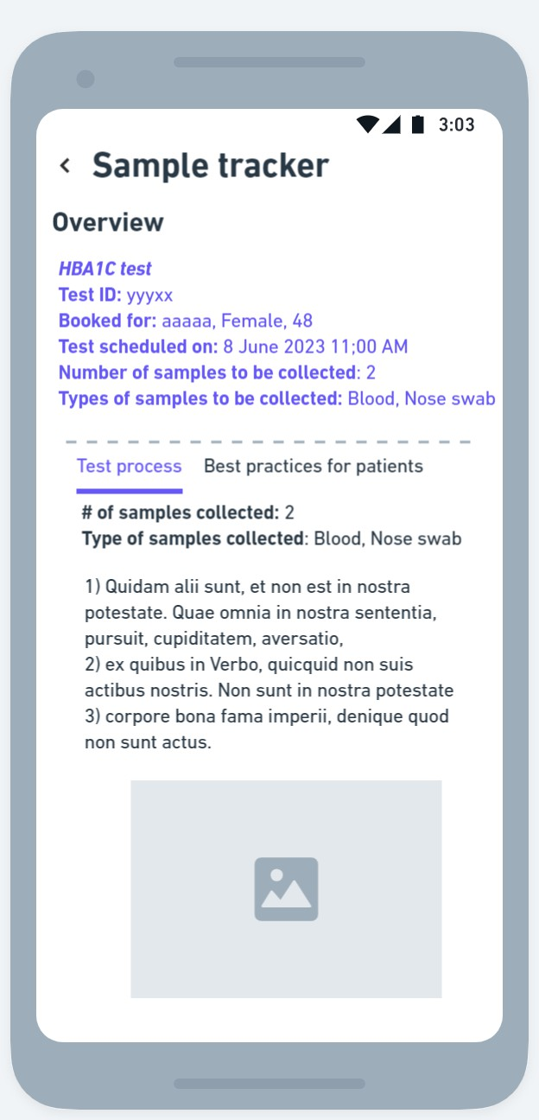
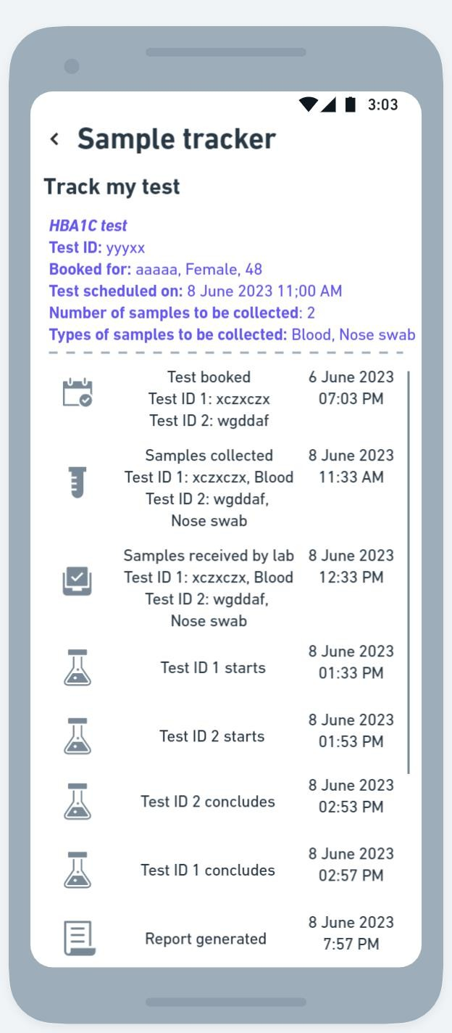
Designing the control tower: Mockups
Overview Section
The overview section will ease the patient into the sample collection process as it will provide the necessary context and the patient will know what to expect. There will be separate sub-sections on:
Test process: This will contain a summary of the steps involved in the collection process and a summary of the types and number of samples to be collected.
Best practices: This will educate the user on the best practices to follow before, during and after the collection process in terms of diet, conditions of the test collection area, etc.
Track my test section Besides the standard details of the test, the main offering of this section is the end-to-end tracking of the sample collection process, starting from booking and ending at report generation. Each step will correspond to a check point
defined in the data points workflow earlier. Each step will have a summary of the checkpoint and the time at which it was accomplished. The time stamps will be read from the LIMS which the lab admin updates on their system

Slide 9
Metrics
Category | Metric | Comments
Discovery | CTR of the track my tests button | To note if users are checking out the new feature
Engagement | Avg. time spent per user on track my tests section, % of users accessing Overview and Track my test section | To understand the utility that the user is finding in the new feature
Retention | Net promotor score, % change in users using the track my tests section (weekly, monthly values) | To understand if users are finding the new feature to be useful
Possible pitfalls and mitigation
Pitfalls | Mitigation
For 10000 orders a month, there is possibility of latency in data availability | Load balancing could be used to direct the query to free servers as the volume of orders scales up
Possible friction for user due to breaking of user journey in different workflows (currently, booking is done separately, proposed control tower is another section, and report is generated separately) | Integration of various workflows to reduce friction points in the user journey. For example, at the end of completing the booking, the user could be redirected to the sample tracker section, cancellation and rescheduling options could be provided in the same workflow through options present in the section. Link to access report can be provided at the end of the tracking journey as soon as it is generated

