Slide 1

Background:
You are a product manager on the user generated content team of TripAdvisor. User generated content (reviews and ratings in this case) helps the platform to show up higher in the search results thus bringing organic traffic to the platform. Since these platforms have an ad-supported business model, more traffic leads to higher ads revenue and hence more reviews on the platform helps the business grow.
Objective:
Growing the number of reviews on the platform
(Assumption: Only business in India is being considered)
Flow of the presentation:
Focus on the pain points that can be solved for maximum user happiness and also generate maximum business value
Generate and evaluate solutions (pros and cons). Use wireframes to list features for the proposed solutions
Hypothesise on possible reasons of low review activity
User research to validate/negate those hypotheses
Find out core user needs and pain points to be solved
List down metrics to track success of proposed solutions

Slide 2

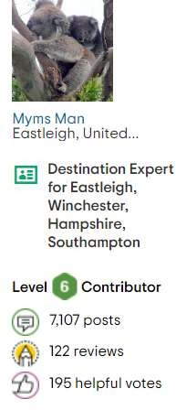
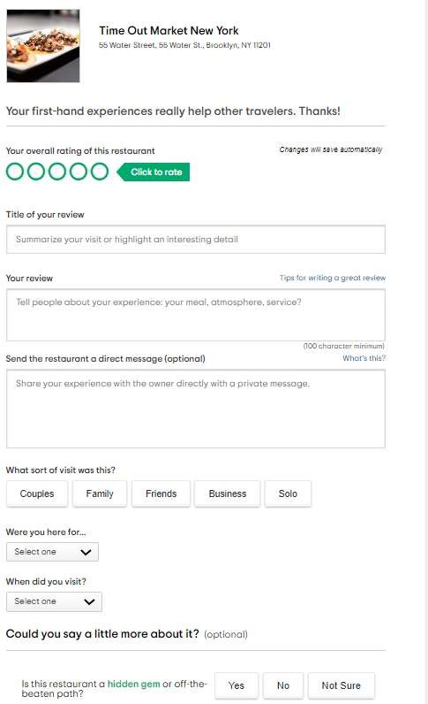
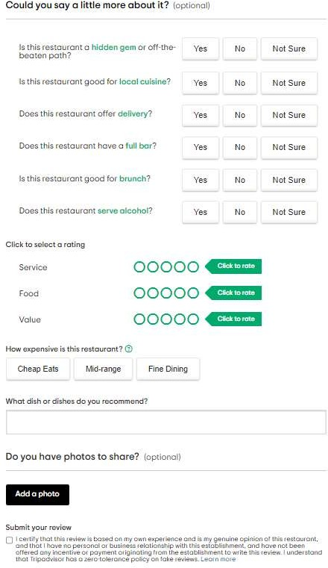




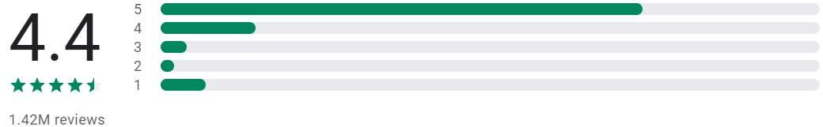
Analysis of
App/website reviews
“ľkc app is gícat roí ícscaíck, a⭲d I oftc⭲ lca:c íc:icws foí otkcís.”
Reviewer profiles are summarised as per their review activity
“S"ck a⭲ cssc⭲tial aid wkc⭲ dccidi⭲g o⭲ a locatio⭲ oí :c⭲"c. EquallQ uscful to lca:c fccdback wkc⭲ a :c⭲uc oí scí:icc disappoi⭲ts.”
This is the overall process of reviewing a listing. As is apparent, it is time consuming and seems like a daunting task at the very onset
More the number of reviews, more the progress in the level of the reviewer. There is also a summary of the contributions made by the reviewer
“I likc to takc a look o⭲ tkc íc:icws tkat tíip ad:isoí pío:idcs fíom otkcí pcoplc ow⭲ cxpcíic⭲ccs about tkc placcs tkcQ :isitcd so I ca⭲ ka:c a cl"c abo"t tkat placc”
“ľkis app c⭲ablcs mc to skaíc ouí opi⭲io⭲ about placcs wc tíQ plus wc bc⭲cfit fíom otkcí's íc:icws of placcs wc co⭲sidcí goi⭲g to. So wc gct a⭲d gi:c fícclQ witk tkis app.”
Personas These are the most likely set of personas that will engage in reviewing activity |  |  |  |  | FRIENDS
Age | 20-30 Yrs | 0-50 Yrs |  | 30-60 Yrs | Variable
Travel frequency | 1-2 months | 2-3 months |  | 2-3 weeks or less | 1-2 months
Reviewing tendencies |  |  |  | Innate Time motivation availability | Innate Time motivation availability
 | Innate Time motivation availability | Innate Time motivation availability
Google Play Store
Apple App Store

Slide 3




1. Identifying the problem
Our problem statement recognises our objective to be growing the number of user generated content (reviews and ratings on the site)
We need to understand the reasons why an individual would or would not review/rate his/her travel experience
We can divide our target audience into different personas and try to hypothesise on possible reasons that they could not be engaging in reviewing and rating on the platform
At the same time, we can validate the possible reasons behind people actually reviewing/rating their experiences
Possible hypotheses that people do not engage in reviews/ratings
General problems:
Can find the number of mandatory fields to be overwhelming/boring and would end up discarding the review altogether
There is no immediate/tangible incentives or benefits for the reviewers
They are unable to perceive how their reviews are useful
Persona specific problems:
Business travellers: might find it time consuming
Non tech-savvy travellers: might find the process difficult
Possible hypotheses that people engage in reviews/ratings
For self validation/expressing their opinion
To vent or talk about a really good or really bad experience
When they are requested by a property/travel partner to do so
What to do next:
Design a survey and confirm/negate the identified hypothesis
Reach out to some of the respondents in order to deep dive into their responses to get a deeper understanding of the problem/pain points

Slide 4
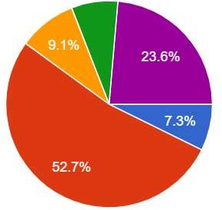
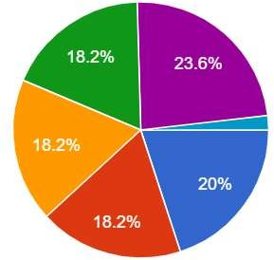
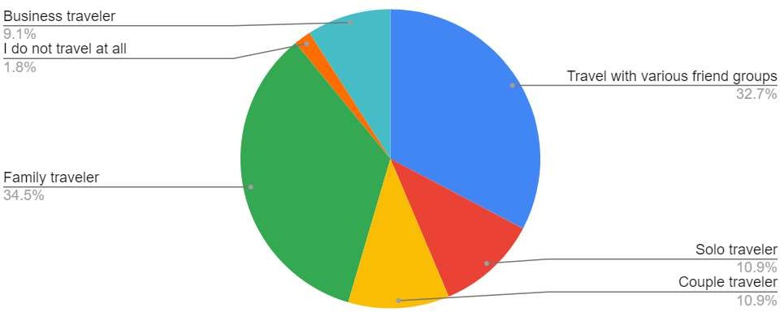

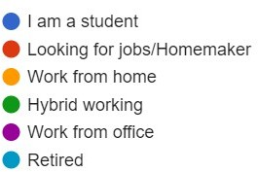
2. User research: Survey/interviews
Questions asked regarding:
Demography: Age, working status, geography
Travel behaviour: Frequency of travel, nature of travel, platforms used to plan and review the itineraries
Reasons behind sharing reviews/rating
Reasons behind not sharing reviews/ratings
Behaviour and motivations while reading ratings/reviews
Summary of responses: Form link: [https://forms.gle/JHFG8hcxUDohNoD59]
Age demographics
Working status
Travel personas
Major causes identified:
No major difference in share of platforms used for planning vs share of platforms used for giving ratings/reviews -> No particular travel platform is being preferred by users to share reviews/ratings
Major motivators for people to give reviews/ratings:
77% responses: To help other people make better decisions
65% responses: To express opinions/to vent or talk about extreme experiences
Major deterrents for people to give reviews/ratings:
75% responses: They find it time consuming/boring
50% responses: The don’t get benefits in return

Slide 5

3. Problems/pain points to be targeted
Follow up through interviews revealed more depth in preferences of the respondents about how the motivators for reviewing and rating could be reinforced:
To help other people make better decisions -> 90% interviewees agreed that it would help if reviewers could know how helpful their contribution is to other people
To express opinions/to vent or talk about extreme experiences -> 80% interviewees agreed that it would help if they could know that their ratings/reviews bring about a difference
At the same time, the major detractors for users to give reviews/ratings could be solved:
They find the process time consuming/boring -> 90% interviewees said that it seems like just a monologue and and they find their interests waning with every question
The don’t get benefits in return -> 100% interviewees agreed that there is nothing except good samaritanism to make them write reviews on public forums
4. Possible solutions to look into
Objective | Reviewers to know about their helpfulness | Extreme opinions | Making the review process less boring | Benefits to reviewers
 | Users can give Kudos to | The review section of each place | Gamification of reviewing system: | Provide travel vouchers,
 | reviewers, these kudos would | of interest could have a separate | Let the reviewers know how far | discounts and benefits to
 | reflect against each reviewer’s | metric displayed that | away they are from achieving the | reviewers based on some
 | profile | summarizes the extreme | next level | criteria
Possible |  | reviews (total % of 1 star and 10
Solutions |  | star reviews)
 | Provide users the option to | Give more weightage to extreme | Use interactive forms (with | Provide direct cash incentives to
 | mention the degree of | opinions so that 1 star and 10 | custom responses mapped to | more active reviewers
 | helpfulness on a standard scale | star reviews have more impact | specific ratings) to make the
 | (for e.g.: 1 to 5) | on overall ratings | process seem like an interaction

Slide 6
5. Detailing of proposed solutions
Objective | Solutions | Features | Impact (1 to 5) | Effort (1 to 5)
Reviewers to know about their helpfulness | Kudos | Reinf Users can give Kudos to reviewers, these kudos would reflect against each reviewer profile and add up to their _{featu} credentials. This is different from the helpful review feature, which reflects against individual reviews. The kudos could be redeemed for gifts/benefits on fixed time intervals | orcer re #1 4 | 3
 | Degree of helpfulness | Provide users the option to mention the degree of helpfulness on a standard scale (for e.g.: 1 to 5). This would replace the current helpful button, so now the user will have to mention every time, how helpful the review is to them Rei | 2 nforcer | 3
Extreme opinions | Extreme reviews metric | The review section of each place of interest could have a separate metric displayed to everyone that summarizes the ^{fea} extreme reviews (% of 1 star and 10 star reviews). This would motivate the property owners/service providers to keep their positive extremes increasing and negative extremes in check. Would also help offering owners to segregate the extreme reviews to take action on them, if required | ture #2 4 | 3
 | Changed weightage | Give more weightage to extreme opinions so that 1-2 star and 9-10 star reviews have more impact on overall ratings. The negative impact it could have is that the people are used to the equal weightage of ratings to this and might lead to false perceptions | 1 | 1
Making the review process less boring | Gamification | Gamification of reviewing system: Let the reviewers know how far away they are from achieving the next level. This would act as a trigger for the user to write more reviews, but could lead to ingenuine reviews. Moreover, the actual form filling process is still boring. Also, this feature is not very effective unless users get tangible benefits from progressing Ov | 1 ercome | 3
 | Interactive forms | fe Use interactive forms (custom responses mapped to specific ratings) to make the process more interactive. For example, if the user rates 4/10, the form could display : “Oh, we are sorry that you had anything less than a perfect experience. What are the aspects that you did not find satisfactory?”, followed by relevant headers for the reviewer to select Ov | ature #1 5 ercome | 4
Benefits to reviewers | Indirect benefits | fe Provide travel vouchers, discounts and travel related benefits to reviewers based on some criteria. These forms of benefits could ensure continued usage of the platform while engaging the users | ature #2 5 | 4
 | Direct benefits | Provide cash incentives to more active reviewers. This would not however, ensure continuity in user engagement | 2 | 3
Using Impact/Effort values, we will go with 2 features that will reinforce the motivations to write reviews and 2 features that will overcome the negative aspects of the review writing process

Slide 7
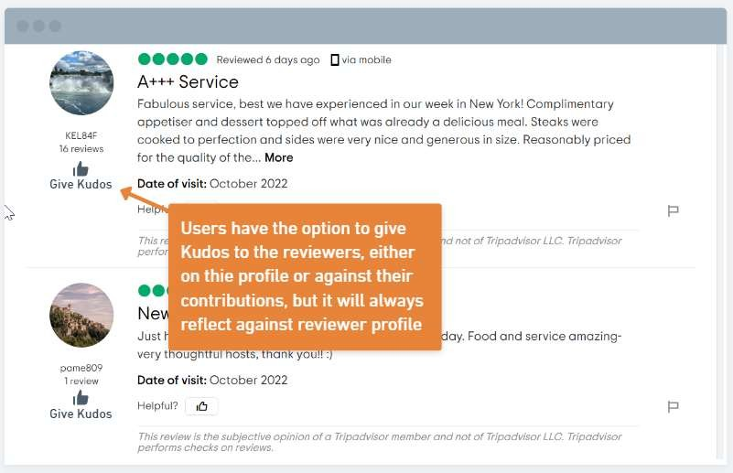
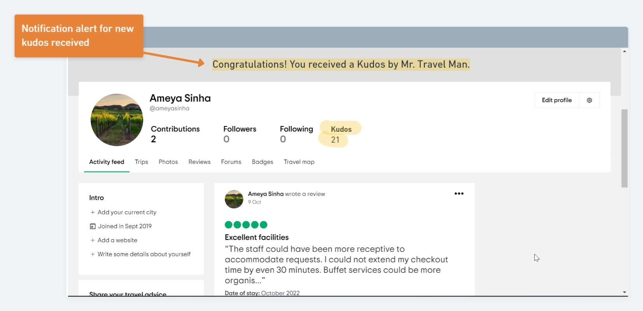

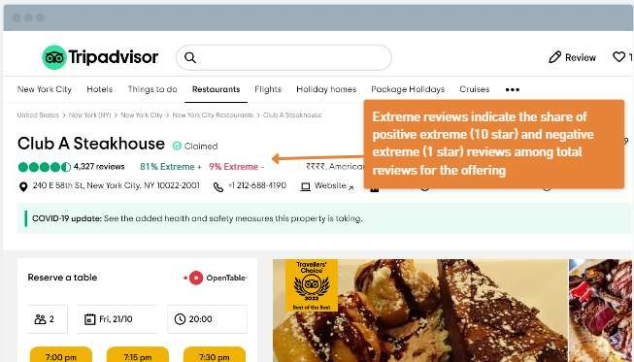
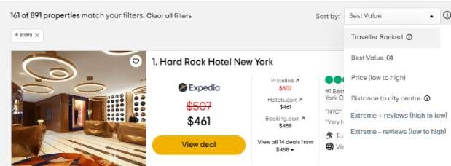
6. Feature additions: Reinforcing the positive aspects of review writing process
Feature #1: Kudos Actor: All users Benefactor: Reviewers
It’s an incentive for the reviewers to keep up their good work. Each reviewer can receive Kudos for their contributions over the TripAdvisor platform that will accumulate against their profile and can later be redeemed for benefits
Wanderlust
@Wanderlust
Wanderlust
Reviewer’s perspective
Non-reviewer’s perspective
Feature #2: Extreme reviews metric Actor: Listing owners/users Benefactor: All users
Simple yet powerful, this new metric will display against every listing that can change the order of results in case of very good or very bad reviews
The sorting criteria will also include the Extreme review cohorts, so users can focus on/try to avoid extreme rated offerings

Slide 8
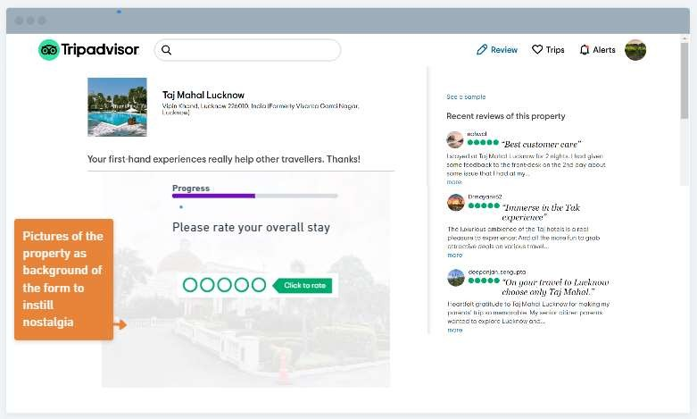
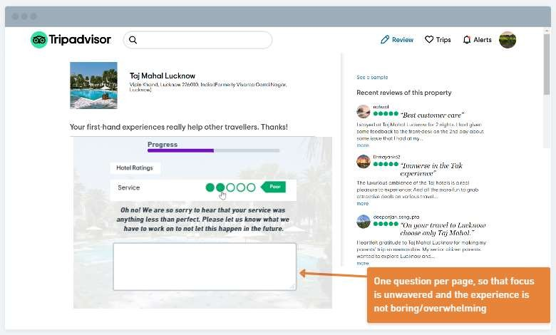
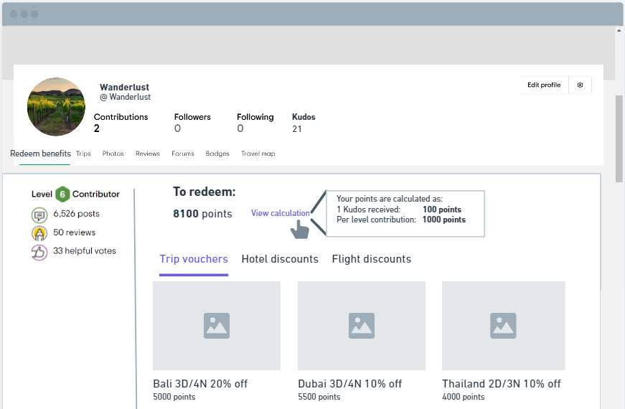
7. Feature additions: Overcoming the negative aspects of review writing process
Feature #1: Interactive forms Actor: Reviewers
Benefactor: Reviewers/Listing owners
The triggers to fill the forms would be notifications and e-mails that would appeal to the helpful aspect of reviewing (already happens to some extent)
The feature we introduce is a new form filling experience which:
Presents one question at a time, so user is not overwhelmed or bored. Displays progress of the review process at the same time
Would interact with the user on the basis of their responses
Has background pictures of the property to induce nostalgia
Feature #2: Indirect benefits Actor: Reviewers Benefactor: Reviewers
The platform already has progressive levels of contribution recognition for reviewers. It can further be tied to indirect benefits like vouchers, discounts, etc.
Point allocation can take place on the basis of fixed criteria
The number of kudos received can also contribute to the points that a reviewer can redeem
All this will incentivize review writing

Slide 9


8. Success metrics to be tracked
Feature specific metrics
Feature | Metrics to be tracked | Summary | What could go wrong with this solution?
Interactive forms | % of questions answered before bounce | An increase in this metric would portray that the user is finding the review process to be more interesting | The picture display feature could incite negative emotions in some cases to such an extent that the user will bounce off from the process
Indirect benefits | # of users redeeming benefits/Number of winning benefits | Since, we will provide benefits through tie-ups or third party providers, we can keep a track on what percentage of the benefits we provide are actually being redeemed and hence, are useful to our users | Reviewers can resort to writing ingenuine reviews just to win prizes. Will need a stricter background check process to validate the reviews
 | CTR on Redeem benefits section | To track discovery of this feature
Kudos | # of users giving kudos | Would indicate adoption of this feature | Reviewers could collect Kudos from friends and families in order to win benefits. Some checks to prevent this are: Point value of Kudos to be kept low Kudos redemption should be vetted against users review activities on the platform
 | # of kudos received per reviewer per week | Would indicate if the reviewer is working with the objective to receive more Kudos
Extreme reviews metric | % change in extreme (1 star and 10 star) reviews per listed offering | Abnormal increase would indicate that users are resorting to ingenuine reviews | Could lead to increase in ingenuine reviews just to promote/demote one listing. Will need a stricter background check process to validate the reviews
 | % change in owners replying to extreme reviews | Would indicate if this feature is helping/motivating the offering owners to drill down and take action on extreme reviews
 | % of times extreme reviews is used as sorting criteria for listings | Would indicate discovery and success of this feature as a sorting criteria
Supporting metrics
% change in weekly reviews/rating
, WAU, MAU
% change in ad revenue
Engagement
Revenue

