Slide 1
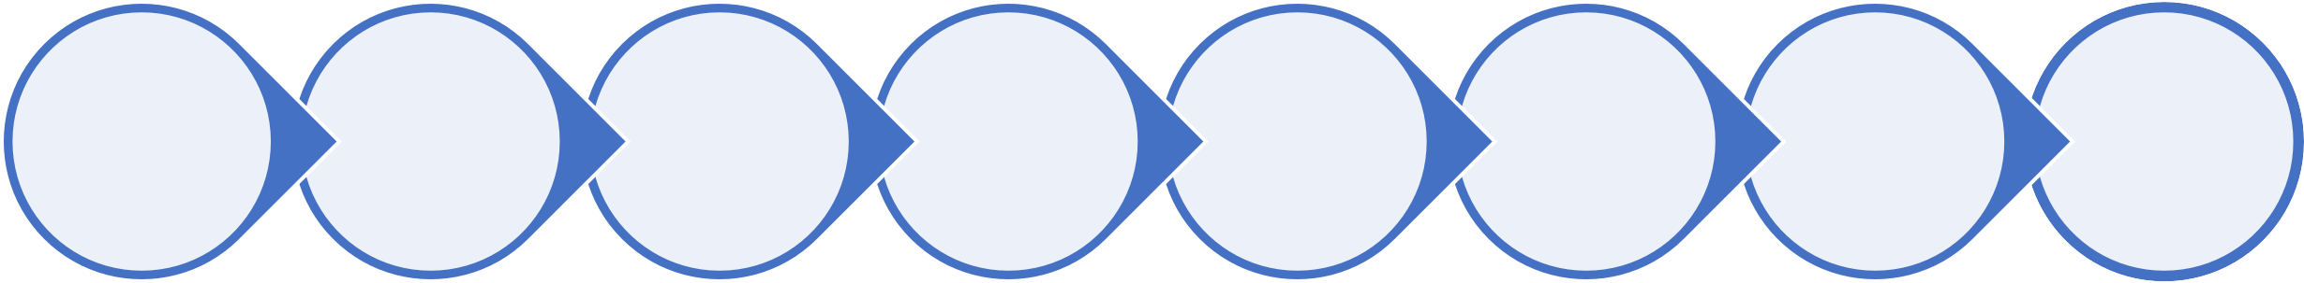
Zluri
Problem statement: Pitch a basic module of Employee dashboard which can solve for employee use cases
Background: Zluri Dashboard’s Users are only Admins of the company like CEO/CTO/COO/IT Admin/Finance Admin/HR Admin since Zluri enables visibility of the whole organisation. But a use case of serving a product to Employees of the organisations remains untouched.This led Zluri to launch it’s own standalone product to serve the employees and named it the “Employee Dashboard”.
Why build an employee dashboard now?
Zluri’s mission is to Accelerate the world’s transition to SaaS. Its current offering serves a limited portion of IT employees and hence, there is a gap to be filled that Zluri can look to fill using its core competencies and features of its existing product.
My approach:
Personas identification and prioritization
Pain points identification and prioritization
Listing solutions and prioritization
Second order thinking/ Summary
Decide upon the objective
Mockups
Go-to-market strategy
Metrics identification
Objective
Since this is a new offering by the company, the objective should to promote and ensure maximum reach and subsequent adoption of this product

Slide 2
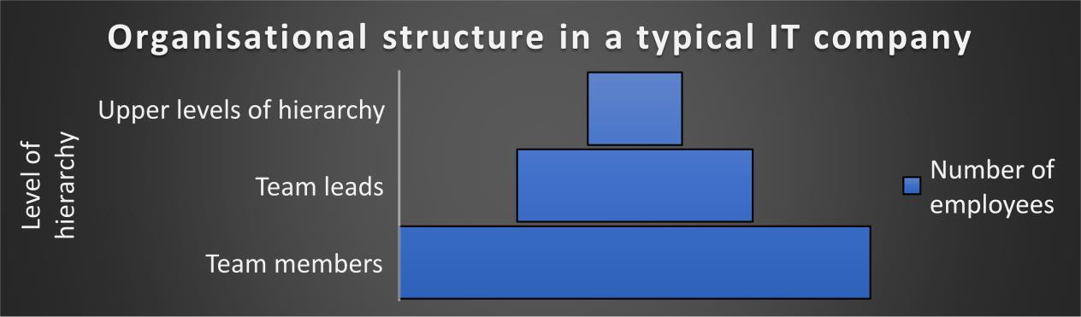


Employee Personas
A typical IT company will have the following departments: Dev, QA, DevOps, HR, Finance, UX/UI designers, Product. Each department may have their own
tools and Software that each member uses to accomplish their daily tasks.
Raj (Software Developer, Company X)
Android developer; started career in company X (product-based) right after college; has been working here for 2 years
Used a different IDE to write code in college. Had to shift to a different one which is the standard platform used in his team.
Had started coding in Java 16; over 2 years Java was renewed twice (present: version 18) with multiple new features introduced. Only got to know about it through a friend who switched jobs to a startup which was using the latest version.
Apart from project related responsibilities, Raj uses the company ERP to access his employment related information
He uses the IT portal to raise tickets regarding any hardware/software issues or requests
Swati (QA Team lead, Company Y)
Has been in QA for 6 years, leads a team of 8 QAs in Company Y (service-based) for a US-based client
Needs to know if there are new tools in the market that could make her team’s work efficient and reduce the go-to-market time
Needs to get licensed software for use by her team in the shortest amount of time possible
Since our objective is maximum reach for the new employee dashboard, we need to target the team member persona (since they are
maximum in number) and hence, we will identify and solve for their problems

Slide 3



Pain points
Here are some identified pain points for the team members persona:
Pain points | Frequency | Intensity | Urgency to be solved | Details
Adjusting to new platforms, when joining a new team | 2 | 6 | 12 | There is a need for systematic Knowledge Transfer for new people in the team
Awareness of new software/new versions of existing software | 5 | 6 | 30 | Employees need to be aware of software/tools that can increase their efficiency. They also need to know whether the time and effort in setting up and getting used to the new software will yield an appropriate increase in efficiency/output
Getting licensed version of new software | 4 | 7 | 28 | Once they decide to switch to a new software, they need to get a licensed version of the same for all team members at the earliest possible
Follow up/update on active tickets on different platforms | 6 | 4 | 24 | There could be different active issues on different platforms (e.g: IT portal, employee helpdesk) and the user might not be timely responding timely to all of them, leading to lower overall efficiency
Through the above analysis, we see that the urgency to be solved (Frequency * Intensity) is maximum for the problem ‘awareness of new
software’. Hence our employee dashboard will require this problem to be solved first.

Slide 4
Solution
Jobs to be done:
When I want use the best software to do my job efficiently, but don’t have knowledge about all available software in the market, help me in
knowing about and choosing the appropriate software, so that I do not have to spend my time and effort in doing so
Feature | Details | Impact | Effort | Efficiency of feature
App discovery | Employees can be made aware of software being used in their organisation or even outside (for similar work) | 10 | 3 | 3.3
App stats | Feature for the user to look at appropriate utilization metrics for the current software used, so they can compare the benefits and costs of replacing the software | 6 | 2 | 3.0
App demo | Demos of the new software, so that user can get a hands-on experience and judge their comfort | 9 | 6 | 1.5
App categorization | All employee applications will be categorized for ease to access and better UX. These categories could be project specific apps (used in specific teams), generic apps (used across organisation). Further categorization could be made according to utility of app (e.g.: Design, coding, testing, etc.) | 5 | 2 | 2.5
Effort scores have been given keeping in mind that features that already exist in the flagship offering need to built from scratch again and can be reused in the employee dashboard
Based on Efficiency (Impact/Effort) scores, App discovery, App stats and App categorization are the features that I would prioritize in my
employee dashboard

Slide 5
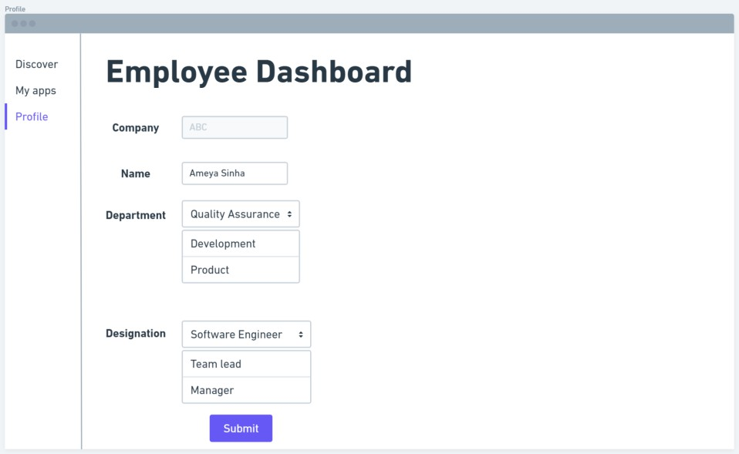
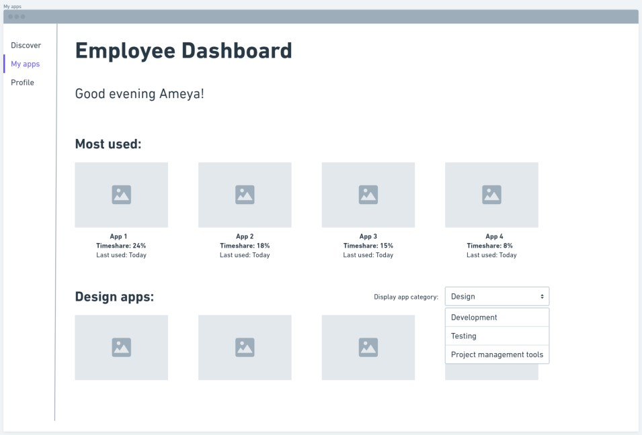
Mockups
Employee profile setup
This will help to create cohorts of users in terms of department, organization or designation
Each employee will setup their employee dashboard by defining these fields which will be editable only through approval of relevant authorities
App categorization
Once Zluri’s algorithms identify the software/tools used by the
employee, categories will be created as follows:
Most used apps will be identified according to timeshare of total active time
App category (defined as metadata by app providers) will be used as a filter to display specific cohorts of applications used by the employee

Slide 6
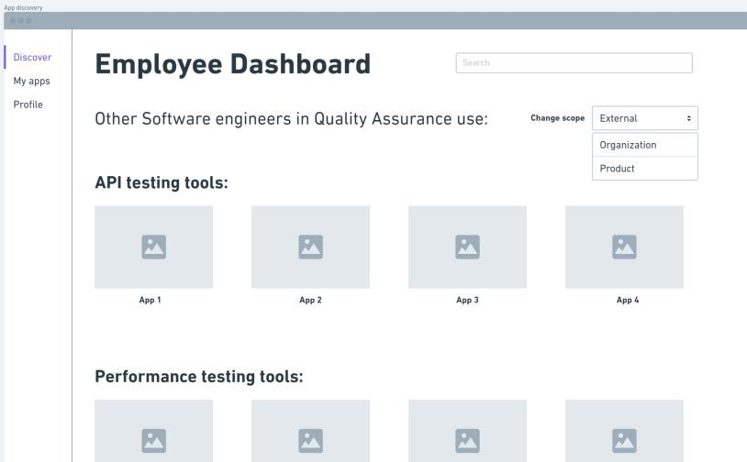
App discovery
Using the employee profile data of users in various organizations (shared voluntarily by organisations), cohorts can be created and displayed on the basis of designation and departments
This will help employees generate awareness about what tools/apps are used in the industry for specific roles and departments. These can be categorized by utility
The employees can choose to browse through/search apps used in their
organization/outside as well as apps used in projects that they are a part of
App stats
Employees can browse through apps in all categories.
They have the option to save apps that they would want to refer to later
or get the licenses for.
They can compare the apps with the ones they have on their system in terms of multiple criteria.
Machine learning algorithms can suggest better alternatives for the user
by performing cost-benefit analysis using the available data

Slide 7
Go-To-Market
Pre launch
Objective: Ensure product-market fit (PMF) with the chosen target group
Train internal teams (e.g.: customer support on the new offering)
Establish metrics (see below) that would be under surveillance to signal smooth onboarding and engagement of users. Track the metrics for estimated vs actual values
Launch a beta release for a chosen cohort of users. UX and in-app behaviour can be tracked using tools like heatmaps.
Monitor user feedback and reported bugs and inculcate it before the final launch of the product
Conduct PMF surveys
During launch Objective: Ensure smooth launch, feature
discovery, and engagement of feature at scale
Promotion: Current users of Zluri can be pitched demos of employee dashboard or allowed free usage for limited time period
The identified target groups should be made aware of the new feature through about the use cases of the new feature
A run-through of the steps should be provided in the form of videos to make the onboarding simpler
Features to be A-B tested can be tested at scale
and feedback collected
The engagement metrics should be specially paid attention to
Post launch
Objective: Continuous feedback from app usage through established channels. Agile deployment of improvements and bug fixes
PMF surveys on larger groups
NPS scores to be measured and evaluated
The retention and health metrics should be paid attention to as the product begins to scale and reach critical mass
Reported bugs should be fixed in shorter sprint cycles till a stable version exists in the market
Adequate customer support should be
available
North star metric: Number of licenses purchased for employee dashboard
Category | Metric | Comments
Adoption | # of employee signups | To note if employees are successfully signing up for the dashboard
Engagement | Avg. time spent per user on app discovery, % of app runs through dashboard | To understand if the employees are completing the intended actions
Retention | Churn rate, % change in users (Week-on-week) | To note the drop-off/addition of users
Health | Correct app cohorts created, new apps added to correct cohorts | To check whether algorithms are functioning as expected

Slide 8
Future scope
Pitfalls
Creating flow for employees to apply for software licenses through dashboard after user discovers a new software that they would like to use. This will also require creating a chain of command on the backend so that approvals for acquiring new licenses can reach the relevant chain of command (High impact, Medium effort)
Creating a built-in platform for users to demo new software and establish their comfort before deciding to switch to it (High impact, High effort)
Options for users to set favourite apps on the My apps (categorization page) (Medium impact, Low effort)
Summary
For the objective of ensuring maximum reach of a new employee offering of Zluri SaaS management platform, we target the team member persona’s problem of lack of awareness of new software in the market and solve it by creating an employee dashboard that would include features of app discovery in the employee system and comparison to other apps in the market on the basis of designated app stats. Employee will also be able to access a categorized view of their apps for better UX
Pitfalls | Mitigation
Organization might not condone visibility of applications at all levels | There can be a feature for the admin to restrict visibility of apps to within the organisation or within the project team only
App stats feature might not generate accurate recommendations in the beginning | Using large sets of data to train the algorithms to make better recommendations

