Slide 1

Social Engagement feature for Zupee
mayank.pm11@gmail.com linkedin.com/in/mayankkumar
+91-9121717703

Slide 2

Problem statement and Objectives
“You have realised from understanding your users’ online behaviour that gamers love to interact with other gamers on platforms like Reddit, Tumblr, Discord and share their experiences with people with similar interests. You want to leverage this behaviour and create a social engagement feature on your own platform, which could act as an
extension of current games on the platform and also help in moving the needle for user engagement.”
The objectives hence identified are:
Introduce a social engagement platform on the app
Drive usage of the engagement platform
User journey stages
Awareness
Interest
Desire
Action
The first step in the journey would be the users knowing about the new social platform
They need to find some value in it to develop interest. This will depend on how we promote the platform and the UI/UX of the platform itself
The desire to use the platform will be generated if the platform has features that directly addresses any existing problem or unmet need of the users of the platform
The call to action needs to simple so that the user actually engages with the new platform

Slide 3





User Personas for Zupee
Ayush
Rishabh
Divya
30 years, runs his general store in an urban
locality
Daily average time spent on gaming apps: 3- 4 hours
Uses Zupee exclusively to make small amounts of money daily. Finds Zupee games to be simple enough to play, but does not find the return on his time investment into the app to be proportionate
App engagement with Zupee: HIGH
21 years, engineering student lives in the college hostel
Daily average time spent on gaming apps: 1-3
hours
Rishabh plays different games on different apps, but prefers the ones in which he can build up and keep a track of his progress as a proxy his expertise in the game. At the same time, he likes to track the progress of players who are better than him in the games he plays
35 years, runs a local bakery from the premises of her home
Daily average time spent on gaming apps:
0.5-1 hour
Takes breaks from her daily routine to play a couple rounds of her favourite games and then returns to her work at hand. Likes to play multi-player games with her neighbourhood friends from the society in which she lives.
App engagement with Zupee: LOW
App engagement with Zupee: MEDIUM
Problem area | Intensity for Ayush | Intensity for Rishabh | Intensity for Divya | Frequency for Ayush | Frequency for Rishabh | Frequency for Divya
Cannot play friends exclusive games
No interaction with other players during or after gameplay
No recognition for gameplay and earnings
No long term game progress tracking
Players like Rishabh will have the highest number of power users and largest total addressable market in the user cohorts for Zupee and hence should be
targeted first

Slide 4
Possible solutions to identified problems
Problem areas to be targeted
No interaction with other players
No recognition for gameplay and earnings
No long term game progress tracking
Features | Details | Problems targeted
Creating private games | Option for users to create a private game with a shareable link that can be forwarded to friends | No interaction with other players
Friends | User can search other Zupee users and send request to add them to their friend lists | No interaction with other players
Zupee Rich clubs | Since the USP of the platform is earning actual money, it would give a boost to players by providing them exclusivity on the basis of the money they have earned. This exclusivity will be coupled with profile badges, access to special games, etc. | No recognition for gameplay and earnings
Create tournaments | This feature will be made available to users who are members of the defined exclusive clubs. They can define the entry amount and date of holding such tournaments. These tournaments can be open or made exclusive according to the profile of the tournament creator | No recognition for gameplay and earnings
Posts | Each game will have a dedicated post section where people can share their experiences or achievements. For example, Snakes and Ladders community can have users post their experiences while other players can interact with it through likes/comments, etc. | No long term game progress tracking
Leaderboards | Leaderboard updates for tournaments or weekly challenges. These will be categorised game-wise | No long term game progress tracking

Slide 5

Analysis of proposed features
Ideally the number of features of picked would depend on the deadline vs available resources evaluation. Since those are not mentioned, I will pick the best solution to each problem identified assuming appropriate resources availability to implement them
Feature | Reach (0-10) | Impact (1-5) | Confidence (1-5) | Effort (1-5) | Final score | Feature specific Success metrics
Creating private games | 6 | 3 | 4 | 3 | 24 | Number of private games played
Friends | 8 | 5 | 4 | 2 | 100 | Number of friend requests sent/accepted
Zupee rich clubs | 10 | 4 | 4 | 3 | 32 | Number of qualifiers for each club tier
Create tournaments | 6 | 3 | 3 | 3 | 18 | Number of tournaments played
Posts | 6 | 5 | 4 | 4 | 30 | Page activity, average time spent by user on communities
Leaderboards | 8 | 4 | 3 | 2 | 48 | Number of posts in each community and user activity on posts (likes/comments)

Slide 6
Implemented solutions
Friends
“The most basic form of user interaction”
User benefits:
Ability to search other users on the Zupee platform
Adding friends to your friend list through sending and accepting requests
Features:
New menu item: A new option created in the app navigator at the bottom. This section will be dedicated to finding and interacting one-on-one with users
Search option to search for other Zupee users. The results will be segregated into friend and non-friend users
Ability to send/receive/accept friend requests where one user sends the request, and if the receiver accepts it, both the users’ friend lists adds the new connection.
Leaderboards
“Long term game progress tracker”
User benefits:
Development of competitive spirit and the yearning to see their name on the leaderboards.
Players can track their progress through their standings on the leaderboards for different games
Features:
Build communities as separate sections where Leaderboards will be displayed. Each game will have a separate community. All game communities are public and open to all
Game servers already collect list of winners at the end of each game. This can just be collated and displayed under the leaderboard tab on each community.
Different variations to leaderboards can be created for more engagement (weekly, monthly, etc.)
Zupee Rich clubs
“Leveraging the basic principle of money-based gaming platforms and extending it as a social status”
User benefits:
Exclusive access to create and play in tournaments
Access to higher entry fee games
Access to recommended tournaments which have better ROI than the general ones
Features:
Define tiers like silver, gold, diamond at
relevant earning levels
Profile badge to stand out from the rest
Game server to create exclusive set of better ROI games for access to only Zupee rich club members

Slide 7
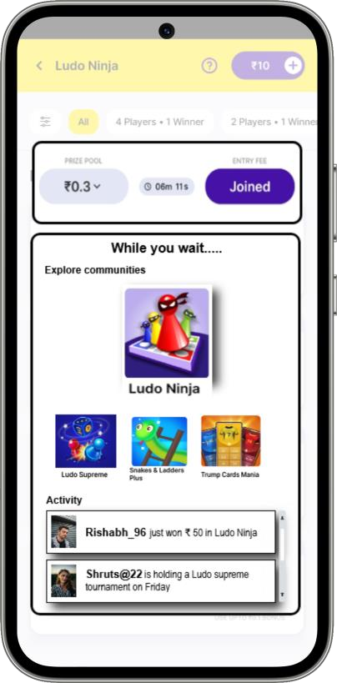
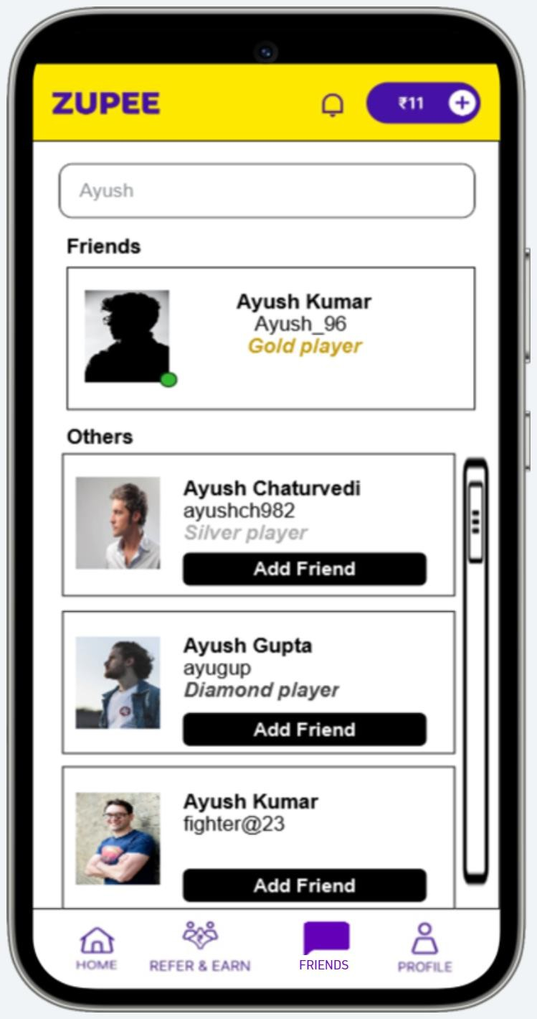
Mockups: Wait screen + Friends section added to app navigator
Wait screen modification to drive engagement
We are losing a major chunk of engagement time with users while they wait for a game to start. We can redirect the users to our engagement solutions at this point
Waiting time before a game starts can be as long as 15 mins. Engagement can be driven through this page generating awareness as well as providing call to actions to the new social features
How it works:
Show a new popup as soon as the user
joins a game and has time to spare
Add sections to this popup with links to:
Explore various communities and their leaderboards
Chat with online friends
User has the option to visit communities or check out their friends’ activities while they wait for their game to start.
The new friends section is accessible from the menu option at the bottom

Slide 8
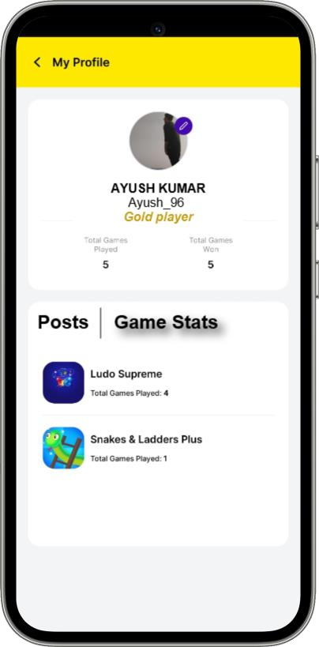
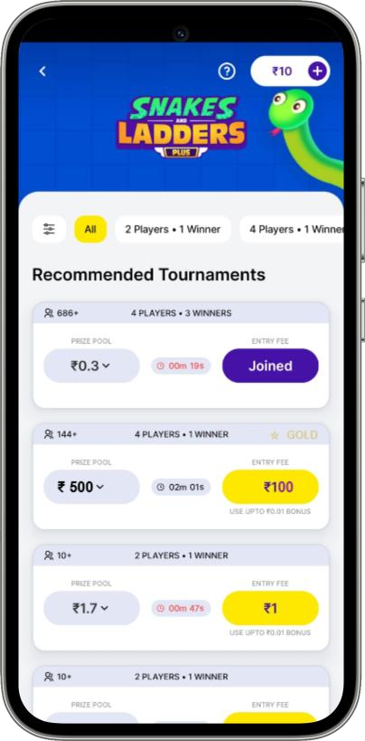
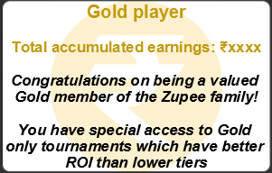

Mockups: Zupee Rich clubs
Rich club members have the relevant badge added on their profiles in addition to the profile search results
Exclusive access to High ROI game

Slide 9
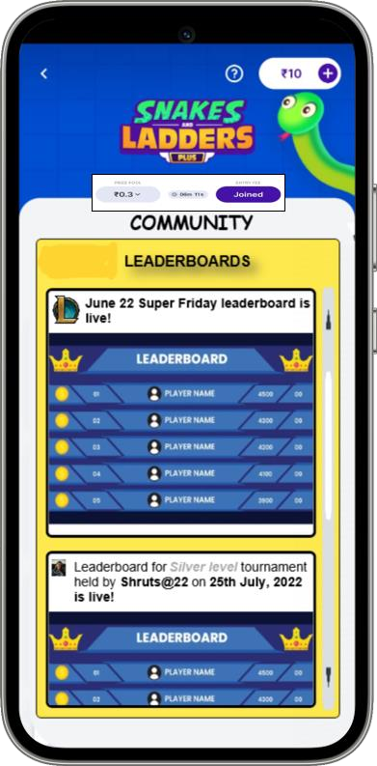

Mockups: Communities to access leaderboards
Communities will be the gateway for the social media section of the platform that can be developed to include more features later on. Currently they will include leaderboards pertaining to each game
While the user explores the other touchpoints of the app, they will be shown the remaining time for the game to start at the top, so that they do not miss it
Communities can also be accessed from the game page directly

Slide 10





Go-to market plan
Pre Launch
Establish a roadmap for the social engagement feature.
Train internal teams.
Establish metrics to be kept under surveillance
Feature
development
Develop the protoype
Release internal beta and check target metrics
Promotion strategies to be generated and tested
Beta launch
Introduce the identified features for the selected set of external beta users.
Measure product- market fit achievement
Feedback
Take constant feedback from the users on the new introduced features
Measure identified metrics on a relative basis to identify the adoption of these features in the user base
Iterative Releases
Inculcate feedback into the product and make this an iterative process so that consequent problems can also be solved in a shorter time period

Slide 11
Thank you!
mayank.pm11@gmail.com linkedin.com/in/mayankkumar
+91-9121717703

