Slide 1

PROBLEM STATEMENT
Design a search experience for map/location search. This should cover a detailed benchmarking of search options available (Google, Apple etc.) and specifically what we can do differently for maps search in India. Careful consideration on current trends and potential usage of search in the future (Where we will have AR/VR applications etc.

Slide 2
Business implications
Our problem statement hints at designing a search experience for map/location search, a space which is currently
dominated by names like Google Maps and Apple Maps
OLA MAPS would have a plethora of use cases:
Easiest to integrate with due to ownership of products
Ola rides application: both driver and passenger apps (currently uses Google Maps)
Ola EV’s digital interfaces: Ola Scooter (currently uses MAPPLS by MapMyIndia). It can also be included in the Ola Car to be launched in 2024
Personal usage: Individuals could use Ola Maps to navigate and use the search experience on a daily basis
Delivery services: A plethora of food/grocery/package delivery service partners use map/location search services.
B2B cases: Ola Map’s API could be used to integrate it into multiple other apps dependent on location services.
Approach to the problem statement:
Ideally, each business case needs to be evaluated separately to find the features that will build up the best search experience. For the purpose of this case, we will evaluate the needs of the Ola rides application in detail and will build our ideal search experience from those insights. The reason behind this is, it is the quickest and most efficient way to build awareness and traction among users for Ola Maps, as the user base of Ola rides surpasses the user base of any other above mentioned case taken individually. Building awareness through Ola EVs is comparatively difficult as it is dependent on the demand, reach and performance of Ola’s EV segment
SEARCH EXPERIENCE: MUST-HAVE FEATURES OF CURRENT AVAILABLE OPTIONS + NEW FEATURES TO GIVE OLA
MAPS AN EDGE OVER COMPETITORS
User psyche
development
AWARENESS
Build awareness of Ola maps through Ola rides app
INTEREST
Build points of engagement for user to shift to Ola maps as an individual user as well
DESIRE/ACTION
Leverage on the benefits of Ola maps over its competitors, to generate usage demand in other sectors as well (e.g: B2B context)

Slide 3




Benchmarking of popular map applications
Here, we compare the features of popularly used map applications in India and identify the must-have features that would bring Ola Maps at par with the current top players in the market
Category | Feature | Google Maps | Apple Maps | MapMyIndia (MAPPLS) |  | OLA Maps
Discovery | Search for categories (restaurants, petrol pumps, hospitals) | Opens a list of the nearby options with zoomed out view | Opens a list of the nearby options with the map pointer set to the first result | Opens a list of the nearby options with the map pointer set to the first result |  | MUST HAVE
 | Reviews and details | Huge crowdsourced metadata, listing multiple points of information about a place | Minimal metadata | Relatively bigger metadata, most of it is incomplete due to smaller user base |  | MUST HAVE
 | Website version | Available | Not available | Available |  | SHOULD HAVE
Engagement | Navigation through different modes | Multiple modes of transport available | Only walking and car navigation available | Multiple modes of transport available |  | MUST HAVE
 | Contextualizing data (e.g.: places of interest along the way) | Yes | Yes (limited) | Yes |  | MUST HAVE
 | Timeline | Yes, a complete history of places visited | No, only search history | No, only search history |  | COULD HAVE
 | Local guide activity/contributions | Yes | No | No |  | COULD HAVE
 | Offline activity | Yes | No | Yes |  | MUST HAVE
Performance | Accuracy (India) | Very high | High | Very high |  | MUST BE ATLEAST HIGH
 | Coverage (India) | Very high | High | Very high |  | MUST BE ATLEAST HIGH
 | User interface | Cluttered, information overload | Minimalist | Clean, balanced |  | Similar To MAPPLS
 | Future technology orientation | Street view (pedestrian only), 360 degree view | Look around (AR), Flyover (VR) | Both AR and VR functionalities are present |  | MUST HAVE

Slide 4
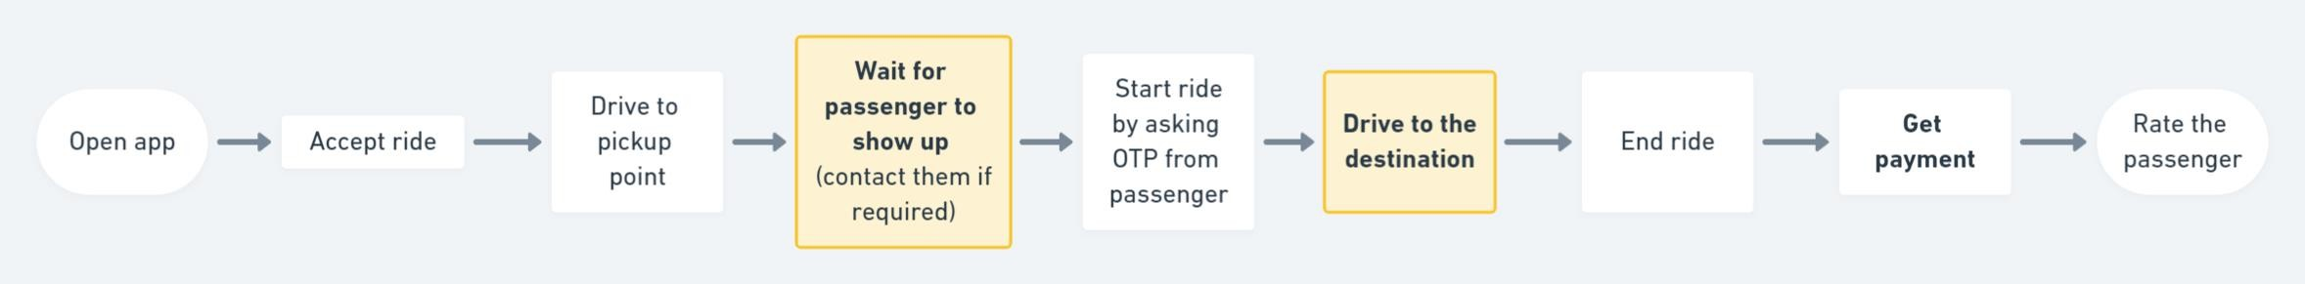
Users of OLA rides and their journeys
The types of users for Ola rides app are:
Passengers: who book cabs for themselves to transfer from a source to destination
Drivers: who accept cab bookings from passengers and use their vehicles to transfer the passenger from the specified source to destination
Indirect passengers: who book cabs for someone else through their Ola app
Below is the generic user journey of each type:
The highlighted boxes denote engagement gap of the users with the application. These are points in the user journey when the user doesn’t engage with the app a lot and hence, presents opportunities that can be leveraged to build Ola Maps awareness and promote engagement
DRIVERS
PASSENGERS
INDIRECT PASSENGERS (in case of booking for someone else)

Slide 5
User Segmentation
Passengers We will use demographic segmentation to define passenger cohorts and mention the use cases for which they could use a cab hailing application College students: going to college, personal use Working professionals: going to work, personal use Senior citizens: personal use | Drivers We will use segmentation by vehicle type to define driver cohorts and mention the kinds of drivers in each cohort 2 wheeler drivers: part time cab drivers, full time cab drivers 3 wheeler drivers: Auto drivers. E-Rickshaw drivers 4 wheeler drivers: part time cab drivers, full time cab drivers | Indirect passengers We will use behavioural segmentation to define indirect passenger cohorts and mention the use cases for which they could use a cab hailing application Relatives of senior citizens who cannot directly use the app Friends/relatives of people who cannot access internet
User interviews (Link)
All 3 user types of the app were asked what problems they face during different phases of their cab trip: Before trip, During trip, After
trip
Our criterion to select the problem to address first would be: Focus of the problem statement-> It has to align with building up the ideal search experience and we are looking for feature additions that would give us an edge over the existing options in the market
Based on responses, we selected the problems which could be lead to possible feature additions and developed user personas

Slide 6





PASSENGER PERSONAS
Rishabh (29, Male): Delhi
Ananya (22, Female): Lucknow
Shikhar (34, Male): Mumbai
Is new to the city
Has a daily 1 hour commute to and from his office.
Doesn’t have personal vehicle, so travels everywhere in the city using cabs
Would like to know the places to explore on weekends,
Has lived in the city since childhood
Loves to hangout with friends and explore new places in city.
Uses cabs to travel as does not know how to drive
Already knows the popular hangouts. Would love to know about the lesser known places
Is a consultant, travels to different cities to meet clients every week
Cannot drive himself as he is either working on the go or needs to be available to take calls
Setting a good impression on the client is of utmost importance to him
Believes that reviews are sometimes ambiguous and would want to have own opinions about a place
DRIVER PERSONAS
Mangey Ram (38, Male): Pune
INDIRECT PASSENGER PERSONAS
Divya (26, Female): Noida
Started working as an Ola driver 4 months ago after some family issues made him quit his job in Mumbai
Keeps his vehicle neat and clean and hopes to build credibility as a good driver
Faces trouble navigating the nooks and streets of Pune and doesn’t want to trouble the passenger a lot
Lives and works away from her family
Family members occasionally visit here (mostly grandparents)
Unable to pick them up every time from the railway station; grandparents are not tech-savvy, hence resorts to booking cabs for them through Ola app
She keeps worrying when they will arrive, as the app locations may not update constantly.

Slide 7
Solutions
Since our product (OLA Maps) is brand-new and we need to build awareness, our priority should be maximum reach and out of the user categories defined for Ola rides application, the passenger cohort will ensure the maximum reach
From the user journey we stated for passengers, waiting for cab arrival for pickup and travel to destination are two phases which could be utilised to makes the user aware about Ola Maps and make them engage with it.
Focusing on the passenger personas defined on the previous slide and their problems, we can define our problem to solve as follows:
Jobs to be done:
When I want to explore places, but need to do so under the constraint of not being able to drive there myself, help me find a way to get it done seamlessly, so that I find the appropriate places on my own.
Solution 1: Interactive Map and Live view
The map inside the Ola Rides app will be made
interactive to show places of interest along the way
AR will be used to enable a passenger to point their camera at their surroundings and get information about places of interest in the captured area. The digital information will be superimposed on the actual camera feed and will keep refreshing as the passenger moves
How it is different from current offerings:
We will have category search in the live view mode. For example, if a passenger is looking for pharmacies on his way to home, he can set the search filter as pharmacies and that will show up pharmacies captured on the camera feed.
The AR feature will only be available for passengers on the move, as drivers could get distracted. Current offerings only provide this feature for pedestrians
Solution 2: Social connect
Enable the passenger to have the social experience
on Ola.
They can add friends and have the option to make their travel history accessible to them.
While searching for places or categories, a place visited by a friend can be given more priority in results and the same information can be displayed in conjunction with Solution 1. For example, when the passenger is searching for good restaurants to go to in the evening on their way to office in the morning, the places that a friend has visited will contain that information as metadata
How it is different from current offerings:
Google Maps also shows if contacts identified by your Google account have visited a place, but Ola Maps will keep the social connect as a focus, instead of just an add-on feature
Solution 3: Virtual preview
Users of Ola Maps can get the option to take a virtual look at their searched places to get a look and feel of the place at different times of the day, for example.
This virtual preview can be generated by using a combination of user sourced pictures (contributions can be incentivized) and AI technologies to generate a real life look and feel of a place
How it is different from current offerings:
The focus will be on the detailed virtual preview. Users should be able to see the same place virtually during different times of the day, different seasons. Incentivization of the crowdsourced pictures and videos will make this process easier. Wherever required, Ola can use their own team to virtually map a place to make it available on the application

Slide 8



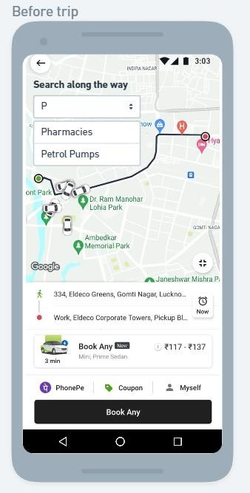
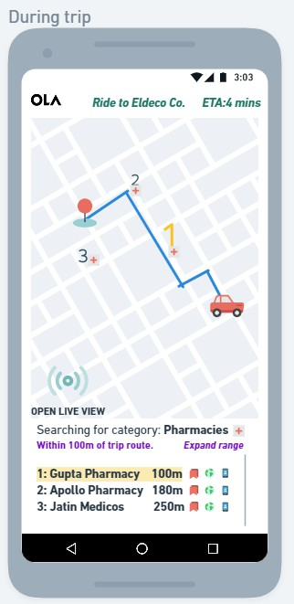
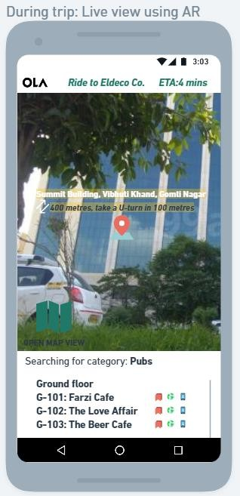
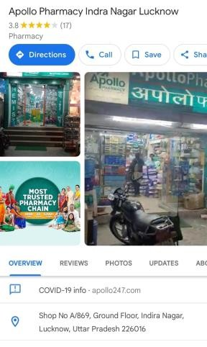
Mockups
Feature | Reach | Impact | Confidence | Effort | Total score | Comments
Interactive Map/ Live view | 9 | 9 | 8 | 7 | 92.57 | This feature can be very useful during the ride (a phase of the passenger user journey where currently his engagement with the app is 0)
Social connect | 6 | 7 | 5 | 5 | 42.00 | The social connect feature will not click with all users and might be popular only with the younger generation
Virtual preview | 9 | 8 | 8 | 8 | 72.00 | Crowdsourcing of material and image processing to build the virtual preview will be a high effort job
Ola Maps will be integrated into the Ola Rides app.
Availability of functionalities is such that the user can maintain engagement during current low engagement points of the user journey (waiting for cab to arrive and riding to destination)
Waiting for ride
User can search for particular places or categories like pharmacies, which will return a
list of results in a defined radius
from the trip route.
Individual results can be bookmarked, explored through its website or be contacted through the provided phone numbers.
The individual results will also have metadata defined against them is a manner to similar to current offerings
Passengers can also experience the live view feature, where AR will be used to augment the camera feed with digital information to make the experience more interactive
This feature will only be accessible to passengers as it may lead to distraction for drivers
Search and other features will remain similar to normal map view
User can search for places along the way and add stops, if required
The virtual preview feature can be also be added later for the passenger to explore destinations of his choice

Slide 9
Metrics analysis
Possible pitfalls and their mitigation
Category | Metric
Discovery | % of riders interacting with Ola Map % of riders interacting with Live View Number of rides taken by user before discovering the new Ola Map features
Engagement | Engagement time as % of total ride time Average interaction time on Live view Average # of actions performed per ride
Retention | Monthly Average Users of Ola Maps Repeat usage rate of Ola cab passengers
Health | Latency time for live view to display the search results Avg. refresh time for live view to update as the camera moves
Satisfaction | Negative Feedback of Ola Maps as percentage of total Feedback NPS score of customers for Ola Maps
Adoption (When standalone application for maps is released) | # of app Downloads through Ola Rides app link # of Monthly Play Store/App Store downloads
Pitfalls | Mitigation
With AR, speed of data refresh as the camera moves around is extremely important. It may make or break the feature | Multiple rounds of Field testing, Beta testing before launching or else people might never use this feature
Display density: It will be important to understand how much data the user likes to view during the Live view as well as Map view. Too much information can be overwhelming, and too little information will be of no use | A/B testing using different densities of data display

Slide 10
Search experience
Discovery
Exploring/Interacting
Contributing data
Our problem statement has been solved using:
Benchmarking with top current players to provide must have features from current offerings to be carried onto Ola Maps
New feature additions that solve current customer problems. These new
features fit perfectly in the user journey gap where the engagement drops.
Ola Maps will be introduced as the default map used for the Ola rides app
initially. A user’s activity, saved places and all related activity will be linked to their Ola account. It can be introduced as a standalone application later.
The Search experience for Ola Maps can be summarized in three phases:
Discovery
Exploring/interacting
Adding data
Search for individual places
Search for categories
Contextualized route between places including distance and time estimates depending on travel mode
Reviews/ratings and metadata like opening/closing times, address, contact info., etc.
Offline activity (ability to download contextual maps and use them without internet)
Interactions with map during trips (searching for places along the route)
Enhanced interaction using AR (Live view)
Ability to bookmark, contact or explore the website of the places
Contributing to map data by providing metadata like menu for restaurants, contact details, etc.
Pictures and videos to build up virtual tours of places to be used in VR applications. These contributions can be incentivized in the form of discount codes for rides, etc.
Future possibilities and implications on parallel businesses
Monetisation using AR advertising: Restaurants, pubs, shops can pay Ola to get their listings mentioned on top when a user searches for a category. This will generate an additional revenue stream
Integration of live view with cameras on the front of EVs: The live camera feed from the front of Ola Scooter or Car can be leveraged with AR, similar to the live view feature discussed before. To prevent distraction and subsequent chances of accident, live view will only be accessible when the speed of the vehicle is below a defined limit
Travel mode: When exploring Maps during a ride, user can select travel mode to get certain tailor made recommendations. For example, on selecting tourist mode, places of interest, hotels will be highlighted on the route. Foodie mode will highlight cafes and restaurants on the route
B2B: Once Ola Maps gain traction, we can introduce additional revenue streams by letting developers integrate Ola Maps into their applications through use of APIs

