Slide 1

Investor pitch for Swiggy
by Mayank Kumar

Slide 2


Introduction
Swiggy is an Indian online food ordering and delivery platform. Founded in July 2014, Swiggy is based in Bangalore and operates in 500 Indian cities as of September 2021. Besides food delivery, Swiggy also provides on-demand grocery deliveries under the name Instamart, and a same-day package delivery service called Swiggy Genie.
Vision statement: “Our mission is to elevate the quality of life for the urban consumer with unparalleled convenience. Convenience is what makes us tick. It's what makes us get out of bed and say, "Let's do this."
For this exercise, I will follow the given approach:
Personas identification and prioritization
Pain points identification and prioritization
Listing solutions and prioritization
Decide upon the objective
Generic user flow
Wireframes
Go-to-market strategy
Metrics identification
Objective
Since this is an investor’s pitch, the goal should be a feature or enhancement that adds logically to Swiggy’s existing
offerings and is a potential revenue generator for the company
Constraints ->
Target food ordering personas only, not the other stakeholders of the platform (delivery partners, restaurant owners)
Consider only the free services of the application (Do not consider Swiggy One)

Slide 3
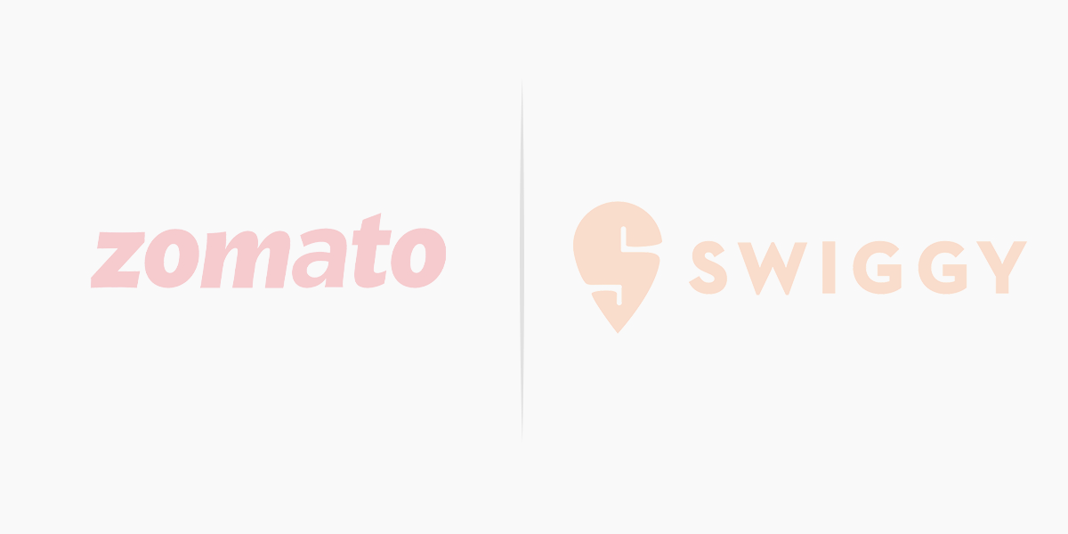


Competitive landscape and benchmarking
The food delivery business in India is a duopoly with Swiggy and Zomato fighting closely for market share, at the same time targeting profitability through multiple offerings and increasing efficiency in their processes
Restaurant Partners (Feb 2022) | 390000 | 128000
MAU (Feb 2022) | 32 million | 20 million
Revenue (FY22) | 4192 crore | 5705 crore
Profits (FY 22) | -1222 crore | -3628 crore
Dining Offering | Zomato Gold Dining | DineOut
Grocery | Blinkit | Instamart
Subscriptions | Zomato Gold | Swiggy One
Special Services | Zomato Legends, Zomato UPI | Swiggy Genie
Zomato is focussed on building an end-to-end food delivery and dining experience, whereas Swiggy sees its delivery network as its strength to provide convenience to its customers
With the introduction of ONDC in this arena, there might be some temporary challenges for both players to face. But focussing on core competencies (food/delivery) and customer service can give these players a higher ground over the government backed initiative
Sources: https://www.indmoney.com/articles/stocks/zomato-vs-swiggy-who-is-winning

Slide 4
User segmentation
Let us segment the population of India into different age brackets
User segment | Age bracket | Percentage of total population | Food ordering apps usage | Constraints of food ordering apps usage
Children | 0-16 | 30% | Not an ideal target group, as they do not directly order food; their parents do. | Not the primary decision makers in household No personal income
Students | 17-22 | 15% | One of the most active users of food ordering apps. | No steady income, leading to wealth consciousness
Independent working class | 23-30 | 15% | One of the most active users of food ordering apps | Health consciousness Wealth consciousness
Living with Family | 31-60 | 30% | Occasional users, usage frequency cannot be increased due to the psychological need to set examples for younger generation | Health consciousness Psychological constraints
Retired | 61+ | 10% | Not an ideal target group, less in number and they are not avid users of food ordering apps | Not very tech savvy Prejudiced against ‘outside food’
The most active user groups should be analysed first for pain points that could be tended to. This group constitutes users who are most likely to adopt new offerings and provide quickest returns, if the product-market fit is established

Slide 5
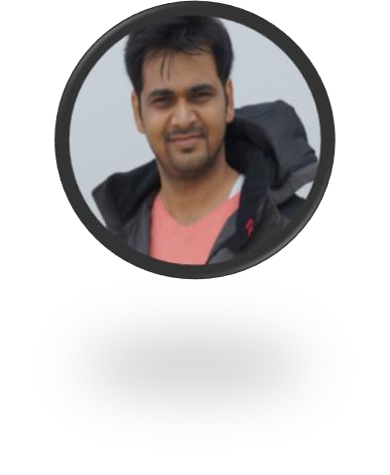
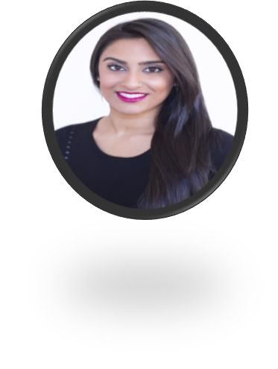



User personas
Rishabh, age 27 (Independent Working Class)
Divya, age 20 (Student)
Has a decent paying job in a tier 1 city
Lives solo in a rented 1 BHK
Leaves for his office after preparing himself a breakfast, has
lunch in office
Student at Delhi University, lives as a Paying Guest near university premises
Has multiple friend groups
User behaviour regarding food ordering:
User behaviour regarding food consumption:
No fixed eating schedule
Hangs out with friends at the food hotspots/stalls/tapris around the university area
Receives monthly allowance from parents, has limited budget
Orders out whenever not feeling like going out or when burdened with college work
Has lunch in the office cafeteria or uses food delivery apps
Limited energy/bandwidth to cook dinner after work and resorts to ordering food online
Is conscious of the fact that he spends a lot more in ordering vs
getting food cooked at home
Ordering food vs going out to eat: 80-20 distribution
Ordering food vs going out to eat: 20-80 distribution
Comparative analysis of students vs independent working class
Intensity vs Frequency of issues
Intensity of issue for independent working class is greater than for students as students are more flexible with their time and bandwidth to check new options online or offline, but the independent working class is not.
Frequency of issue for independent working class is greater than for students as it is almost a daily problem for people who have irregular/long work hours
Bandwidth to try various
options
Independent working class
Students
Money availability
Time availability
0 5 10
It makes sense to target users like Rishabh who have more urgent, unresolved pain points that can be possibly solved by Swiggy.
Hence, moving forwards, we will try to detail out the pain points of the independent working class and solve them

Slide 6
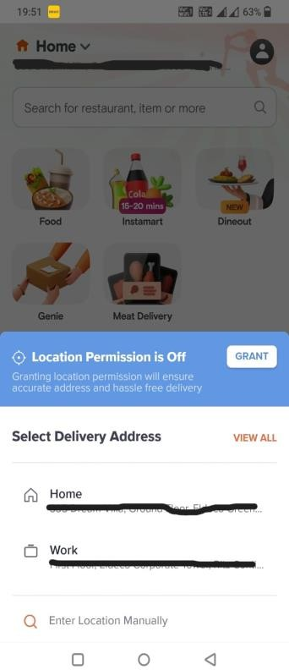
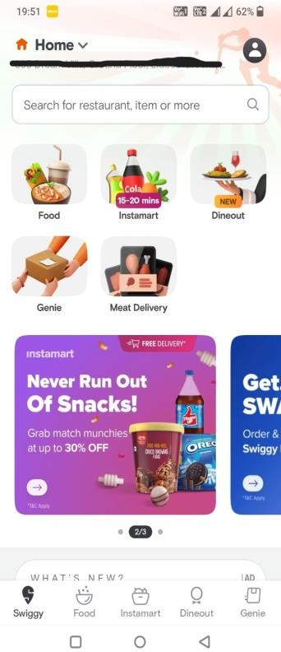
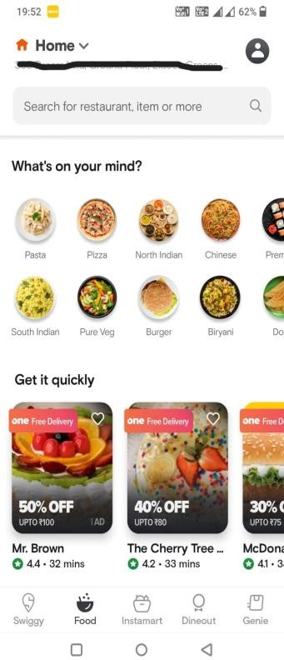
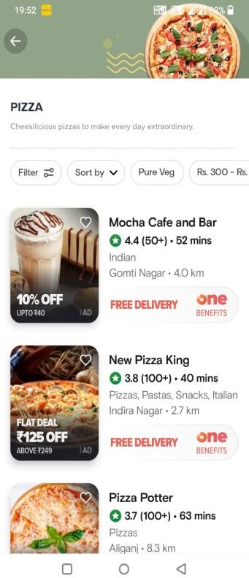
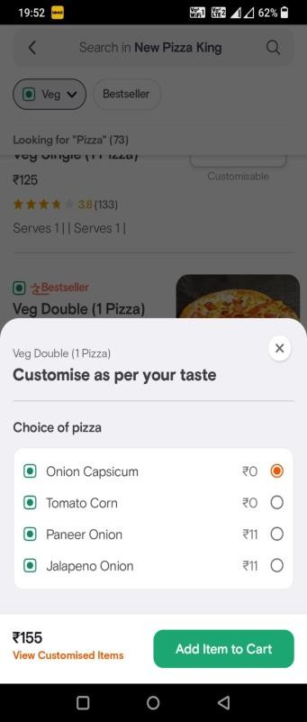
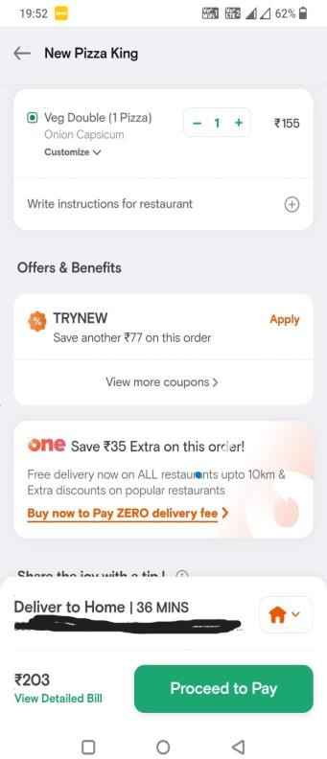
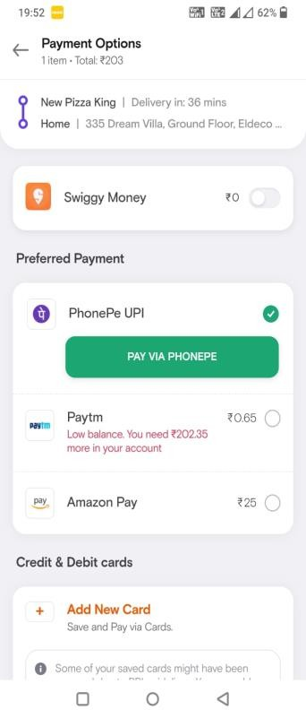
User flow for an existing regular user
1. Location access:
If the location access is not turned on, an existing user has to either turn the location on or set the location to one of their saved addresses
2. Choosing the service:
The user has to select the service type he wants to opt from food, grocery, genie, etc
3. Selecting the restaurant/food category User has to select the
4. Selecting the item After zeroing down on the restaurant, user has
5. Customization of items 6. Delivery instructions
7. Final payment Selecting the payment mode and going through the steps to complete payment for the order
In cases where it is applicable, user has to customize the order from the various options available
and applying offers
User adds special cooking instructions and goes through applicable offers on the order for discounts/benefits
restaurant or food category to select the final items
that (s)he wants to order from. This is the first of the 2 most time taking parts of the user flow
they are going to order and add them to cart individually
Psych rating | - 5 psych | + 5 psych | - 10 psych | - 10 psych | + 5 psych | + 5 psych | - 5 psych
Time share | 5% | 5% | 30% | 20% | 10% | 10% | 20%

Slide 7





Pain points
I will go through the user journey listed on the previous slide to point out common points for a regular app user. It should be noted that most problems originate because of the repeated usage of the platform on a regular basis.
Pain points | Severity of issue (1 : lowest, 5 : highest)
Have to start with setting the location every time if the location of the phone is not turned on
Have to explore multiple restaurants and food options every time they want to order
If they like a particular food option customised a certain way, they have to specify the customisation every time they order the item
Have to repeat special delivery instructions or directions to reach the address (if required) for every order
Go through the checkout process and payment for every order
The most time taking and monotonous part of the food ordering process is selecting the food category/restaurant and then the food item to be ordered, because users have to spend time to think of new food items to order every time. The paradox of choice is the root cause, which should be tackled by our solution
Jobs To Be Done:
When I need to order food regularly but I do not want to deal with the pain and time input into searching a restaurant/food for every instance, help me to avoid this repetition, so that I save time and mental bandwidth

Slide 8



Solutions
Reach, Impact and Confidence should be as high as possible and Effort should be as low as possible. Solution having the highest (R*I*C)/E value will be prioritised over others
Solution | Features for MVP | Drawbacks | Reach | Impact | Confidence | Effort | Total
Swiggy Regular | New functionality in the app which gives user the ability to set food schedule for a defined number of days. Options available to user will be: Set food items and restaurants that they want to order against each day at the start of the week or month, this can be edited as per requirement Set the time to receive food everyday Combined payment for multiple orders (This feature will save 20% time share of the user flow for each fulfilled order) All the maximum negative psych steps in the user journey are focussed by this approach. | High price points may still be a problem, can be solved through special discounts or menu items for Swiggy Regular users Combined payment for weeks’ worth of orders may result in huge user credit (liability for company), so we can start with advance payment and move to post service payment option for repeat customers | 8 | 8 | 7 | 6 | 74.67
Tiffin service | Tie up with the tiffin services available in the city. The app would provide an interface where the tiffin service providers can list the menu options and users can choose from among them. This solution solves both the choice paradox and the price issues | Not available everywhere Scaling up the tiffin service providers due to increased order volume will be a challenge | 6 | 9 | 6 | 8 | 40.50
Surprise me! | The user can set preferred restaurants and food items and the app chooses a random item and restaurant from the list to add to cart every day | The chances of food randomizer coming up with a choice that a user really wants to eat in a given instance is very subjective, and may not be very successful | 9 | 5 | 5 | 5 | 45.00

Slide 9
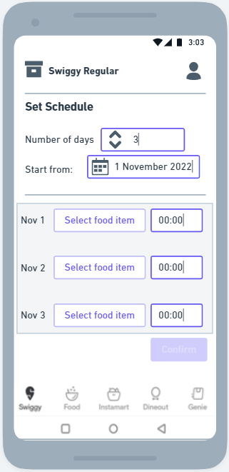
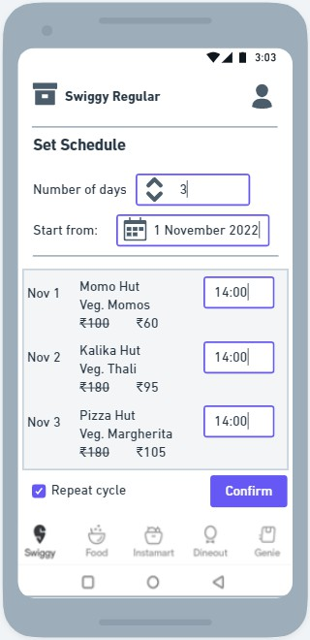
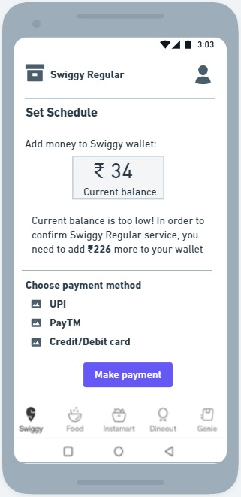
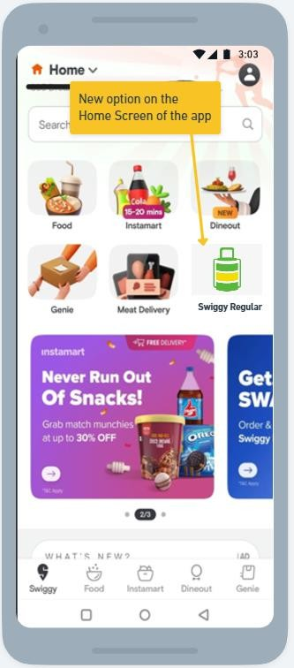
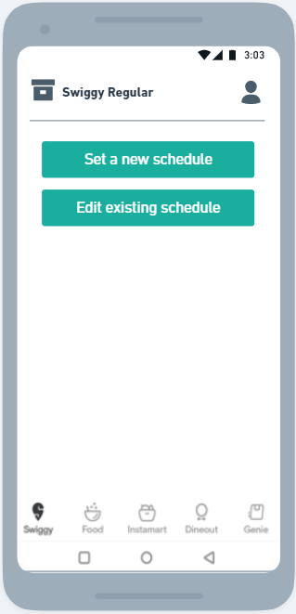
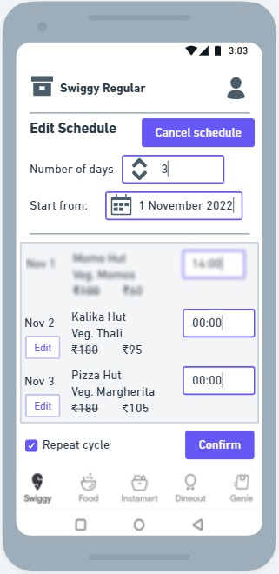
Wireframes
2. Edit schedule
Options for user to cancel/modify their existing schedules. The orders already executed will not be editable. For example, below is the screen for a user who is trying to edit schedule on 2nd November 2022 (before the restaurant receives order)
“Swiggy Regular”
1. Set a new schedule
User flow:
Set the number of days for schedule
Set the starting date
Set food items and time of ordering for each day
User can tick the Repeat Cycle checkbox in order to continue the defined cycle once the current one ends
There will be a threshold number of days (5-7) for an order to qualify for Swiggy Regular. This will ensure that the discounted rates that the customer enjoys is compensated by the LTV s(he) provides to the company
Multiple schedules can be
set simultaneously
Payment: Advance payment can be arranged through adding money in Swiggy wallet, money will only be deducted after each order is successfully delivered
There will be a new option for Swiggy Regular services in the Home page that opens up by default
Inside the Swiggy Regular section, there will be option to
Set a new schedule
Edit existing schedules
User will see the discounted price they get for this option as compared to normal ordering

Slide 10
Metrics
North Star Metric: Revenue from Swiggy Regular
Category | L1 Metric | L2 metric
Discovery | CTR of new feature on Home screen | % share of Swiggy Regular being clicked compared to other options on Home page
Adoption | Weekly # of schedules set | Average % of schedules completed (to keep a tab on cancellations before completion of a schedule)
Engagement | Average time spent in the ‘Swiggy Regular’ section per user, WAU, DAU | Average number of schedules per user Hourly distribution of Swiggy Regular orders during the day (will denote which times of the day are popular for this option)
Revenue | Weekly cart value, Average Revenue per User | Average User wallet split between normal orders and Swiggy Regular orders
Retention | Monthly repeat schedules per user | Net CTR of Repeat cycle checkbox (= positive clicks-negative clicks)

Slide 11

Go-to market strategy
Pre launch
Objective: Ensure product-market fit (PMF) with the chosen target group
During launch
Objective: Ensure smooth launch, feature discovery, and engagement of feature at scale
Post launch
Objective: Continuous feedback from app usage through established channels. Agile deployment of improvements and bug fixes
Train internal teams (e.g.: customer
support on the new offering)
Establish metrics that would be under surveillance to signal smooth onboarding and engagement of users
Establish a beta release for a chosen cohort of users. UX and in-app behaviour can be tracked using tools like heatmaps. Track the metrics for estimated vs actual values
Monitor user feedback and reported bugs and inculcate it before the final launch of the product
Conduct PMF surveys
Promotion: Notifications to target cohorts will be sent on pre-set timings (e.g: lunch/dinner hours)
The identified target groups should be made aware of the new feature through notifications, in-app popups about the use cases of the new feature
A run-through of the steps should be provided in-app to make the onboarding simpler
Features to be A-B tested can be tested at scale and feedback collected
The discovery and engagement metrics should be specially paid attention to
PMF surveys on larger groups
NPS scores to be measured and
evaluated
The retention and health metrics should be paid attention to as the product begins to scale and reach critical mass
Reported bugs should be fixed in shorter sprint cycles till a stable version exists in the market
Adequate customer support
should be available

Slide 12

Thank you!
mayank.pm11@gmail.com | linkedin.com/in/mayankkumar
+91-9121717703

