Slide 1

Summer Training Presentation On MACHINE LEARNING
Completed under guidance of : Mr. Sarthak Nigam
Presented by : Mayank Pratap Singh
Registration number : 11713175

Slide 2
CONTENTS …
Introduction…………………………………………………… What is Machine Learning?............................................
Why Machine Learning?................................................
Stages of Machine Learning …………………………………………
Types of Machine Learning…………………………….
Supervised Learning………………………………………..
Unsupervised Learning..................................................
Reinforcement Learning …………………………………………..
Platform used for working ………………………………………
Project

Slide 3
Machine Learning
Study of Algorithms that improve their performance at some task with experience.
Optimize a performance criterion using example data or past experience.
Getting Computers to program themselves

Slide 4
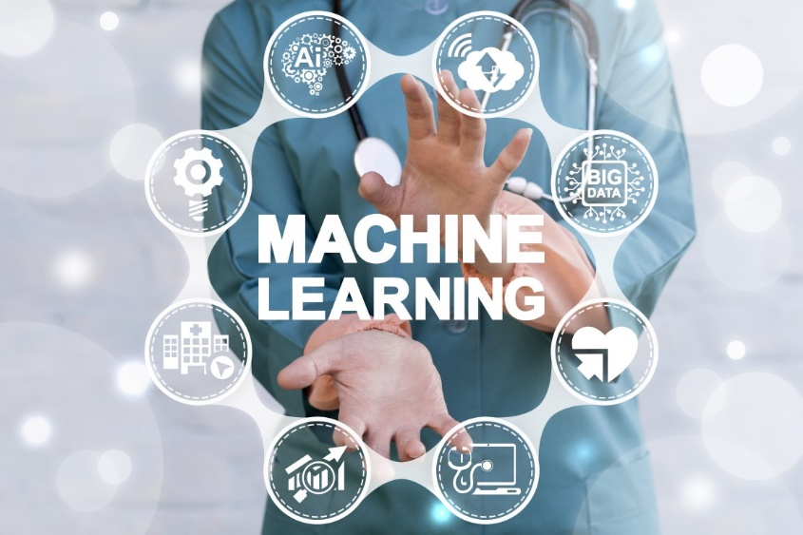
A Big Picture………………………………

Slide 5
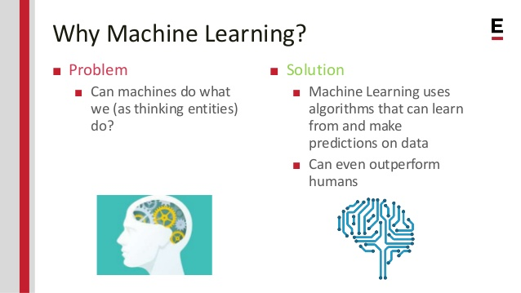

Slide 6
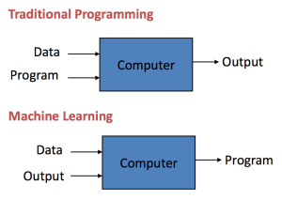

Slide 7
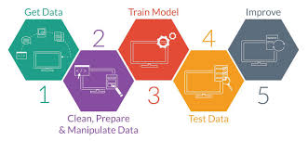

Slide 8
Types of Learning
Supervised (inductive) learning
Training data includes desired outputs
Unsupervised learning
Training data does not include desired outputs
Reinforcement learning
Rewards from sequence of actions

Slide 9
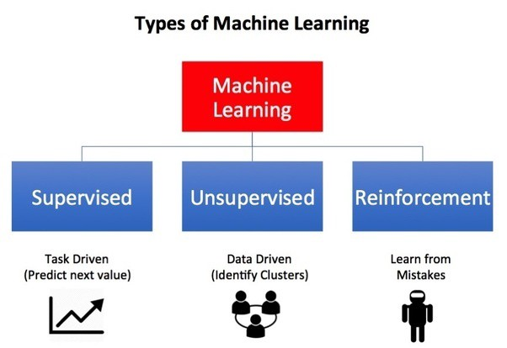

Slide 10
Supervised Learning
Prediction of future cases: Use the rule to predict the output for future inputs
Knowledge extraction: The rule is easy to understand
Compression: The rule is simpler than the data it explains
Outlier detection: Exceptions that are not covered by the rule, e.g., fraud

Slide 11
Unsupervised Learning
Learning “what normally happens”
No output
Clustering: Grouping similar instances
Other applications: Summarization, Association Analysis
Example applications
Customer segmentation in CRM
Image compression: Color quantization
Bioinformatics: Learning motifs

Slide 12
Reinforcement Learning
Topics:
Policies: what actions should an agent take in a particular situation
Utility estimation: how good is a state (→used by policy)
No supervised output but delayed reward
Credit assignment problem (what was responsible for the outcome)
Applications:
Game playing
Robot in a maze
Multiple agents, partial observability, ...

Slide 13
Platform Used
Kaggle is an online community of data scientists and machine learners, owned by Google LLC. Kaggle allows users to find and publish data sets, explore and build models in a web-based data-science environment

Slide 14
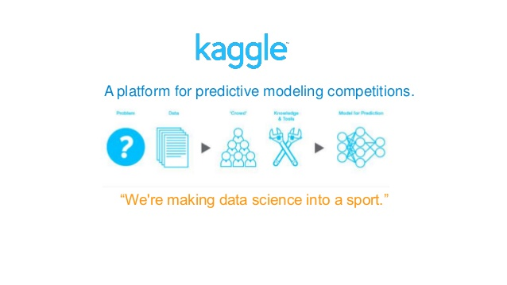

Slide 15
The CIFAR-10 dataset
The CIFAR-10 dataset consists of 60000 32x32 colour images in 10 classes, with 6000 images per class. There are 50000 training images and 10000 test images. Task : Object Recognition in Images
Link : https://www.kaggle.com/mayank1212/kernelc1ac177b28/notebook

Slide 16


