Slide 1
PYTHON PROJECT
Travelling Salesman Problem
Group members:
Krunal
Mayank
Veena
Section: K17SJ
Group: 16

Slide 2
Platforms Used
IDLE
Spyder
Tkinter
Matplotlib
SQLite3

Slide 3
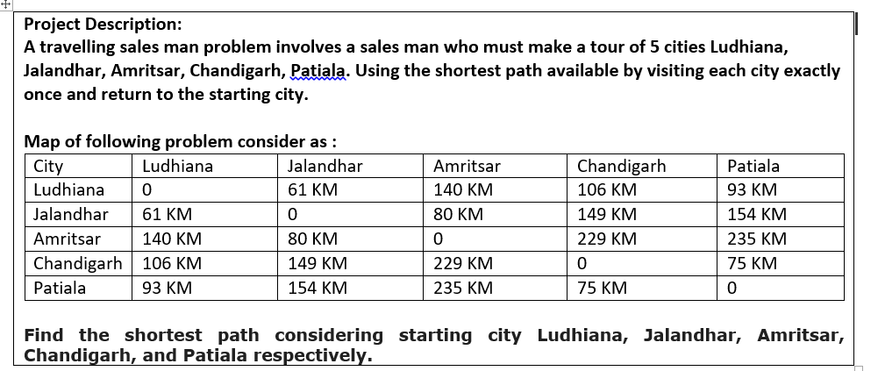
About

Slide 4
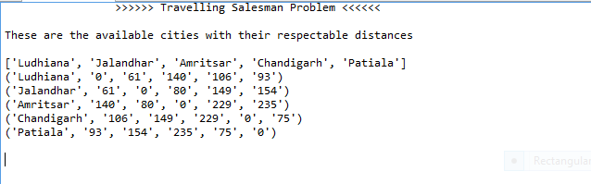
Distance Between Cities

Slide 5
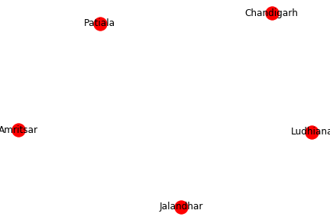
Graph of cities

Slide 6
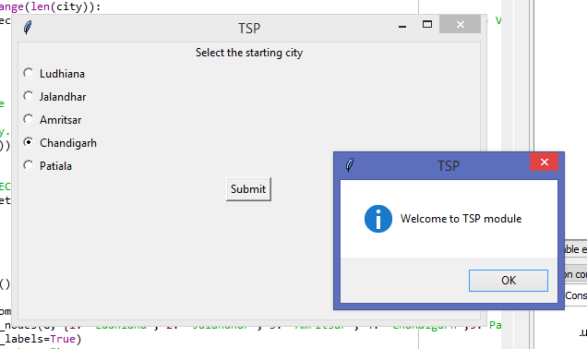
Select Starting city

Slide 7
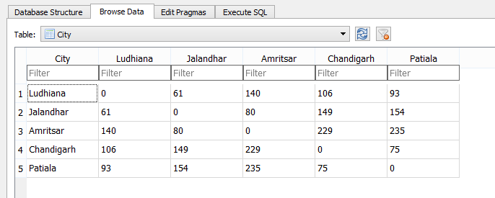
Database Table

Slide 8
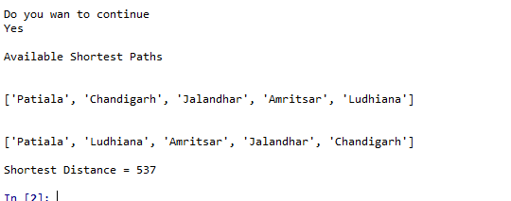
Final output

Slide 9
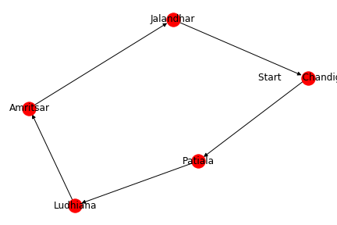
Graph representing shortest path

