Slide 1
The client moved 15% of TV into digital.
Was the data ever asking for it?
The Two Calendars · a marketing-mix-model case in diabetes
FDE associate · Q3 readout in 10 days
Notes:
Open with the stakes. The Brand Director told their VP this move was data-backed, and it has been implemented. Three weeks into the quarterly refresh, weekly totals look slightly off against the campaign calendar. Our job in 10 days: find out whether that small discrepancy could have changed the decision, and make sure it cannot happen again.

Slide 2
A weekly TV file and monthly everything-else: the two calendars disagree
TV is bought by media week, Monday to Sunday.
Digital, email and sales arrive by calendar month.
The shortcut puts a whole week into one month.
One week, $700k (29 Jan – 4 Feb)
Jan · 3 days
Feb · 4 days
Correct: $300k to Jan, $400k to Feb
Naive: $700k to Jan, $0 to Feb
2
Notes:
Explain the two calendars simply. Media weeks run Monday to Sunday. Sales and digital come as calendar months. A week can straddle a month end. The shortcut is to drop the whole week into the month of its Monday. Example: $700k week from 29 Jan to 4 Feb. Correct is $300k January and $400k February. Naive is $700k January, $0 February. Total spend is the same; the timing is wrong, and the model learns from timing.

Slide 3
We built a world where we already know the answer, then asked the model to find it
Daily truth
(known effects)
Published like vendors
TV weekly · rest monthly
Aggregate TV
naive vs correct
Same MMM
on both
Compare with
answer key
48 months
18 · 14 · 6 %
-0.6%
4 years of data, 210 vendor weeks
true share of sales: TV · digital · email
true effect of the 15% shift on sales (it hurts)
3
Notes:
We cannot check the client's model against reality, so we simulate. Four years of daily truth with a known effect per channel: TV 18 percent of sales, digital 14, email 6. We publish it the way vendors do, aggregate TV both ways, fit the same MMM, and compare to the answer key. We also know the true effect of the 15 percent move, because we can re-run the true daily process.

Slide 4
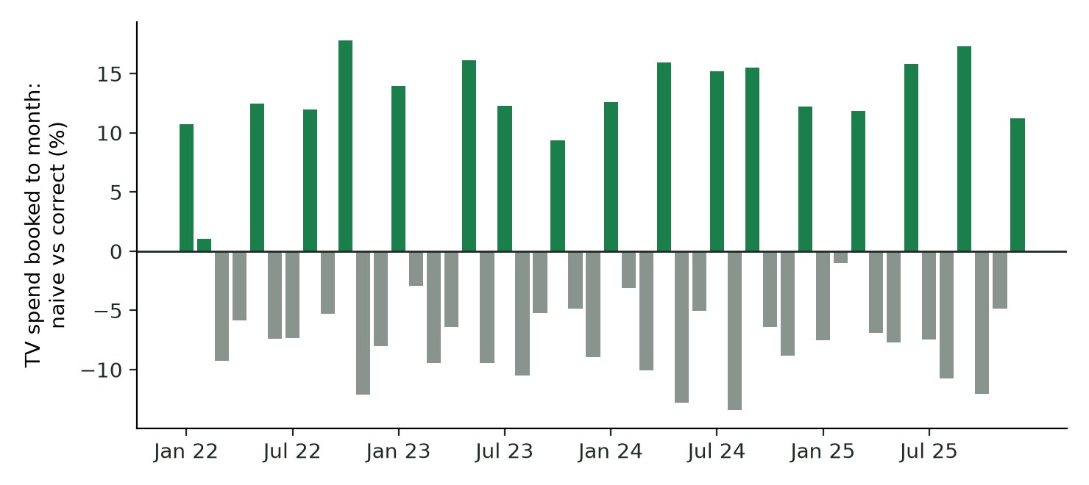
Same budget, wrong months: a typical month is off by about 9%
9%
median monthly TV deviation, naive vs correct
0%
difference in total spend. Only timing moves.
Months with five Mondays look expensive; four-Monday months look cheap.
4
Notes:
This is the error reproduced. Each bar is one month of steady TV spend; naive minus correct as a percent of correct. Total spend is identical, only the timing moves. Median absolute month deviation is 9 percent here and 12 percent in the pulsed world. Months with five Mondays get five weeks of spend, months with four get four, regardless of how many days they really contain.

Slide 5
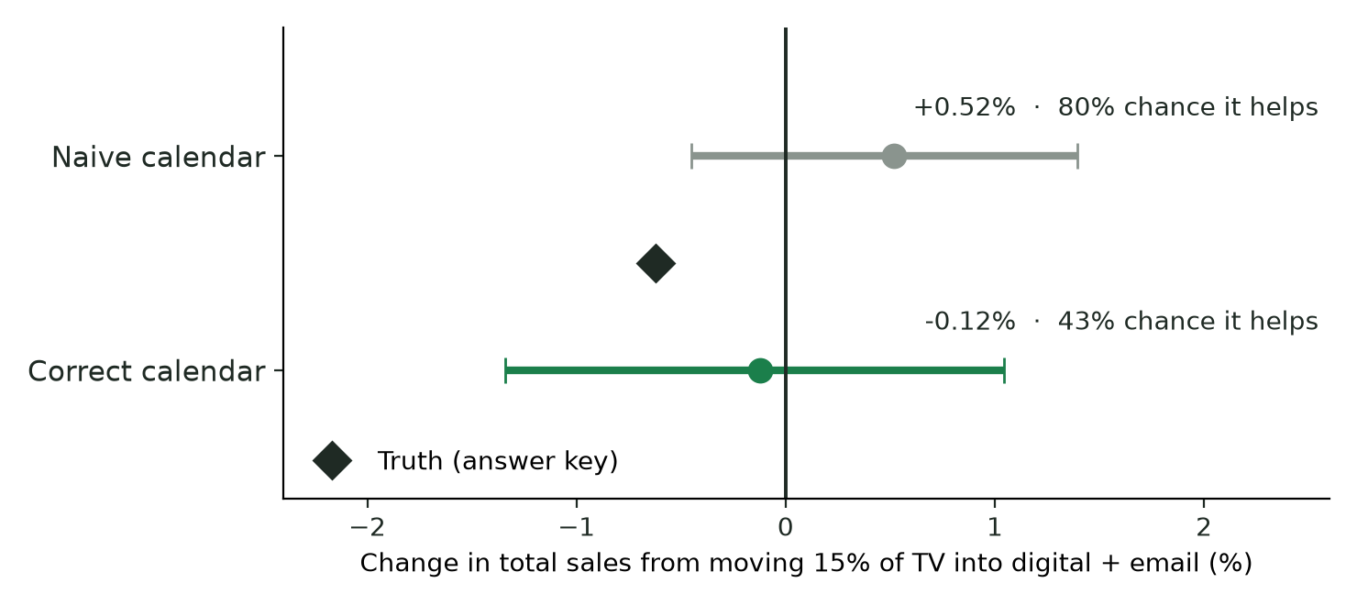
When TV runs steadily, the naive calendar manufactures the recommendation
15% → 20%
TV credit, naive → correct (truth: 18%)
33% vs 0%
of 12 worlds showed a confident win: naive vs correct
The fix does not prove the shift is bad. It removes a false signal that made it look good.
5
Notes:
This is the core finding and it mirrors the client's situation. With steady weekly TV, the naive series has spurious month-to-month swings. The model blames TV for sales noise it cannot explain, so TV looks weak: 14.5 percent credited versus a true 18. The naive model says the shift adds 0.52 percent of sales with a 80 percent chance of helping. The correct calendar says -0.12 percent and 43 percent, which is indecision, as it should be. The truth is -0.62 percent. Across 12 re-simulated worlds the naive pipeline showed a confident win in 33 percent of them, the correct pipeline in none, while the true effect was negative in all.

Slide 6
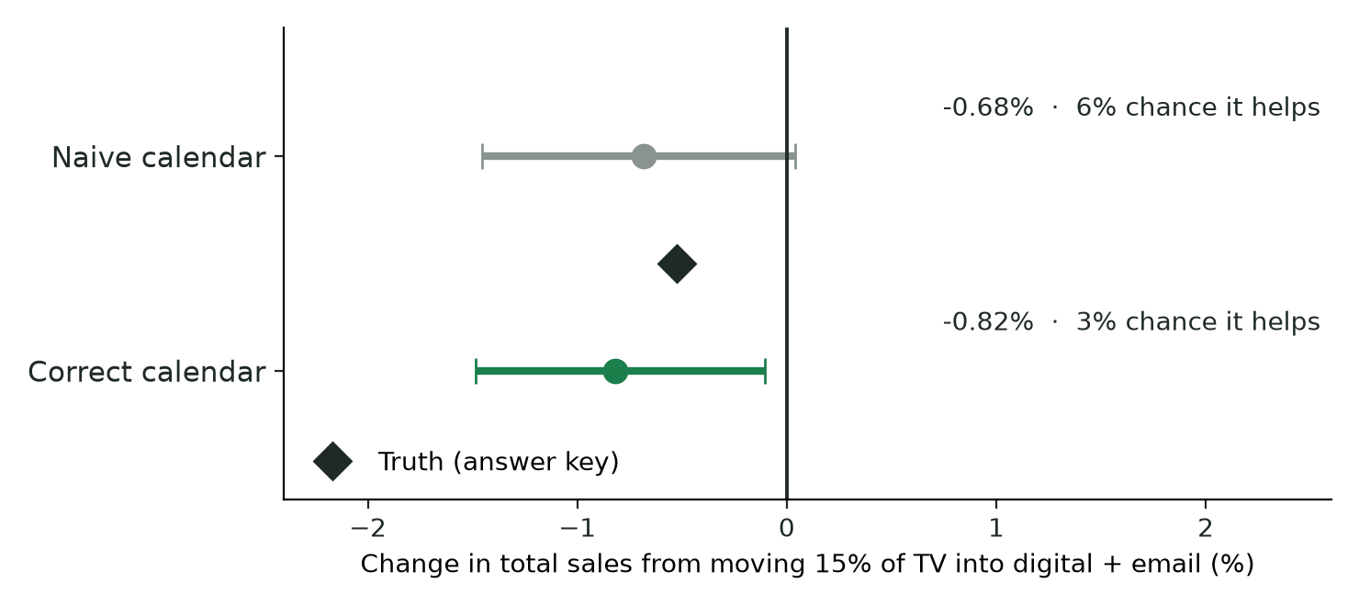
When TV is heavily pulsed, the calendar matters less. The shift still fails.
-0.82%
sales impact of the shift, correct calendar
25%
of the time the 90% interval caught the true TV share. Treat intervals as optimistic.
So the calendar is one risk, not the only one: model confidence is the other.
6
Notes:
Honesty slide. In a heavily flighted world, TV on-off pulses give the model so much real variation that the calendar error is second-order: it moves a channel's share by roughly 2 points with no consistent sign. Both versions say the shift loses sales: naive -0.68, correct -0.82, truth -0.53. The bigger risk here is overconfidence: the 90 percent intervals covered the true TV share only 25 percent of the time, because the model is simplified and the bootstrap only sees sampling noise. So the answer depends on how the client phases TV, which we can check from their file in minutes.

Slide 7
The safeguard: nothing reaches the model unchecked, including what the LLM reads
1 Validate every refresh
2 LLM reads the spec
• Week starts Monday, 7-day spacing
• Month-start dates, no gaps
• Weeks cover the window
• Apportioning conserves spend
• Errors block the model
• Extracts calendar and grain claims
• Quote must exist word for word
• Real file must agree
• Only verified claims act
• Conflicts go to a human
Live test: spec said “Sunday”, data said Monday. The LLM repeated the spec; the data check overruled it.
7
Notes:
Prevention. Twenty deterministic checks run on every refresh and any error blocks the fit. An LLM reads the vendor specs and extracts claims such as weeks start Monday. It is a reader, not the authority: each claim needs its quote to appear word for word in the spec, and a test on the real file has to agree. Live run with groq:openai/gpt-oss-120b: 14 verified, 2 advisory, none rejected. Then we gave it a spec that wrongly said the date is the Sunday the week ends. The model repeated it faithfully, and the data check caught it because 0 percent of dates were Sundays. Any conflict goes to a human.

Slide 8
What we tell the Brand Director before the Q3 readout
Say
Do this week
Build in
• The shift is not supported by the data.
• Correct calendar: no confident gain in any world we tested.
• Position it as under review, not data-backed.
• Re-run the refresh with apportioned TV.
• Check how steady weekly TV spend is.
• Ask the vendor how weeks were mapped to months.
• Validation gate on every refresh.
• LLM spec reader with verification.
• Request daily data at the source.
Caveat: synthetic data and a truth we designed. This validates the method, not the brand.
8
Notes:
Close with actions. One: do not present the shift as data-backed; present it as under review. Two: re-run the refresh on apportioned data. Three: check how steady the client's weekly TV is. If it is steady, the naive calendar is the dangerous case and our smooth world is the relevant one. Four: ask the vendor for daily or weekly digital, email and sales so the grain gap is fixed at the source. Caveat to state aloud: all of this is synthetic; the design of the truth is ours.

