Slide 1

Application of Statistical models in Stock market
Group members: Faculty:
Deepak Yadav 16BEC0218 Prof. Anuradha D
Mayank Sethia 16BCE2302

Slide 2
What is STOCK ?
Stocks are issued by companies in order to raise capitals and are bought by investors in order to acquire a portion of the company.
For example- If a company has 1000 shares of stock outstanding and a person owns 50 of them, then he/she owns 5% of the company.
Most stock also provides voting rights, which give shareholders a proportional vote in certain corporate decisions

Slide 3
STATISTICAL MODELS USED
Linear Regression: Linear regression attempts to model the relationship between two variables by fitting a linear equation to observed data.
Graphs: Graphs have been used to help us determine the relationship between the various stock parameters.
Correlation: Correlation is a statistical technique that can show whether and how strongly pairs of variables are related. For example, height and weight are related; taller people tend to be heavier than shorter people. Correlation can tell you just how much of the variation in peoples' weights is related to their heights.
Standard Deviation: A measure of the dispersion of a set of data from its mean. The more spread apart the data the higher the deviation.

Slide 4
Types of Regression
Simple linear regression 1 dependent variable (interval or ratio), 1 independent variable (interval or ratio or dichotomous)
Multiple linear regression 1 dependent variable (interval or ratio) , 2+ independent variables (interval or ratio or dichotomous)
Logistic regression 1 dependent variable (dichotomous), 2+ independent variable(s) (interval or ratio or dichotomous)
Ordinal regression 1 dependent variable (ordinal), 1+ independent variable(s) (nominal or dichotomous)
Multinominal regression 1 dependent variable (nominal), 1+ independent variable(s) (interval or ratio or dichotomous)
Discriminant analysis 1 dependent variable (nominal), 1+ independent variable(s) (interval or ratio)

Slide 5
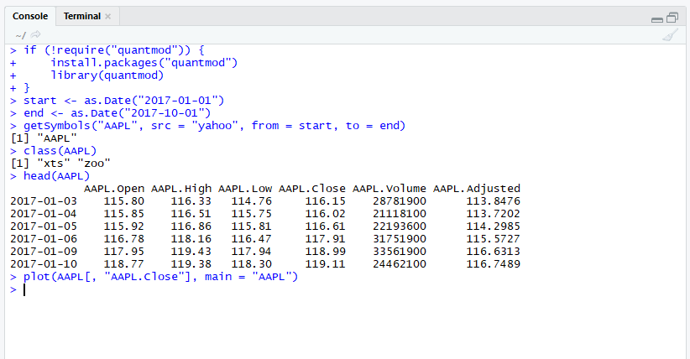
Getting and Visualizing Stock Data with quantmod
Before we analyze stock data, we need to get it into some workable format. Stock data can be obtained from Yahoo! Finance, Google Finance, or a number of other sources, and the quantmod package provides easy access to Yahoo! Finance and Google Finance data, along with other sources.

Slide 6
Analysis
Yahoo! Finance provides six series with each security. Open is the price of the stock at the beginning of the trading day (it need not be the closing price of the previous trading day), high is the highest price of the stock on that trading day, low the lowest price of the stock on that trading day, and close the price of the stock at closing time. Volume indicates how many stocks were traded. Adjusted close is the closing price of the stock that adjusts the price of the stock for corporate actions.

Slide 7
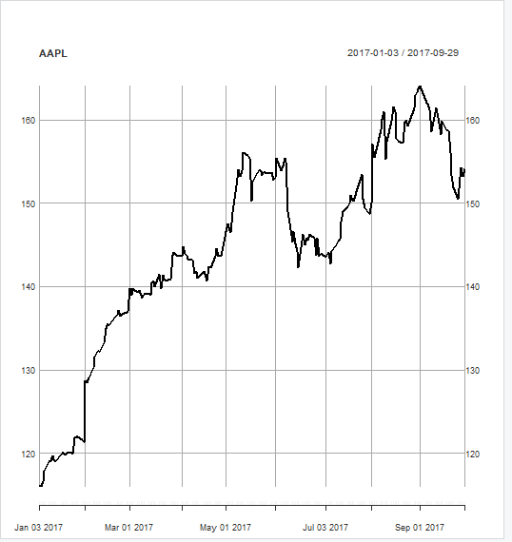
Visualizing Stock Data

Slide 8
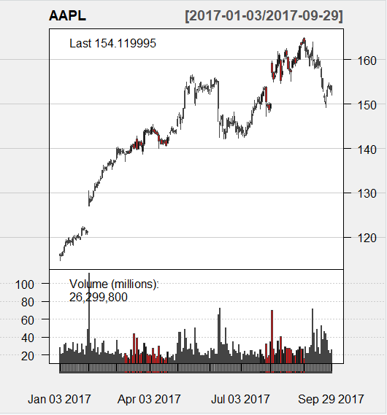
A line chart is fine, but there are at least four variables involved for each date (open, high, low, and close), and we would like to have some visual way to see all four variables that does not require plotting four separate lines. Financial data is often plotted with a Japanese candlestick plot, so named because it was first created by 18th century Japanese rice traders.

Slide 9
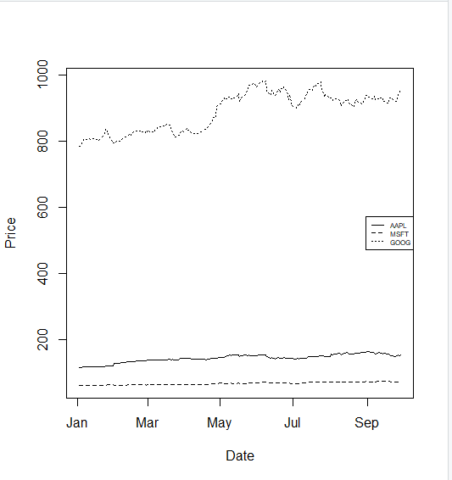
What’s wrong with this chart?
While absolute price is important (pricey stocks are difficult to purchase, which affects not only their volatility but your ability to trade that stock), when trading, we are more concerned about the relative change of an asset rather than its absolute price. Google’s stocks are much more expensive than Apple’s or Microsoft’s, and this difference makes Apple’s and Microsoft’s stocks appear much less volatile than they truly are (that is, their price appears to not deviate much).
One solution would be to use two different scales when plotting the data; one scale will be used by Apple and Microsoft stocks, and the other by Google.

Slide 10
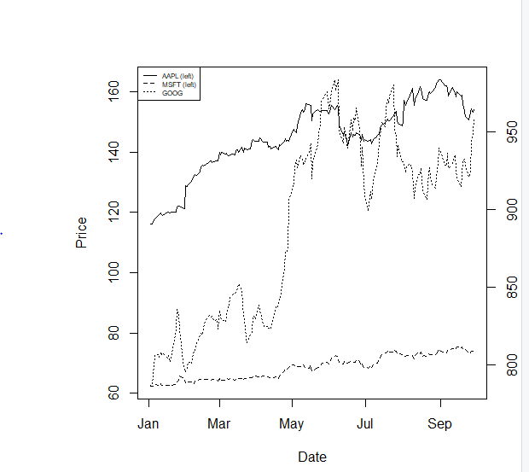
Not only is this solution difficult to implement well, it is seen as a bad visualization method; it can lead to confusion and misinterpretation, and cannot be read easily.
A “better” solution, though, would be to plot the information we actually want: the stock’s returns. This involves transforming the data into something more useful for our purposes. There are multiple transformations we could apply.
One transformation would be to consider the stock’s return since the beginning of the period of interest. In other words, we plot:
Return(t,0) = price(t)/price(0)

Slide 11
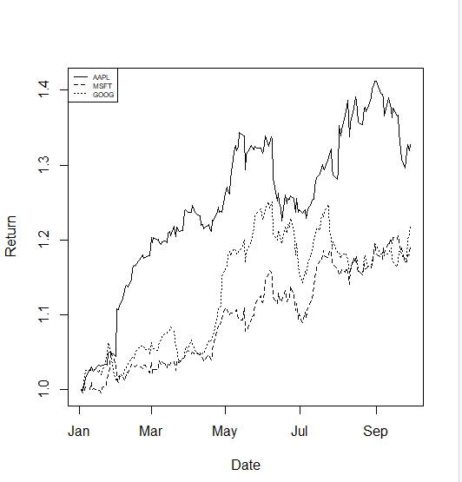
Alternatively, we could plot the change of each stock per day. One way to do so would be to plot the percentage increase of a stock when comparing day to day.
These formulas are not the same and can lead to differing conclusions, but there is another way to model the growth of a stock: with log differences.
change(t) = log(price(t))-log(price(t-1))
(Here, is the natural log, and our definition does not depend as strongly on whether we use or .) The advantage of using log differences is that this difference can be interpreted as the percentage change in a stock but does not depend on the denominator of a fraction.

Slide 12
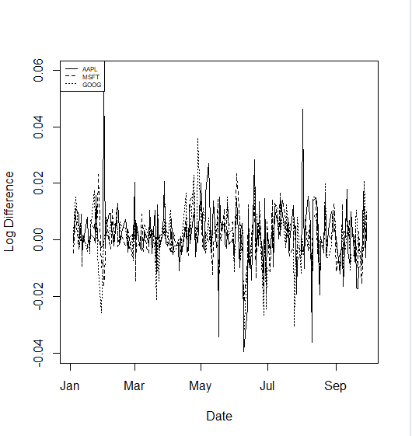
CHANGES IN STOCK PRIZES ON A DAY TO DAY BASIC USING LOG TRANSFORMATION

Slide 13
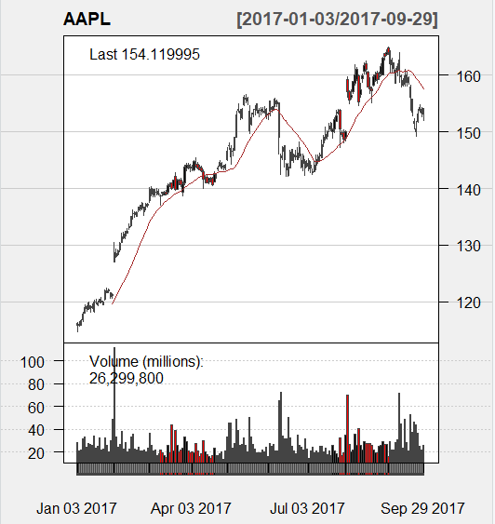
Moving Averages
Moving averages smooth a series and helps identify trends. The larger q is, the less responsive a moving average process is to short-term fluctuations in the series x(t). The idea is that moving average processes help identify trends from “noise”. Fast moving averages have smaller and more closely follow the stock, while slow moving averages have larger , resulting in them responding less to the fluctuations of the stock and being more stable.

Slide 14
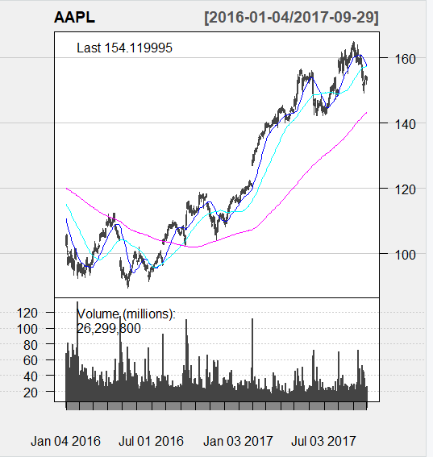
The 20-day moving average is the most sensitive to local changes, and the 200-day moving average the least. Here, the 200-day moving average indicates an overall bearish trend: the stock is trending downward over time. The 20-day moving average is at times bearish and at other times bullish, where a positive swing is expected. You can also see that the crossing of moving average lines indicate changes in trend. These crossings are what we can use as trading signals, or indications that a financial security is changing direction and a profitable trade might be made.

Slide 15
A simple linear regression model for predicting volatility
Linear regression attempts to model the relationship between two variables by fitting a linear equation to observed data. One variable is considered to be an explanatory variable, and the other is considered to be a dependent variable. For example, a modeler might want to relate the weights of individuals to their heights using a linear regression model. Before attempting to fit a linear model to observed data, a modeler should first determine whether or not there is a relationship between the variables of interest. This does not necessarily imply that one variable causes the other (for example, higher SAT scores do not cause higher college grades), but that there is some significant association between the two variables. A scatterplot can be a helpful tool in determining the strength of the relationship between two variables. If there appears to be no association between the proposed explanatory and dependent variables (i.e., the scatterplot does not indicate any increasing or decreasing trends), then fitting a linear regression model to the data probably will not provide a useful model.

Slide 16
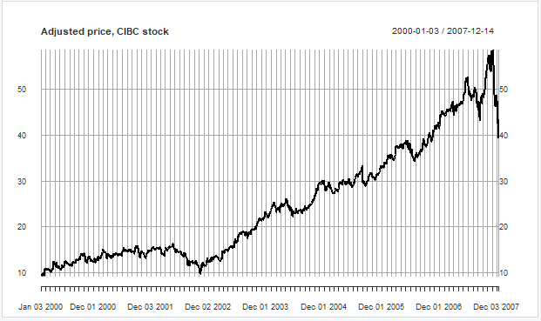
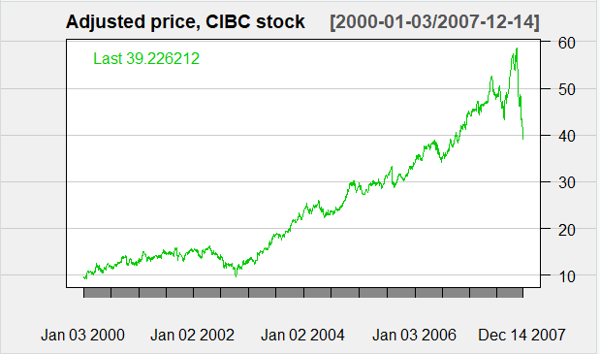
Adjusted price, CIBC Stock

Slide 17
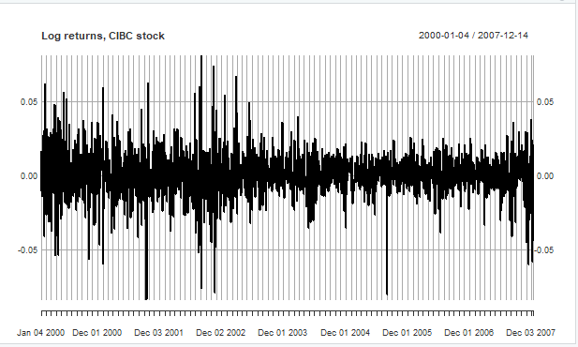
Next, we compute the log return for the stock price.

Slide 18
Least-Squares Regression: The most common method for fitting a regression line is the method of least-squares. This method calculates the best-fitting line for the observed data by minimizing the sum of the squares of the vertical deviations from each data point to the line (if a point lies on the fitted line exactly, then its vertical deviation is 0). Because the deviations are first squared, then summed, there are no cancellations between positive and negative values.

Slide 19
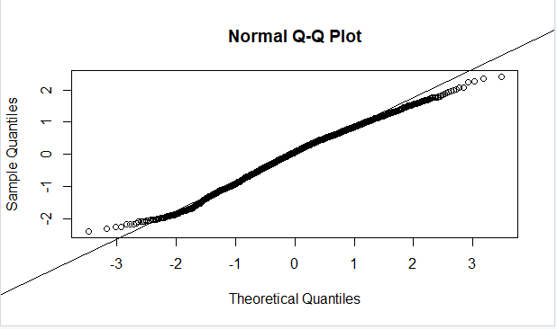
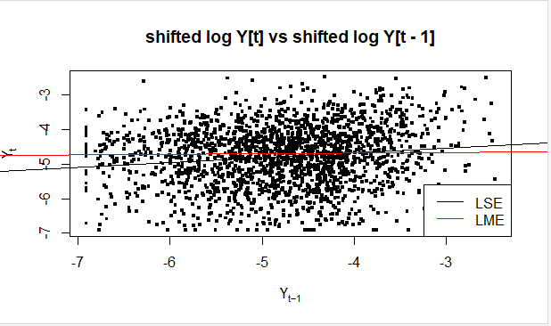
Fit a linear model

Slide 20
THANK YOU!

