Slide 1
Mini Capstone Project
Crime Data Analysis with MySQL and Python

Slide 2
Contents :
Introduction
Technical Stack
Project Architecture
Let’s Know About Our Data
Data Dictionary
Geographical Hot Spot
Age Distribution
Age Distribution Graph
Gender Distribution
Gender Distribution Graph
Top 10 Crime HotSpot Distribution
Top 10 Crime HotSpot Graph
Top 10 Reported Crime Code Count
BoxPlot And BarPlot For Crime Code

Slide 3
Introduction:
In This Capstone Project, We Will Use Python, Specifically the PyMySQL Library, to Interact with a MySQL Database in Order to Analyze and Gain Insights from Crime Data.

Slide 4
Technical Stack :
MySQL Workbench
Python/PyCharm
Libraries :
PyMySQL
Pandas
Matplotlib
Seaborn
Warnings

Slide 5
Project Architecture :
Loading
PyMySQL
Data
WorkBench
PyCharm
Connection
Query
Read.SQL
Questions
Code
DataFrame
Run
Code Execution
Final Answers / Graphs

Slide 6
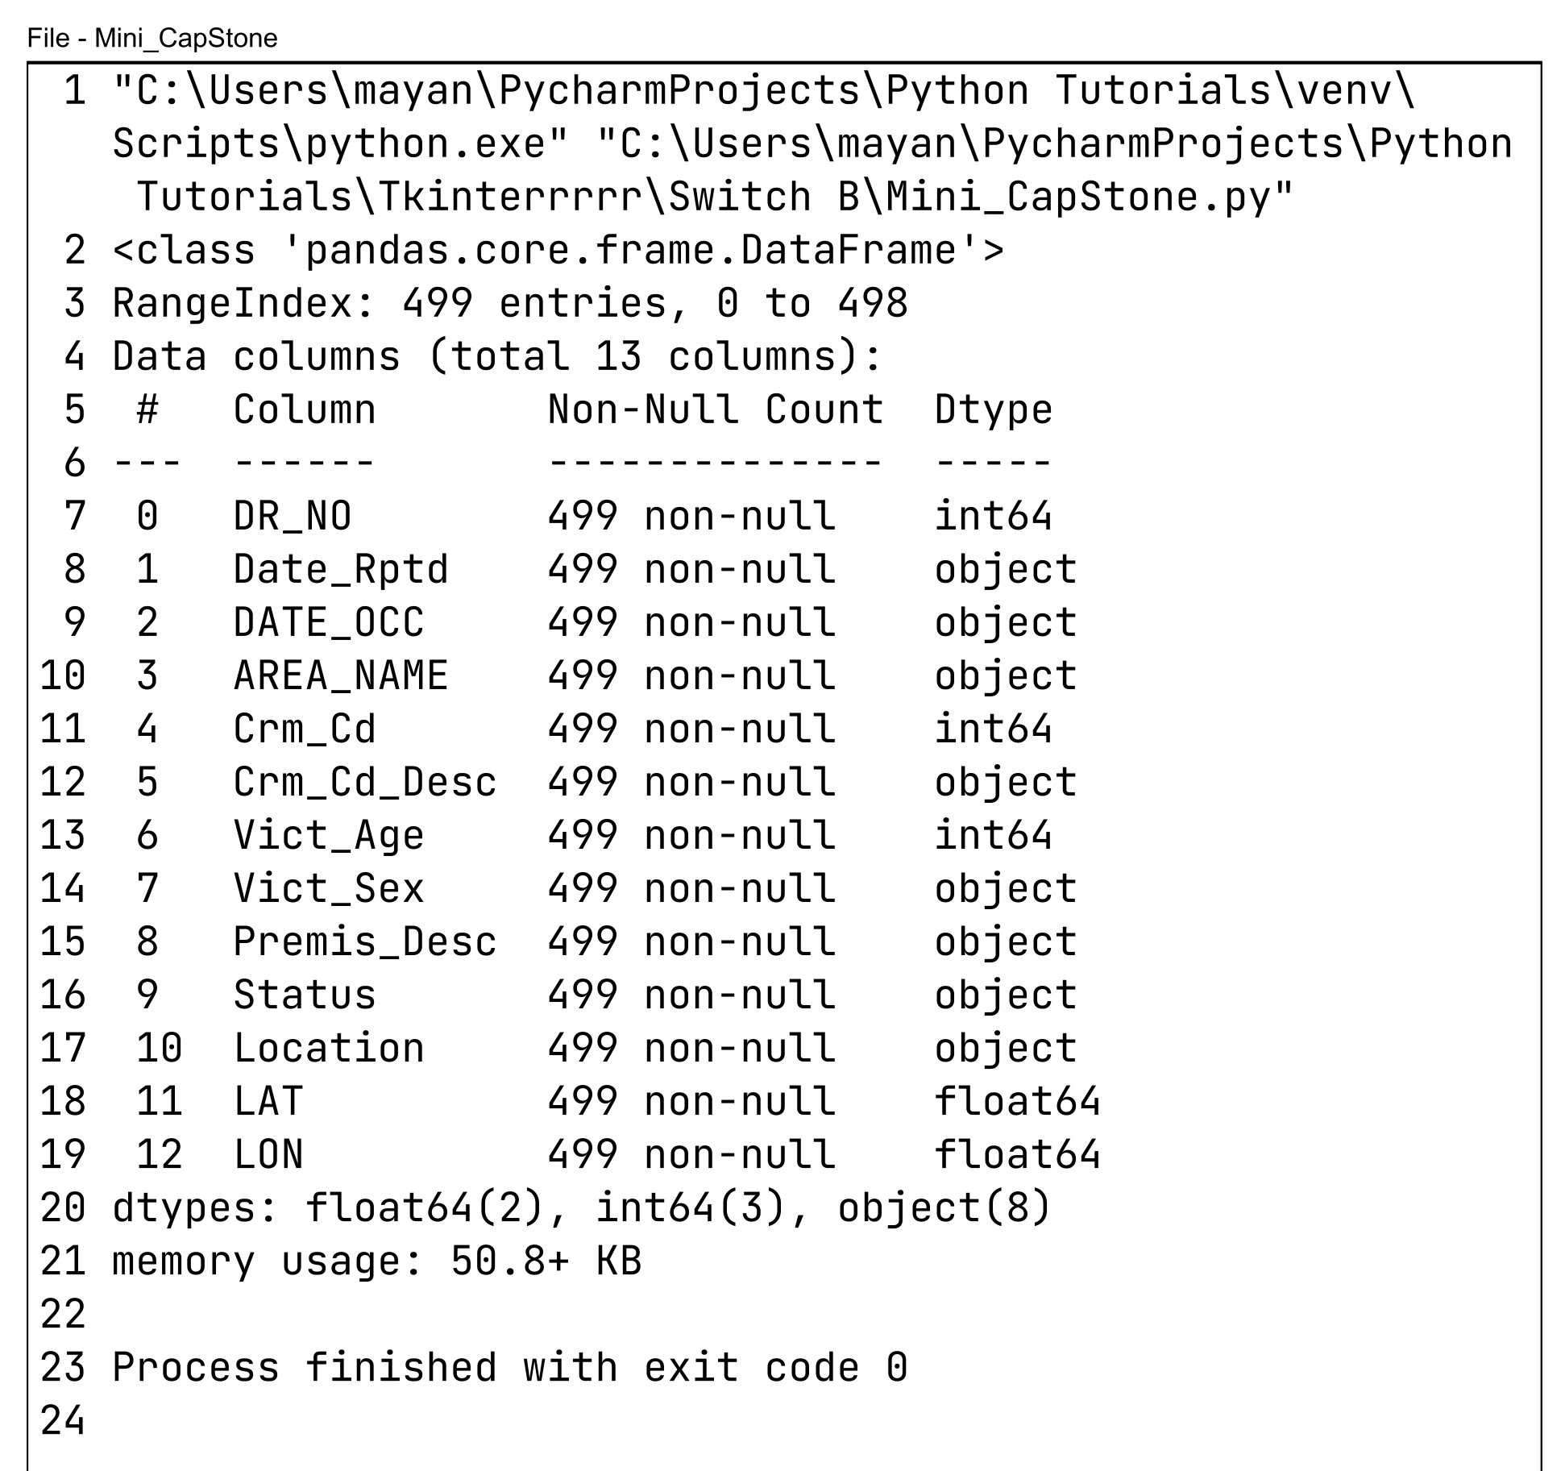
Let’s Know About Our Data :

Slide 7
Data Dictionary :
Columns
Description
DR_NO
Date_Rptd
DATE_OCC
AREA_NAME
Crm_Cd
Crm_Cd_Desc
Vict_Age
Vict_Sex
Premis_Desc
Status
Location
LAT
LON
Document Reference Number
Crime Reported Date
Crime Occurrence Date
Area Of Crime Occurrence
Crime Code
Description Of The Crime Code
Victim Age
Gender of Victim
Premises Description
Status Of Crime Code
Location of Crime Occurrence
Latitude of Crime Occurrence
Longitude of Crime Occurrence

Slide 8
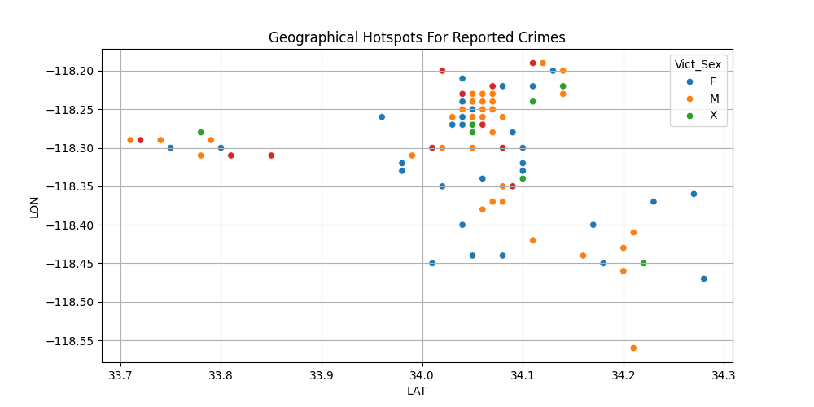
Geographical Hot Spot :

Slide 9
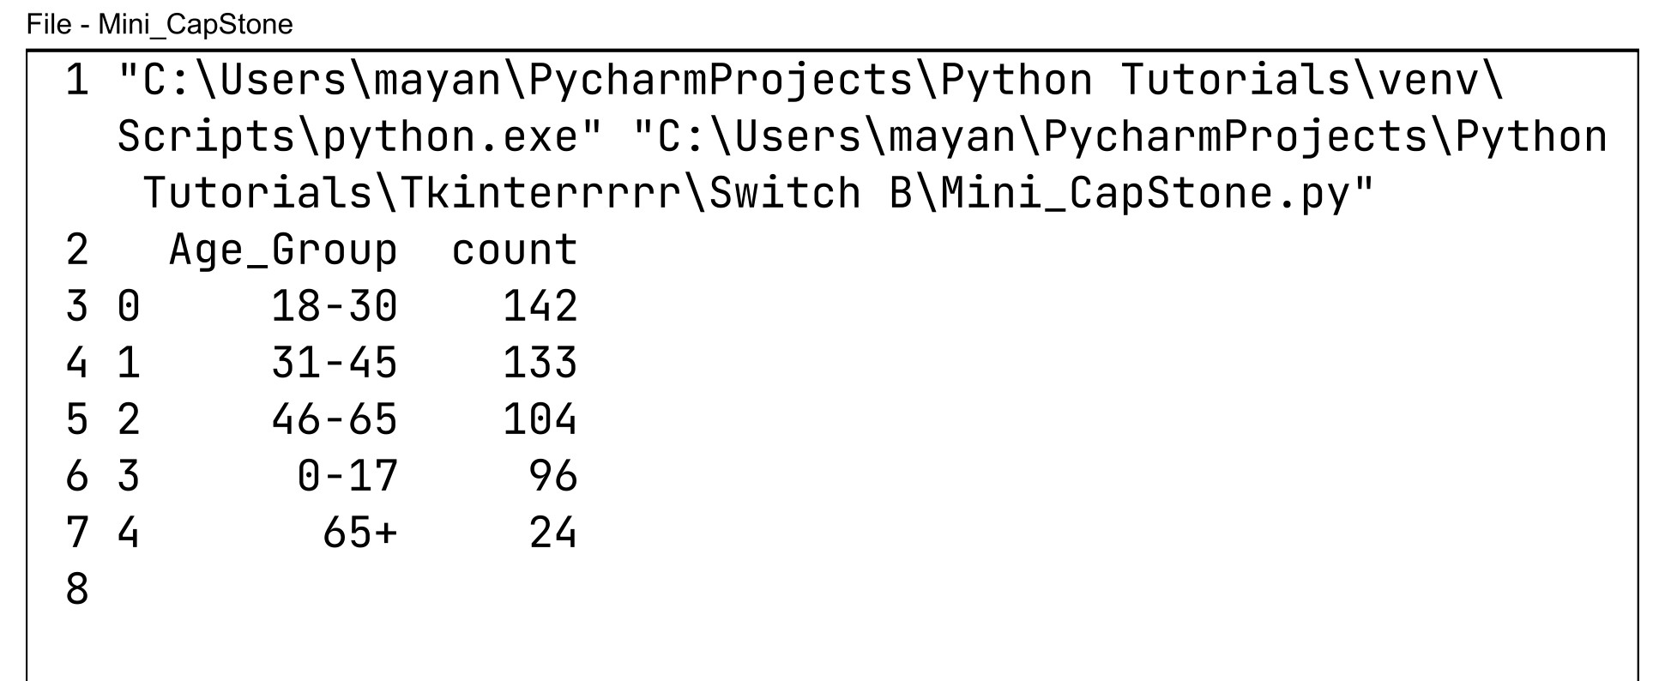
Age Distribution :

Slide 10
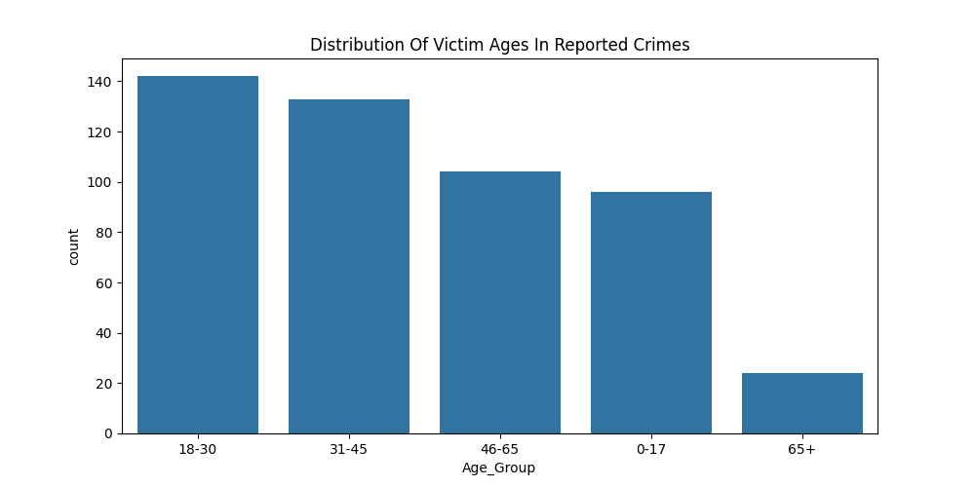
Age Distribution Graph :

Slide 11
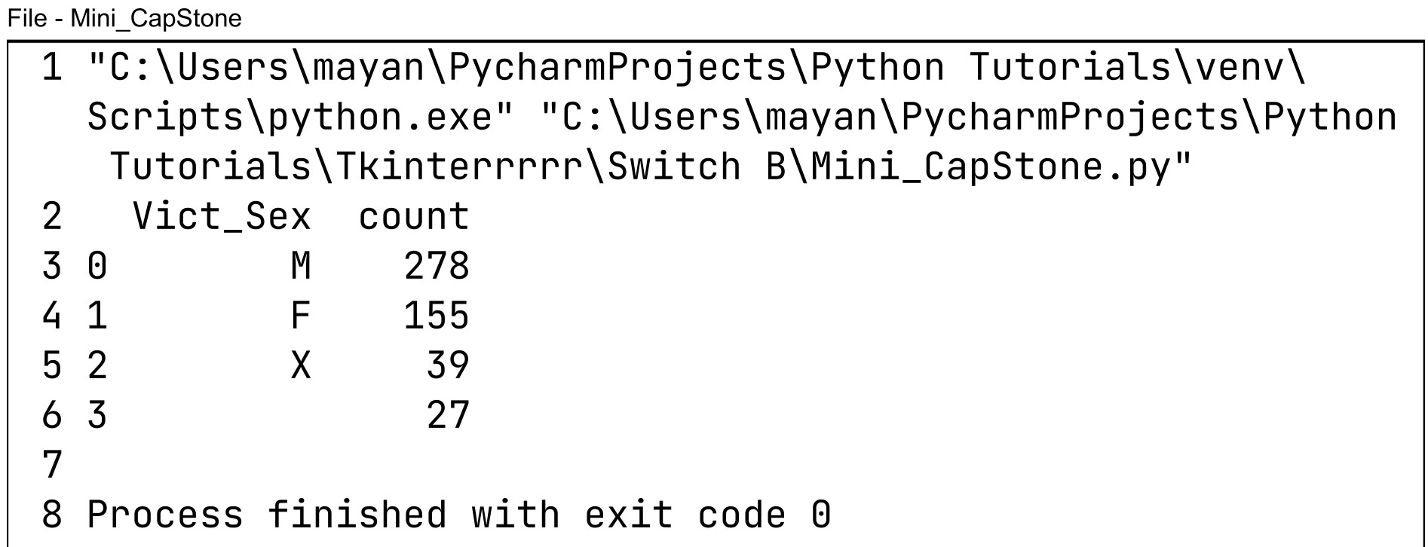
Gender Distribution :

Slide 12
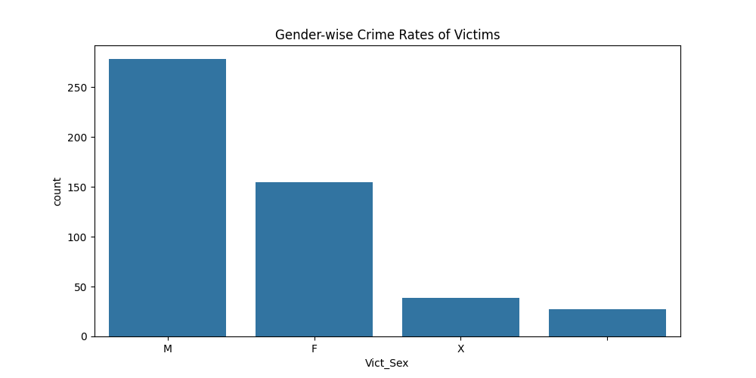
Gender Distribution Graph :

Slide 13
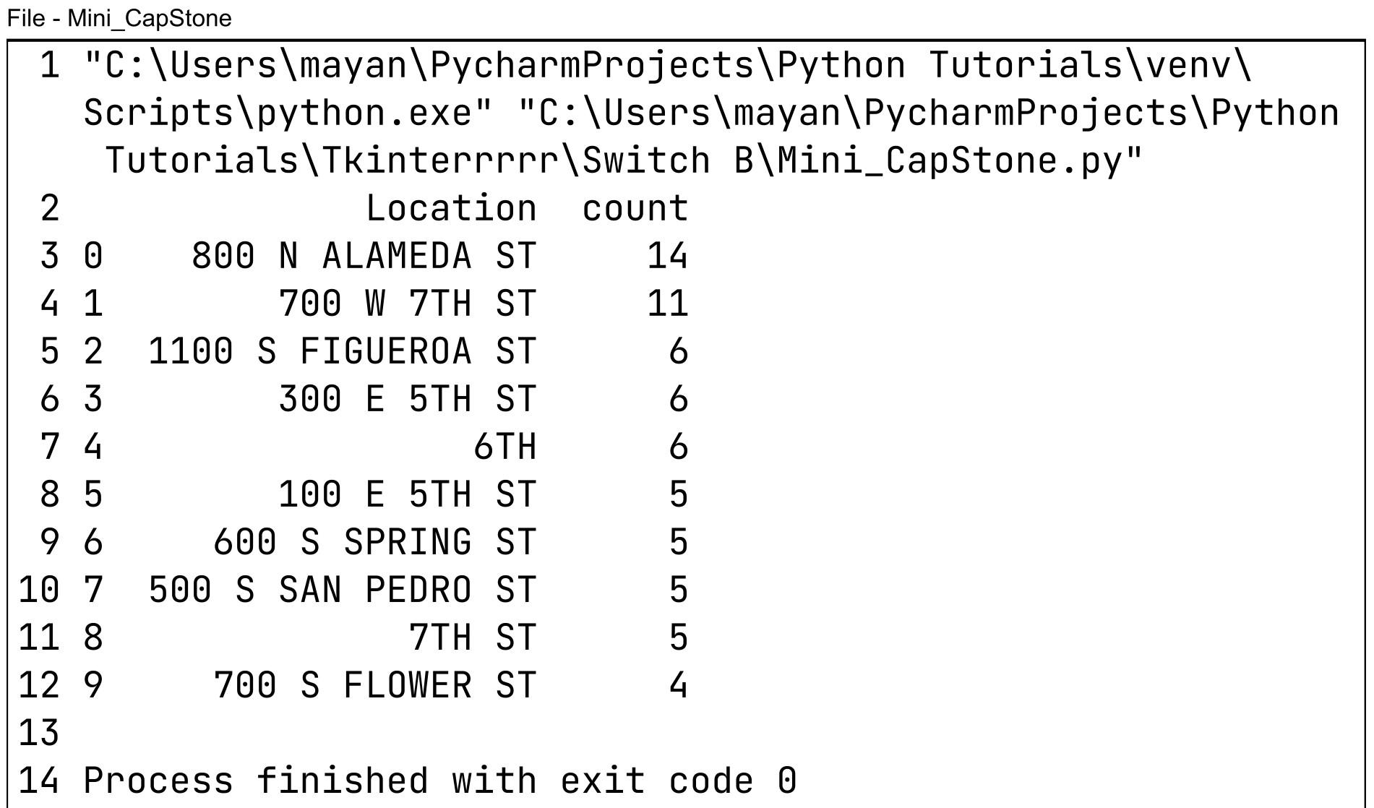
Top 10 Crime HotSpot Distribution :

Slide 14
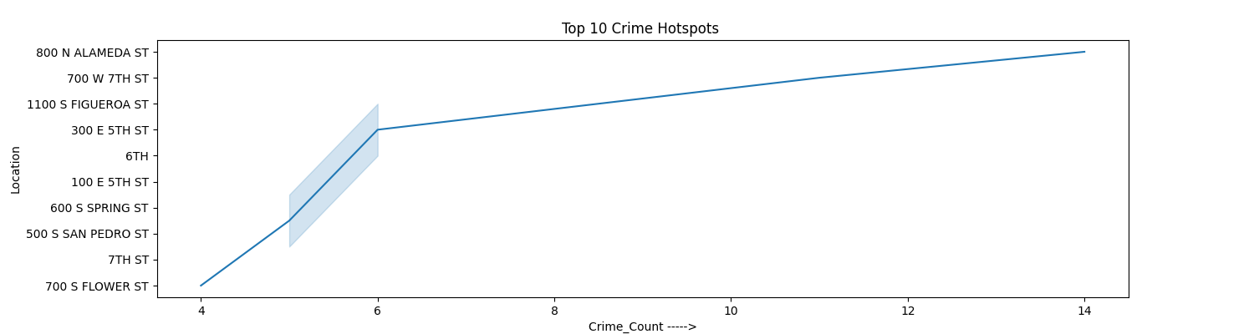
Top 10 Crime HotSpot Graph :

Slide 15
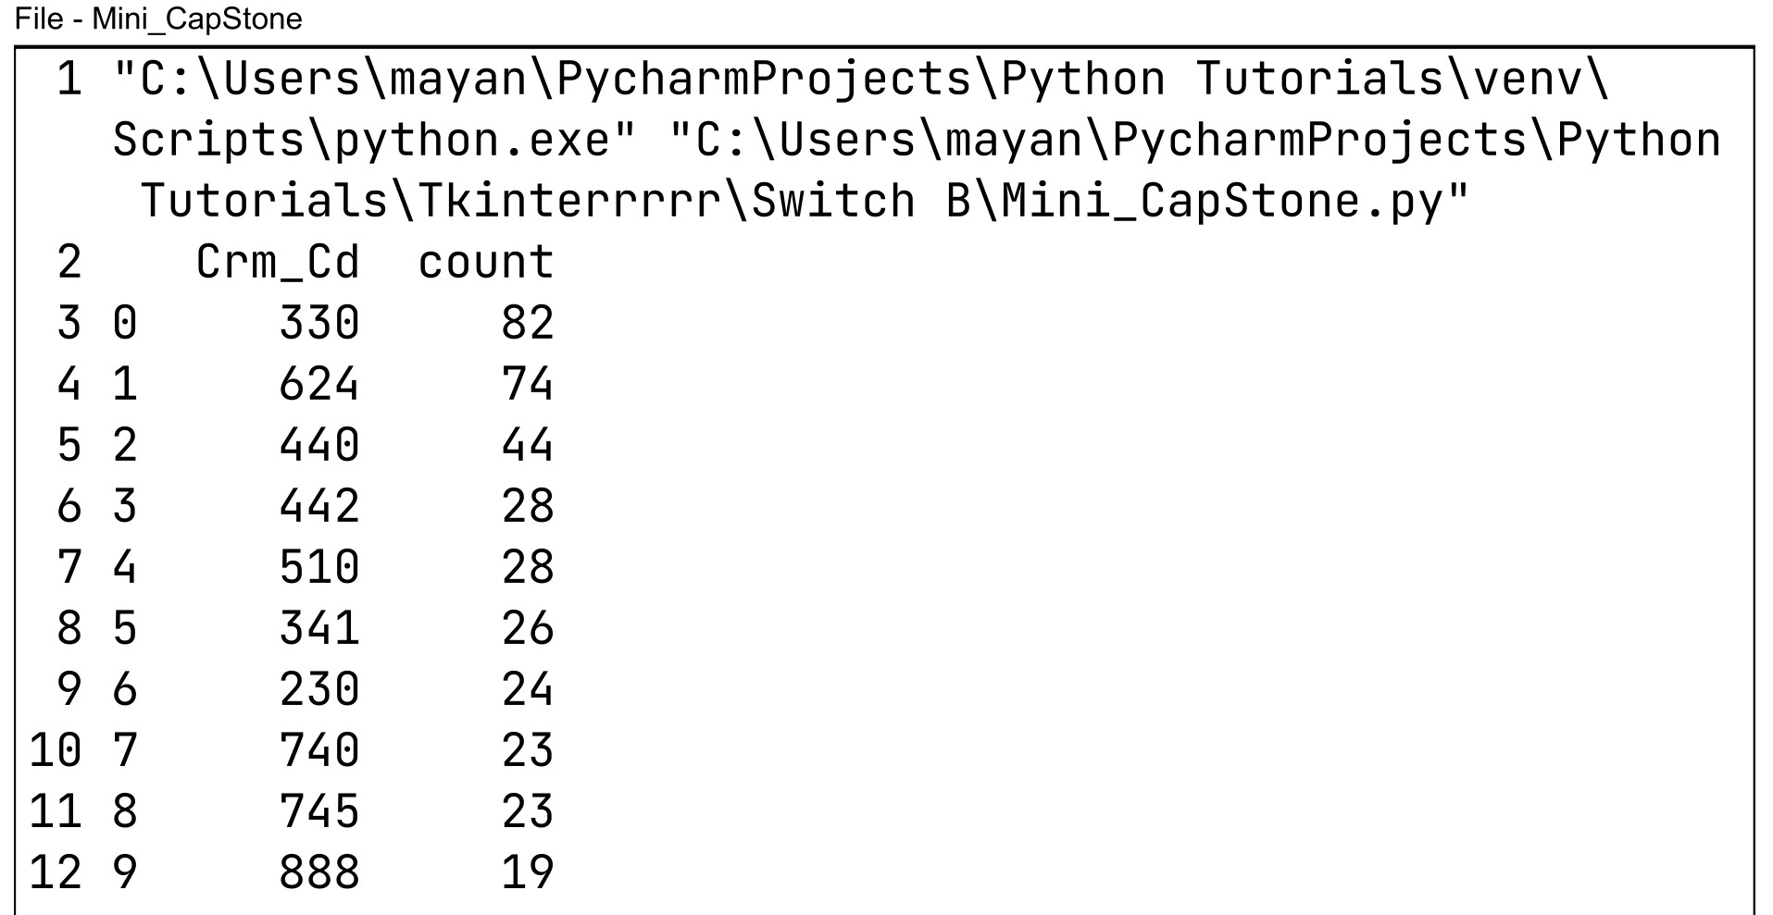
Top 10 Reported Crime Code Count :

Slide 16
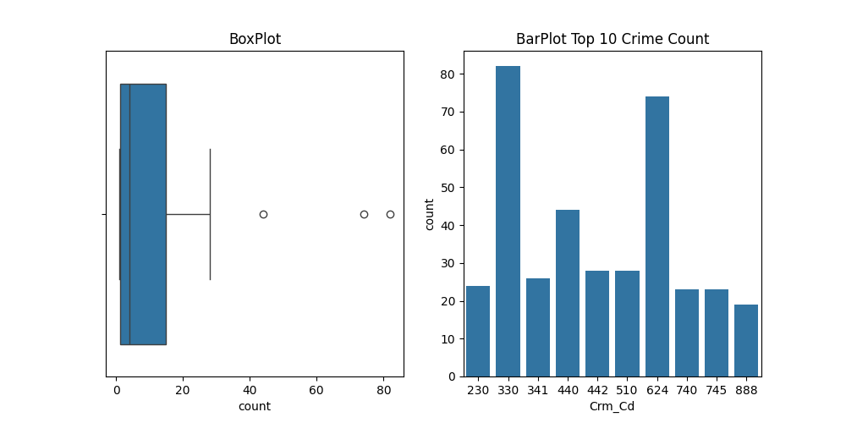
BoxPlot And BarPlot For Crime Codes :

Slide 17
Query :
Q & A

Slide 18
Thanks

