Slide 1

Healthcare Data Analysis — Executive Summary
Analysis of transactional healthcare records (20K admissions) to surface actionable insights on patient flow, treatment costs, department utilization, and revenue performance across a multi-hospital network. Workflows combined Python (Pandas) for data preparation, MySQL for analytical queries, and Power BI for executive dashboards.

Slide 2

Dataset Snapshot
Scale
Key Features
20,000 rows across Admissions, Billing, Patients; ~30 columns spanning demographics, clinical and financial records.
Age, Gender, Blood Type, Diagnosis, Department, Length of Stay, Doctor, Total Cost, Insurance Coverage, Payment Status.
Data Quality
Missing continuous values imputed with medians; categorical gaps filled via random sampling. Derived fields: age_group, stay_category.

Slide 3

Python EDA & Preparation
We read Excel sheets into Pandas, validated shapes and previewed records. Example: patients (20,000×6), admissions (20,000×8), billing (20,000×9), doctors (350×5), hospitals (10×4). Feature engineering included age groups and full_name; cleaned tables exported to CSV then loaded into MySQL.
[51]: p_df.shape -> (20000, 6)
[53]: a_df.shape -> (20000, 8)
[55]: b_df.shape -> (20000, 9)
[56]: d_df.shape -> (350, 5)
[57]: h_df.shape -> (10, 4)

Slide 4

From Cleaned Data to Relational Store
Clean CSVs were ingested into MySQL via SQLAlchemy. Tables created: patients, admissions, doctors, billing, hospitals. This enabled performant joins and window-function analytics for revenue, ranking, and time-series queries.
Connection snippet used secure engine pattern (SQLAlchemy) and if_exists="replace" to ensure alignment between cleaned DataFrames and DB tables.

Slide 5
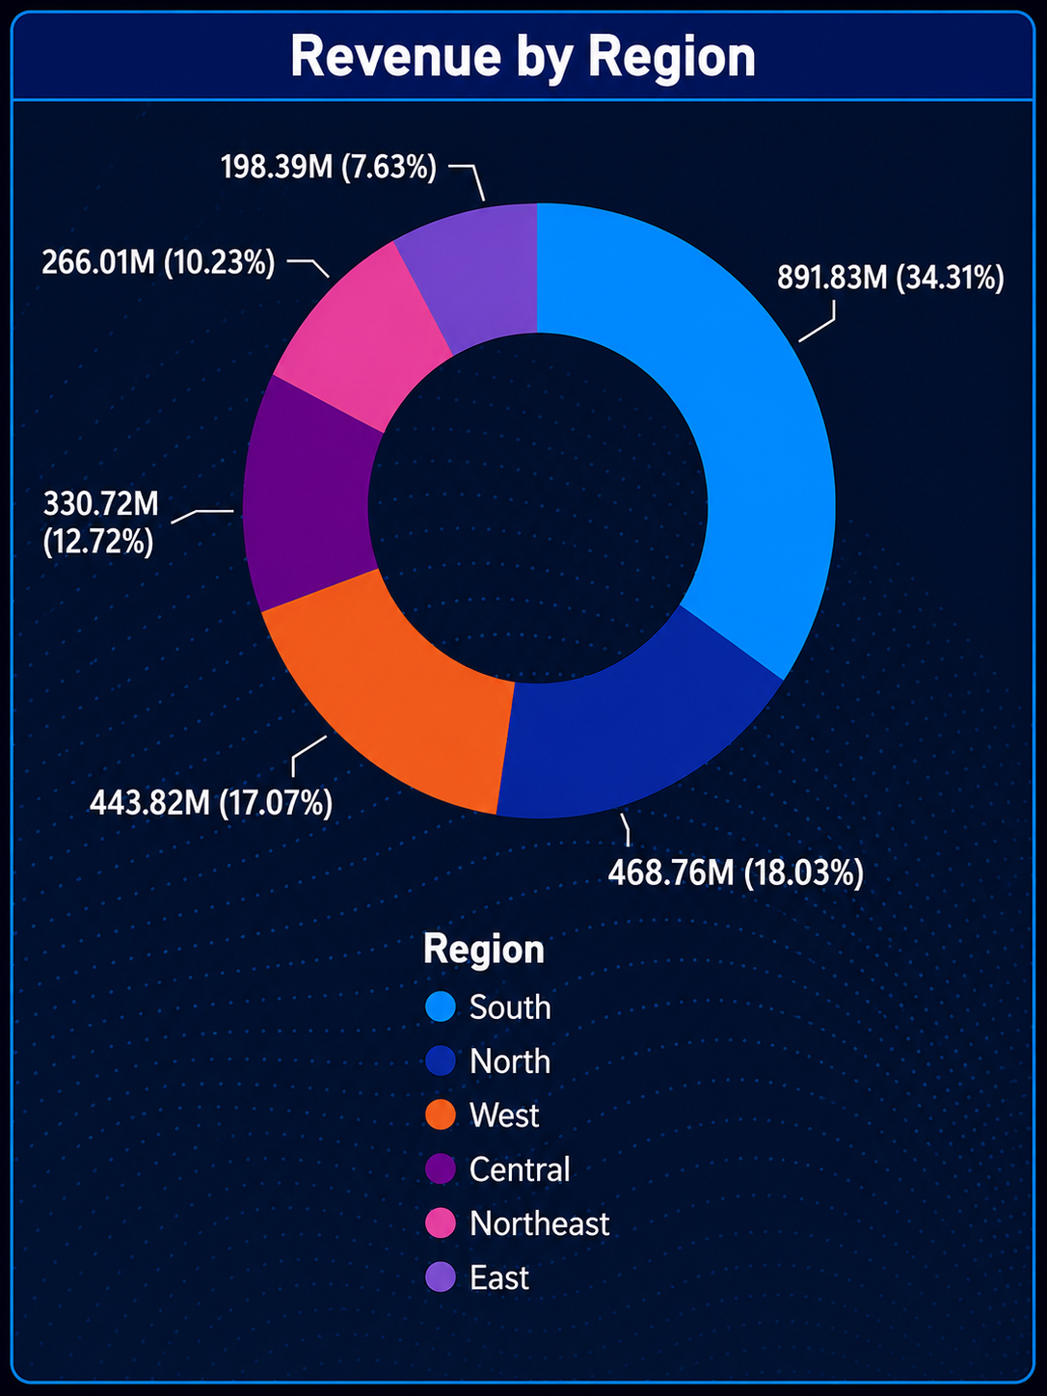
Regional Revenue — Key Finding
Total gross revenue is concentrated in the South and North. SQL aggregation (billing ↔ admissions ↔ hospitals) produced regional totals used for strategic capacity planning and service expansion prioritization.
Top regions
Action
South: ₹891.8M • North: ₹468.8M • West: ₹443.8M
Consider expanding specialized services and targeted marketing in South region hospitals to capture additional high-margin referrals.

Slide 6

Compute MoM Change
Identify Trends
Use a lagged window to get percent change.
Mark sustained positive or negative patterns.
Aggregate Revenue
Flag for Review
Sum monthly cleared revenue per account.
Tag months needing operational review.
The month-over-month cleared revenue analysis used a windowed lag to compute percent change. Results highlight volatility across months (notable +27% in Mar 2022, multi-month declines), supporting cash-flow and staffing cadence decisions.

Slide 7

Identifying 'Star Doctors' by Region
Using window functions and region partitioning, we ranked doctors by total revenue. The top performers can inform referral programs, clinician-led service lines, and compensation modeling.
Central
North
West
AIIMS Regional — Dr. Aarti — ₹9.75M
Apex Health — Dr. Amit — ₹10.42M
Sunrise Medical — Dr. Manish — ₹10.17M

Slide 8
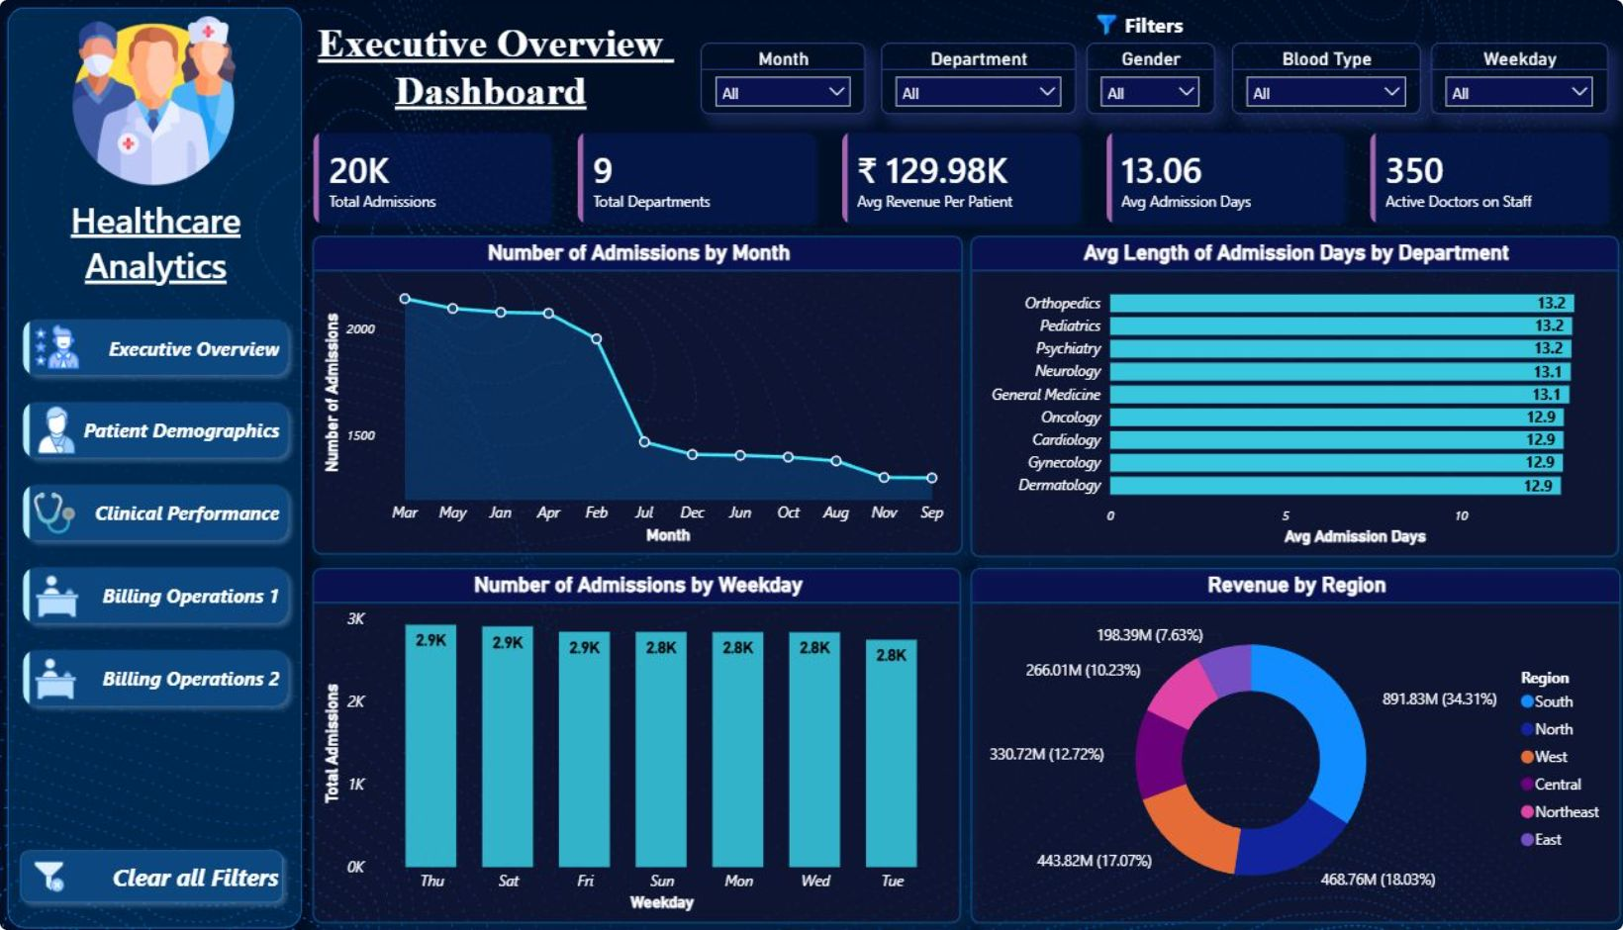
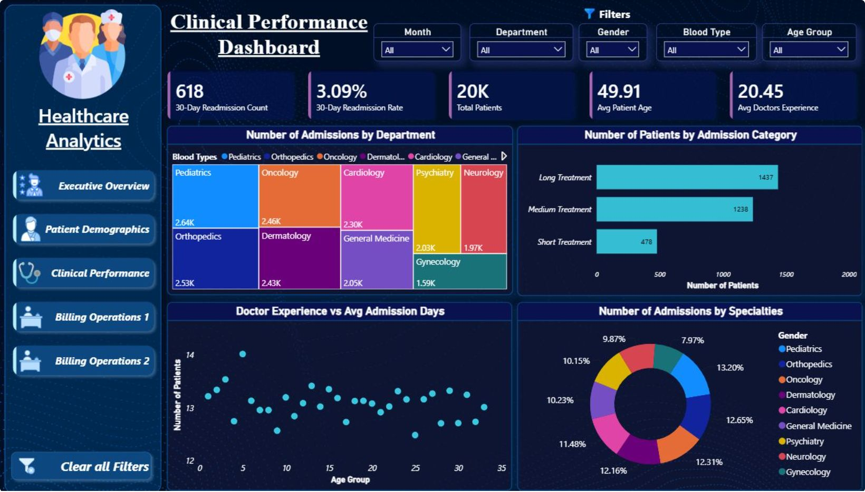
Power BI Dashboards — Executive & Clinical Views
Interactive dashboards present executive KPIs: total admissions (20K), avg revenue per patient (₹129.98K), avg length of stay (13.06 days), 350 active doctors. Visuals include admissions by month/weekday, admission days by department, revenue by region, and readmission metrics for operational monitoring.

Slide 9
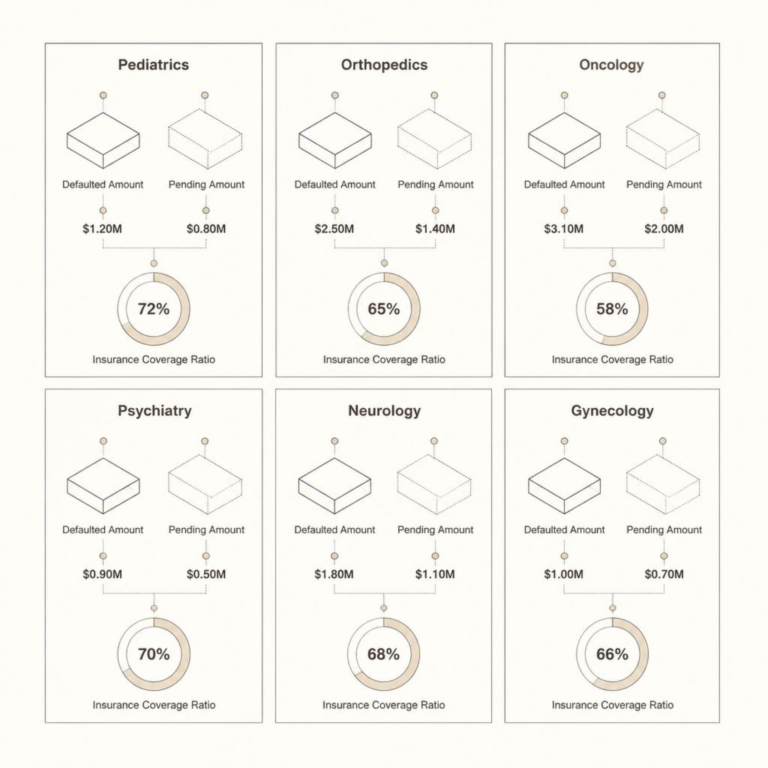
Billing Operations — Risks & Metrics
Key financial metrics: Total Gross Revenue ₹2.60B, Cleared Revenue ₹1.15B, Outstanding Debt ₹695.26M. Insurance coverage ratio ~51.1% and payment clearance rate ~44.2%. Unpaid debt clusters by department (Pediatrics, Orthopedics, Oncology) indicate targeted revenue-cycle interventions are needed.

Slide 10
Strategic Recommendations & Next Steps
1. Resource Allocation
2. Revenue Cycle Improvements
3. Regional Strategy
Prioritize beds and staffing for Pediatrics and Orthopedics where admissions are highest; align on peak-month staffing and weekend coverage.
Scale specialized services in South region hospitals; evaluate capacity expansion at high-performing centers like Max Wellness and Sunrise Medical City.
Strengthen upfront insurance verification, automate claim scrubbing, and implement prioritized follow-up for departments with highest outstanding debt.
4. Supply & Blood Bank Alignment
Adjust blood procurement to match dominant blood types (AB+ and O-). Tighten inventory turnover and cold-chain monitoring to reduce waste.

