Slide 1
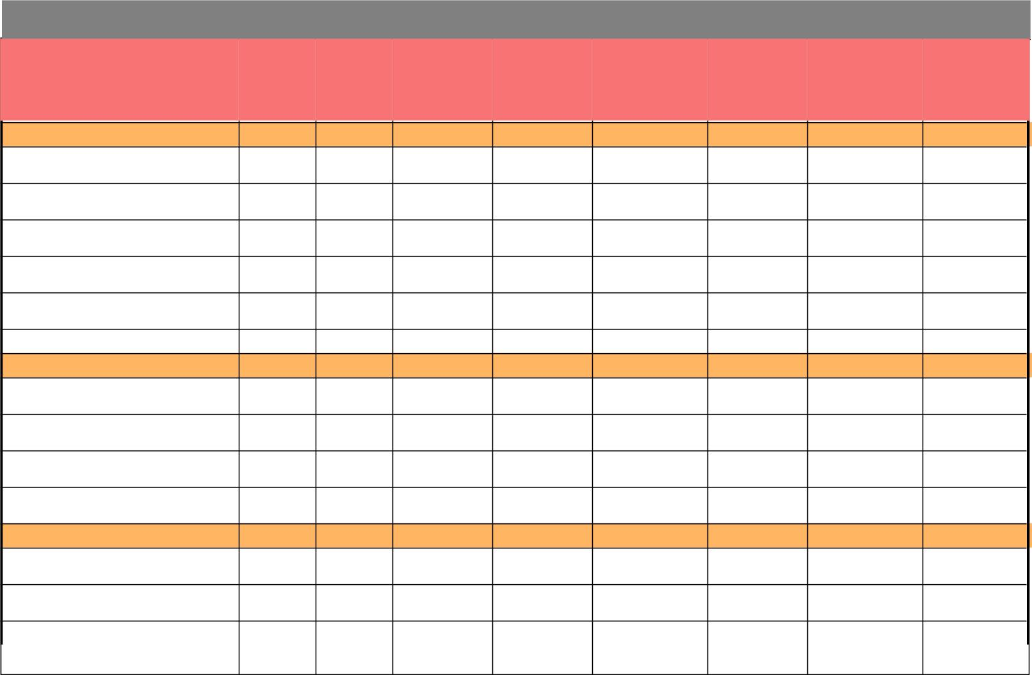
Evaluation Only. Created with Aspose.PDF. Copyright 2002-2022 Aspose Pty Ltd.
Circle Wise Target and Achievement Analysis (07 - 2022): AMRUT
Total
EMB
Total
Invoice
Value
OtherDept
Current
Month
Deduction
Release
Current
Month
Mobilizatio
n Adv
Total
Achivement
in Current
Month
Circle
Target in
Lakhs
Achievement
Percentage
Current
Month
Current
Month
Current
AGRA ZONE -
5667
107
753
159
1569
0
1019
17.98
%
%
AGRA ZONE - 14TH CIRCLE
KANPUR NAGAR
AGRA ZONE - CONS. CIRCLE
ALIGARH
AGRA ZONE - CONS.
CIRCLE(E/M) AGRA
AGRA ZONE - GM GANGA JAL
PROJECT UNIT AGRA
AGRA ZONE - GM GPCU
KANPUR NAGAR
50
38
0
0
0
9
611
528
151
225
0
38
0
75.33
1287
565
0
0
0
0
0
0
0.00
56.05
2.50
%
%
%
%
0
196
0
121
0
317
69
2758
272
69
0
407
0
407
149.51
AGRA ZONE - GM YPCU AGRA
734
6087
1942
0
-42
0
150
961
168
38
2
45
2255
322
0
0
0
188
921
168
25.63
15.12
8.66
%
%
%
GHAZIABAD ZONE -
GHAZIABAD ZONE - 18TH
CIRCLE GHAZIABAD
0
GHAZIABAD ZONE - 4th CIRCLE
BAREILLY
GHAZIABAD ZONE - GM YPCU
GHAZIABAD
GHAZIABAD ZONE - NIRMAN
MANDAL (E/M) GHAZIABAD
LUCKNOW ZONE -
2185
1241
718
0
0
108
362
323
0
0
2
535
1245
152
0
0
0
108
362
283
4.94
29.15
39.33
%
%
%
-42
7667
112
1380
10
1467
0
1501
19.58
%
%
LUCKNOW ZONE - 17TH
CIRCLE GORAKHPUR
LUCKNOW ZONE - GM GOMTI
PCU LUCKNOW
2642
41
171
0
166
0
212
8.04
2514
1749
70
0
775
210
0
583
369
0
0
846
220
33.64
12.56
%
%
LUCKNOW ZONE -
10
INSEPECTION WING (CIRCLE)
LUCKNOW
This Report is Generated from ePayment System.
Friday, 29 July, 2022
7:49:48PM
Page 1 of 2

Slide 2
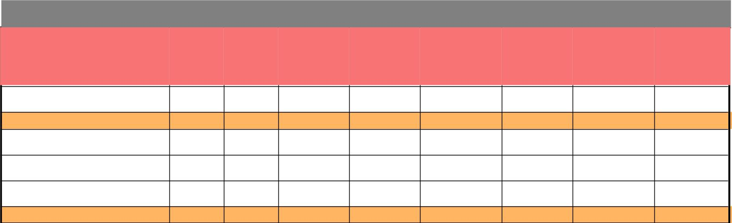
Evaluation Only. Created with Aspose.PDF. Copyright 2002-2022 Aspose Pty Ltd.
Circle Wise Target and Achievement Analysis (07 - 2022): AMRUT
Total
EMB
Total
Invoice
Value
OtherDept
Current
Month
Deduction
Release
Current
Month
Mobilizatio
n Adv
Total
Achivement
in Current
Month
Circle
Target in
Lakhs
Achievement
Percentage
Current
Month
Current
Month
762
0
Current
LUCKNOW ZONE - Nirman
Mandal Ayodhya
223
0
349
0
223
29.31
%
PRAYAGRAJ ZONE -
9580
202
1416
50
908
0
1668
17.42
%
%
PRAYAGRAJ ZONE -
Construction Circle (Civil) Banda
PRAYAGRAJ ZONE - GM GPCU
PRAYAGRAJ
PRAYAGRAJ ZONE - GM GPCU
VARANASI
217
0
1
0
31
0
1
0.36
3733
5630
0
202
378
278
1138
4510
0
50
410
467
0
0
0
278
1390
5109
7.44
24.69
17.62
%
%
%
Uttar Pradesh -
29000
220
6199
This Report is Generated from ePayment System.
Friday, 29 July, 2022
7:49:48PM
Page 2 of 2

