Slide 1
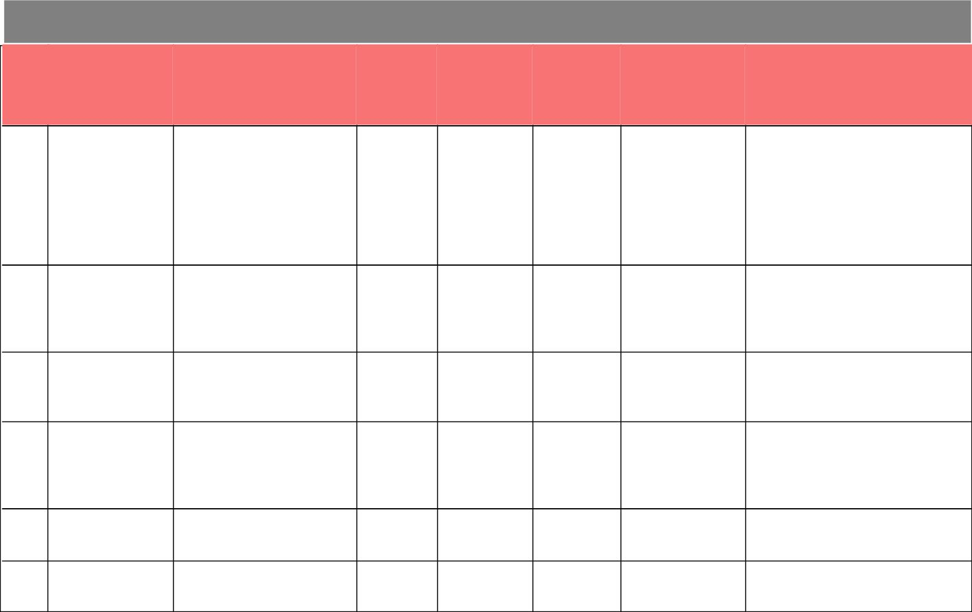

Evaluation Only. Created with Aspose.PDF. Copyright 2002-2022 Aspose Pty Ltd.
Stagnant Physical Progress for more than 60 Days - : AMRUT
Physical
Progress -
(%)
Financial
Progress - (%)
Last Invoice
Generated
On
Days Since Last
Invoice Generated
Issue Reported (if Any)
S.No
Circle - Division
Project
1 GM GPCU
District-III Zone-I Kanpur
89.00
75.58 28/01/2022
182 Technical: Work will be completed
after the completion and
KANPUR NAGAR Sewerage
- PM GPCU-3
KANPUR NAGAR
commissioning of rehabilitation
work of the trunk line to baniyapur
15 MLD MPS/ STP for Which
Estimated of Rs. 32.66 Cr. Has
been submitted U.P. Government
for approval.
2 GM GOMTI PCU
LUCKNOW - PM
TEMP GPCU
Laying of Sewer line in
Dist-4, Zone-4, Phase-I,
Lucknow
47.09
43.96 02/05/2022
88 Technical: Drainage line are also
laid in the area due to which
proper right of way is not available
for laying sewer. Detailed survey
to be conducted by contractor.
88
LUCKNOW
3 GM GOMTI PCU
LUCKNOW - PM
TEMP GPCU
LUCKNOW
4 GM GPCU
Sewer House connection,
Sewerage District-4,
zone-4, Phase-II Lucknow
10.50
97.70
2.89 02/05/2022
91.58 30/04/2022
MAKING OF WATER
90 : 300 nos connection are pending
near vindhyachal corridor .To be
started when NOC will issue from
UPRNN.
PRAYAGRAJ - PM SUPPLY HOUSE
GPCU (New)
Mirzapur
CONNECTION IN
MIRZAPUR NAGAR
PALIKA PARISHAD
Azamgarh sewer house
connection scheme.
5 GM GPCU
43.00
12.00
40.20 27/12/2021
2.61 27/12/2021
214 No Invoice To Be Generated:
VARANASI - 2ND
CD AZAMGARH
6 GM GPCU
Works is in progress.
Maunath Bhanjan Septage
Management
214 Land Issue: Work is stopped due
to Hor. High Court Stay order on
dated 19-07-2021
VARANASI - 2ND
CD AZAMGARH
This Report is Generated from ePayment System.
Friday, 29 July, 2022
11:18:49PM
Page 1 of 3

Slide 2


Evaluation Only. Created with Aspose.PDF. Copyright 2002-2022 Aspose Pty Ltd.
Stagnant Physical Progress for more than 60 Days - : AMRUT
Physical
Progress -
(%)
Financial
Progress - (%)
Last Invoice
Generated
On
Days Since Last
Invoice Generated
Issue Reported (if Any)
S.No
Circle - Division
Project
7 GM GPCU
Ghazipur Septage
Management(Co-
treatment)
0.00
0.00 13/11/2021
258 Technical: Contract bond has not
been executed by
VARANASI - 2ND
CD GHAZIPUR
contractor. Due to non construction
of STP,
construction of co-treatment unit is
not
justifiable. The completion date of
STP
construction is 09.01.2024. Please
dropped this
project till the completion of STP.
214 Payment Pending Due To
Unavailability Of SNA Limit:
Payment pending against funds
diverted from state sector. Already
bills have been uploaded
262 Technical: Contract Bond has not
been executed by contractor till
date. However, due to non
construction of STP, the
construction of Co-treatment is not
justifiable. The project should be
dropped till the construction of
STP.
8 GM GPCU
VARANASI - CD
BALLIA
N.P.P Ballia Sewerage
House connection
68.00
0.00
45.92 27/12/2021
0.00 09/11/2021
9 GM GPCU
VARANASI - CD
BALLIA
Ballia Septage
Management(Co-
treatment)
This Report is Generated from ePayment System.
Friday, 29 July, 2022
11:18:49PM
Page 2 of 3

Slide 3


Evaluation Only. Created with Aspose.PDF. Copyright 2002-2022 Aspose Pty Ltd.
Stagnant Physical Progress for more than 60 Days - : AMRUT
Physical
Progress -
(%)
Financial
Progress - (%)
Last Invoice
Generated
On
Days Since Last
Invoice Generated
Issue Reported (if Any)
S.No
Circle - Division
Project
10 GM GPCU
Jaunpur N.P.P. Pipe Peyjal
Yojana Reorganization
Phase-II, Zone-1A,1B
74.00
32.07 25/05/2022
65 Technical: After failing of 2 No
tubewells, resistivity test has been
performed. As per the report,
another pilot bore has been done,
which also failed due to salinity.
Nowhere in the area of about 5
kms, there is scarcity of saline free
water. The scheme should be
closed at this stage.
VARANASI - CD
JAUNPUR
11 GM GPCU
VARANASI -
Mugalsari Septage
Management Scheme
0.00
0.00 23/10/2021
279 Land Issue: Stay order has been
issued by Hon High Court
GPPU VARANASI
Allahabad on the land originally
provided. After that land had not
been finalized
This Report is Generated from ePayment System.
Friday, 29 July, 2022
11:18:49PM
Page 3 of 3

