Slide 1
SECURITY SYSTEM FOR DNS USING
CRYPTOGRAPHY
HARI SUMANTH
CSE~518

Slide 2
Overview of DNS
The DNS translates Internet domain and host names to IP address. DNS automatically converts the names we type in our Web browser address bar to the IP addresses of Web servers hosting those sites.
The mapping or binding of IP addresses to host names became a major problem in the rapidly growing Internet and the higher level binding effort went through.
We got the different stages of development up to the currently used Domain Name System (DNS).

Slide 3
OBJECTIVE
To provide security by combining the concept of both the Digital Signature and Asymmetric (public key) cryptography by sending the Public key over the Network.

Slide 4
Digital Signatures
The DNS Security is designed to provide security by combining the concept of both the Digital Signature and Asymmetric key (Public key) Cryptography.
A digital signature is a mathematical scheme for demonstrating the authenticity of a digital message or document.
A valid digital signature gives a recipient reason to believe that the message was created by a known sender, and that it was not altered in transit.

Slide 5
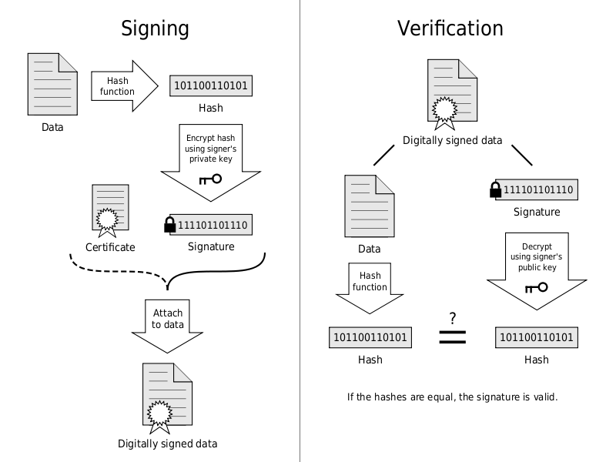

Slide 6
Asymmetric key
The asymmetric key algorithms are used to create a mathematically related key pair: a secret private key and a published public key.
Each user has a pair of a public encryption key and a private decryption key.
The practice of cryptography begin in 1970's.

Slide 7
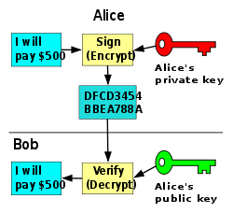
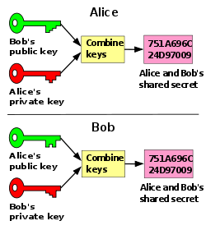

Slide 8
Message Digest Algorithm
The DNS security uses Message Digest Algorithm to compress the Message(text file) and PRNG(Pseudo Random Number Generator) Algorithm for generating Public and Private key .
In cryptography, Message-Digest algorithm is a widely used cryptographic hash function with a 128-bit hash value.

Slide 9
pseudo-random number generator
A pseudo-random number generator is a deterministic algorithm to generate a sequence of numbers with little or no discernible pattern in the numbers, except for broad statistical properties.
The sequence is not truly random in that it is completely determined by a relatively small set of initial values, called the PRNG's state.
The message combines with the Private key to form a Signature using DSA Algorithm, which is send along with the Public key.

Slide 10
The receiver uses the Public key and DSA Algorithm to form a Signature.
If this Signature matches with the Signature of the message received, the message is Decrypted and read else discarded.
By combining the concept of both the Digital Signature and Asymmetric key (Public key) Cryptography we get additional security.

Slide 11
EXISTING SYSTEM
The existing system is manually maintained.
It uses RSA Algorithm for key generation.
Since it uses RSA Algorithm it is necessary to provide two Prime numbers to generate Key Pair which results in Mathematical and Brute force attack.
It sends the Private key through the Network.
Time consumption
Low reliability
DISADVANTAGES
Error prone
Less operational speed
Low speed communication

Slide 12
PROPOSED SYSTEM
Taking the above prevailing system into consideration the best solution is using Pseudo Random Number Generator for generating Key Pair in a quick and more secured manner.
SHA-1 for producing We use MD5 (or) Message Digest and Compressing the message.
Signature is created using Private Key and Message Digest which is transmitted along with the Public Key.
The transfer of the packets from each System to System is shown using Graphical User Interface (GUI).

Slide 13
ADVANTAGES OF PROPOSED SYSTEM
They are not limited to 1024 bits like DSA
They can use hash longer than 160 bits.

Slide 14
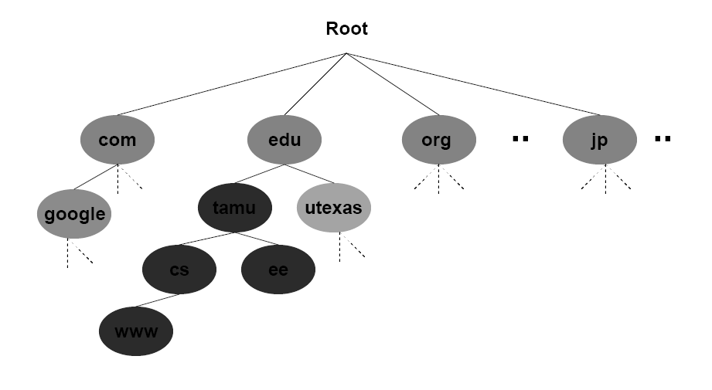
DNS Architecture

Slide 15
MODULES
Key Generation
Encryption and Decryption
Signature Creation
Signature Verification

Slide 16
MODULE DESCRIPTION
KEY GENERATION
Taking two prime numbers
Generating random numbers
Generating public and private keys
The key pair (public and private key) is generated using the Cryptography PRNG (Pseudo Random Number Generator) Algorithm.

Slide 17
SIGNATURE GENERATION
M
E
Enc Mes
D
M
Private key
Public key

Slide 18
Key Generation
Module Design
PRNG ALGORITHM
CALL THE METHOD IN
THE CODING
GENERATE TWO RANDOM NUMBERS
(PUBLIC AND PRIVATE KEY)
DISPLAY THE KEYS IN THE
BACK END
GENERATE SIGNATURE
AND SEND

Slide 19
MESSAGE ENCRYPTION
MESSAGE DIGEST ALGORITHM
READ CHARACTER BY
CHARACTER
CONVERT EACH CHARACTER
TO ASCII CODE
CONVERT THE ASCII CODE
TO HEX CODE
ENCRYPTED MESSAGE

Slide 20
KEY GENERATION
PRNG ALGORITHM
CALL THE METHOD IN
THE CODING
GENERATE TWO RANDOM NUMBERS
(PUBLIC AND PRIVATE KEY)
DISPLAY THE KEYS IN THE
BACK END
GENERATE SIGNATURE
AND SEND

Slide 21
SIGNATURE GENERATION
DSA ALGORITHM
PRIVATE KEY + ENCRYPTED
TEXT FILE
GENERATE SIGNATURE
PUBLIC KEY + SIGNATURE
SEND THROUGH THE
NETWORK

Slide 22
VERIFYING SIGNATURE AND DECRYPTING
DESTINATION
PUBLIC KEY ,SIGNATURE
FROM THE SENDER
GENERATE SIGNATURE USING
DSA ALGORITHM
VERIFY THE SIGNATURE
NO MATCH
DISCARD
IF MATCHES
DECRYPT THE MESSAGE
OR FILE
REPLY TO THE SOURCE

Slide 23
Software Requirements
Language : JDK1.3 (or) Higher.
Front End Design : Swings
Operating System : Windows

Slide 24
Hardware Requirements
Main processor : Pentium III (or) IV
RAM : 128MB
Hard Disk : 4.2GB
Clock Speed : 550 MHZ
System Bus Speed : 400 MHz
Cache RAM : 256 KB

