Slide 1

SmartTuning
Workload-based applications tuning
Adalberto Junior, Ivan Beschastnikh | Don Bourne, Daryl Maier, Vijay Sundaresan
University of British Columbia | IBM

Slide 2
Definitions
SmartTuning tune continually applications running on Kubernetes
Workload is a probability distribution of URLs served by an application in an interval
SmartTuning groups similar workloads into types
Configuration is a set of parameters that can be adjusted in an application
Workloads have the same type if their distribution of requests to the application are similar
Performance is a metrics that SmartTuning monitors to selects the best configuration, i.e., the objective to max/min
?
Observed workload
SmartTuning loop

Slide 3
Problem #1: Teams typically have little time to tune or even learn the most important tuning parameters for every type of runtime they need to deploy and manage. This leads to services being overprovisioned or deployed with an “average” configuration. The problem is compounded by short upgrade cycles for microservices.
# of different
services / runtimes
Time

Slide 4
Problem #2: Teams typically use one configuration for the life of a service/app. This configuration may result in sub-optimal performance when the app is faced with different workloads or needs that change over time. The problem is more pronounced in non-microservice apps where each server handles multiple request types, which are still common for our customers to be porting to Kubernetes.
Expected volume
Observed volume - URL 1
Observed volume - URL 2
Observed volume - URL 3
workload0
workload1
workload2
workload3
workload4
Lack of resources, e.g., long-lived http connections; connections should be short-lived
Wasting resources, e.g., few simultaneous connections; connection pool should be smaller
Request volume
time

Slide 5
Proposed solution: SmartTuning, a tool to automatically tune servers/apps based on the real, and potentially changing conditions seen at runtime
SmartTuning
Monitors applications
Extracts workloads – e.g., URL requests
Tracks app specific metrics – e.g., opened connections
Tracks performance metrics – throughput, CPU consumption
Exposes /metrics
Monitoring
Application
Stack
Analysis
Classifies workloads:
Learns when each workload type is seen during the application run
Recommends the next config to try for the given workload type
Planning
Decides on best action:
Reacts to/Predicts the next workload
Applies the best config
Configures

Slide 6
SmartTuning: Data Sources
Observables
(metrics)
Prometheus
Tunables
(Search Space)
Search Space
CRD
K8s cAdvisor/
Metrics Server
Monitoring Proxy
Deployment
Container limits
ConfigMap
HTTP Requests
CPU
Memory
CPU
Env Var
Key:value
File*
Request Size
Memory
Number Requests
Process Time
* uses specific plugins according to the config format, e.g, jvm.options, *.toml, *.yaml

Slide 7



SmartTuning: Deployment
apiVersion: "smarttuning.ibm.com/v1alpha2" kind: SearchSpace metadata: name: <deployment target> spec: deployment: <deployment target> service: <deployment service> namespace: <namespace> manifests: - name: <manifest’s name> type: <deployment | configMap> data: - name: <manifest name> tunables: number: - name: <tunable’s name> lower: <lower bounder> upper: <upper bounder> step: <step between iterations> ...
option: - name: <tunable’s name> values: - <any value> ... ...
Production
Pod
Proxy
/metrics/http_requests
/metrics/throughput
/metrics/proc_time
Search
Space
App
/metrics/cpu
/metrics/memory
/metrics | →
last config | →
Config
map
best config
Smart
Tuning
Reloader
← New config
Workload
+
config
*K8s Operator
Training
Pod
Proxy
/metrics/http_requests
/metrics/throughput
/metrics/resp_time
App
/metrics/cpu
/metrics/memory
The objective function is defined in terms of the metrics, e.g., max(throughput/memory)
Config
map
new config
* Partially implemented as an operator

Slide 8
SmartTuning: Optimization
Bayesian Optimization
max/min objective function
Selects the best config for a given
workload-type based on the observables
Config Optimization
performance
time
production
← Best config
Workload
Type Z
Workload-z | Config-A | 17.5
Workload-z | Config-N | 14.2
Workload-z | Config-K | 9.87
Workload-z | Config-W | 5.32
Workload-z | Config-B | 2.09
training
Current workload →
(Workload-Z, config-w, 5.32)
Centroid:
0.3 | 0.1 | 0.2 | 0.25 | 0.15

Slide 9
SmartTuning
evaluate current config
Workload
Bayesian Optimization module
new “random” config
Training
Pod
Smart
Tuning
→ Classify workload
→ Analyze metrics
→ Sample new config
workload
+
config
+
perf_value
Production
Pod
Lookup best config
Workload
Type K
Sample a new config
Wait t
Sample app’s perf + workload
Store (workload, perf, config)
Minimize/Maximize observables

Slide 10
At every interval, SmartTuning updates the application to handle a workload type (dashed). Each workload type is similar to the average of all workloads that was grouped. Therefore, whenever a same type repeats its configuration is set again to the application.
Expected volume
Observed volume - URL 1
Observed volume - URL 2
Observed volume - URL 3
workload0
workload1
workload2
workload3
Workload4 ~ workload 1
Request volume
Config 0_e
Config 1_k
Config 2_d
Config 3_b
Config 1_k
time

Slide 11
SmartTuning key advantages
Workload classification
Proactive and continuous experimentation over search space
Automatic application of tuning at application, runtime, and infrastructure levels to improve performance
Workload prediction to provide a good starting configuration when workload changes
Can work in any environment where required metrics are available, including bare metal as well as container environments

Slide 12
Wrapping up
SmartTuning can quickly found suitable configurations for applications in large search spaces
It takes about 20min to begin the improvements on AcmeAir performance from its default configuration
SmartTuning uses statistic analysis (Bayesian Optimization) to find out the best candidates possible for knobs, reducing the effort to tune the app drastically.
It tune about 10 knobs at once
Though finding out the max global for larger search spaces (> 10 knobs) is still a challenge.

Slide 13
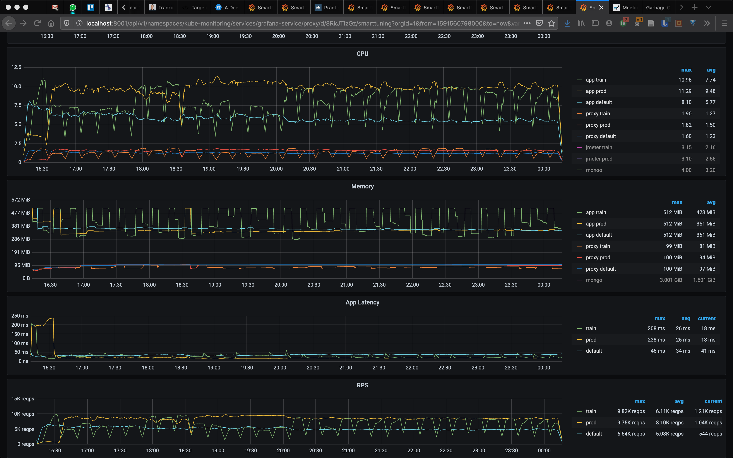
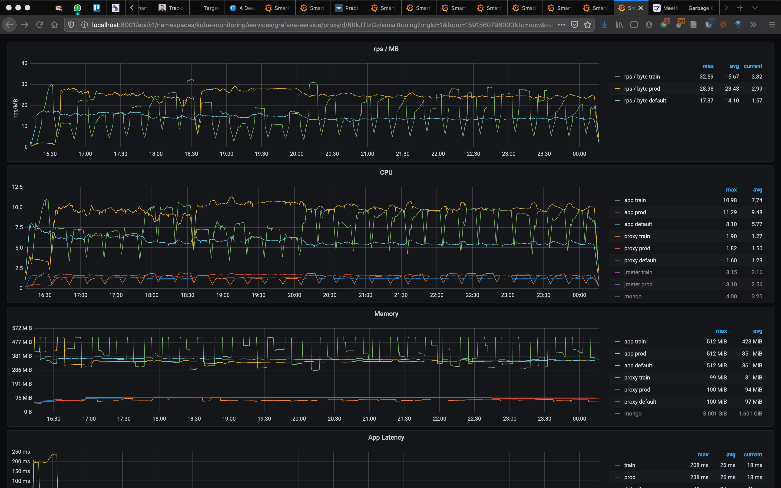
AcmeAir

