Slide 1


Application of Python in Academics
presented by
Mayank Walia (1000014924)
Ritik Raturi (1000015495)
Supervisor : Dr. Fateh Singh
Department of Mathematics
School of Physical Sciences, DIT University

Slide 2

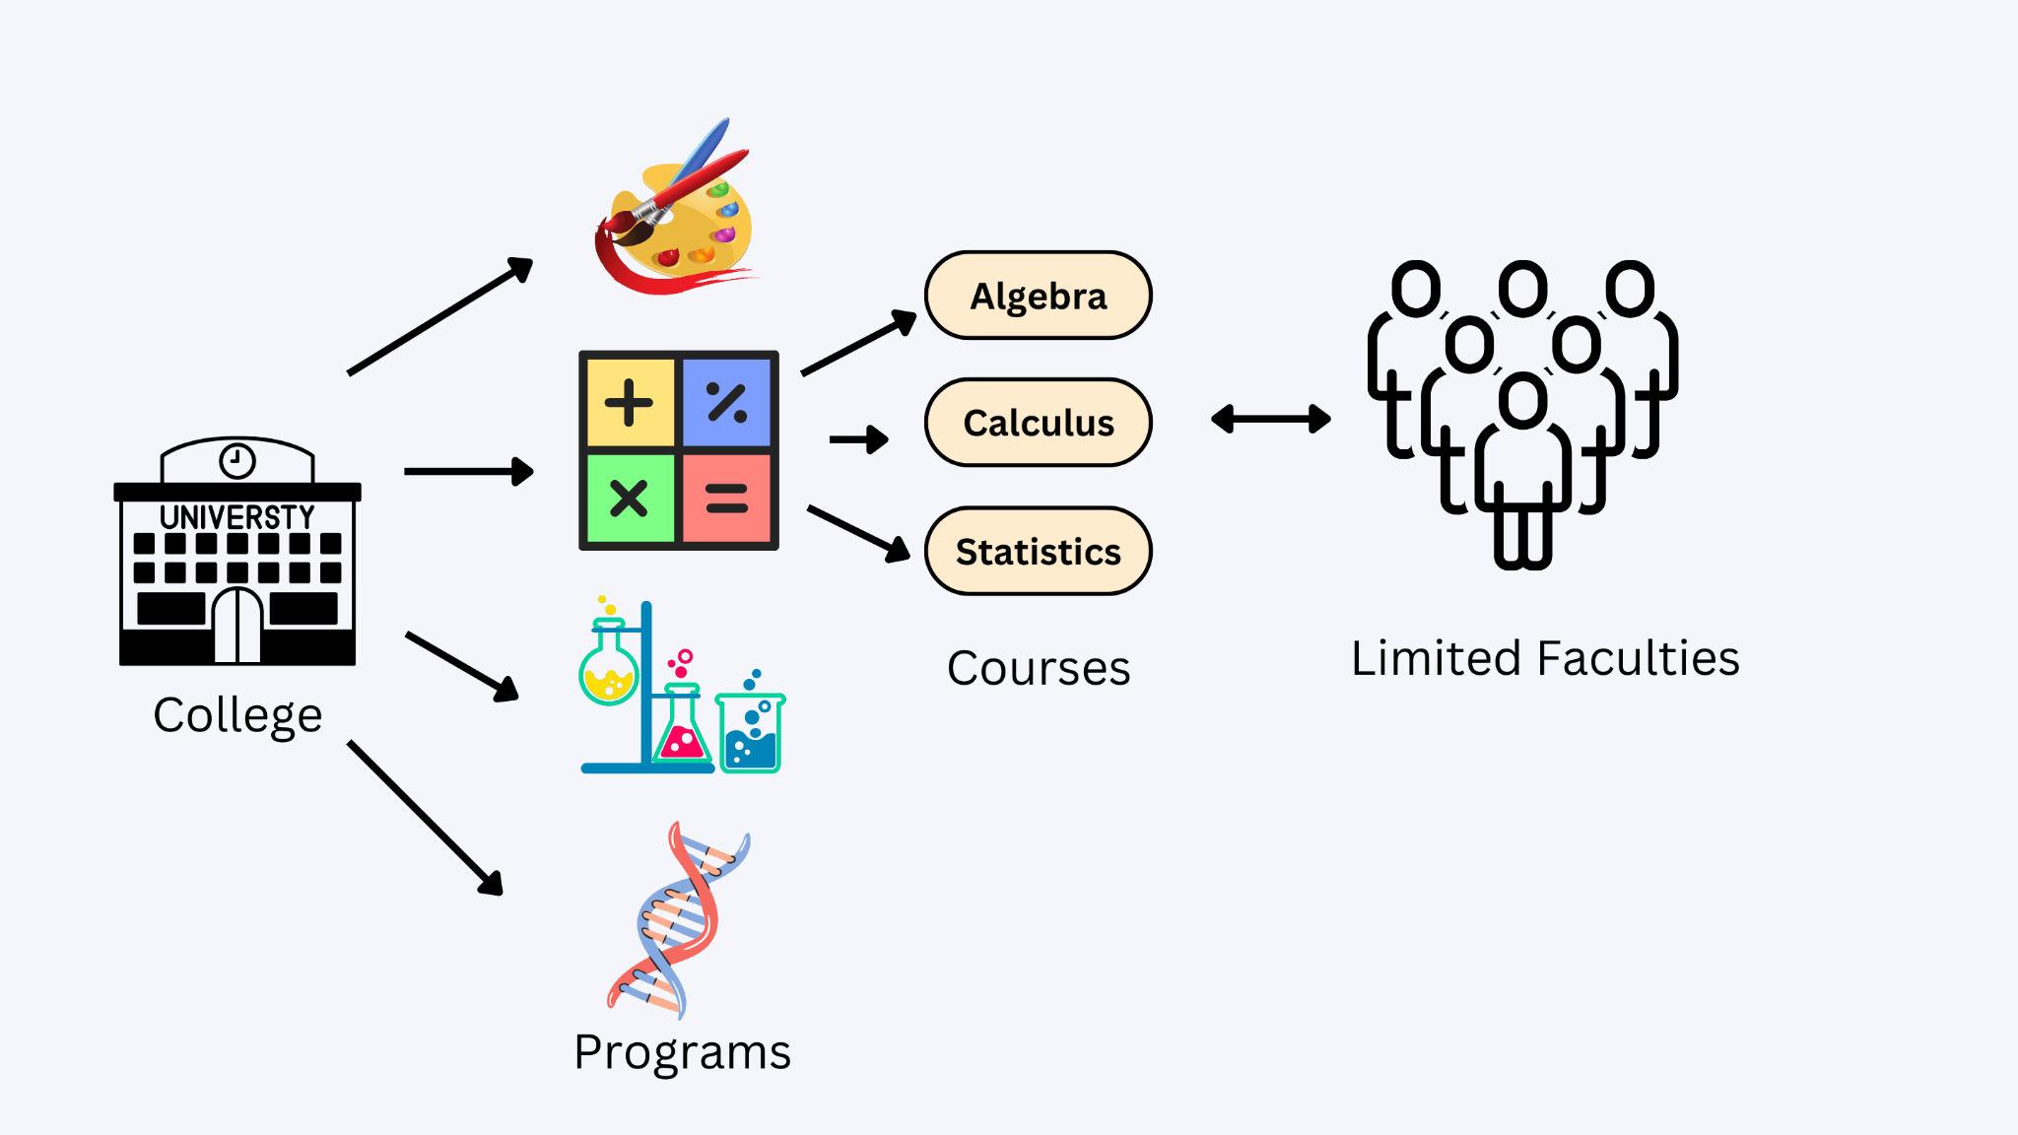
Problem Statement
“Given a set of constraints we are required to generate a timetable”

Slide 3
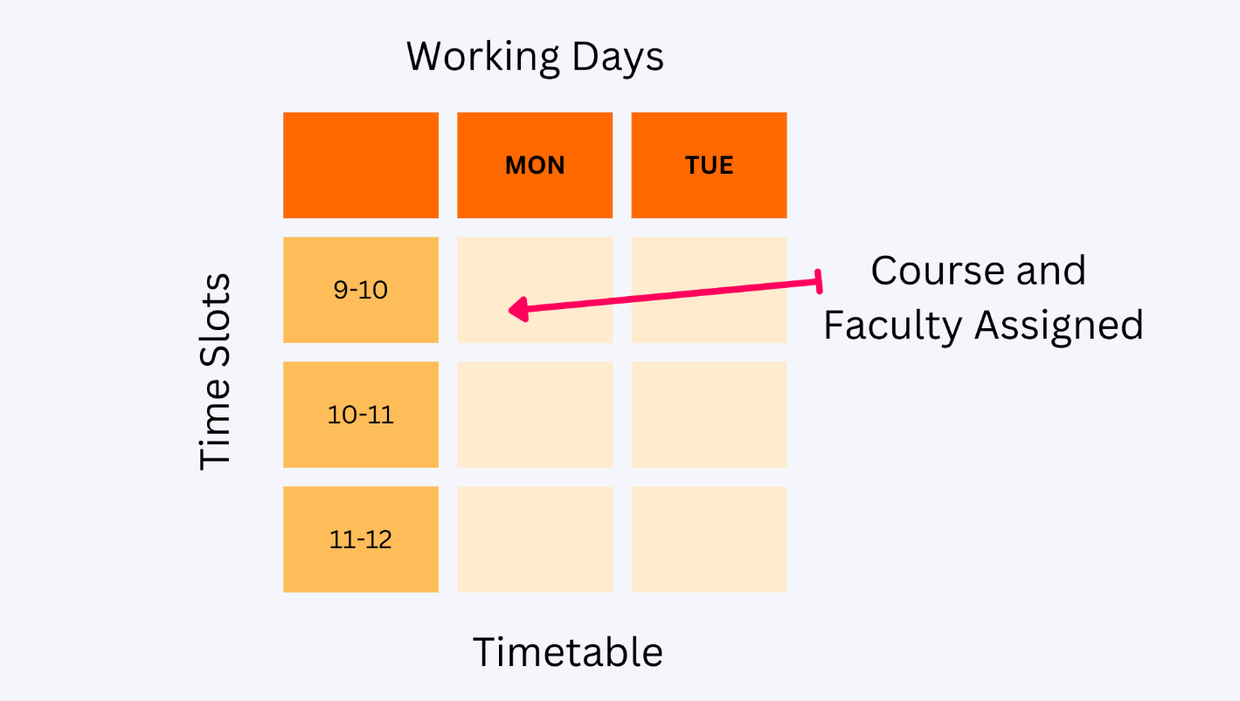
Time Table

Slide 4
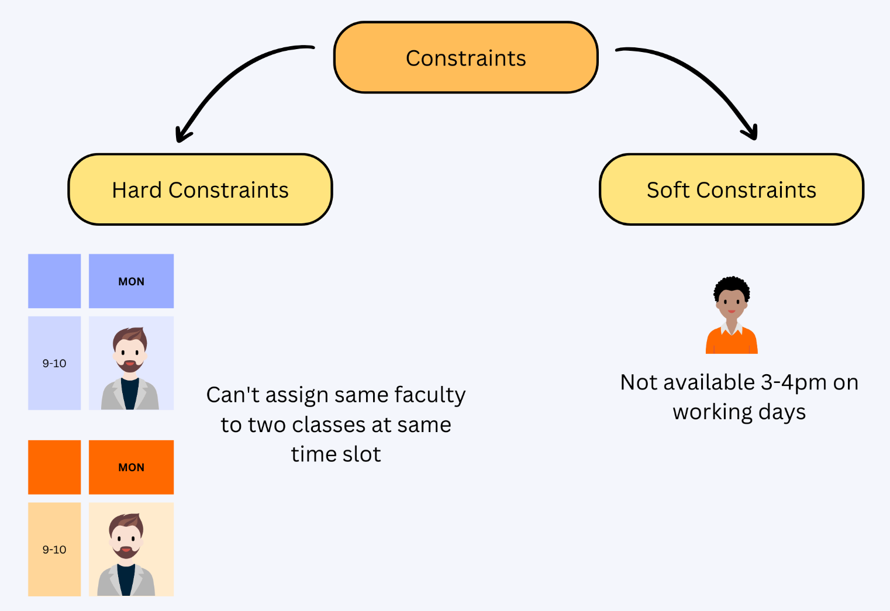
Constraints
Limited number of Faculty
Limited Infrastructure
Lecture Halls
Seating Capacity
Rooms with projectors
Labs
Faculty Load
More than 3 consecutive classes not preferred.
Student Load
Arrange classes for Students repeating the course
Meet individual faculty requirements and needs
Makes it “NP Hard” problem.

Slide 5
Approaches used worldwide
1. Direct heuristic was the first approach used, followed by
2. Algorithm based on Integer programming and network flow method
3. Search techniques such as genetic algorithm and simulated annealing by AI researchers
4. Graph coloring heuristics (most common approach)
5. Meta-heuristic techniques have also been applied
Burke and Petrovic classified the methodologies used for these problems as sequential methods, cluster methods, constraint-based methods, and meta-heuristic methods
Although most of the approaches dealing with this problem have been reported as successful, it is still lacking of the capability for application in institutions other than where it was designed

Slide 6
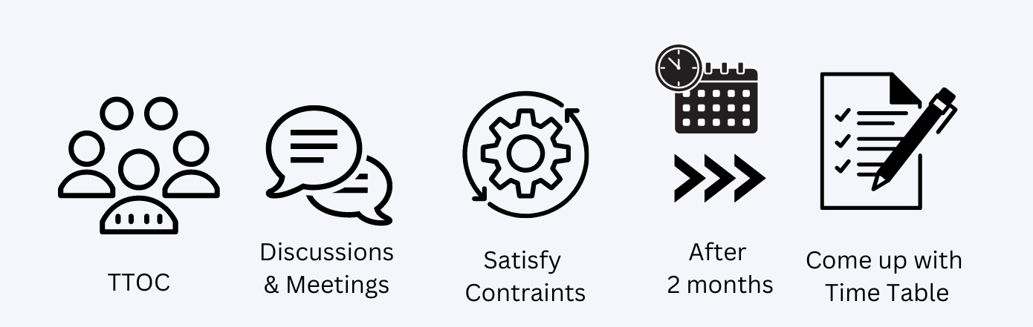
Time Table Generation Process in our University
TTOC is a committee that creates timetable together consisting of members from every department

Slide 7
Where is the problem?
Consumes lot of time.
Lots of human work is involved which may result in error if proper care is not maintained.
Any modifications or changes after the timetable generation is very difficult.
Most of the time preferences (soft constraints) remained unsatisfied.
Optimal set of timetables is generally not achieved (i.e. not all soft constraints are satisfied) because all the feasible set of timetables must be made to find the optimal one among them.
Manual generation of timetable starts with a set of hard constraints, some of which are bent or relaxed later to achieve feasibility of Time Table.

Slide 8
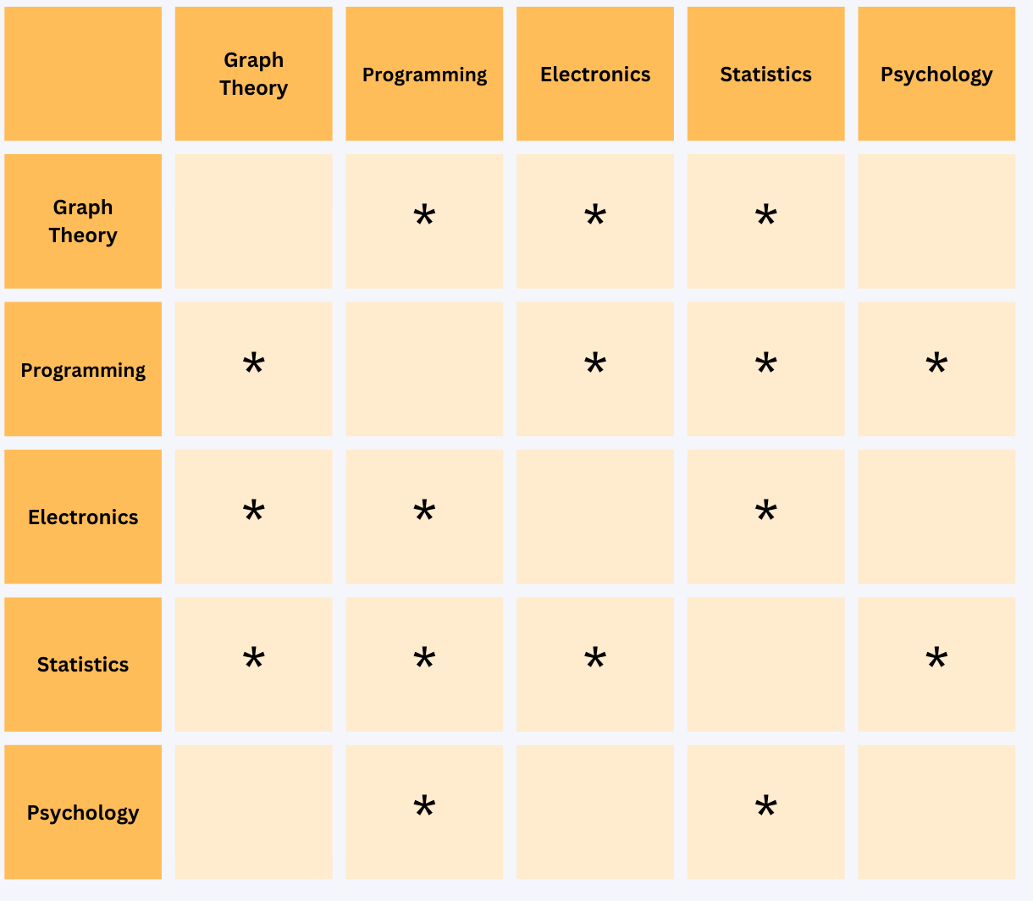
Mathematics Involved
Graph Theory
The problem of determining the minimum
number (or reasonable number) of distinct time slots needed to schedule all the courses subject to restrictions is a Graph coloring problem.
Conflicting cause can be anything like
Same professor teaches both courses
or same room opting both courses.
*
indicates pairs of courses that would cause
a timetabling conflict if both were scheduled
at the same time

Slide 9
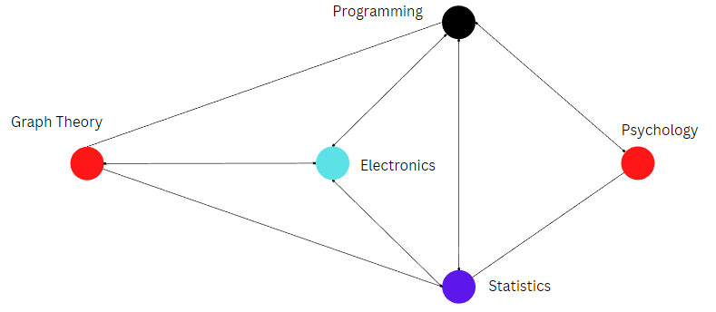
Mathematics Involved
By solving this graph coloring problem,
we get that the Chromatic number is 4.
Therefore 4 periods is the minimum
requirement to avoid conflict in the time table
for these courses.
Edge → Conflicting Courses
Node → Subjects

Slide 10
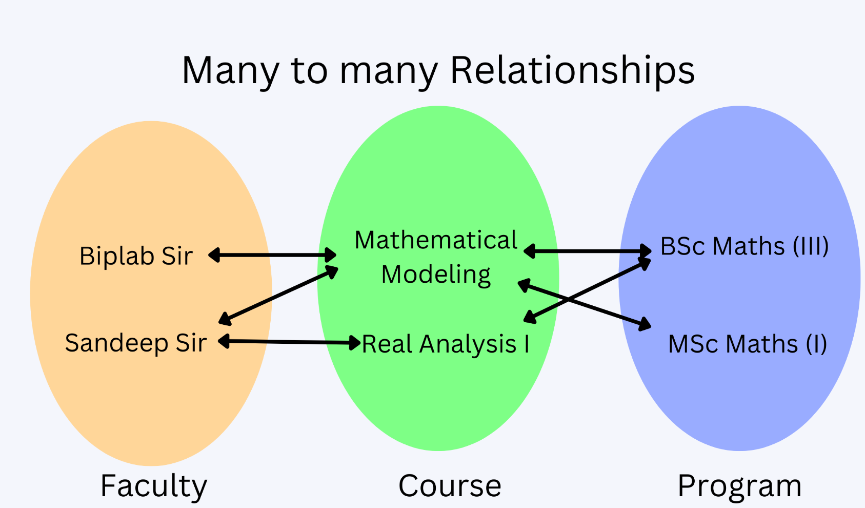
Application
Application has three parts
Input
Faculty - Course - Program mapping
Preferences which serves as soft constraints
Core part consisting of
Classes, Objects
File Handling
Algorithms
Time table for programs, faculties and rooms.
Output
Interfaces
Graphical User Interface (GUI)
Tkinter library in Python
Website (if time permits)
Technologies: Vue JS in frontend with Python as Backend
In the form of PDFs, Excel files.

Slide 11
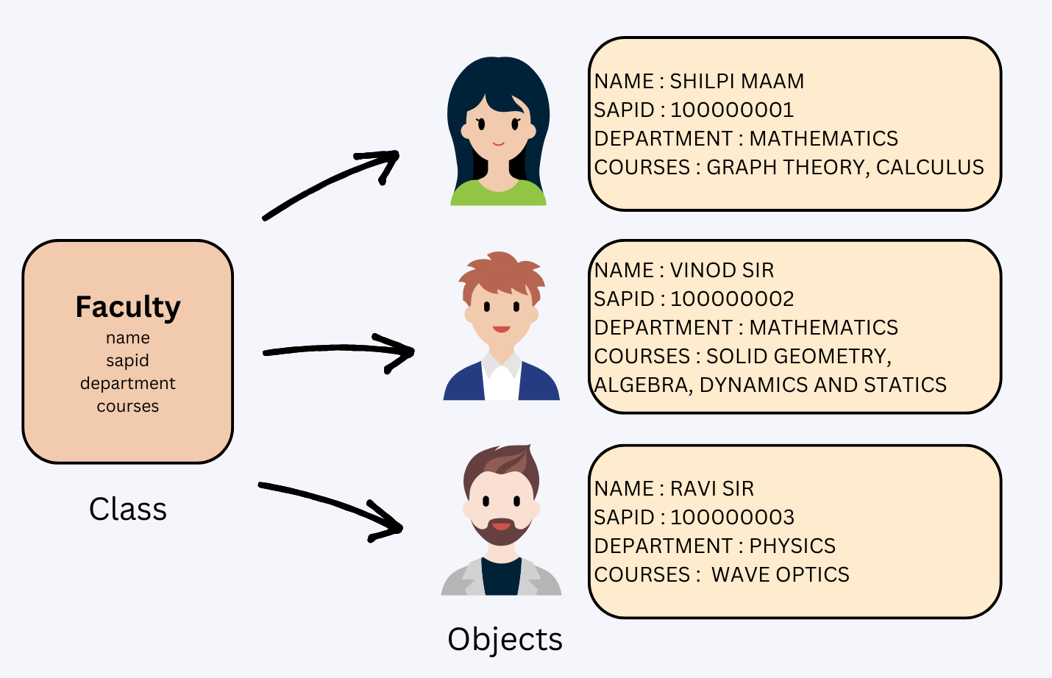
Object Oriented Programming
Classes
Blueprint for objects
Can be considered as a sketch or prototype
Objects
Instance of a class
Can create as many objects as required from a single class
Collection of:
Attributes
Data
Methods
Behaviour

Slide 12
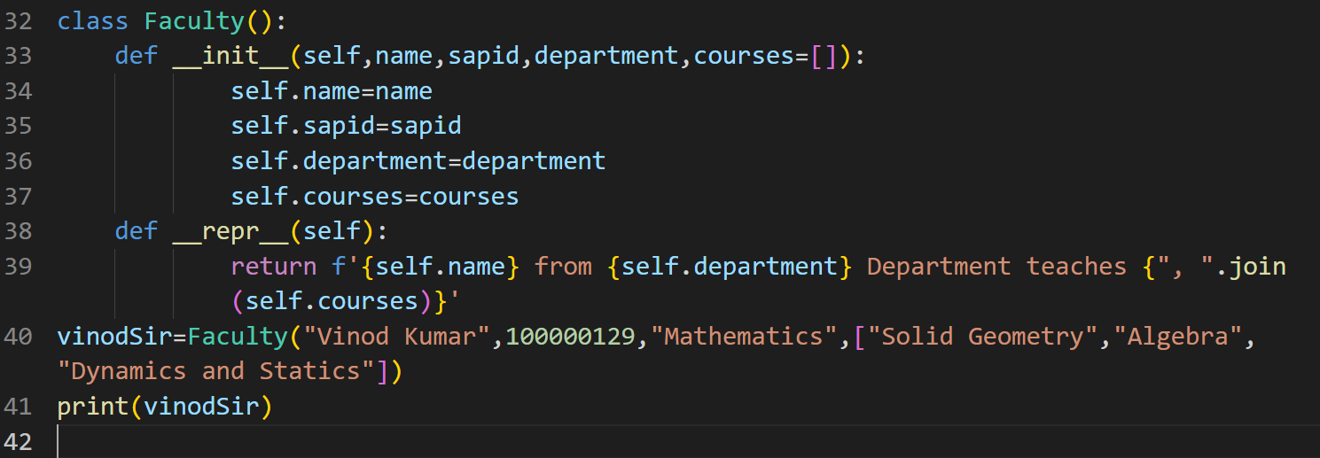
Faculty Class
Code
Output
Vinod Kumar from Mathematics Department teaches Solid Geometry, Algebra, Dynamics and Statics

Slide 13
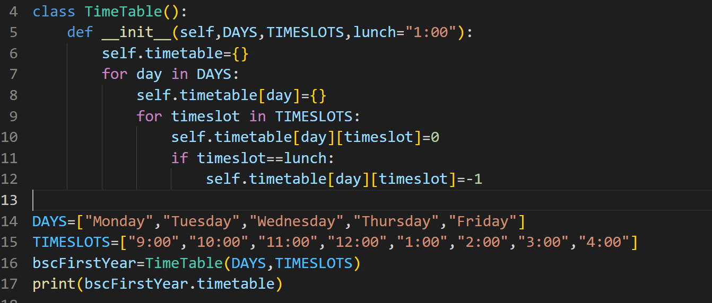
Time Table Class
Code
Output
{'Monday': {'9:00': 0, '10:00': 0, '11:00': 0, '12:00': 0, '1:00': -1, '2:00': 0, '3:00': 0, '4:00': 0}, 'Tuesday': {'9:00': 0, '10:00': 0, '11:00': 0, '12:00': 0, '1:00': -1, '2:00': 0, '3:00': 0, '4:00': 0}, 'Wednesday': {'9:00': 0, '10:00': 0, '11:00': 0, '12:00': 0, '1:00': -1, '2:00': 0, '3:00': 0, '4:00': 0}, 'Thursday': {'9:00': 0, '10:00': 0, '11:00': 0, '12:00': 0, '1:00': -1, '2:00': 0, '3:00': 0, '4:00': 0}, 'Friday': {'9:00': 0, '10:00': 0, '11:00': 0, '12:00': 0, '1:00': -1, '2:00': 0, '3:00': 0, '4:00': 0}}

Slide 14
Greedy Algorithms
An approach for solving a problem by selecting the best option available at the moment.
Doesn't worry whether the current best option will bring the overall optimal result.
Examples
Graph Theory
Kruskal's algorithm
Prim's algorithm
Use: Pick up random course and check for a time slot.

Slide 15
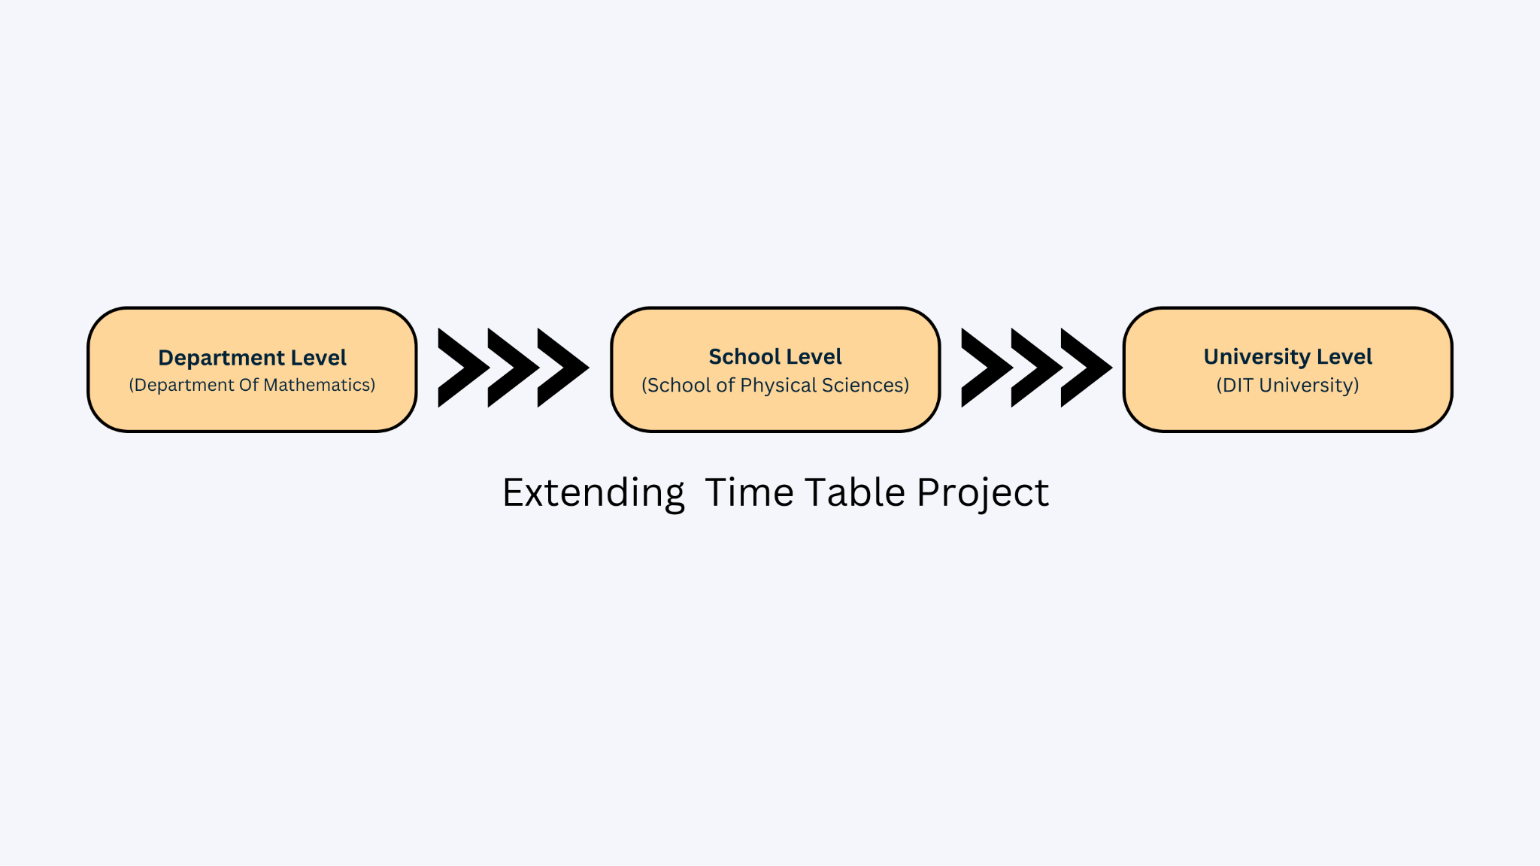
How it can be extended?

Slide 16
References
A Study on Course Timetable Scheduling using Graph Coloring Approach by Runa Ganguli and Siddhartha Roy. Link
Student Time Table by Graph Coloring Algorithm, by Baki Koyuncu. Link
Mathematical Modelling of University Timetabling: A Mathematical Programming Approach by Aizam NAH and C.Y. Liong. Link

Slide 17
THANK YOU

