Slide 1
CONNECT FOUR
Project 01
Maya Prado

Slide 2
Connect Four is a two-player connection game in which the players take turns dropping colored discs from the top into a seven-column, six-row vertically suspended grid. The pieces fall straight down, occupying the next available space within the column. The objective of the game is to be the first to form a horizontal, vertical, or diagonal line of four of one's own discs.
MVP - two-player game (both players are human) with one difficulty level, 6x7 grid, two colored disks, possibility to win and to lose.

Slide 3
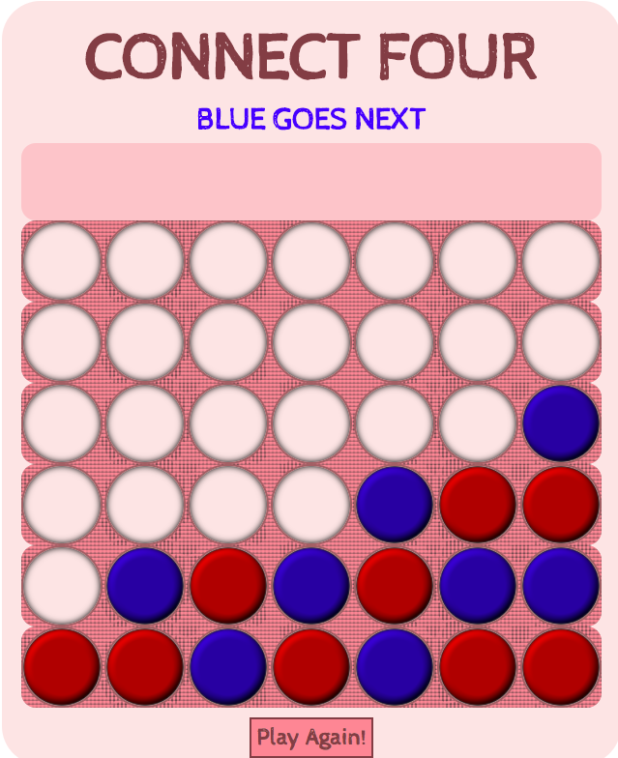
Main Challenges:
Checking for a win:
1st step – assigning id to each cell from 0 to 48;
2nd step – getting all rows columns and diags;
3rd step – checking every row, col and diag after every move to see if there are 4 disks in it of the same color;
4th step – putting id-s of those disks in an array, sorting them from biggest to smallest, subtracting every next id from the previous and looking for subtracting results combination – 111 or 777 or 888 or 666.

Slide 4
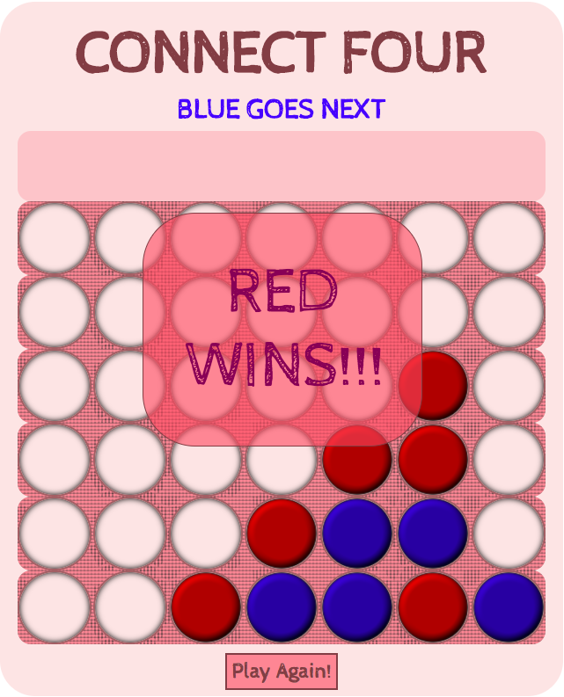
Example:
Check and see there are 4 red disks in right diag;
Push id-s of these disks into array – [26, 32, 38, 44];
Sort this array from bigger to smaller – [44, 38, 32, 26];
Map this sorted array and return only results of subtraction of every next item from the previous – [6, 6, 6];
Join this array of subtraction results into a string – 666;
Check if this string === ‘666’ for right diags, or ‘111’ for rows, or ‘777’ for cols, or ‘888’ for left diags.

Slide 5
Features in progress: 1. Computer as a second player with winning logic behind the moves; 2. Adding difficulty levels by adjusting computer’s logic; 3. Adding ability to log in and create and account for a player.

Slide 6
Thank you!

