Slide 1
Graduation Project
2023

Slide 2
Team Meet
Hafsa
Zahran
Mayar Mohamed
Bassem Mohamed
Reham Ragab

Slide 3
TABLE OF CONTENTS
1.
2.
3.
4.
Motivation Of The Project
Data Warehouse Modeling
The SQL Queries
Dashboard Analysis and Insights

Slide 4
Motivation Of The Project
Would it be better to invest in Fawry an e-payments and digital finance solution or Juhayna the food industry one?

Slide 5
1
Data warehouse Modeling

Slide 6
Logical Model

Slide 7
Business Process
Stock Market Analysis & Portfolio Recommendations.

Slide 8
Granularity
Daily:
For the Stock Price
Yearly:
For the Financial reports
Per each company:
For the Summery data.

Slide 9
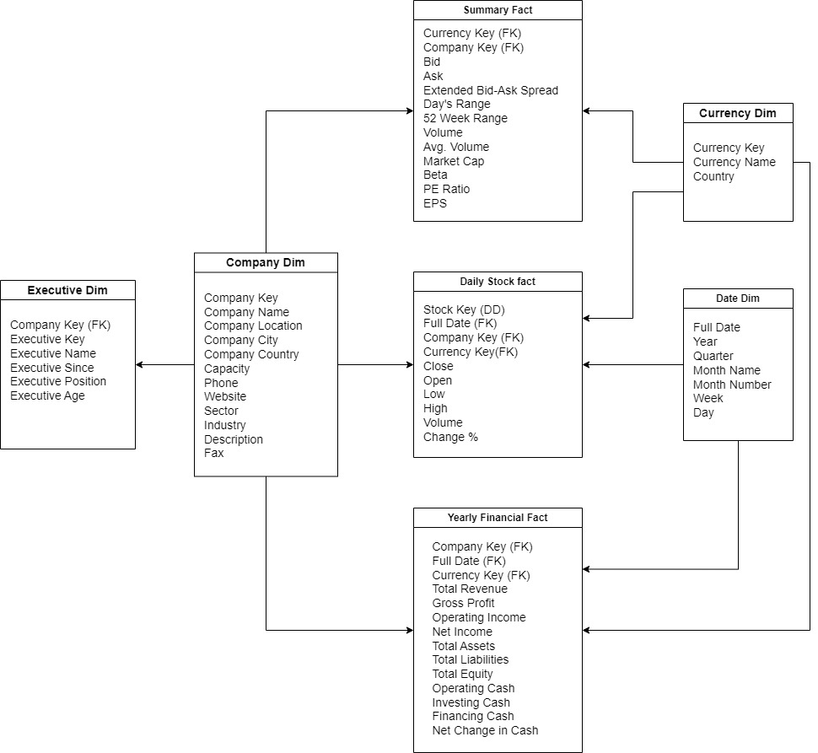
Dimensions & Facts

Slide 10
Physical Model

Slide 11
2
The SQL Queries

Slide 12
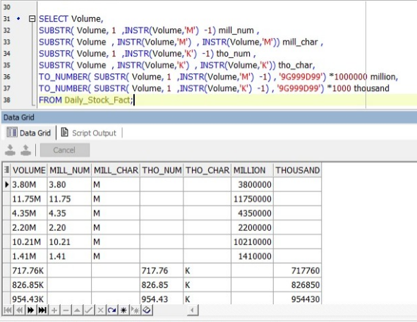
Query (1)
Problem description:
Notes:
The volume column within the summery fact has been represented in the form of K and M.
So in order to be able to turn it into number we had to split the text symbol and do some multiplication and update.

Slide 13
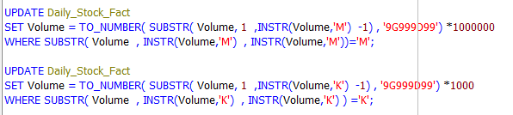
Query (1)
Code:

Slide 14
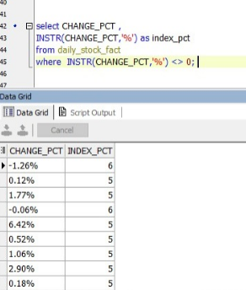
Query (2)
Problem description:
We needed to remove the % sign from change_pct column in order to cast it to integer.

Slide 15
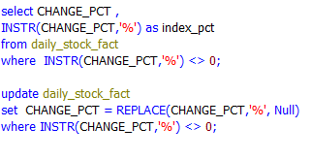
Query (2)
Code:

Slide 16
Query (3)
Problem description:
Does the stock can be bought and sold easily between the seller and buyer ?

Slide 17
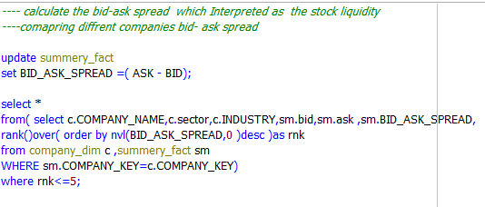
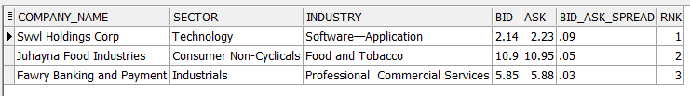
Query (3)
Code:

Slide 18
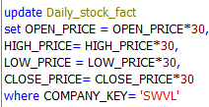
Query (4)
Problem description:
SWVL currency is USD and we need to convert it to EGP.
Code:

Slide 19
Query (5)
Problem description:
What is the 5 higher and lower prices the stock have recorder?

Slide 20
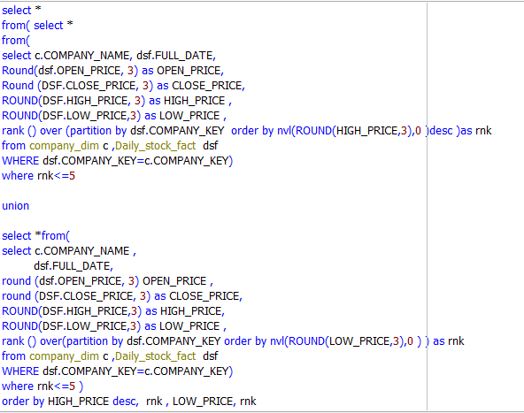
Query (5)
Code:

Slide 21
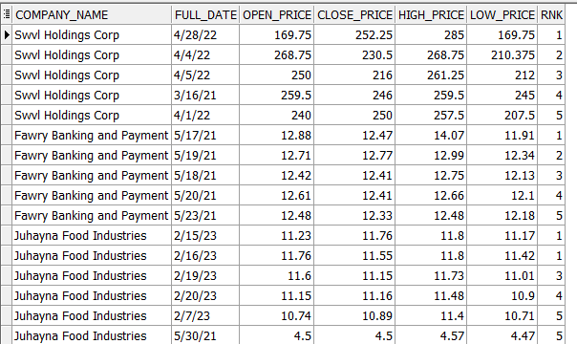
Query (5)
Output:

Slide 22
Query (6)
Problem description:
What is moving average so we can indicates whether there is an uptrend or downtrend?

Slide 23
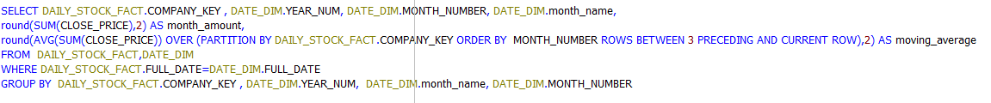
Query (6)
Code:

Slide 24
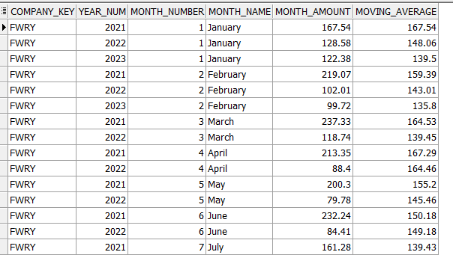
Query (6)
Output:

Slide 25
3
The Dashboard

Slide 26
Thank You

