Slide 1
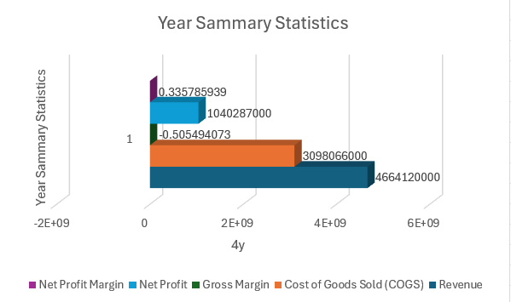
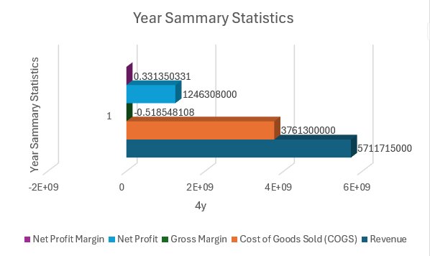
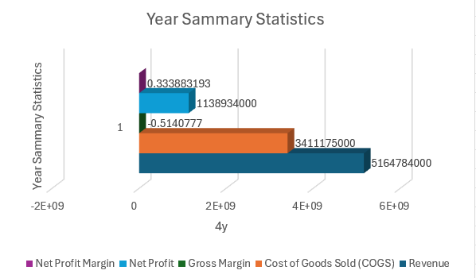
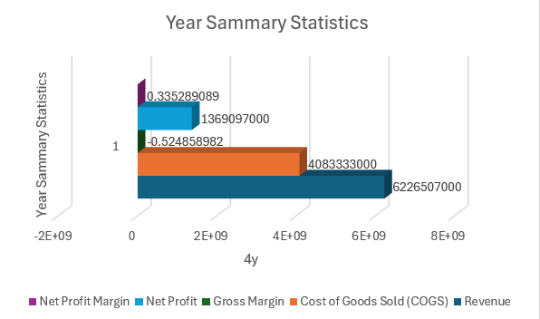
1. How has the revenue of TSCO company changed over the years?
Year 1
Year 3
Revenue Trend: Over the 4 years, the company experienced a strong growth in revenue from Year 1 to Year 3 with consistent increases in each year. However, in Year 4, there was a decline in revenue.
Possible Insights: The drop in revenue in Year 4 could suggest changes in market conditions, competition, or other external factors that impacted the company’s performance. Further investigation into the cause of this decline may be needed for a deeper understanding.
Year 2
Year 4

Slide 2
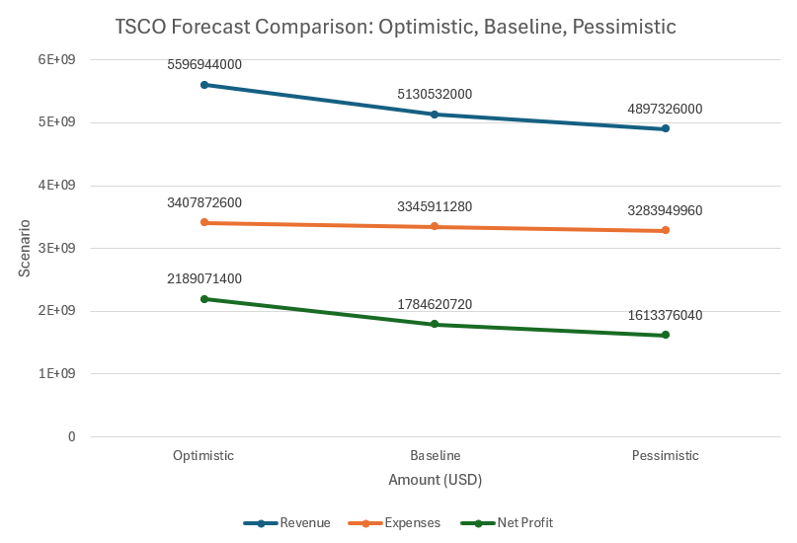
Please make a copy!
File -> Make a Copy
Remember to include your workbook and this presentation in your submission!

