Slide 1
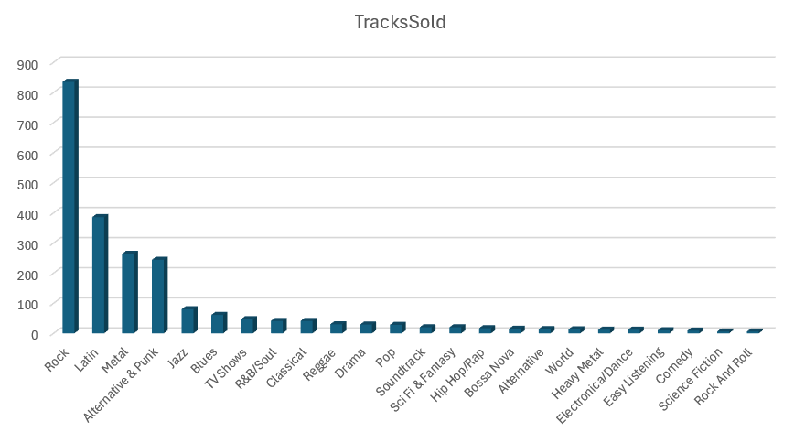
Which music genres are the most popular based on the number of tracks sold?
Most Popular Genres: The most popular genre is Rock, with 835 tracks sold, followed by Latin (386) and Metal (264), demonstrating a strong preference for Rock and related genres among customers. Less popular genres like Easy Listening, Comedy, and Science Fiction show significantly lower sales, with fewer than 10 tracks sold.

Slide 2
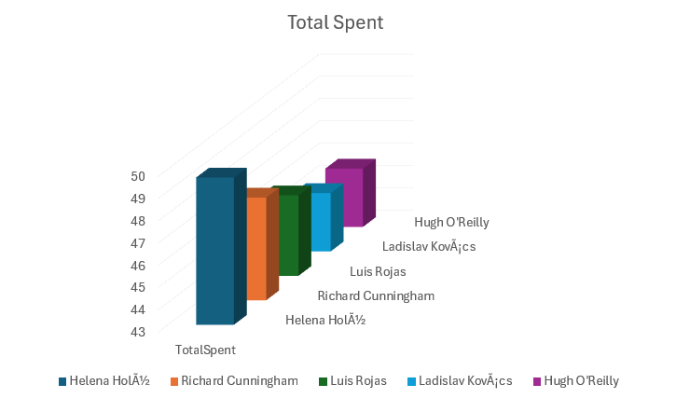
Who are the top 5 customers based on total spending?
Top Customers: The top customer, Helena Holý, spent the most at $49.62, closely followed by Richard Cunningham ($47.62) and Luis Rojas ($46.62). The top five customers collectively represent significant contributors to total revenue.

Slide 3
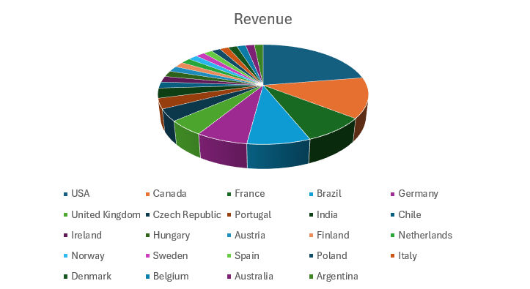
What is the total revenue generated in each country?
Total Revenue by Country: The USA leads in revenue generation with $523.06, followed by Canada ($303.96) and France ($195.10), reflecting strong sales in North America and parts of Europe. Other countries like Argentina and Australia contribute lower revenue at $37.62 each, indicating varied customer activity across regions.

Slide 4
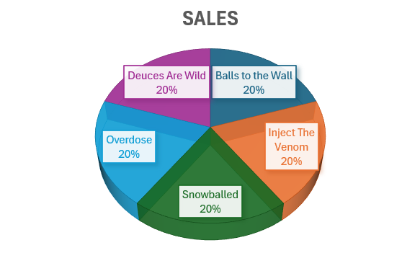
What are the top 5 most sold tracks?
Top 5 Most Sold Tracks: The most sold tracks, including "Balls to the Wall," "Inject The Venom," and "Snowballed," each recorded 2 sales, highlighting a relatively even distribution of track popularity with no standout track dominating sales.

