Slide 1


Digital Freelancer:
Managing Freelancing Projects
Project: Working with a Mock Client

Slide 2
Part 1
Project Listing

Slide 3
Sample Project Listing #1: Web Development
Web application development support needed for healthcare application.
Posted 2 hours ago
Hourly: $35.00 - $65.00 Based on experience.
Project Time: 3 months, 25 hours a week.
Project Description:
We are a web development company working with a healthcare client looking to connect patients directly with their doctors. We need someone to be able to take PSD mockup files from our designer and convert them into custom code using HTML, CSS, and JavaScript. We have not decided on which JavaScript library to use, but will be open to working with the one you’re most familiar with. We have the designs for 10 pages and will need them to be completed in 3 months. We are open to working with all levels of experience, but the pay will be adjusted based on your experience.

Slide 4
Part 2
Expression of Interest

Slide 5
Expression of Interest
Write an initial expression of interest (EoI) to the client:
Now that you’ve understood what the client is asking for, it’s time for you to reach out to them.
Write out an EoI message addressing their requirements as well as how you can help them.
This message will be their first impression of how you communicate with them, so it is good to be professional.
Please keep word limit between 200 - 300 words.

Slide 6
Expression of Interest (Provided)
Which Sample Project Listing did you select to respond to?
Answer:
Please type your initial response to the client below. This should be between 200 - 300 words.
Expression of Interest:
Subject: Application for Web Development Support Role
Dear Client,
I hope this message finds you well. I am writing to express my interest in collaborating with your team on the healthcare application project. With over a year of experience in web development, I specialize in converting design concepts into dynamic, user-friendly interfaces using HTML, CSS, and JavaScript. Your mission to connect patients with doctors is inspiring, and I am excited about contributing to this innovative solution.
To ensure a smooth development process, I propose adopting an Agile methodology. Using this approach, I will deliver the 10 web pages in iterative cycles, enabling timely feedback and adjustments. I will also ensure that the application is optimized for performance, responsive across devices, and accessible to all users. If required, I can assist in selecting and integrating the most suitable JavaScript library based on your project's scalability and performance needs.
My expertise includes working with PSD mockups to create responsive and accessible web pages. I am proficient in JavaScript and comfortable adapting to various frameworks and libraries, ensuring flexibility based on your project's needs. I propose creating a structured plan to deliver the 10 pages within the specified timeline of three months. Each page will be optimized for both functionality and user experience, adhering to industry best practices in web development.
My ability to convert designs into functional web pages, coupled with my commitment to meeting deadlines and maintaining high-quality standards, makes me a strong candidate for this role. I am confident in my ability to deliver a healthcare application that not only meets but exceeds your expectations.
I would love the opportunity to discuss this project further and demonstrate how I can assist in achieving your goals. Thank you for considering my application, and I look forward to hearing from you.
Best regards, Mayar Amein [Your Contact Information]

Slide 7
Part 3
Project Management Process

Slide 8
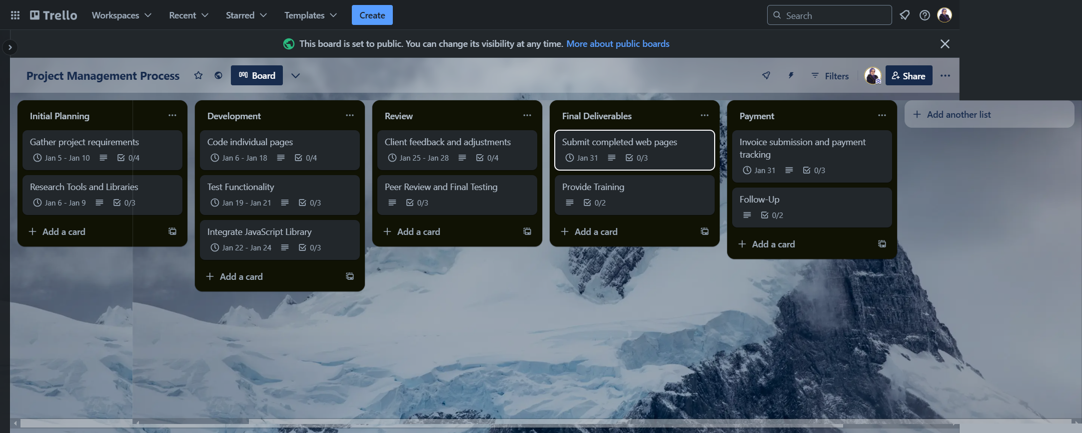
Trello Board
Please include the following information for your Trello board:
A link to your public Trello board should be provided here:
https://trello.com/b/RIcDTsCI/project-management-process
Include a screenshot of the board below:

Slide 9
Part 4
Invoice and Payment Options

Slide 10
[Your Full Name or Your Company Name]
[Your Address or Address Your Company is Registered to]
Invoice
Recipient:
[Company/Client Name]
[Client Address]
Invoice #: 001
Date issued: 05 Jan 2025
Date due: 05 May 2025
Total Payment Due: $5,250.00
Payment Methods: Bank Transfer
Bank Transfer: Bank Name: [Your Bank Name] Account Name: [Your Account Name] Account Number: [Your Account Number] SWIFT Code: [SWIFT Code]
Service | Description of Work Done | Hours Spent | Amount Per Hour | Total
Page Development (HTML/CSS/JS) | Converting PSD mockups into responsive, fully functional web pages using HTML, CSS, and JavaScript. Delivered 10 pages as per project specifications. | 75 | 50 | 3750
Revisions/Client Adjustments | Addressing client feedback, implementing design changes, and refining functionality across all 10 pages to meet client expectations. | 10 | 50 | 500
Testing and Debugging | Conducting functionality testing, debugging errors, and ensuring compatibility across different browsers and devices for a seamless user experience. | 15 | 50 | 750
Final Deployment Assistance | Assisting with the final deployment of the web application, including transferring files to the production server and ensuring proper functionality. | 5 | 50 | 250

