Slide 1



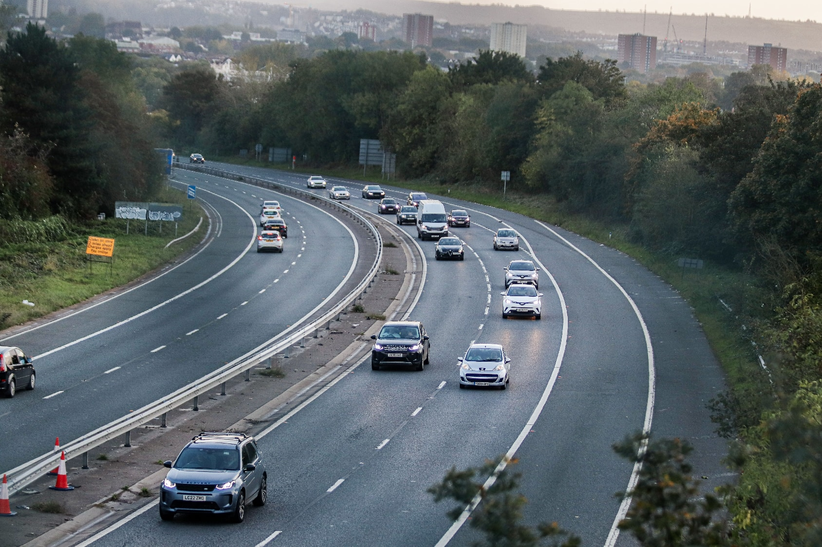
UK Road Accident Severity: Predicting KSI Outcomes
SIC – AI801
Notes:
Note:
1

Slide 2

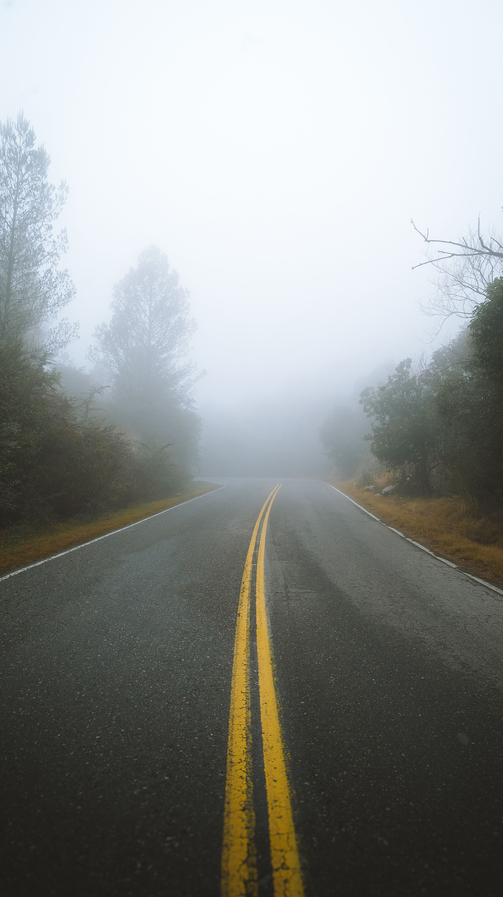
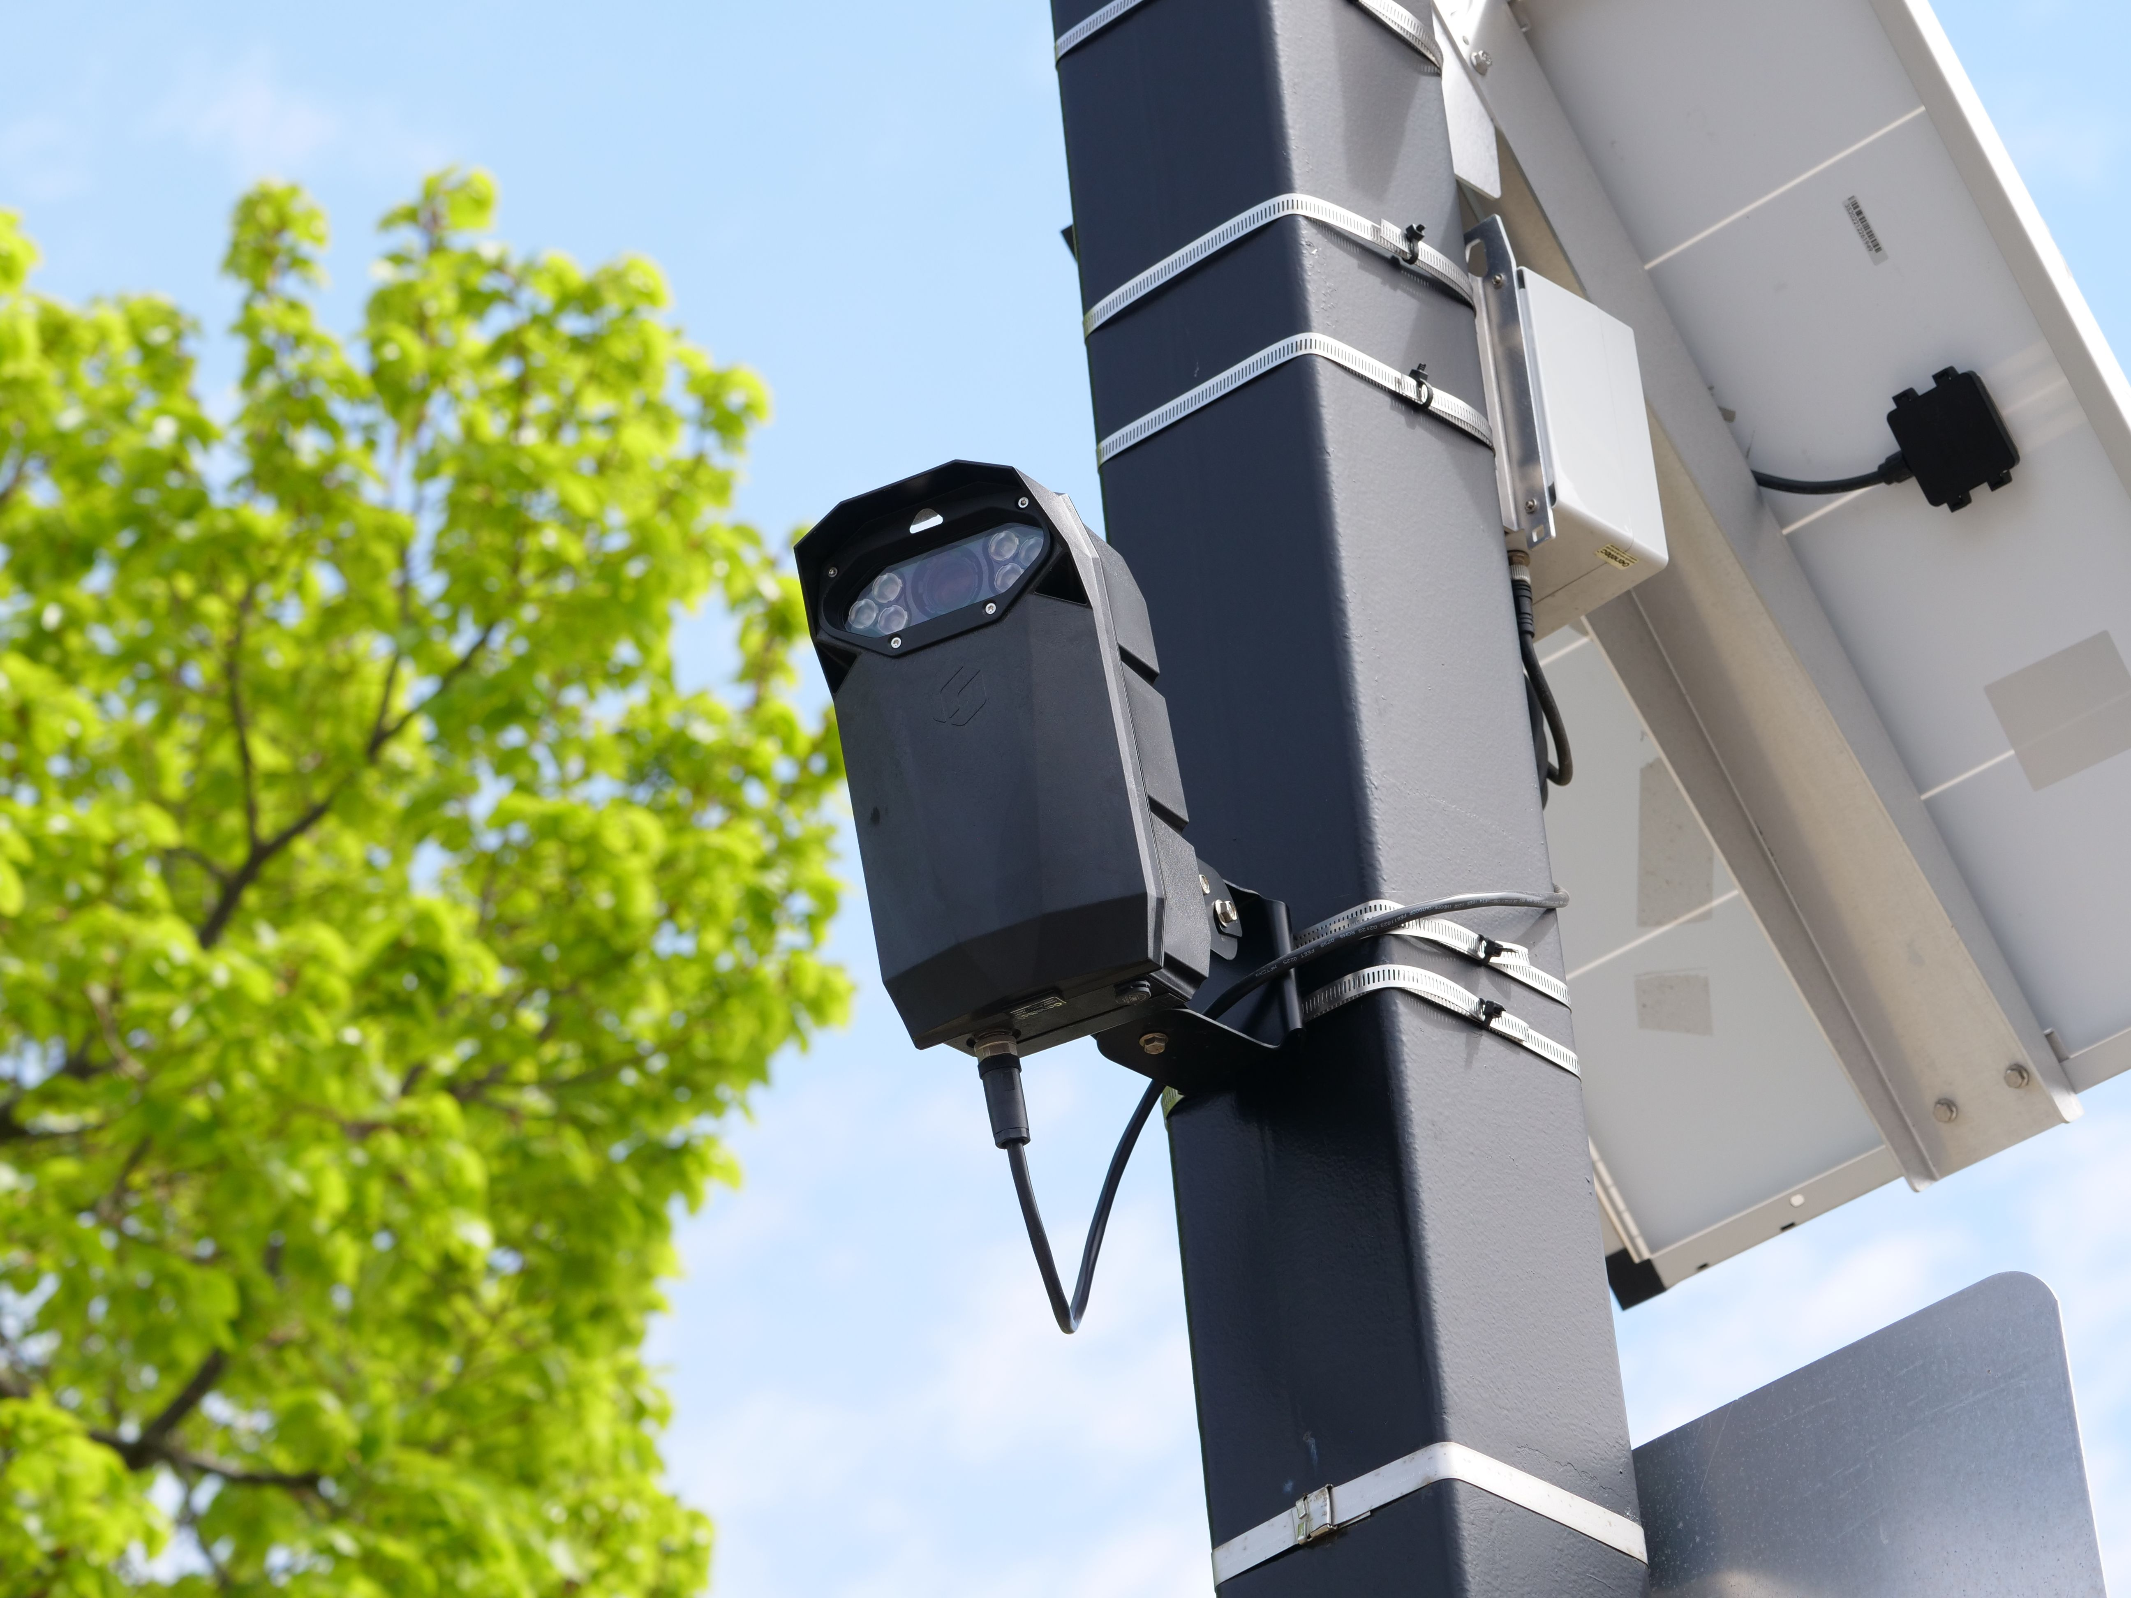
MACHINE LEARNING · SEPTEMBER 2026
UK Road Accidents
Severity (KSI) Prediction
Data-Driven Insights into Accident Severity & Road Safety

Slide 3




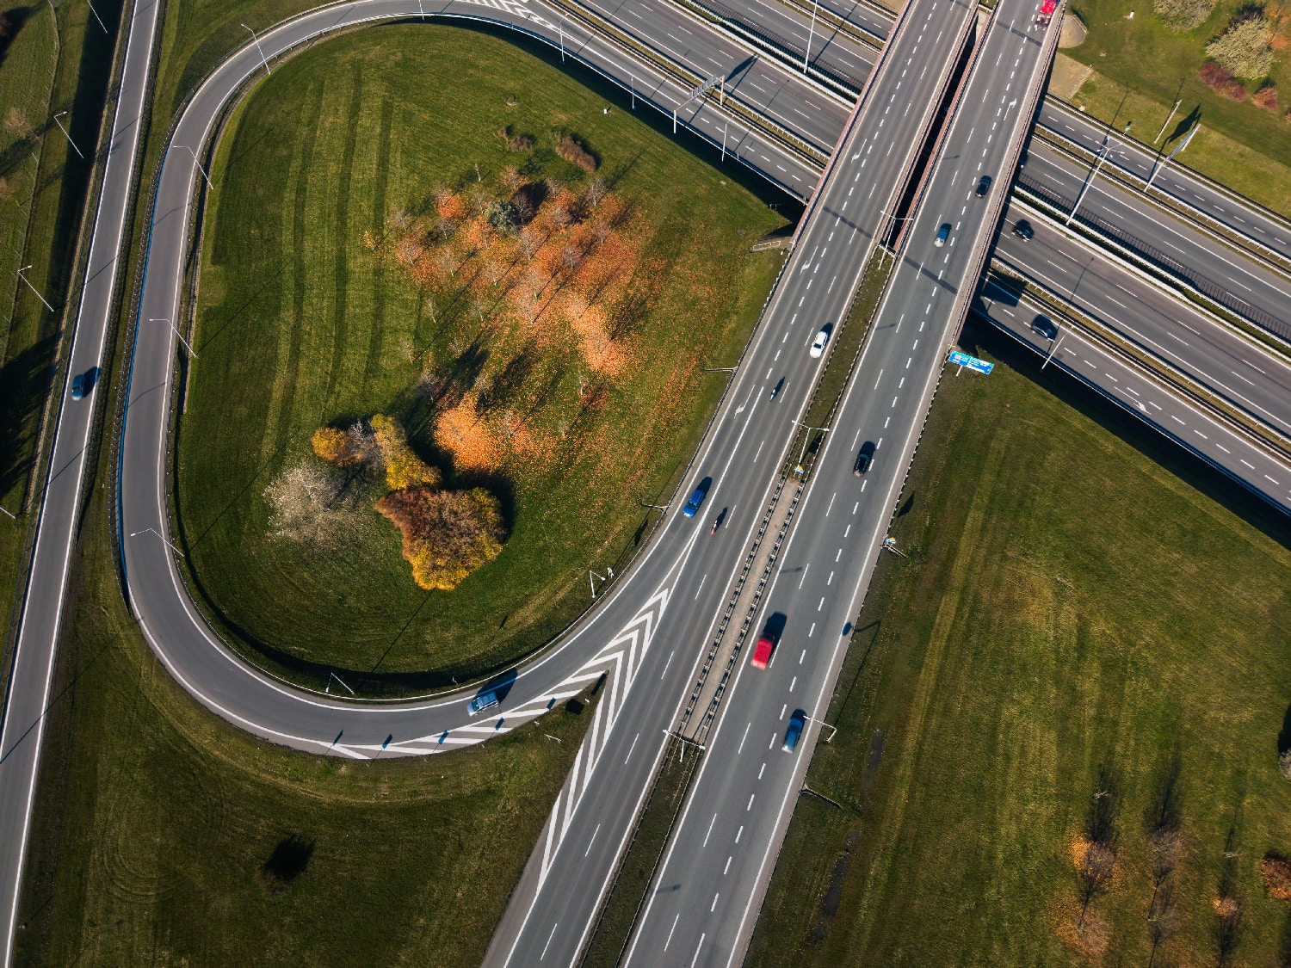
Team Members
Islam Mohamed Fathy
Mayar elaraby
Moataz Sameh Shehata
Youssef Elkess Toma
Road Safety · Data Analyst · Machine Learning

Slide 4
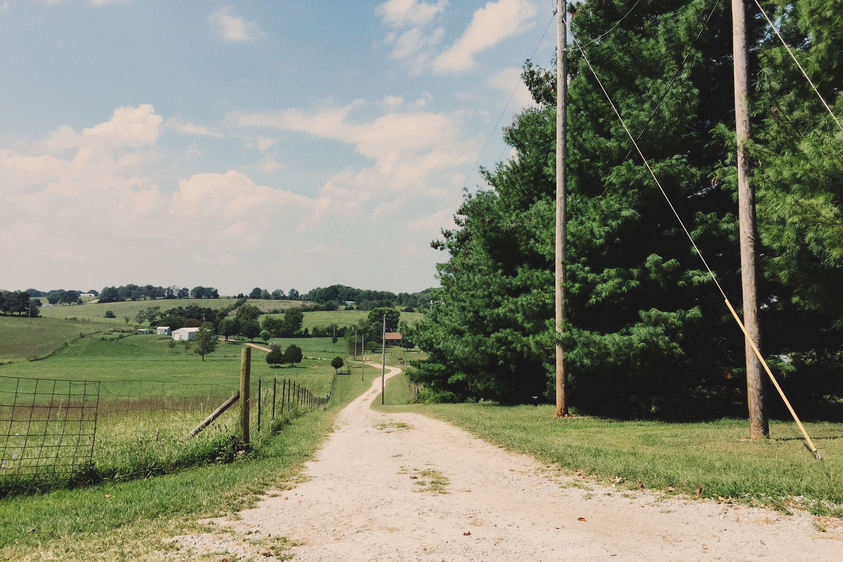

AGENDA
What We'll Cover
01
Business Problem
Why road safety needs a data-driven lens
02
Data & Cleaning
From 122,635 raw accidents to an analysis-ready dataset
03
Key Insights
What actually drives accident severity
04
Model & Evaluation
Comparing models and validating performance
05
Recommendations
Turning findings into road-safety actions
2

Slide 5



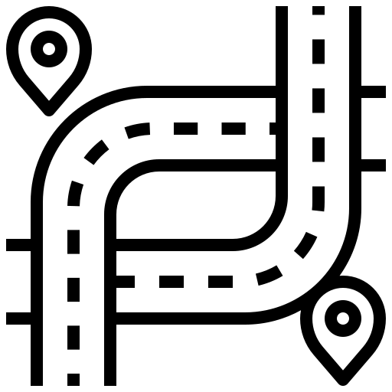

THE CHALLENGE
Business Problem
Road-safety decisions need to be grounded in data, not intuition alone.
Road safety authorities and transport planners face one core question: what actually makes an accident severe? Without a clear answer, safety investment defaults to guesswork.
SPD
HR
Speed Limit
Time of Day
Analysis Goal
?
RD
WX
Explore how speed, time of day, weather, road type, and driver/vehicle factors relate to accident severity (KSI), and quantify which matter most.
Road Type
Weather/Light
3

Slide 6
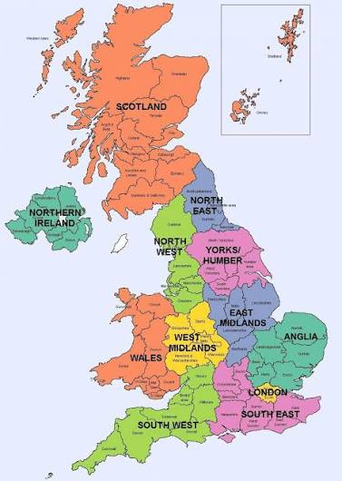




Dataset Overview
122,635 UK road accidents (2018 STATS19), merged with vehicle data.
122,635
226,409
Accidents recorded
Vehicle records merged
Accident-level features
Speed_limit
Road_Type
Light_Conditions
Weather
39
Urban/Rural
Local_Authority
Vehicle-derived features
Features after merging
Year covered (STATS19)
Driver_Age
Engine_CC
Veh_Count
Vehicle Age
Male Drivers
Each row represents one accident record — the unit of analysis throughout this deck.
4

Slide 7
PREPARATION
Data Cleaning Process
Six steps turned raw, messy accident/vehicle records into an analysis-ready dataset.
Standardize identifiers
Impute missing specs
Accident_Index unified from mixed types (str/int)
avg_driver_age, max_engine_cc, avg_vehicle_age filled via IterativeImputer (Decision Tree)
Aggregate vehicle data
Flag missingness
One-to-many Vehicles data aggregated (avg driver age, engine cc, etc.) before merging
3 missing-value flags added — absence itself correlated with higher severity
Drop unusable rows
Correct invalid values
Rows missing coordinates or time removed; sparse columns dropped
Engine CC > 10,000 and driver age < 15 treated as errors, set to missing
5

Slide 8

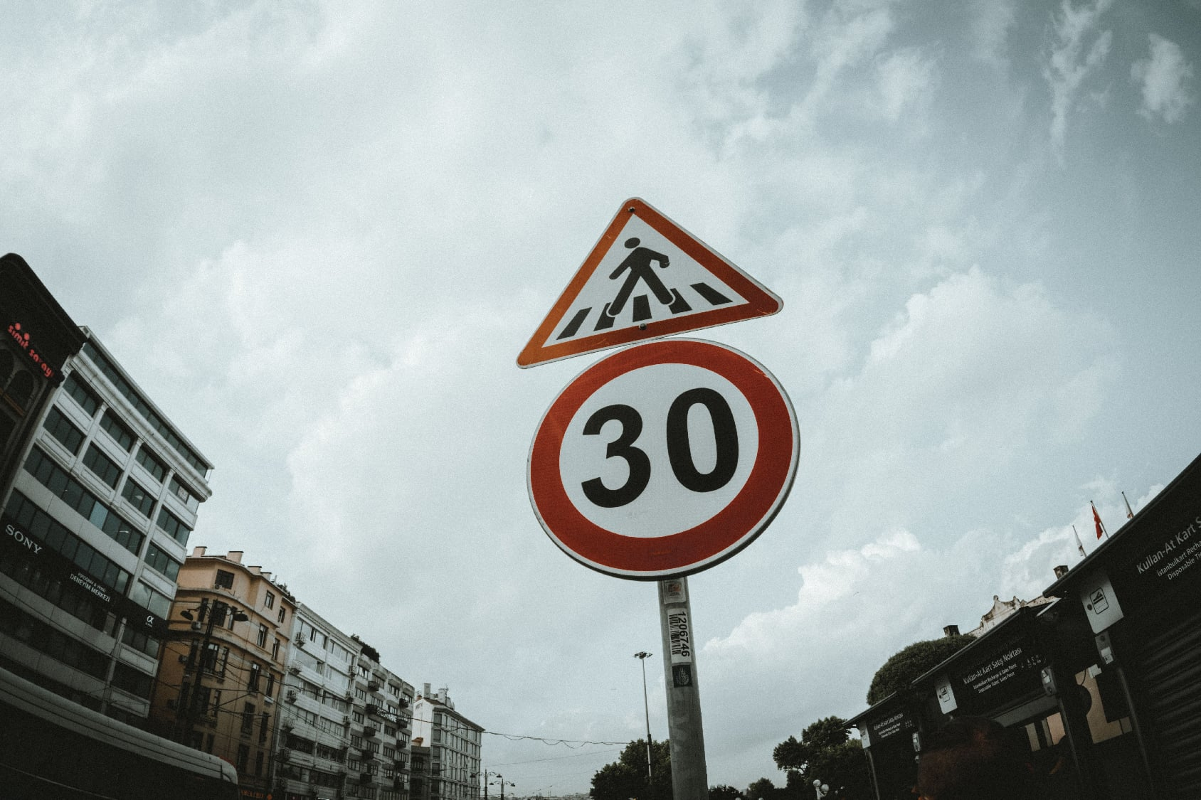

FRAMING THE ANALYSIS
Key Questions & Hypotheses
Five questions guided every chart and test in this analysis.
Does a higher speed limit increase accident severity?
Is there a day/night effect on how severe accidents are?
Do rural roads see more severe accidents than urban roads?
Does poor lighting or bad weather raise severity risk?
What are the strongest predictors of severity overall?
6

Slide 9
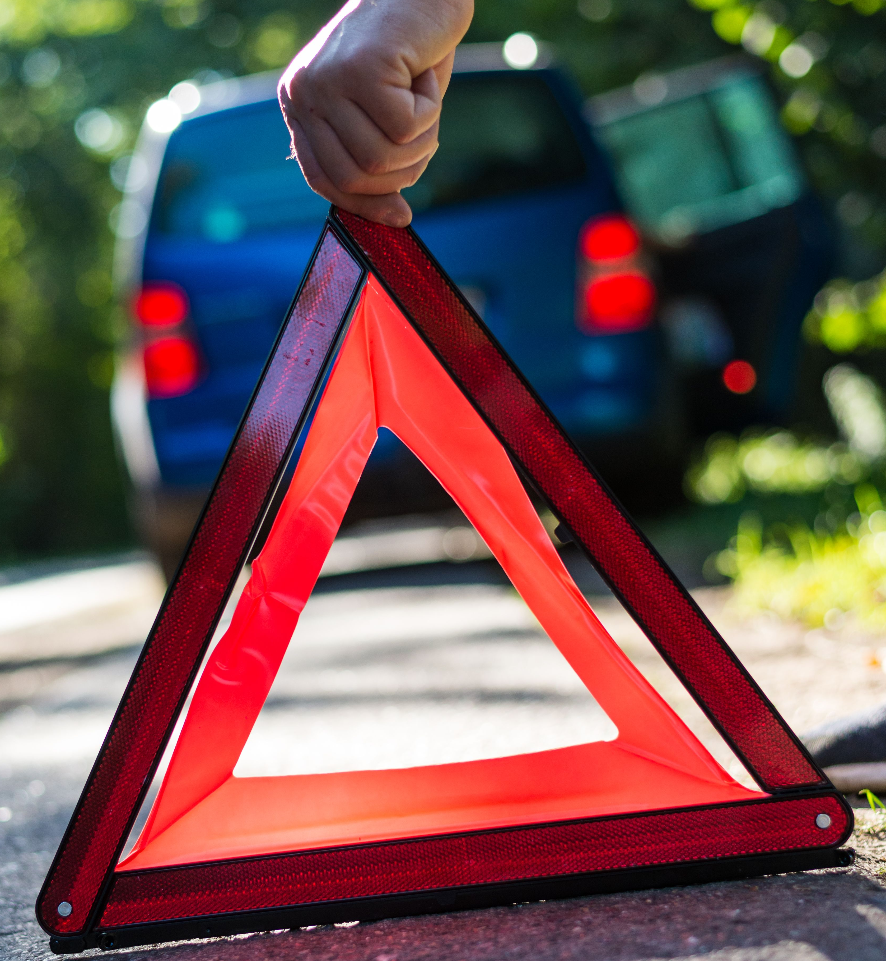

STATISTICAL FOUNDATION
Correlation Insight
Urban/Rural area and Speed limit show the strongest (though still weak) links to KSI risk.
is_KSI
Speed_limit
Urban/Rural
Casualties
Veh. Count
Male Drivers
is_KSI
1.00
0.07
0.08
0.07
-0.07
0.04
Speed_limit
0.07
1.00
0.68
0.16
0.12
0.13
Urban/Rural
0.08
0.68
1.00
0.14
0.07
0.08
Casualties
0.07
0.16
0.14
1.00
0.22
0.14
Veh. Count
-0.07
0.12
0.07
0.22
1.00
0.54
Male Drivers
0.04
0.13
0.08
0.14
0.54
1.00
Weak correlation (|r| < 0.5)
Strong correlation (|r| ≥ 0.5)
7

Slide 10
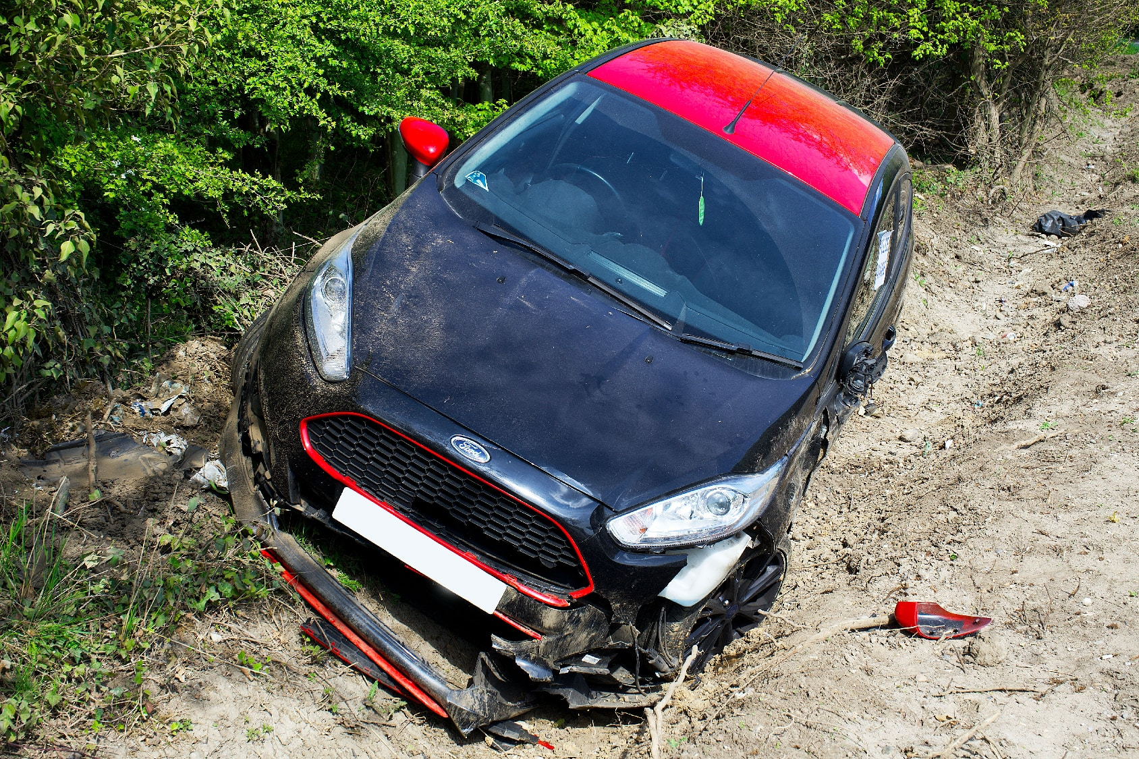
HYPOTHESIS TEST
Rural Roads Carry More Risk
Rural accidents are significantly more likely to be severe than urban ones.
18.0%
1.4x
24.9%
KSI rate — Urban roads
KSI rate — Rural roads
Rural vs urban KSI rate
Reading the result
Accidents on rural roads are about 1.4x more likely to be KSI than on urban roads (24.9% vs 18.0%), consistent with higher rural speeds, longer emergency-response times, and less-controlled junctions.
8

Slide 11
VISUALIZATION
KSI Rate by Speed Limit
KSI rate rises with speed limit up to 60 mph, then drops on 70 mph roads.
29.2%
Peak KSI rate at
60 mph roads
KSI rate drops on 70 mph roads despite the higher speed limit, suggesting that speed limit alone does not explain severity.
9

Slide 12
VISUALIZATION
KSI Rate by Hour of Day
Late-night accidents are less frequent but far more likely to be severe.
The night effect
KSI rate rises from a low of ~15% around 8 AM (rush hour) to a peak of ~29% at 2-4 AM.
Fewer accidents happen at night, but darkness, fatigue, and higher speeds make the ones that do happen more severe.
10

Slide 13
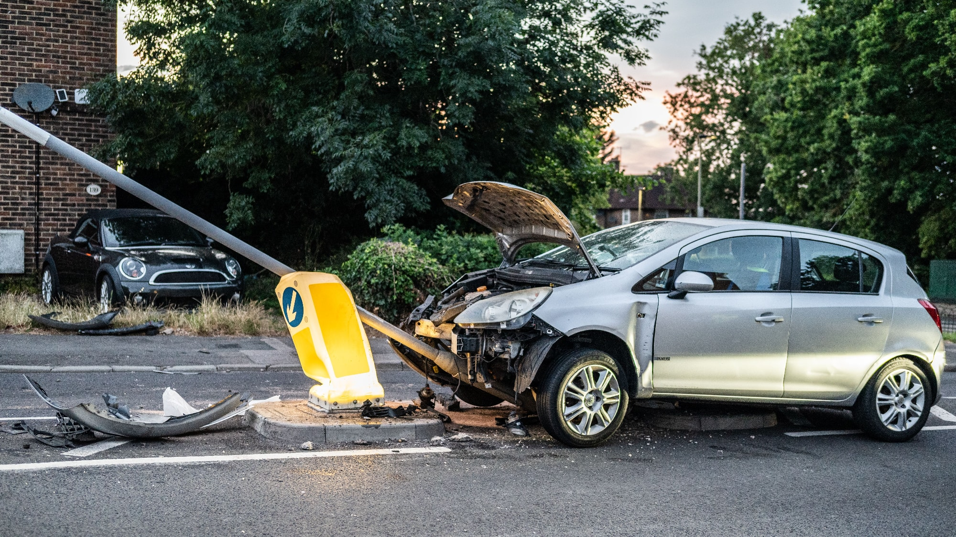
VISUALIZATION
Top Predictors of Accident Severity
Vehicle count, road authority, and area type rank above raw driver/vehicle specs.
UK Road Accidents — Severity (KSI) Prediction
11

Slide 14
VISUALIZATION
KSI Rate by Lighting Conditions
Unlit darkness carries the highest severity risk of any lighting condition.
Highest risk: Unlit darkness
Unlit darkness
KSI rate climbs steadily as lighting worsens: 19.3% in daylight, 21.2% under lit darkness, and 31.0% in unlit darkness — the single highest KSI rate of any category studied.
Lit darkness
Daylight
31.0%
Recommendation: prioritize street-lighting upgrades on unlit rural and semi-rural roads.
19.3%
21.2%
12

Slide 15
VISUALIZATION
Weather & Severity
Fog and mist show the highest KSI rate; heavy weather adds risk beyond fine conditions.
13

Slide 16
VISUALIZATION
Urban vs. Rural Accidents
Most accidents happen in urban areas, but rural accidents are more often severe.
67%
of accidents occur in urban areas
Why it matters
Urban roads see more accidents overall, but rural roads have a meaningfully higher KSI rate (24.9% vs 18.0%) — safety investment should not follow accident volume alone.
14

Slide 17
AT A GLANCE
Dashboard Summary
Urban vs. Rural Split
KSI Rate by Speed Limit
Top Severity Predictors
KSI Rate by Hour
15

Slide 18
Model & Evaluation
Comparing models and validating performance
Model | Accuracy | Percision | Recall | F1 | Roc AUC | PR AUC
XGBoost (Tuned) | 0.643 | 0.3088 | 0.615 | 0.4112 | 0.686 | 0.3538
LightGBM (Tuned) | 0.641 | 0.3067 | 0.6124 | 0.4087 | 0.685 | 0.3528
LightGBM | 0.6427 | 0.3081 | 0.6140 | 0.4103 | 0.6839 | 0.3512
Random Forest | 0.7217 | 0.3441 | 0.4132 | 0.3755 | 0.6715 | 0.3355
Logistitic Regression | 0.6038 | 0.2836 | 0.6267 | 0.3905 | 0.6591 | 0.3198
XGBoost | 0.6357 | 0.2902 | 0.5528 | 0.3806 | 0.6473 | 0.3281
Decision Tree | 0.6281 | 0.2919 | 0.5866 | 0.3898 | 0.6459 | 0.3021

Slide 19
SYNTHESIS
Key Findings Summary
Seven takeaways from the analysis, ranked by relevance to road safety.
Speed limit and road type are the strongest behavioral drivers of severity.
KSI rate peaks at night (2-4 AM) despite lower accident volume.
1
2
Rural roads have a significantly higher KSI rate than urban roads (24.9% vs 18.0%).
Unlit darkness carries the highest severity risk of any lighting condition (31.0%).
4
Linear correlations with is_KSI are all weak — severity depends on non-linear, categorical patterns.
Tree-based models (XGBoost, LightGBM) outperform Logistic Regression on this data.
6
Tuned XGBoost is the final model (ROC-AUC 0.686), threshold lowered for ~75% recall.
7
16

Slide 20
TURNING INSIGHT INTO ACTION
Business Recommendations
Four moves to translate the analysis into road-safety strategy.
Target high-risk speed zones
Prioritize rural road safety
60
Increase enforcement and review limits where KSI rate is highest (60 mph roads).
Fund safety audits, signage, and emergency-resource allocation for rural roads.
Increase night patrols
Use the model as a decision tool
2AM
Add lighting and patrols during the 12 AM–4 AM peak-risk window.
Rank locations by predicted KSI risk to prioritize limited safety budgets.
17

Slide 21
LOOKING AHEAD
Limitations & Next Steps
Findings are associations from one year of data, not proven causation.
LIMITATIONS
NEXT STEPS
Trained on a single year (2018) of UK data — revalidate before applying elsewhere.
Pilot any intervention (e.g. a speed-limit change) before full rollout.
Revalidate the model against more recent years and other regions.
Precision is low (~28-31%) at the chosen threshold — many false alarms alongside true detections.
Use the model alongside expert judgment, not as a sole decision-maker.
18

Slide 22
Thank You
Questions & Discussion
Road Safety · Data Analyst · Machine Learning
UK Road Accidents — Severity (KSI) Prediction | September 2026

