Slide 1
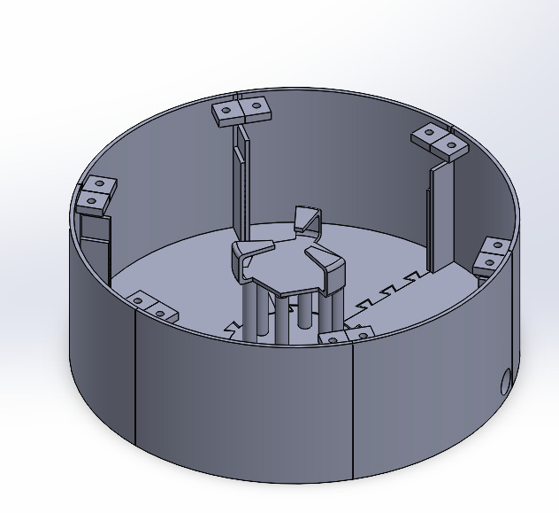
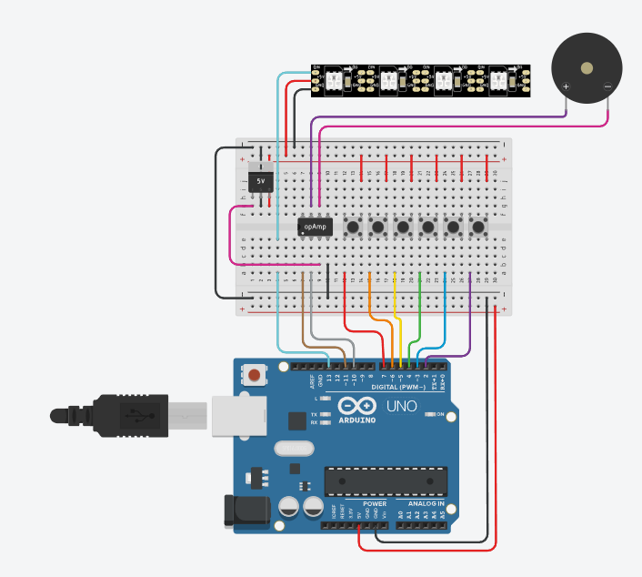
BRIGHT Learn
Building Responsive Interactions for Growth, Healing, and Therapeutic Learning
Mayari Merchant, John Board, Ph.D.
Duke University - Electrical & Computer Engineering
Motivation
Physical Casing
Conclusion
There are many benefits to using light, music, and color in stimulating children with developmental disabilities.
The client, Marin Merchant, is a 12-year-old child with special needs, who is learning the colors during occupational therapy. She has trouble with fine motor skills, including dexterity with her fingers and movement-to-target accuracy. This project aims to use a combination of music and lights to teach Marin the colors, while challenging her coordination.
One problem with existing methods of teaching Marin the colors is the lack of interaction. Thus, a feedback input and output system was prioritized in the design.
Marin’s parents proposed the creation of a toy that integrates motor skills, decision-making, problem-solving, and color recognition. They expressed desire to make the toy robust against physical force, easy to turn on and off, and to not be battery-powered. They also suggested an element of familiarity be included.
A modular design for the base of the toy was created, for ease of 3D printing (Fig 2).
The lid was laser-cut from wood, with acrylic “windows” press-fit into each section to display the LED strip lights inside. The lid was painted such that each segment had an associated color.
Colored push-buttons were mounted into holes in the lid, allowing external input to system.
Issues included tolerancing the edges and corners, modifying the design for new components as they were added, adjusting the height. Iterative design was essential to creating a viable final product.
In order to make the speaker more audible, a column was introduced, with a stand for the speaker to sit on. A hollow cylinder (not pictured) was fit over it to further amplify the sound.
Threaded inserts were heat-set into slots in each segment, so that bolts were not needed when screwing down the lid, facilitating removing and replacing the lid for maintenance as necessary.
In
Design
Figure 1: 3D Model assembly of components making the base of the part. Parts were individually 3D-printed, then press-fit together, then the cracks were sealed using a soldering iron.
Future Directions
Slot for screw to fit in to hold down lid
Additional considerations for future iterations of this project:
Waterproofing design with a sealant
Alternate versions of the arcade-style buttons would be used that have LEDs
A volume knob, possibly realized using a potentiometer, could be implemented for comfort of the client’s parents.
On-off switch to power device off without unplugging
Space for LED strip to fit in
Stand for speaker
Dovetail jointing mechanism
Circuitry & Connectivity
Slot for power cord
An Arduino Mega 2560 was selected as the microcontroller due to its large number of pinouts for greater connectivity (Fig 1).
Input from pushbuttons signals the Arduino to light up LEDs with appropriate color and trigger audio event corresponding to the color.
Audio is produced via a TX/RX SD-card reader that communicates with the Arduino to select an .mp3 file and play it from speaker.
This audio output is routed through the LM386 amplifier to speaker for a more robust sound.
The LED strip was noted to draw up to 2A of current, which exceeds the Arduino pinout capability. Thus an L7805 voltage regulator was introduced to provide an additional power source independent of the Arduino.
Code used to program the Arduino is available at https://github.com/mayarim/BRIGHT-Learn
Figure 2: Block diagram of circuit components:
8 Ohm Speaker
References
Tricolor LED Array
https://docs.arduino.cc/hardware/mega-2560/
https://github.com/FastLED/FastLED/
https://github.com/salvadorrueda/SerialMP3Player
https://www.ti.com/lit/ds/symlink/lm386.pdf
https://www.st.com/resource/en/datasheet/l78.pdf
Array of pushbuttons (colors not pictured)
L7805 5V Voltage Regulator
Acknowledgements
SD-card reader & LM386 Audio Amplifier
Marin Merchant for motivation and encouragement.
Sarika and Birju Merchant for proposing the idea.
Mohamed Ismail for advice with CAD tools and brainstorming.
Christopher Bingham for support with equipment.
Prof. John Board for technical advice and guidance.
Arduino Mega 2560¹
1. Arduino Mega 2560 was used in the project but an Arduino Uno is pictured here.

Slide 2
BRIGHT Learn
Building Responsive Interactions for Growth, Healing, and Therapeutic Learning
Mayari Merchant, John Board, Ph.D.
Duke University - Electrical & Computer Engineering
Motivation
Physical Casing
Play-Flow
There are many benefits to using light, music, and color in stimulating children with developmental disabilities.
The client, Marin Merchant, is a 12-year-old child with special needs, who is learning the colors during occupational therapy. She has trouble with fine motor skills, including dexterity with her fingers and movement-to-target accuracy. This project aims to use a combination of music and lights to teach Marin the colors, while challenging her coordination.
One problem with existing methods of teaching Marin the colors is the lack of interaction. Thus, a feedback input and output system was prioritized in the design.
Marin’s parents proposed the creation of a toy that integrates motor skills, decision-making, problem-solving, and color recognition. They expressed desire to make the toy robust against physical force, easy to turn on and off, and to not be battery-powered. They also suggested an element of familiarity be included.
Base of Toy: modular design, for ease of 3D printing (Fig 1).
Lid: laser-cut from wood, with acrylic “windows” press-fit into each section to display the LED strip lights inside.
Colored push-buttons: mounted into holes in the lid, allowing external input to system.
Speaker: Central column with a stand for the speaker to sit on. A hollow cylinder (not pictured) was fit over it to amplify the sound.
Power-On
Slot for screw to fit in to hold down lid
Startup Audio and Light Sequence
Space for LED strip to fit in
Stand for speaker
Dovetail jointing mechanism
Press Colored Button
Slot for power cord
Corresponding Audio and Light Sequence Plays
Figure 1: 3D Model assembly of components making the base of the part. Parts were individually 3D-printed, then press-fit together, then the cracks were sealed using a soldering iron.
Prompt a Random Color, Wait for Button-Press
Issues: tolerancing the edges and corners, modifying the design for new components as they were added, adjusting the height. Iterative design was essential to creating a viable final product.
Ease of use: Power on/off controlled by plugging in power cord, lid easily unscrewed for removal, Threaded inserts were heat-set into slots in each segment, so that bolts were not needed when screwing down the lid, facilitating removing and replacing the lid for maintenance as necessary.
If Correct: Song Plays
If Incorrect: Lights Guide Towards Color
Future Directions
Additional considerations for future iterations of this project:
Waterproofing design with a sealant
Alternate versions of the arcade-style buttons would be used that have LEDs
A volume knob, possibly realized using a potentiometer, could be implemented for comfort of the client’s parents.
On-off switch to power device off without unplugging
Circuitry and Connectivity
Microcontroller: Arduino Mega 2560 due to large number of pinouts for greater connectivity (Fig 2).
Pushbutton input: signals Arduino to light up LEDs and trigger audio event corresponding to the color.
Audio: produced via a TX/RX SD-card reader that communicates with the Arduino to select an .mp3 file and play it from speaker.
Audio output is routed through LM386 amplifier to speaker for more robust sound.
8 Ohm Speaker
Design Plan
Tricolor LED Array
Interview with client, parents, and occupational therapists
Array of colored pushbuttons
L7805 Voltage Regulator
SD-card reader & LM386 Audio Amplifier¹
Evaluation of Available Parts and Resources
Arduino Mega 2560²
References
https://docs.arduino.cc/hardware/mega-2560/
https://github.com/FastLED/FastLED/
https://github.com/salvadorrueda/SerialMP3Player
https://www.ti.com/lit/ds/symlink/lm386.pdf
https://www.st.com/resource/en/datasheet/l78.pdf
Figure 2: Block diagram of circuit components:
SD-card reader and LM386 Audio Amplifier are separate modules but grouped together here.
Arduino Mega 2560 was used in the project but an Arduino Uno is pictured here.
Design of Assembly
Logic Flow Outline
Power consumption: LED strip was noted to draw up to 2A of current, which exceeds the Arduino pinout capability.
Thus, an L7805 voltage regulator was introduced to provide an additional power source independent of the Arduino.
Code used to program the Arduino is available at https://github.com/mayarim/BRIGHT-Learn
Includes code from Arduino libraries FastLED and SerialMP3Player
Acknowledgements
Join Physical Components
Program and Connect Arduino
Marin Merchant for motivation and encouragement.
Sarika and Birju Merchant for proposing the idea.
Mohamed Ismail for advice with CAD tools and brainstorming.
Christopher Bingham for support with equipment.
Prof. John Board for technical advice and guidance.
Integration

Slide 3
BRIGHT Learn
Building Responsive Interactions for Growth, Healing, and Therapeutic Learning
Mayari Merchant, John Board, Ph.D.
Duke University - Electrical & Computer Engineering
Motivation
Challenges, Trade-offs
Conclusion
There are many benefits to using light, music, and color in stimulating children with developmental disabilities.
The client, Marin Merchant, is a 12-year-old child with special needs, who is learning the colors during occupational therapy. She has trouble with fine motor skills, including dexterity with her fingers and movement-to-target accuracy. This project aims to use a combination of music and lights to teach Marin the colors, while challenging her coordination.
One problem with existing methods of teaching Marin the colors is the lack of interaction. Thus, a feedback input and output system was prioritized in the design. Furthermore, the client’s older sister’s voice was used in the audio output for familiarity and enjoyment.
Issues included tolerancing the edges and corners, modifying the design for new components, physically assembling parts.
Design Criteria: Robust against physical force, easy to turn on and off,
In
Design
Figure 1: Block diagram of circuit components:
8 Ohm Speaker
Tricolor LED Array
Future Directions
Components
Additional considerations for future iterations of this project:
Waterproofing design with a sealant
Alternate versions of the arcade-style buttons would be used that have LEDs
A volume knob, possibly realized using a potentiometer, could be implemented for comfort of the client’s parents.
On-off switch to power device off without unplugging
Array of pushbuttons (colors not pictured)
Physical Components:
Modular design of casing (Fig. 1)
Lid was laser-cut from wood, with acrylic “windows” press-fit into each section to display the LED strip lights inside.
Colored push-buttons were mounted into holes in the lid, allowing external input to system.
Circuitry:
An Arduino Mega 2560 was selected as the microcontroller due to its large number of pinouts for greater connectivity.
Input from pushbuttons signals Arduino to light up LEDs with appropriate color and trigger an audio event.
Audio is produced via a TX/RX SD-card reader that communicates with the Arduino to select an .mp3 file and play it from speaker.
This audio output is routed through the LM386 amplifier to speaker for a more robust sound.
Code used to program the Arduino is available at https://github.com/mayarim/BRIGHT-Learn
L7805 5V Voltage Regulator – to allow LEDs and speaker to be powered from outlet rather than Arduino for greater power output
LM386 Audio Amplifier
Arduino Mega 2560¹: Programmable microcontroller with many pinout connectivity capabilities.
Figure 2: 3D Model assembly of components making the base of the part. Parts were individually 3D-printed, then press-fit together, then the cracks were sealed using a soldering iron.
References
Slot for screw to fit in to hold down lid
https://docs.arduino.cc/hardware/mega-2560/
https://github.com/FastLED/FastLED/
https://github.com/salvadorrueda/SerialMP3Player
https://www.ti.com/lit/ds/symlink/lm386.pdf
https://www.st.com/resource/en/datasheet/l78.pdf
Space for LED strip to fit in
Stand for speaker
Acknowledgements
Slot for power cord
Marin Merchant for motivation and encouragement.
Sarika and Birju Merchant for proposing the idea.
Mohamed Ismail for advice with CAD tools and brainstorming.
Christopher Bingham for support with equipment.
Prof. John Board for technical advice and guidance.
1. Arduino Mega 2560 was used in the project but an Arduino Uno is pictured here.

