Slide 1

Yemeksepeti Order Analysis
Maya Sezgin 31989

Slide 2
Motivation and Purpose
Food ordering platforms like Yemeksepeti play a significant role in modern lifestyles, especially for students managing academic responsibilities. As a student with a busy academic schedule, I observed a pattern of increased food orders during weekends, which seemed to be influenced by the need to relax after a stressful week.

Slide 3


Dataset Description
Yemeksepeti Order History
2024 Exam Period

Slide 4
Project Idea
This project aims to analyze the increase in weekend orders on Yemeksepeti and investigate its connection to academic workload during weekdays.
My hypothesis is : Weekend food orders are significantly higher than weekday orders due to reduced academic workload and the need for relaxation.
The project will provide insights into how external factors influence food ordering behavior.

Slide 5
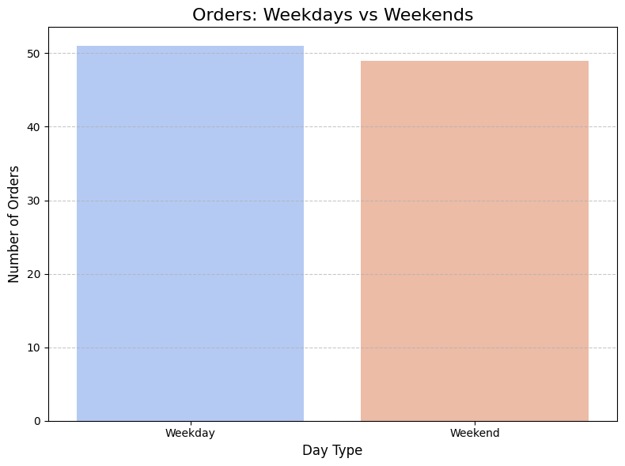
First, I examined the total order numbers on weekends and weekdays, but since there are 2 days on weekends and 5 days on weekdays, I had to look at it in more detail

Slide 6
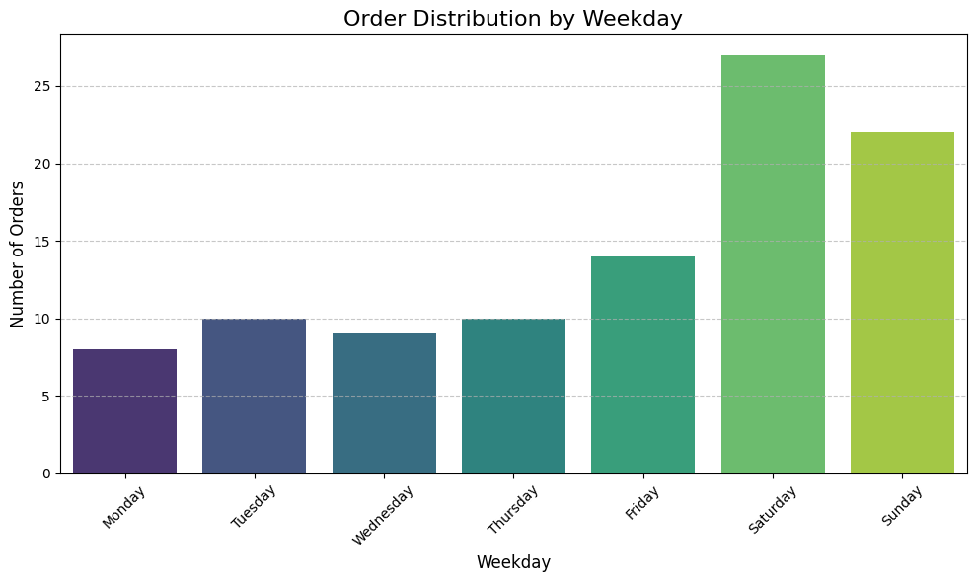
This bar chart illustrates the distribution of orders across the days of the week.
The chart highlights a significant daily increase in orders during the weekend (Saturday and Sunday) compared to weekdays.
The higher number of orders during the weekend can be attributed to relaxation time.
Weekdays show relatively consistent order volumes while Friday has a slight increase. This increase can reflect early relaxation behaviors.

Slide 7
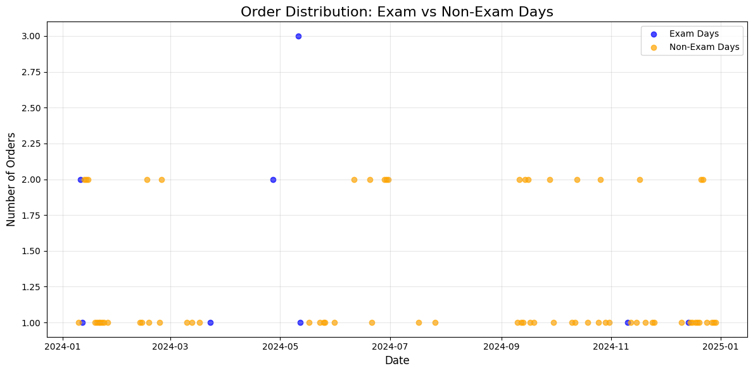
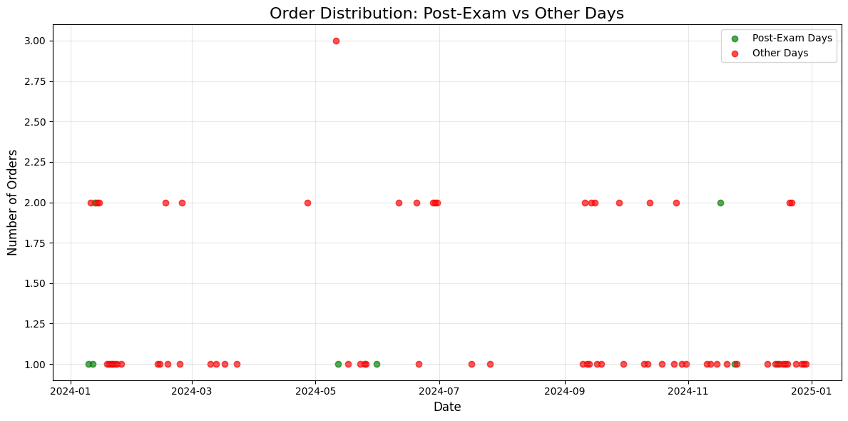
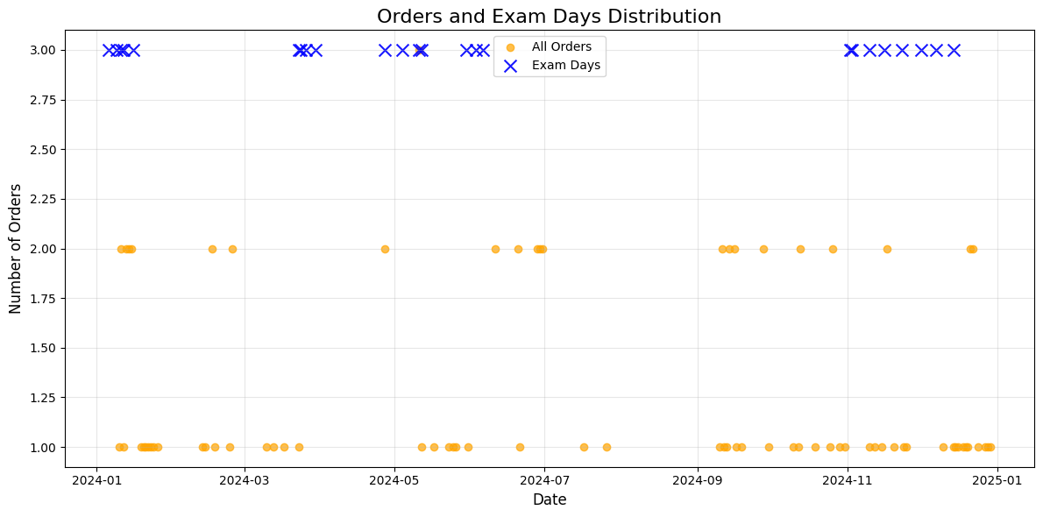
How about the exam period?
I also conducted analyses to explore how exam days or the days following them impact my food ordering behavior. While I don't believe that exam days specifically have a significant effect, I do observe a need for relaxation during those weeks, likely stemming from the intense study sessions leading up to the exams.

Slide 8
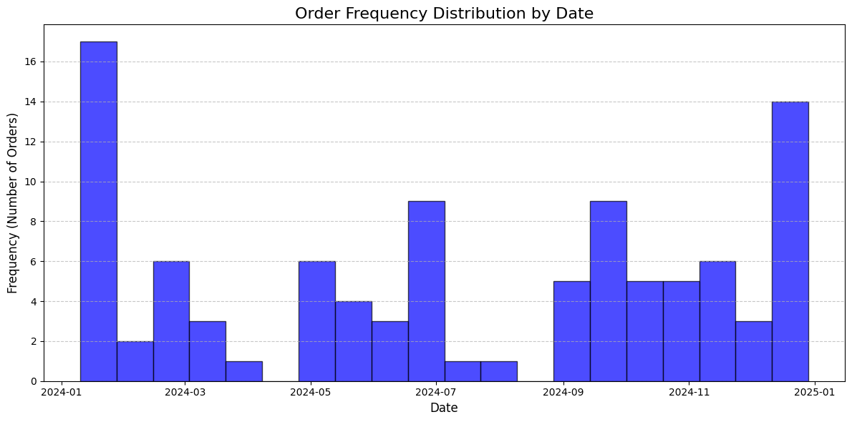
Additional data

Slide 9
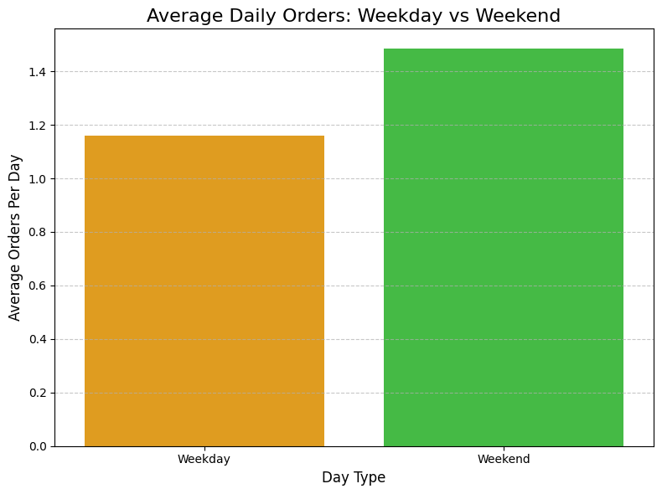
FINDINGS
Weekend orders are significantly higher than weekday orders.
Since I have school every weekday and exams on specific dates, I also explored their impact. I believe that having school every weekday has contributed to an increase in my weekend orders due to the need for relaxation.

Slide 10
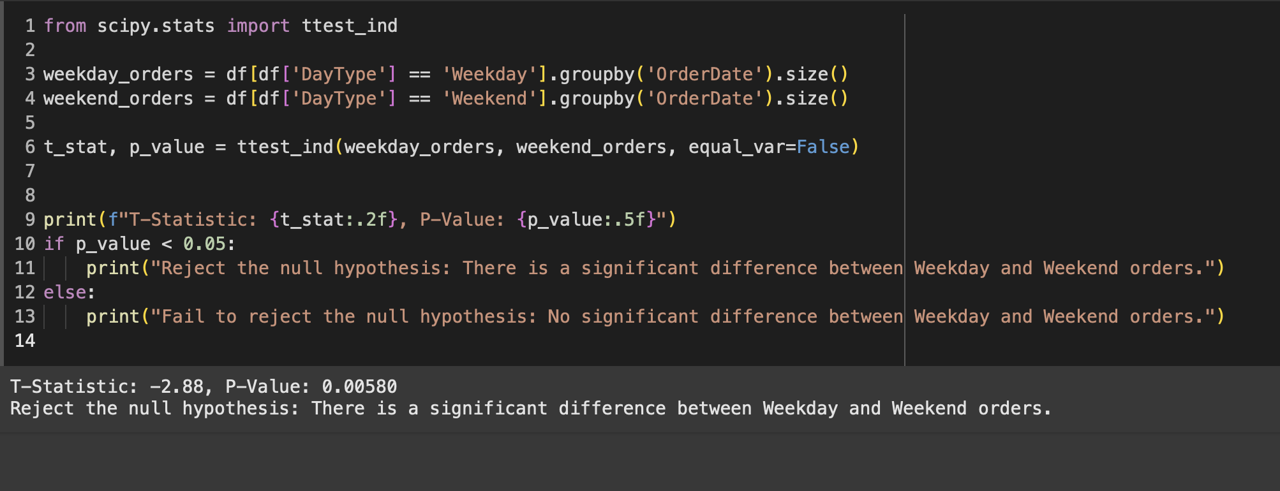
STATISTICAL RESULTS
A two-sample t-test was conducted to compare the number of orders on weekdays and weekends. The null hypothesis (H₀) assumes that there is no significant difference in the average number of orders between weekdays and weekends. The alternative hypothesis (H₁) states that there is a significant difference in the average number of orders between these two time periods.
The results yielded a t-statistic of -2.88 and a p-value of 0.0058, which is below the significance threshold of 0.05. Therefore, we reject the null hypothesis, concluding that there is a statistically significant difference between weekday and weekend orders.

Slide 11
CONCLUSION
This study aimed to analyze the relationship between my food ordering behavior and key external factors such as exam schedules, weekdays, and weekends. By combining statistical analyses and visualization techniques, several interesting insights were uncovered.
I did not reject my hypothesis «Weekend food orders are significantly higher than weekday orders due to reduced academic workload and the need for relaxation.» based on the observations that I made

Slide 12
CONCLUSION
Firstly, the results indicate a significant difference in ordering behavior between weekdays and weekends, with weekends showing a higher average number of orders. This suggests that my school routine during the weekdays likely suppresses my ordering frequency, while weekends allow for more flexibility and relaxation, leading to increased orders.

Slide 13
CONCLUSION
Secondly, an examination of exam days revealed that while the specific day of the exam may not directly affect ordering behavior, there appears to be a relaxation effect in the surrounding period, potentially driven by the relief of completing exams or the reduced mental burden after intense study sessions.

Slide 14
CONCLUSION
Limitations: Other factors like weather, holidays, or discounts were not considered.
Future Work: In the future, incorporating additional factors such as weather, promotions, or emotional states, as well as analyzing larger datasets, could provide deeper insights into ordering behaviors and enable predictive modeling for improved decision-making.

Slide 15
CONCLUSION
These findings highlight the influence of external factors on my food ordering habits and suggest that moments of reduced routine or mental stress are key drivers of increased orders. Understanding these behavioral patterns can help make more informed decisions in the future, such as planning for healthier or more cost-efficient eating habits during high-stress periods.

Slide 16
Thank You
Maya Sezgin

