Slide 1
Implementation of Classification and Segmentation for Plant Diseases Using a Deep Learning Model
School Of Computer Science & Engineering
Galgotias University

Slide 2
Student Detail
NAME | ADMISSION NO | ENROLLMENT NO | SECTION
MAYA SHANKAR JHA | 19SCSE1010573 | 19021011736 | 03
MUSKAN RAHUJA | 19SCSE1010074 | 19021011279 | 03
Guide- Mr. Anandhan k

Slide 3
ABSTRACT
Misdiagnosis of many diseases affecting agricultural crops can lead to the misuse of chemicals that lead to the emergence of resistant pathogens, increased input costs, and further outbreaks with significant economic losses and environmental impacts. Current diagnostic tests based on human testing are time-consuming and expensive, and although computer-based models promise increased efficiency, significant differences in symptoms due to age of infected tissue, genetic variation, and light conditions in trees reduce the accuracy of detection. We are going to build a model based on deep learning which can accurately identify the diseases type and help farmers to take related correct step. The models will be trained by using different data sets of images collected from many agricultural locations by the kaggle team to better understand the disease. Model uses deep learning convolutional neural network training to classify the images.

Slide 4
INTRODUCTION
Agriculture, a major occupation all over the world plays a lead role in Indian economy. The area under apple cultivation in India increased by 24% from 1.95 lakh ha. in 1991-92 to 2.42 lakh ha. in 2001-02 although production increased by less than 1% (i.e. from 11 to 12 lakh tones). It is mostly grown in the states of Jammu & Kashmir, Himachal Pradesh, Uttaranchal, Arunachal Pradesh and Nagaland.
To date, Apple's best year of manufacturing in India was in 2017, when it shipped 3.2million units. In 2020, it had shipped 3.1million units despite the pandemic.

Slide 5
Diseases have adverse effects on the plant and agricultural fields. The main causes of these diseases are viruses, genetic disorders, and infections agents such as bacteria, fungi, and viruses. Therefore, to identify and evaluate these plant diseases of such importance impel us to builds an automated intelligence that can be built yield yield, enhances farmer profits, and more contribution to the national economy. Earlier many researchers in the field of computer science image processing and photographic proposal is proposed for use traditional imaging techniques such as LBP, K-means the combination of detecting these leaf diseases. In-depth learning models are better at mapping and therefore are better featurem generators. Therefore, we created an in-depth learning model to find a leaf diseases that use several classifications in this paper.

Slide 6
LITERATURE SURVEY
Studies says that most of the fungus, viruses and bacterial disease in plants leaf and roots can easily be studied and identified using the image processing techniques like RGB to grey scale conversion.
With a purpose of providing more accurate and faster solution for detecting disease in plants leaf, this system uses k means clustering approach for detecting a more accurate data for plant disease with a precision between 83% and 94%.[1]
Model uses logistic regression over the pre-trained models like VGG19 for extracting the relevant features from the dataset for fine-tuning(transfer learning) and outperformed the other existing models with a big classification accuracy around 97.8% over the test dataset.[2]

Slide 7
By monitoring and diagnosing police diseases, a number of advances have been made including RGB imaging, X-ray, ultrasound, and many hyperspectral technologies. The method proposed by Macedo-Cruz et al aims to measure the damage caused by ice on oat plants. The authors used three blocking techniques: the Otsu method, the Isodata algorithm, and the ambiguous blockchain. A program proposed by Yao et al. aims to identify and classify three types of diseases affecting rice crops. This image is divided in the manner of Otsu, after which the diseased areas are separated. Color, shape and texture features are extracted, the latter appearing in the HSV color space. The components are sent to the Vector Support Machine, which performs the final separation.

Slide 8
The method proposed by Padikar and Sil detects and separates the two diseases affecting the rice plants, transforming the image into a HSI color spectrum, an entropy-based boundary used for differentiation. A detector is used on the edge in a split image, and spots are detected using the size of the green material.
The images are separated by a K-means algorithm, and then 50 colors, textures and texture elements are extracted. The method proposed by Wiwart et al aims to identify and discriminate between the four types of mineral deficiencies - nitrogen, phosphorus, potassium and magnesium. Prior to color analysis, images are converted to HSI and L * a * b * color spaces. Those differences are calculated by Euclidean ranges, which are calculated in both color spaces. In their two papers, Kurniawati et al. proposed a way to identify and label three different types of diseases that affect powdered crops. Recently, Sharada Prasanna Mohanty et al. use a deep convolutional neural network to identify 14 plant species and 26 diseases. Our work will use key features of RGB images and machine learning to detect disease in plants.

Slide 9
Proposed Plan
In this program, we aim to diagnose and diagnose diseases affecting the leaves of the apple plant. Initially, the image of the leaf was taken with the camera and mobile devices and stored somewhere. The image is then pre-processed, first by converting the RGB image to gray. Then the image is taken in RGB format, and the captured image is transformed from the RGB color model to Gray. This image is stored in the same directory. Next, comes the image file reproduction, which is done to supply the input data in the direction of the neural network at a certain pixel width. The pixels the width described here are 256 * 256. Next, we calculate the average values, variations, and standard deviations [18].

Slide 10
The following is the process of deleting a feature. This can be described as a size reduction that well represents the advanced parts of the image in the way of a vector element. The image was initially dark to some degree, so it was easily slippery. Now, this smooth image is stored on the side of the file. This is taken from the training data index. This image is used for the sensory training network. Image can be resized and read for better accuracy or precision. In addition, this image is included in the file training guide and the architecture for the projected system is shown below in fig. 1
Our proposed five-point system is data collection and import, data preparation and training, pre-data processing, model adjustment, and single-image decision-making [19]. These all contribute to constructing the whole model.

Slide 11

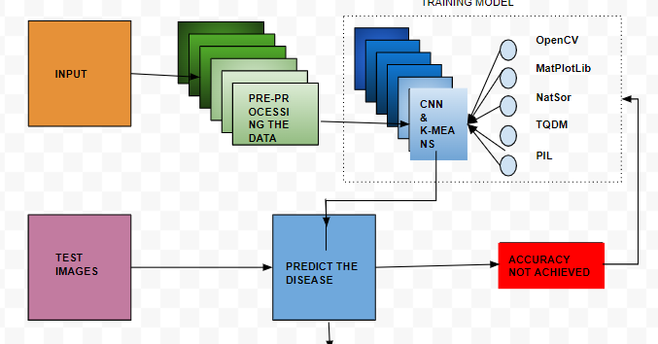

Architecture diagram for the proposed system

Slide 12
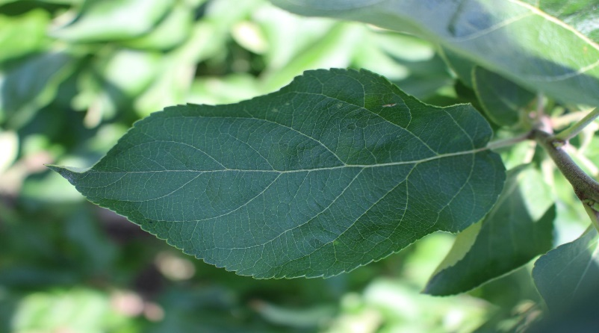
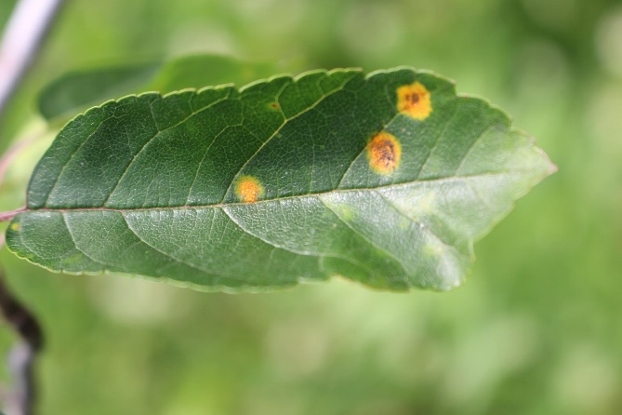
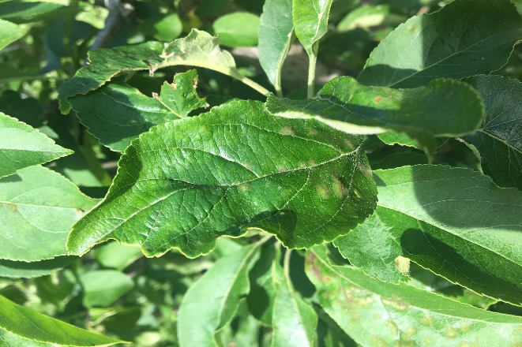
Figures
Healthy Leaf Affected by rust Affected by scab

Slide 13
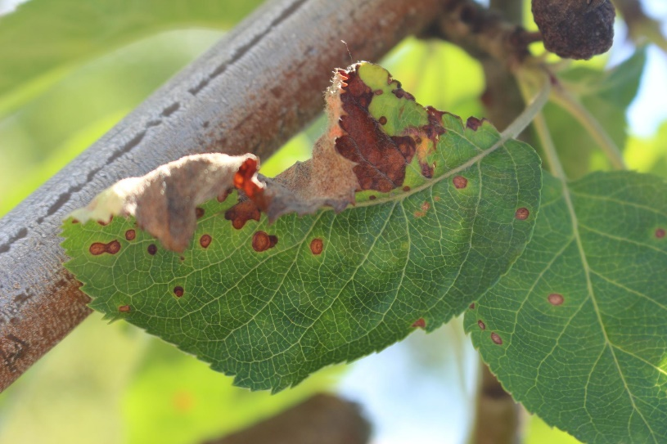
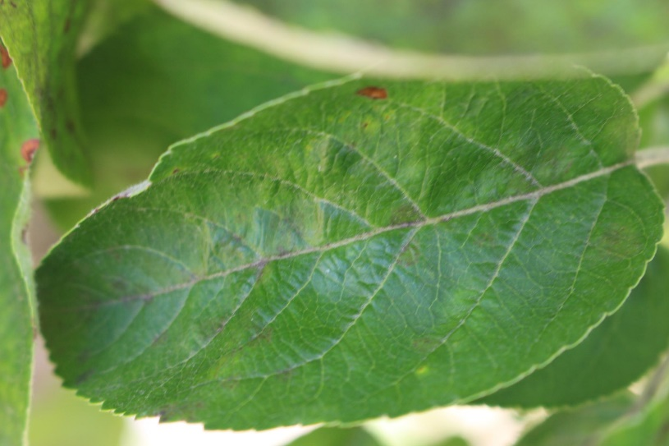
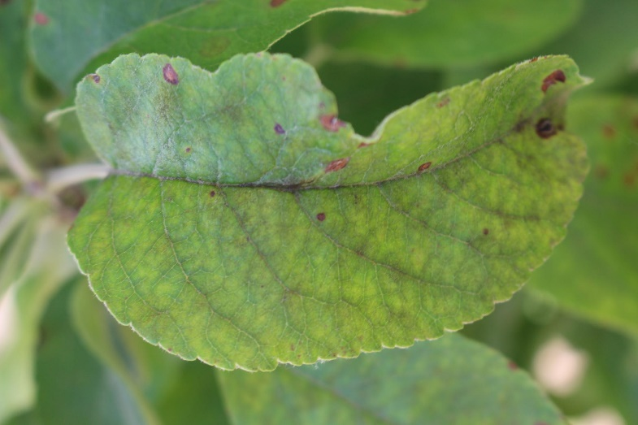
Train 01
Train 06
Train 25
Leaves affected by Multiple disease

Slide 14
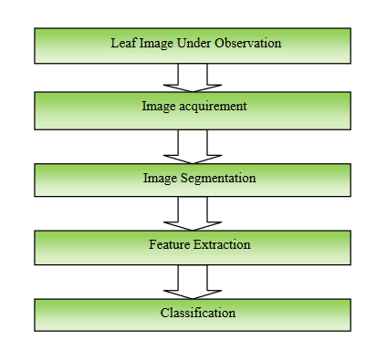
Flowchart

Slide 15
Conclusion
An intensively designed CNN-based model attention is to detect the familiar apple leaf disease to maintain and enhance the effective management of Orchards. A large number of apple leaf images have been collected by several cameras and cell phone devices. A total of 3,642 images have been acquired from the public database from the Kaggle platform. It contains healthy apple leaves, affected by rust and scab, or are affected by many diseases. In this paper, an apple pest control program has remained proposed which stands based on the technology of Convolutional Neural Network (CNN) having a well-trained architectural design. The primary purpose of this proposed model is to diagnose potted plant diseases early in order to increase plant production and reduce losses due to diseases such as apple peel and rust on the leaves of the apple plant. The model has been trained and validated using a dataset containing 3642 colored apple leaf pictures. The dataset is divided into training and testing. Models are tested in 30 epochs and each epoch contains 91 total steps. The accuracy rate of this proposed model is around 93.8%.

Slide 16
Acknowledgment
We would like to thank the our guide and reviewers for their valuable suggestions on our work.

Slide 17
References
[1] H. A. Hiary, S. B. Ahmad, M. Reyalat, M. Braik, and Z. Alrahamneh, “Fast and Accurate Detection and Classification of Plant Diseases,” International Journal of Computer Applications, vol. 17, no. 1, pp. 31–38, 2011.
[2] Potato Leaf Diseases Detection Using Deep Learning May 2020 DOI:10.1109/ICICCS48265.2020.9121067 Conference: 2020 4th International Conference on Intelligent Computing and Control Systems (ICICCS)
[3] M. Islam, Anh Dinh, K. Wahid and P. Bhowmik, "Detection of potato diseases using image segmentation and multiclass support vector machine," 2017 IEEE 30th Canadian Conference on Electrical and Computer Engineering (CCECE), Windsor, ON, 2017, pp. 1-4.
[4 ] Samer I. Mohamed, “Potato Leaf Disease Diagnosis and Detection System Based on Convolution Neural Network”, International Journal of Recent Technology and Engineering (IJRTE) ISSN: 2277-3878, Volume-9 Issue-4, November 2020
[5 ] Tan Soo Xian & Ruzelita Ngadiran, Plant Diseases Classification using Machine Learning [doi:10.1088/1742-6596/1962/1/012024, 1962 (2021) 012024]
[6 ] G. Geetha, S.Samundeswari, G.Saranya ,K.Meenakshi and M. Nithya Plant leaf disease classification and detection system using machine learning, Journal of Physics: Conference Series 1712 (2020) 012012 doi:10.1088/1742-6596/1712/1/012012

Slide 18
Thank You

