Slide 1
Dynamical Systems Modeling of Dyadic Physiological Data: A Report from the Trenches
Society for Ambulatory Assessment
Dynamic Systems Preconference
June 14, 2017
Niall Bolger
Katherine Zee
Columbia University

Slide 2
From last year’s conference….
How do we get from a non-dynamic systems approach to a dynamic systems approach, without losing the plot?
How do we connect to the current, non-dynamic systems based literature?
How do we convince skeptics?

Slide 3
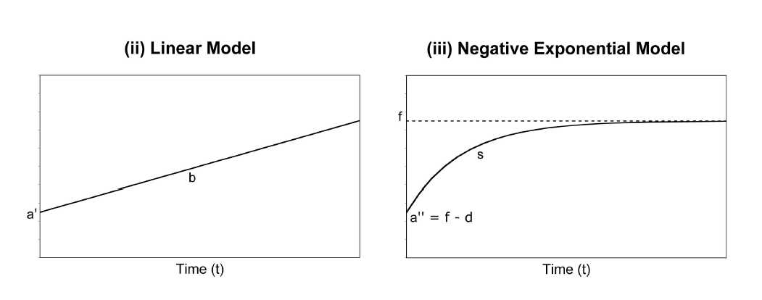
Adjustment to bereavement
Carnelley, K. B., Wortman, C. B., Bolger, N., & Burke, C. T. (2006). The time course of grief reactions to spousal loss: Evidence from a national probablility sample. Journal of Personality and Social Psychology, 91, 476-492.

Slide 4
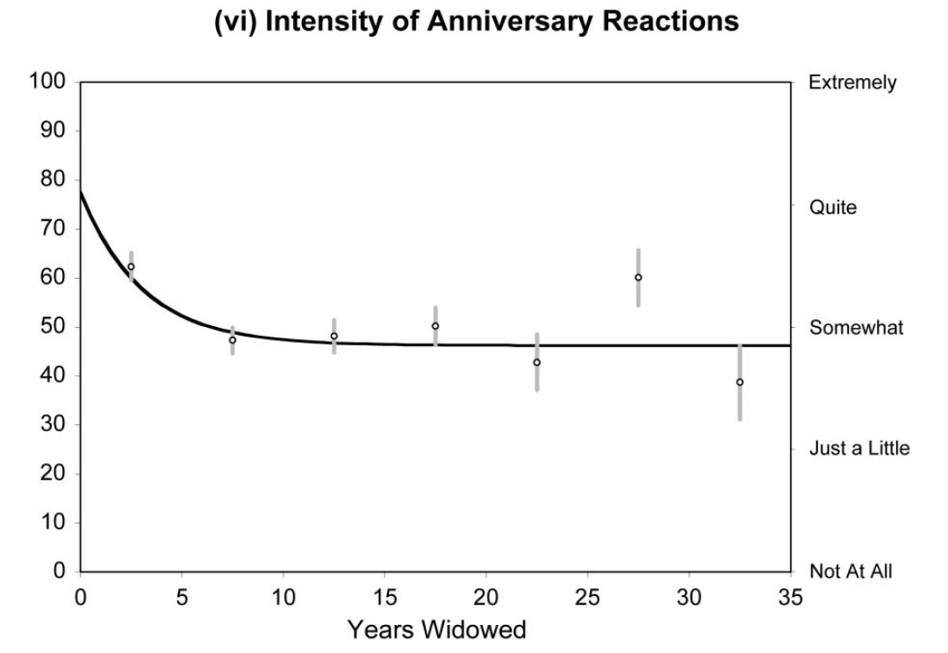

Slide 5
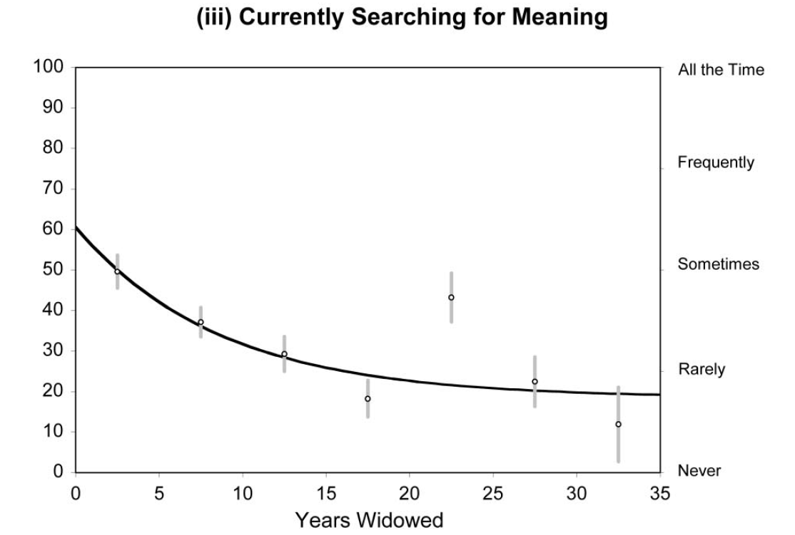

Slide 6
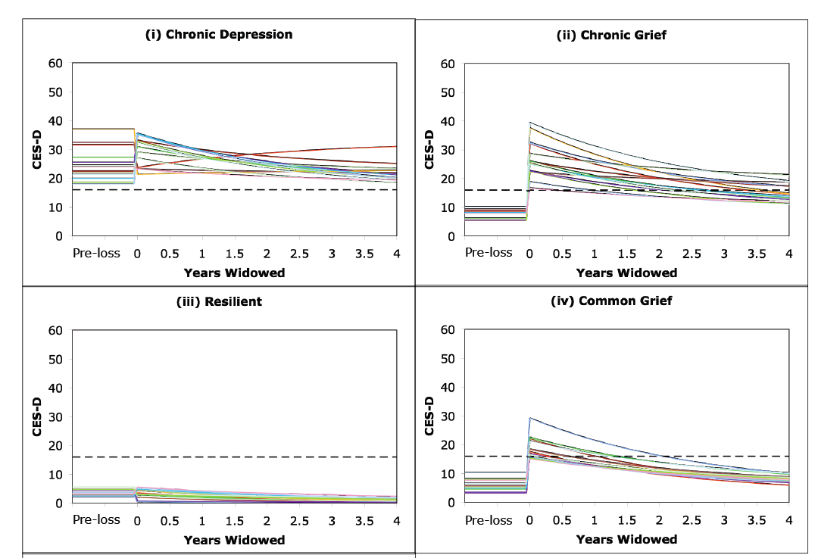
Incorporating random effects
Burke, C. T., Shrout, P. E., & Bolger, N. (2007). Individual differences in adjustment to spousal loss: A nonlinear mixed model analysis. International Journal of Behavioral Development, 31, 405-415.

Slide 7
Application: How weekly routines are dampened by a major stressor

Slide 8
Predicted Values of Support Provision System by Day
Predicted Logit Estimates
Diary Day

Slide 9
Predicted Values of Support Provision System by Day
Moderate Stress Phase: β = 0.004, p<0.10
Acute Stress Phase:β = 0.385, p<0.001
Predicted Logit Estimates
Diary Day

Slide 10
De-trended Support Provision by Day
Predicted Detrended Logit Estimates
Diary Day

Slide 11
Step 2: Dynamical Model
Multilevel Dampened Linear Oscillator Model
where x is a function of the logit value of support provision at diary day (t)
ζ_{i} : dampening parameter
η_{i} : frequency of oscillation parameter

Slide 12
Results of the Dynamical Model
η = -0.51, p<0.01
ζ = 0.04, p<0.05
Likelihood of Support Provision

Slide 13
Application: Modeling dyadic data as a dynamic system

Slide 14
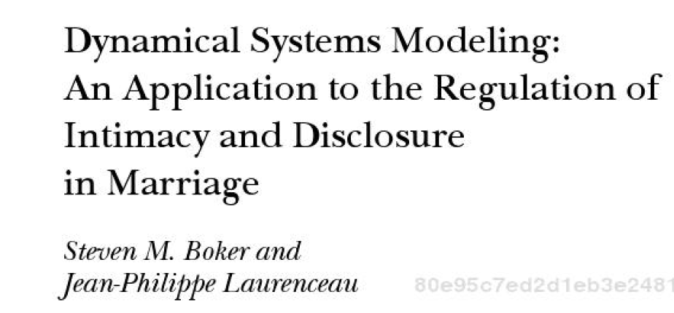
Classic paper

Slide 15
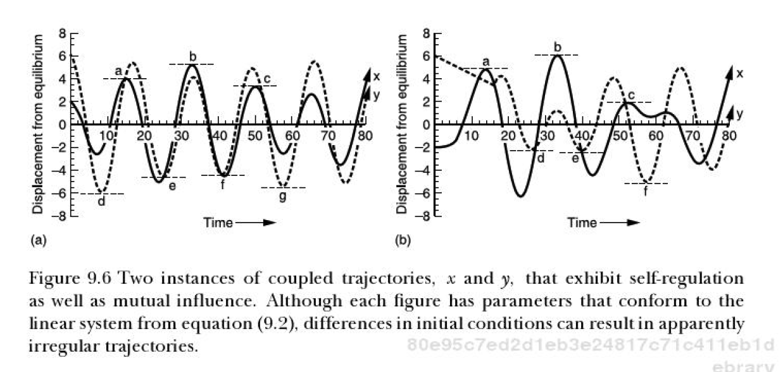

Slide 16
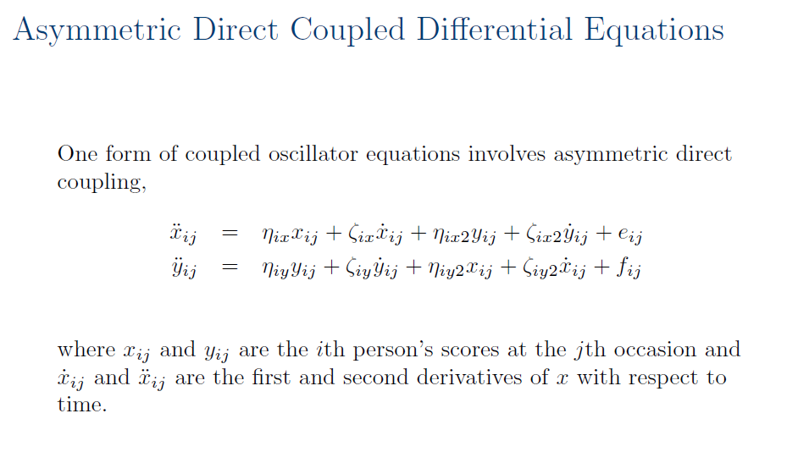

Slide 17
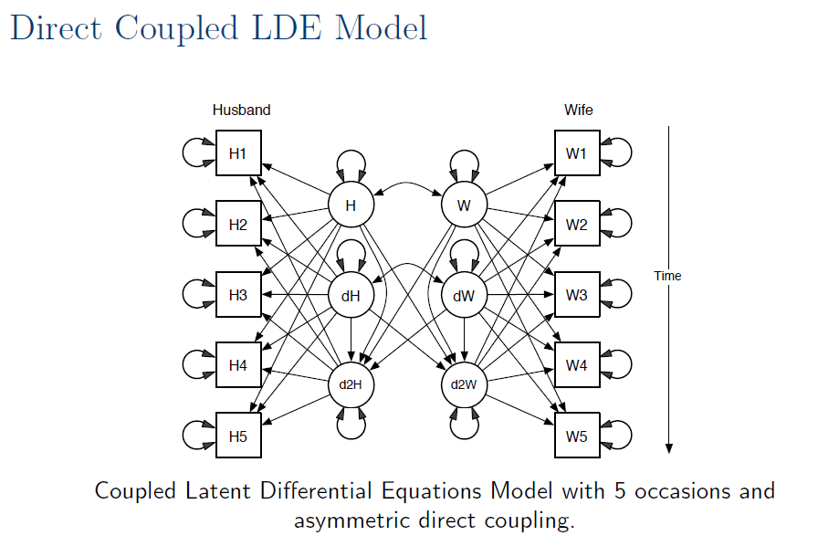

Slide 18

Method
Notes:
N = 78 romantic partner dyads
Mean Relationship Length = 3.9 years (SD = 3.1)
Mean Age = 27.4 (SD = 6.3)

Slide 19

Method
Notes:
N = 78 romantic partner dyads
Mean Relationship Length = 3.9 years (SD = 3.1)
Mean Age = 27.4 (SD = 6.3)

Slide 20

Method
Notes:
N = 78 romantic partner dyads
Mean Relationship Length = 3.9 years (SD = 3.1)
Mean Age = 27.4 (SD = 6.3)

Slide 21
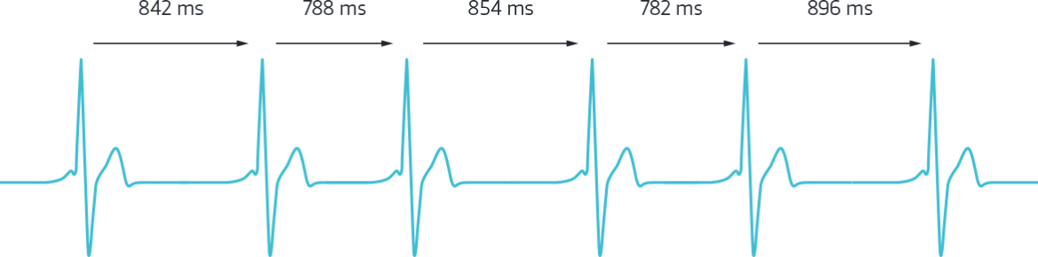
Respiratory Sinus Arrhythmia (RSA)
Relevant to support because taps into:
Emotion Regulation (Geisler et al., 2013)
Social Sensitivity (Muhtadie et al., 2015)
Used in prior studies of covariation in couples (Helm, Sbarra, & Ferrer 2014)
Good temporal sensitivity

Slide 22
Respiratory Sinus Arrhythmia (RSA)
10 second intervals = 30 observations/phase
Social Support:
Male Provide / Female Receive

Slide 23
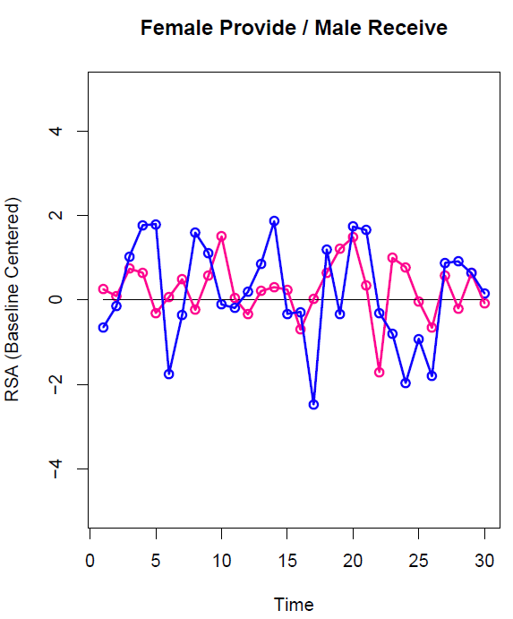
Dyad 168
Equilibrium = Baseline RSA

Slide 24
Analysis Strategy
Case Study: 1 dyad as dynamic system
Coupled LDE model (Boker & Laurenceau, 2005)
Time Delay Embedding = 4

Slide 25
Results
 | Female Provide / Male Receive
F→F η_{x} | -1.53 (.32)
F→F ζ_{x} | 0.0
M→M η_{y} | -.77 (.24)
M→M ζ_{y} | 0.0
F → M γ_{y} | -.29(.28)
M → F γ_{x} | -.09 (.28)
Standard Errors are in parentheses

Slide 26
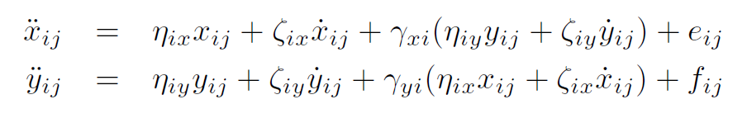
Model in Equation Form
-1.53
0.0
-0.29
-0.77
0.0
-0.09

Slide 27
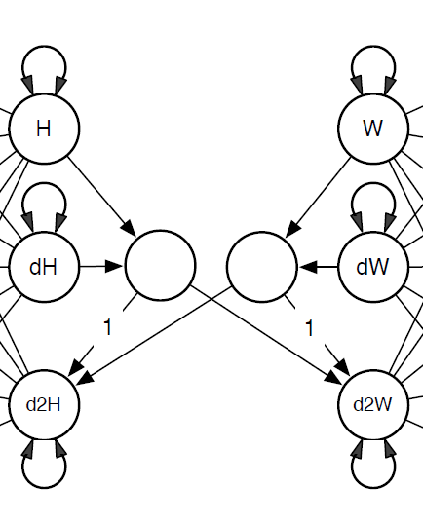
As SEM Structural Model

Slide 28
Results
Evidence of self-regulation, but only during female provide / male receive phase
For both partners, the higher one’s RSA relative to baseline, the RSA slows down (lower ‘velocity’)
How well does model capture raw data?
Notes:
One’s own level predicts a lowering of one’s own second derivative (deceleration) but only during female provide/male receive.
Even though we get this effect for this couple, this is fairly consistent with what we find looking at all dyads, i.e., this deceleration seems to happen when females provide/males receive but not vice versa.

Slide 29
Model Fit: Female Provide/Male Receive

Slide 30
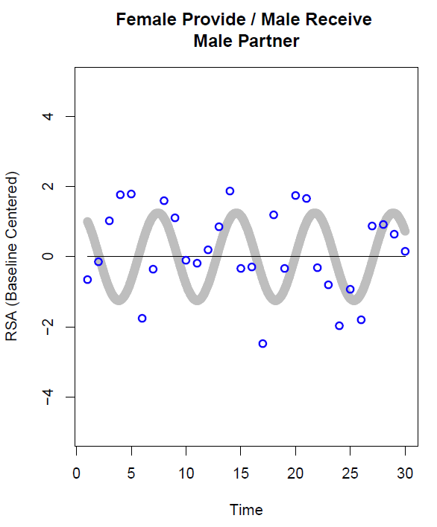
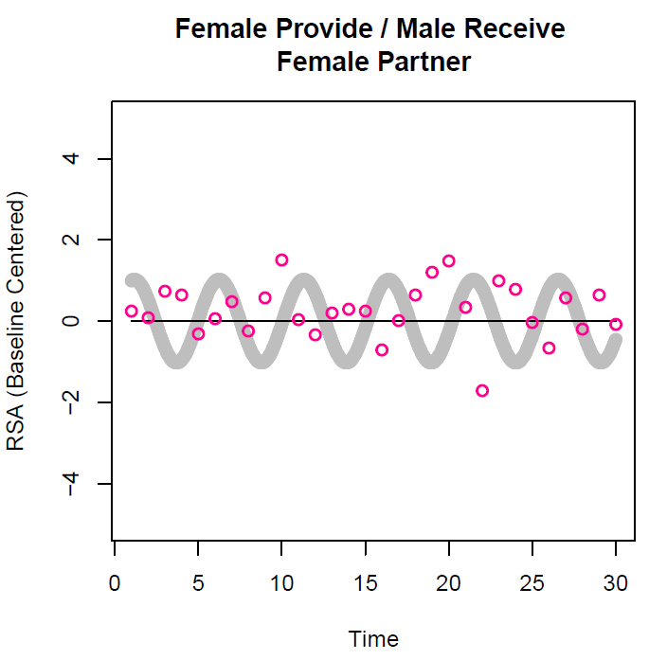
Model Fit: Female Provide/Male Receive

Slide 31
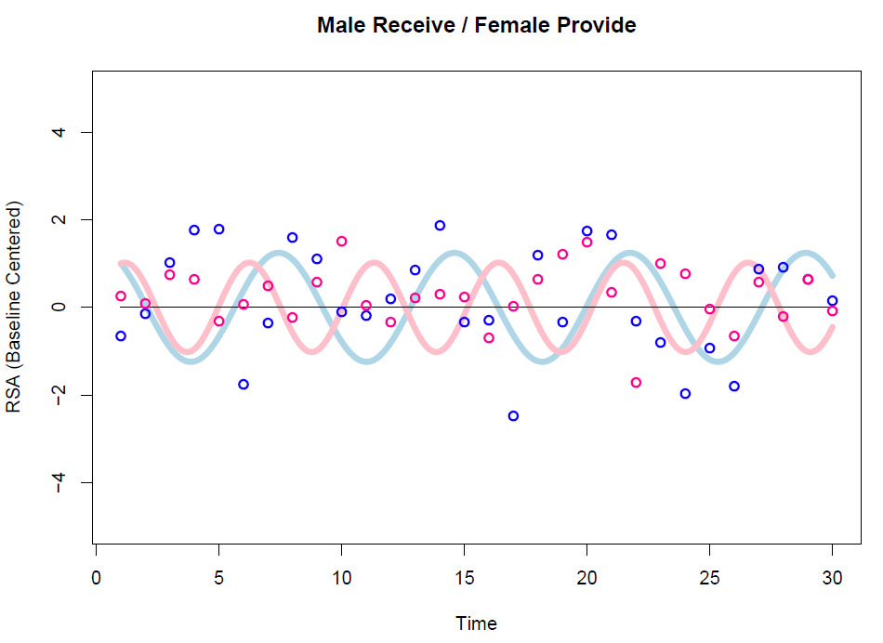

Slide 32
Comparing Approaches
Standard Cross-Lagged Regression Model
Do we find evidence of self-regulation effects?
One’s own RSA predicting one’s own RSA at the next time point
Do we find evidence of cross-partner effects?
One’s own RSA predicting one’s partner’s RSA at the next time point

Slide 33
Cross-Lagged Results
 | Female Provide / Male Receive
F_{t} → F_{t+1} | -.04 (.29)
M_{t} → M_{t+1} | .16 (.15)
F_{t} → M_{t+1} | .45 (.28)
M_{t} → F_{t+1} | -.07 (.16)
Standard Errors are in parentheses

Slide 34
Summary
Evidence of self-regulation (“cycling”) using Coupled LDE when female partners provide support / male partners receive support
No evidence of any effect in a standard cross-lagged analysis

Slide 35



Thank you!
Research Assistants:
Carina Brown, Jessica Paek, Sophia Golden, Jessica Gingrich,
Kate Puglia, Jordan Cline, Lauren Cohen, Alexander Fulmer,
Sarah Goetzke, Lana Khamash, Shelagh Mahbubani, Max Mikelic,
Courtney Peters, Sam Pitasky, and Saya Weissman

