Slide 1
Dynamical Systems Modeling: A Report from the Trenches
Niall Bolger
Society for Ambulatory Assessment
June 14, 2017

Slide 2
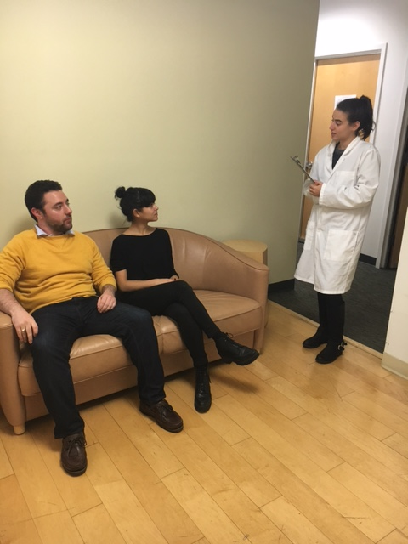
Method
N = 78 romantic partner dyads
Mean Relationship Length = 3.9 years (SD = 3.1)
Mean Age = 27.4 (SD = 6.3)
Notes:
Age range is 18-60
Relationships up to 21 yrs in length

Slide 3
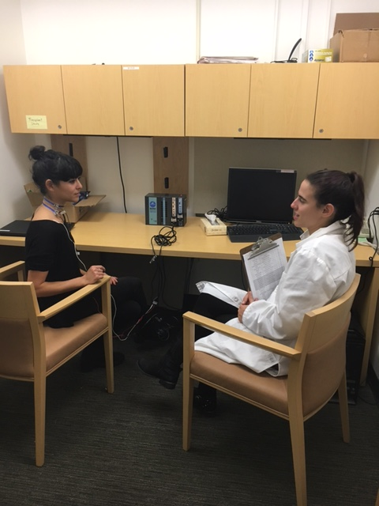
Method
N = 78 romantic partner dyads
Mean Relationship Length = 3.9 years (SD = 3.1)
Mean Age = 27.4 (SD = 6.3)
Notes:
Age range is 18-60
Relationships up to 21 yrs in length

Slide 4
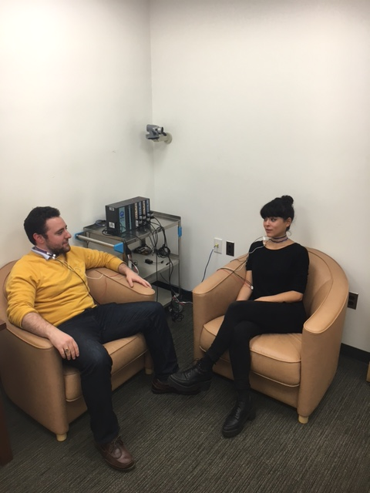
Method
N = 78 romantic partner dyads
Mean Relationship Length = 3.9 years (SD = 3.1)
Mean Age = 27.4 (SD = 6.3)
Notes:
Age range is 18-60
Relationships up to 21 yrs in length

Slide 5
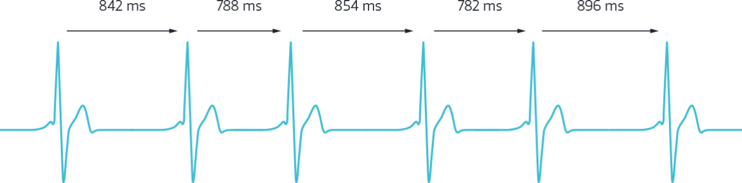
Respiratory Sinus Arrhythmia (RSA)

Slide 8
Syncing up
Equilibrium

Slide 9
Analysis Strategy
Subset of 14 dyads
40 segments/dyad x 14 dyads = 560 obs.
Coupled LDE models (Boker & Laurenceau, 2005)
Separate models run for each dyad, with summary statistics aggregated

Slide 10
Summary

Slide 11
Open Questions and Next Steps
Prediction? How to examine heterogeneity?
Comparing results across different types of analyses (Coupled LDE vs. MLM?)
Interval length: 30 seconds? 5 seconds?

Slide 12
Future Directions
Explore heterogeneity
Dynamical systems modeling
Recipient HRV
Provider
Recipient
Lagged Provider HRV
Butler (2011)

Slide 13



Thank you!
Symposium Chair: Michael Russell
Abdiel Flores
Matti Vuorre
Research Assistants:
Carina Brown, Jessica Paek, Sophia Golden, Jessica Gingrich,
Kate Puglia, Jordan Cline, Lauren Cohen, Alexander Fulmer,
Sarah Goetzke, Lana Khamash, Shelagh Mahbubani, Max Mikelic,
Courtney Peters, Sam Pitasky, and Saya Weissman

Slide 16
Control Discussion

