Slide 1
Dynamical Systems Modeling of Dyadic Physiological Data: A Report from the Trenches
Society for Ambulatory Assessment
Dynamic Systems Preconference
June 14, 2017
Niall Bolger
Katherine Zee
Columbia University

Slide 2
Niall will add some introductory material here

Slide 3
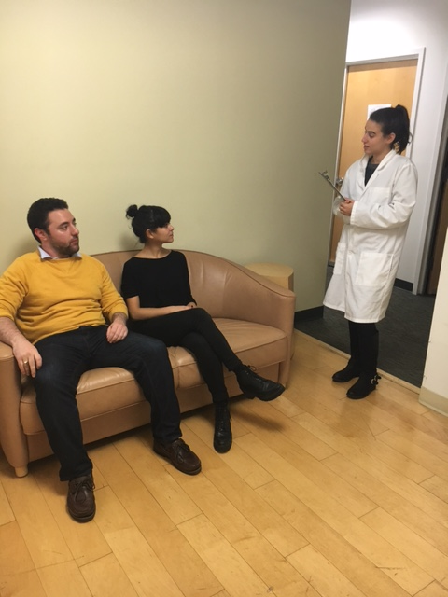
Method
Notes:
N = 78 romantic partner dyads
Mean Relationship Length = 3.9 years (SD = 3.1)
Mean Age = 27.4 (SD = 6.3)

Slide 4
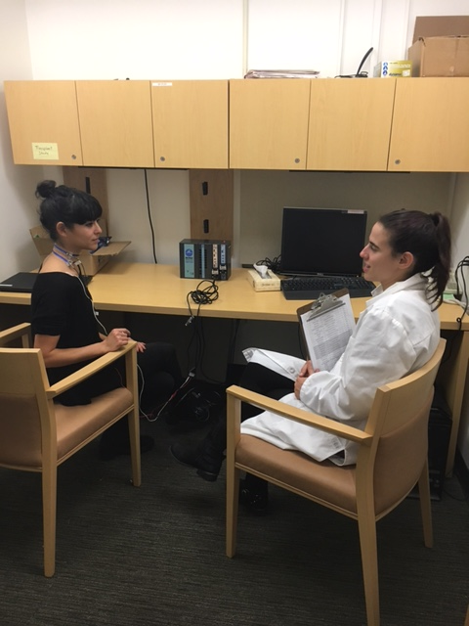
Method
Notes:
N = 78 romantic partner dyads
Mean Relationship Length = 3.9 years (SD = 3.1)
Mean Age = 27.4 (SD = 6.3)

Slide 5
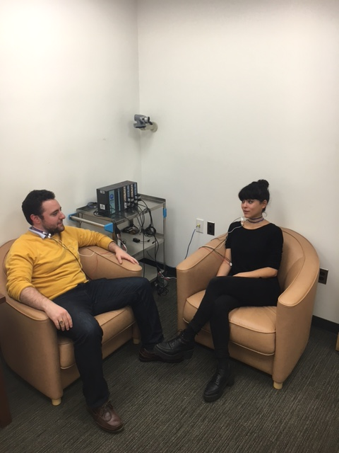
Method
Notes:
N = 78 romantic partner dyads
Mean Relationship Length = 3.9 years (SD = 3.1)
Mean Age = 27.4 (SD = 6.3)

Slide 6
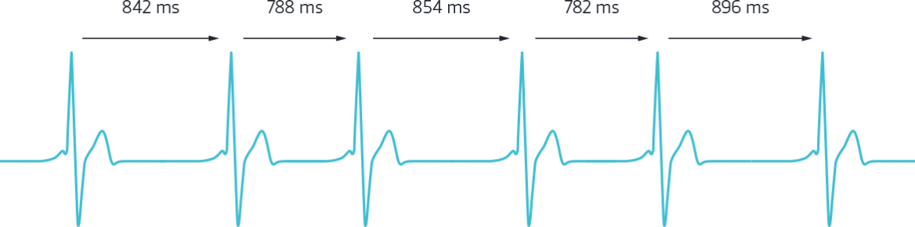
Respiratory Sinus Arrhythmia (RSA)
Relevant to support because taps into:
Emotion Regulation (Geisler et al., 2013)
Social Sensitivity (Muhtadie et al., 2015)
Used in prior studies of covariation in couples (Helm, Sbarra, & Ferrer 2014)
Good temporal sensitivity

Slide 7
Respiratory Sinus Arrhythmia (RSA)
10 second intervals = 30 observations/phase
Phase 1 = Male Provide / Female Receive
Phase 2 = Female Provide / Male Receive

Slide 8
Dyad 168
Equilibrium = Baseline RSA

Slide 9
Dyad 168
Equilibrium = Baseline RSA

Slide 10
Analysis Strategy
Case Study: 1 dyad as dynamic system
Coupled LDE model (Boker & Laurenceau, 2005)
Time Delay Embedding = 5

Slide 11
Results
 | Male Provide / Female Receive | Female Provide / Male Receive
F → F1 | -.39 (.35) | -1.45 (.44)
F → F2 | -.81 (.64) | 6.66 (NA)
M → M1 | -.22 (.41) | -.71 (.15)
M → M2 | .66 (.55) | .08 (.23)
F → M2 | .22 (.52) | -.40 (NA)!
M → F2 | .40 (1.36)! | .03 (.24)
1 = First Derivative
2 = Second Derivative
! = Hitting upper/lower bound constraints
Standard Errors are in parentheses

Slide 12
Results
Evidence of self-regulation, but only during female provide / male receive phase
For both partners, the higher one’s RSA relative to baseline, the RSA slows down (lower ‘velocity’)
How well does model capture raw data?
Notes:
One’s own level predicts a lowering of one’s own second derivative (deceleration) but only during female provide/male receive.
Even though we get this effect for this couple, this is fairly consistent with what we find looking at all dyads, i.e., this deceleration seems to happen when females provide/males receive but not vice versa.

Slide 13
Model Fit: Male Provide/Female Receive
Notes:
**Note: to generate most of the figures, we could not use the model’s estimated zeta values. Use .1 instead

Slide 14
Model Fit: Male Provide/Female Receive

Slide 15
Model Fit: Female Provide/Male Receive

Slide 16
Model Fit: Female Provide/Male Receive

Slide 17
Both Partners, Both Phases

Slide 18
Comparing Approaches
“Multilevel” model (no random effects)
Linear model estimating effects separately for male partner and female partner
Do we find evidence of linear self-regulation effects?
RSA predicting one’s own RSA at next timepoint

Slide 19
“Multilevel” Results
 | Male Provide / Female Receive | Female Provide / Male Receive
F_{t} → F_{t+1} | .14 (.31) | -.04 (.29)
M_{t} → M_{t+1} | .18 (.32) | .16 (.15)
F_{t} → M_{t+1} | .13 (.32) | .45 (.28)
M_{t} → F_{t+1} | -.03 (.17) | -.07 (.16)
F_{t+1}→ M_{t+1} | -.06 (.31) | .35 (.28)
M_{t+1} → F_{t+1} | -.02 (.16) | .12 (.16)
Standard Errors are in parentheses
All effects NS

Slide 20
Summary
Evidence of self-regulation (“cycling”) using Coupled LDE when female partners provide support / male partners receive support
Different results from different models
No apparent self-regulation using traditional approaches
If anything, trends seem stronger for cross-partner effects

Slide 21
Open Questions and Next Steps
Different time delay embed values may be necessary for each phase
e.g., unable to estimate SE for some parameters, some parameters physiologically implausible
Interval length: 10 seconds? 2 seconds?
Limitations: estimating RSA requires intervals of at least 10 seconds in Mindware

Slide 22



Thank you!
Research Assistants:
Carina Brown, Jessica Paek, Sophia Golden, Jessica Gingrich,
Kate Puglia, Jordan Cline, Lauren Cohen, Alexander Fulmer,
Sarah Goetzke, Lana Khamash, Shelagh Mahbubani, Max Mikelic,
Courtney Peters, Sam Pitasky, and Saya Weissman

