Slide 1
Dynamical Systems Modeling: A Report from the Trenches
Niall Bolger
Society for Ambulatory Assessment
Dynamics Systems Preconference
June 14, 2017

Slide 2
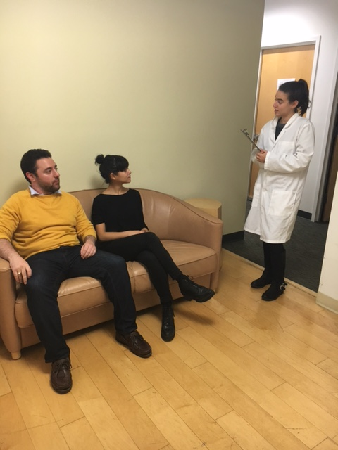
Method
Notes:
N = 78 romantic partner dyads
Mean Relationship Length = 3.9 years (SD = 3.1)
Mean Age = 27.4 (SD = 6.3)

Slide 3
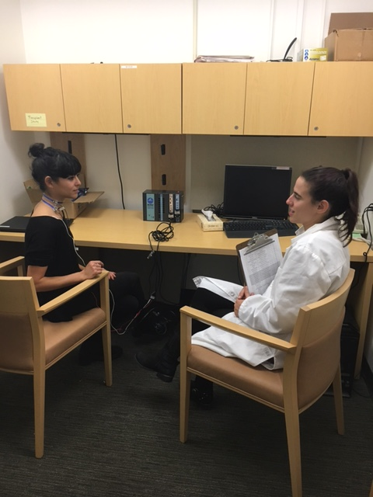
Method
Notes:
N = 78 romantic partner dyads
Mean Relationship Length = 3.9 years (SD = 3.1)
Mean Age = 27.4 (SD = 6.3)

Slide 4
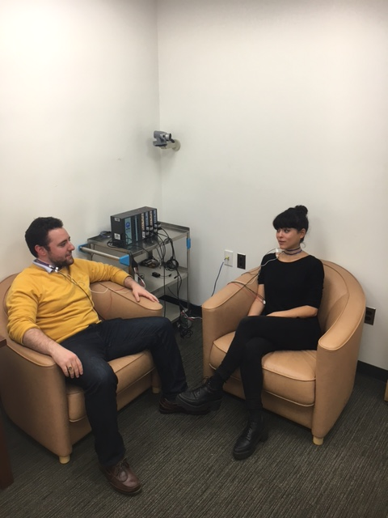
Method
Notes:
N = 78 romantic partner dyads
Mean Relationship Length = 3.9 years (SD = 3.1)
Mean Age = 27.4 (SD = 6.3)

Slide 5
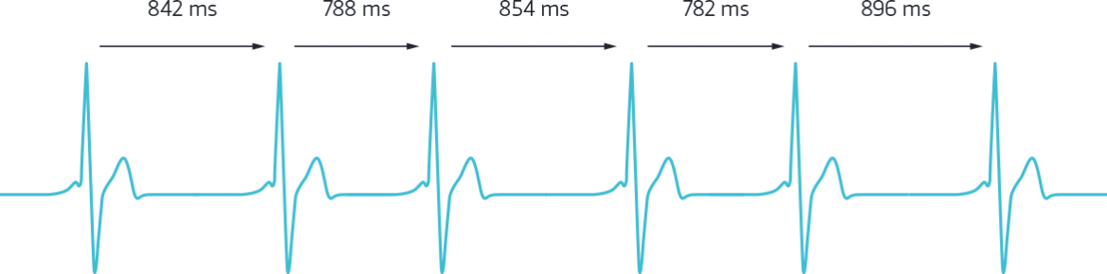
Respiratory Sinus Arrhythmia (RSA)
10 second intervals = 30 observations/phase
Phase 1 = Male Provide / Female Receive
Phase 2 = Female Provide / Male Receive

Slide 6
Dyad 168

Slide 7
Dyad 168

Slide 8
Analysis Strategy
Case Study: 1 dyad as a dynamic system
Coupled LDE model (Boker & Laurenceau, 2005)
Time Delay Embedding = 5

Slide 9
Results
 | Male Provide / Female Receive | Female Provide / Male Receive
F → F1 | -.39 (.35) | -1.45 (.44)
F → F2 | -.81 (.64) | 6.66 (NA)
M → M1 | -.22 (.41) | -.71 (.15)
M → M2 | .66 (.55) | .08 (.23)
F → M2 | .22 (.52) | -.40 (NA)!
M → F2 | .40 (1.36)! | .03 (.24)
1 = First Derivative
2 = Second Derivative
! = Hitting upper/lower bound constraints
Standard Errors are in parentheses

Slide 10
Results
Evidence of self-regulation, but only during male receive / female provide phase
For both partners, the higher one’s RSA relative to baseline, the more changes in RSA slow down
Notes:
One’s own level predicts one’s own second derivative (acceleration) but only during female provide/male receive
^ even though we get this effect for this couple, this is somewhat consistent with what we find looking at all dyads (i.e., there seems to be something special happening when female provide/male receive but not vice versa)

Slide 11
Open Questions and Next Steps
Different time delay embed values may be necessary for each phase

Slide 12
Open Questions and Next Steps
Different time delay embed values may be necessary for each phase
Interval length: 10 seconds? 2 seconds?
Limitations: estimating RSA requires intervals of at least 10 seconds in Mindware

Slide 13
Open Questions and Next Steps
Different time delay embed values may be necessary for each phase
Interval length: 10 seconds? 2 seconds?
Limitations: estimating RSA requires intervals of at least 10 seconds in Mindware
Prediction? Examining heterogeneity?

Slide 14
Open Questions and Next Steps
Different time delay embed values may be necessary for each phase
Interval length: 10 seconds? 2 seconds?
Limitations: estimating RSA requires intervals of at least 10 seconds in Mindware
Prediction? Examining heterogeneity?
Comparing results across different types of analyses (Coupled LDE vs. MLM?)

Slide 15



Thank you!
Research Assistants:
Carina Brown, Jessica Paek, Sophia Golden, Jessica Gingrich,
Kate Puglia, Jordan Cline, Lauren Cohen, Alexander Fulmer,
Sarah Goetzke, Lana Khamash, Shelagh Mahbubani, Max Mikelic,
Courtney Peters, Sam Pitasky, and Saya Weissman

Slide 18
Syncing up
Equilibrium

