Slide 1
Dynamical Systems Modeling of Dyadic Physiological Data: A Report from the Trenches
Society for Ambulatory Assessment
Dynamic Systems Preconference
June 14, 2017
Niall Bolger
Katherine Zee
Columbia University

Slide 2

Method
Notes:
N = 78 romantic partner dyads
Mean Relationship Length = 3.9 years (SD = 3.1)
Mean Age = 27.4 (SD = 6.3)

Slide 3
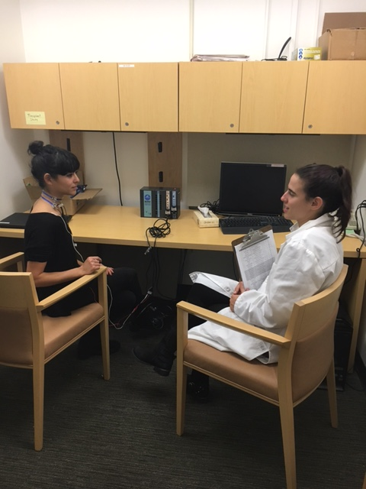
Method
Notes:
N = 78 romantic partner dyads
Mean Relationship Length = 3.9 years (SD = 3.1)
Mean Age = 27.4 (SD = 6.3)

Slide 4
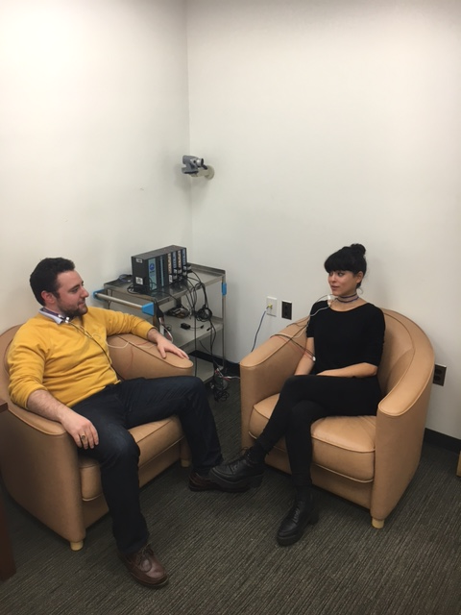
Method
Notes:
N = 78 romantic partner dyads
Mean Relationship Length = 3.9 years (SD = 3.1)
Mean Age = 27.4 (SD = 6.3)

Slide 5
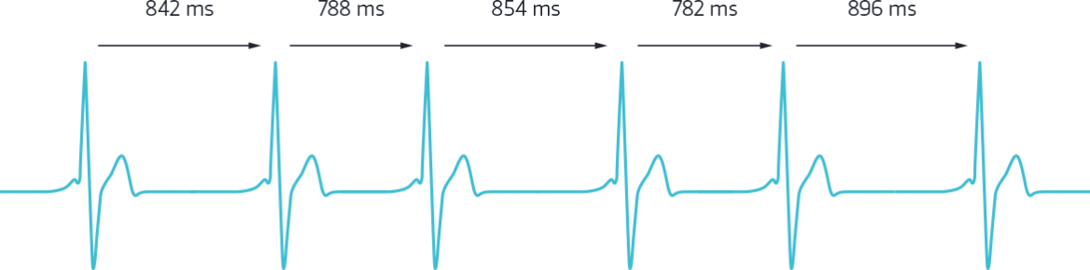
Respiratory Sinus Arrhythmia (RSA)
10 second intervals = 30 observations/phase
Phase 1 = Male Provide / Female Receive
Phase 2 = Female Provide / Male Receive

Slide 6
Syncing up
Redo figure with correct
phases and intervals
Equilibrium

Slide 7
Dyad 178

Slide 8
Dyad 178

Slide 9
Analysis Strategy
1 dyad as dynamic system
Coupled LDE model (Boker & Laurenceau, 2005)
Time Delay Embedding = 5

Slide 10
Results
 | Male Provide / Female Receive | Female Provide / Male Receive
F → F1 | -.39 (.35) | -1.45 (.44)
F → F2 | -.81 (.64) | 6.66 (NA)
M → M1 | -.22 (.41) | -.71 (.15)
M → M2 | .66 (.55) | .08 (.23)
F → M2 | .22 (.52) | -.40 (NA)!
M → F2 | .40 (1.36)! | .03 (.24)
1 = First Derivative
2 = Second Derivative
! = Hitting upper/lower bound constraints

Slide 11
Results
Evidence of self-regulation, but only during female provide / male receive phase
For both partners, the higher one’s RSA relative to baseline, the more changes in RSA slow down
Notes:
One’s own level predicts a lowering of one’s own second derivative (deceleration) but only during female provide/male receive.
Even though we get this effect for this couple, this is fairly consistent with what we find looking at all dyads, i.e., this deceleration seems to happen when females provide/males receive but not vice versa.

Slide 12
Open Questions and Next Steps
Different time delay embed values may be necessary for each phase

Slide 13
Open Questions and Next Steps
Different time delay embed values may be necessary for each phase
Interval length: 10 seconds? 2 seconds?
Limitations: estimating RSA requires intervals of at least 10 seconds in Mindware

Slide 14
Open Questions and Next Steps
Different time delay embed values may be necessary for each phase
Interval length: 10 seconds? 2 seconds?
Limitations: estimating RSA requires intervals of at least 10 seconds in Mindware
Prediction? Examining heterogeneity?

Slide 15
Open Questions and Next Steps
Different time delay embed values may be necessary for each phase
Interval length: 10 seconds? 2 seconds?
Limitations: estimating RSA requires intervals of at least 10 seconds in Mindware
Prediction? Examining heterogeneity?
Comparing results across different types of analyses (Coupled LDE vs. MLM?)

Slide 16



Thank you!
Research Assistants:
Carina Brown, Jessica Paek, Sophia Golden, Jessica Gingrich,
Kate Puglia, Jordan Cline, Lauren Cohen, Alexander Fulmer,
Sarah Goetzke, Lana Khamash, Shelagh Mahbubani, Max Mikelic,
Courtney Peters, Sam Pitasky, and Saya Weissman

