Slide 1
Synchronization (OpenMP Synchronization)

Slide 2
Synchronization
OMP_SINGLE
OMP MASTER
OMP CRITICAL
OMP ATOMIC
OMP BARRIER
OpenMP programs use shared variables to communicate.
We need to make sure these variables are not accessed at the same time by different threads (will cause race conditions, WHY?).
OpenMP provides a number of directives for synchronization.

Slide 3
OMP_SINGLE
Only one of the threads will execute the following block of code
The rest will wait for it to complete
Good for non-thread-safe regions of code (such as I/O)
Must be used in a parallel region
Applicable to parallel for sections

Slide 4
OMP_SINGLE
It specifies that the enclosed code is to be executed by only one thread in the team.
The thread chosen could vary from one run to another.
Threads that are not executing in the SINGLE directive wait at the END SINGLE directive unless NOWAIT is specified.

Slide 5
#include<stdio.h>
#include<omp.h>
int main()
{ int i, sal1=0,sal2=0;
#pragma omp parallel shared(sal1,sal2)
{
for(i=0;i<5;i++)
{ Sal1=sal1+I; }
Printf(“Salary of the first company=%d”, sal1);
for(i=0;i<5;i++)
{
Sal2=sal2+i
}
Printf(“Salary of the first company=%d”, sal2);
}
Return 0;
}

Slide 6
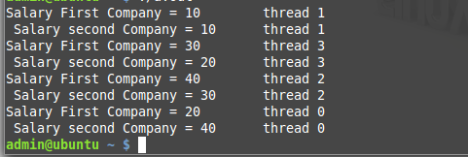
Threads – 4
Data Races

Slide 7
#include<stdio.h>
#include<omp.h>
Int main()
{ Int I, sal1=0,sal2=0;
#pragma omp parallel reduction(:+sal1)
For(i=0;i<5;i++)
{
Sal1=sal1+i
}
Printf(“Salary of the first company=%d”, sal1);
#pragma omp parallel reduction(:+sal2)
For(i=0;i<5;i++)
{
Sal2=sal2+i
}
Printf(“Salary of the first company=%d”, sal2);
Return 0;
}

Slide 8

This solution is quite nice. It doesn’t have any data races and it uses less lines of code to express the solution.
A possible disadvantage of this version is that we have to wait for computations of all salaries to complete before we are able to see the results.

Slide 9
#pragma omp parallel shared(sal1,sal2)
{
#pragma omp parallel reduction(:+sal1)
For(i=0;i<5;i++)
{Sal1=sal1+i}
#pragma omp single
{ Printf(“Salary of the first company=%d”, sal1); }
#pragma omp parallel reduction(:+sal2)
For(i=0;i<5;i++)
{
Sal2=sal2+i
}}
Printf(“Salary of the first company=%d”, sal2);
Return 0; }

Slide 10


Slide 11
#pragma omp parallel shared(sal1,sal2)
{
#pragma omp parallel reduction(:+sal1)
For(i=0;i<5;i++)
{Sal1=sal1+i}
#pragma omp single
{
Printf(“Salary of the first company=%d”, sal1);
}
#pragma omp parallel reduction(:+sal2)
For(i=0;i<5;i++)
{Sal2=sal2+I }
#pragma omp single
{
Printf(“Salary of the first company=%d”, sal2);
} }
Return 0;
}

Slide 12
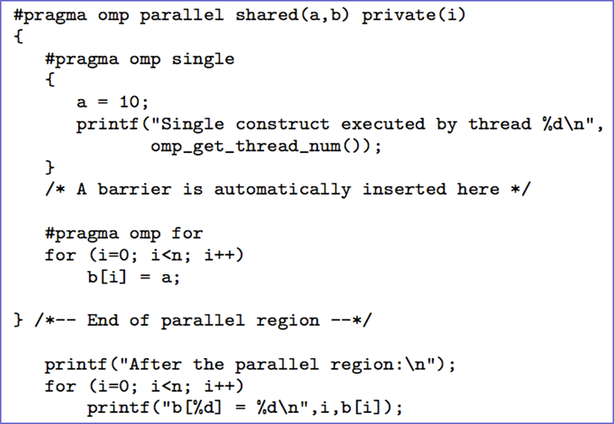
OMP_SINGLE
Only one thread
initializes the
shared variable a

Slide 13
OMP Master
Specifies a region that is to be executed only by the master thread of the team.
All other threads on the team skip this section of code
It is similar to the SINGLE construct.
This Directive ensures that only the master threads executes instructions in the block.
There is no implicit barrier so other threads will not wait for master to finish.
The following block will be executed by the master thread
No synchronization involved
Applicable only to parallel sections

Slide 14
OMP Master
#include <omp.h>
#include <stdio.h>
int main( )
{ int a[5], i;
#pragma omp parallel
{ // Perform some computation.
#pragma omp for
for (i = 0; i < 5; i++)
a[i] = i * i;
// Print intermediate results.
#pragma omp master
for (i = 0; i < 5; i++)
printf("a[%d] = %d\n", i, a[i]);
// Wait.
#pragma omp barrier // Continue with the computation.
#pragma omp for
for (i = 0; i < 5; i++) a[i] += i; } }

Slide 15
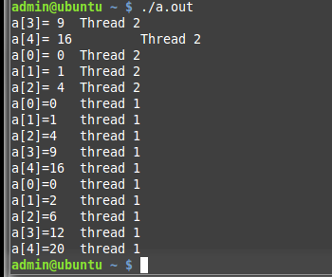

Slide 16
Difference
Single Master
1.Wait 1.No wait
2.Separate thread for that region 2.Master thread

Slide 17
OMP CRITICAL
This Directive makes sure that only one thread can execute the code in the block.
If another threads reaches the critical section it will wait untill the current thread finishes this critical section.
It provides a means to ensure that multiple threads do not attempt to update the same shared data simultaneously.
An optional name can be given to a critical construct. Name must be global and unique
When a thread encounters a critical construct, it waits until no other thread is executing a critical region with the same name.
Every thread will execute the critical block and they will synchronize at end of critical section
Introduces overhead
Serializes critical block
If time in critical block relatively large → speedup negligible

Slide 18
#include <omp.h>
#include <stdio.h>
#include <stdlib.h>
#define SIZE 10
int main()
{ int i; int max; int a[SIZE];
for (i = 0; i < SIZE; i++)
{ a[i] = rand();
printf(“ a[%d] = %d \t thread no %d\n", i, a[i]),omp_get_num_threads(); }
max = a[0];
#pragma omp parallel for
for (i = 1; i < SIZE; i++) {
if (a[i] > max)
{ #pragma omp critical
{ // compare a[i] and max again because max could have been changed by another thread after
// the comparison outside the critical section
if (a[i] > max) max = a[i]; }
} }
printf("max = %d\t thread no = %d\n", max, omp_get_num_threads()); }
Output
41 18467 6334 26500 19169 15724 11478
29358 26962 24464 max = 29358

Slide 19
OMP CRITICAL
#pragma omp critical [name]
Standard critical section functionality
Critical sections are global in the program
Can be used to protect a single resource in different functions
Critical sections are identified by the name
All the unnamed critical sections are mutually exclusive throughout the program
All the critical sections having the same name are mutually exclusive between themselves
i n t x = 0 ;
#pragma omp p a r a l l e l s h a r e d ( x )
{ #pragma omp c r i t i c a l
x++; }

Slide 20
Difference between single and critical
single specifies that a section of code should be executed by single thread(not necessarily the master thread)
critical specifies that code is executed by one thread at a time

Slide 21
Example
int a=0, b=0;
#pragma omp parallel num_threads(4)
{
#pragma omp single
a++;
#pragma omp critical
b++;
}
printf("single: %d -- critical: %d\n", a, b);

Slide 22


Slide 23
OMP ATOMIC
#OMP ATOMIC
This Directive is very similar to the #OMP CRITICAL
Difference is that #OMP ATOMIC is only used for the update of a memory location.
Specifies that a specific memory location must be updated atomically, rather than letting multiple threads attempt to write to it.
Read,Write,Update,Capture

Slide 24
OMP ATOMIC
The omp atomic directive allows access of a specific memory location atomically.
It ensures that race conditions are avoided through direct control of concurrent threads that might read or write to or from the particular memory location.
for(i = 0; i<10; i++)
{
#pragma omp atomic
x[j[i]]= x[j[i]] + 1.0;
}

Slide 25
Ordered
#pragma omp ordered
It allows one to execute a structured block within a parallel loop in sequential order.
The code outside this block runs in parallel.
if threads ﬁnish out of order, there may be an additional performance penalty because some threads might have to wait.

Slide 26
Ordered
#pragma omp parallel for
for(i = 0; i < nproc; i++)
{
do_lots_of_work(result[i]);
#pragma omp ordered
fprintf(fid,”%d %f\n,”i,result[i]”);
#pragma omp end ordered
}

Slide 27
OMP BARRIER
Important restrictions:
Each barrier must be encountered by all threads in a team, or by none at all.
The sequence of work-sharing regions and barrier regions encountered must be the same for every thread in the team.
Without these rules some threads wait forever (or until somebody kills the process) for other threads to reach a barrier

Slide 28
OMP BARRIER
Synchronizes all threads in the team.
When a BARRIER directive is reached, a thread will wait at that point until all other threads have reached that barrier.
All threads then resume executing in parallel the code that follows the barrier.

Slide 29
OMP BARRIER
barrier synchronizes threads
Here barrier assures that a(1) or a[0] is available before computing myval
#pragma omp parallel private(myid,istart,iend)
myrange(myid,istart,iend);
for(i=istart; i<=iend; i++){
a[i] = a[i] – b[i];
}
#pragma omp barrier
myval[myid] = a[istart] + a[0]

Slide 30
OMP BARRIER
Performs a barrier synchronization between all the threads in a team at the given point.
!$OMP BARRIER will enforce every thread to wait at the barrier until all threads have reached the barrier.
!$OMP BARRIER is probably the most well known synchronization mechanism; explicitly or implictly.
The following omp directives we discussed before include an implicit barrier:

Slide 31
REDUCTION
f o r ( j =0; j<N; j++) {
sum = sum+a [ j ] b [ j ] ;
}
How to parallelize this code?
sum is not private, but accessing it atomically is too expensive
Have a private copy of sum in each thread, then add them up
Use the reduction clause!
#pragma omp parallel for reduction(+: sum)
Any associative operator must be used: +, -, ||, |, *, etc.
The private value is initialized automatically (to 0, 1, ~0 . . . )

Slide 32
Exercise
Develop an OpenMP C Parallel Program to perform the travelling salesman problem

