Slide 1

Python Flow
Lecture 1. Collections.
Basic Algorithms.

Slide 2

OVERVIEW
Built-in collections
Collections module
Built-in functions
Map
Reduce
Filter
Basic algorithms

Slide 3
Built-in collections
Python offers several built-in types. Here are the main ones
list - data structure that holds an ordered collection of items i.e. you can store a sequence of items in a list.
tuple - data structure similar to a list. The difference is that we cannot change the elements of a tuple once it is assigned whereas in a list, elements can be changed.
dictionary - an unordered collection of items. While other compound data types have only value as an element, a dictionary has a key: value pair.
set - an unordered collection of items. Every element is unique (no duplicates) and must be immutable (which cannot be changed).

Slide 4
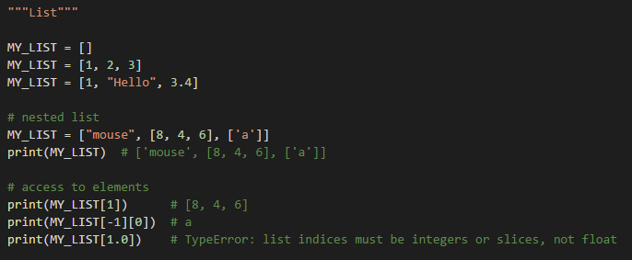
List

Slide 5
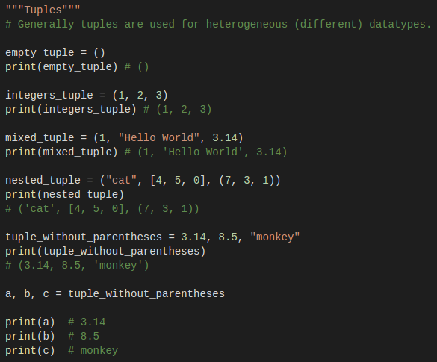
Tuples

Slide 6
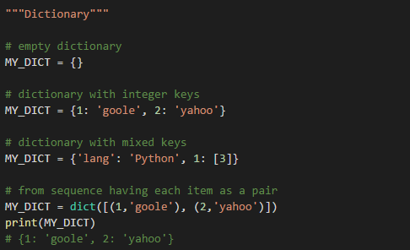
Dictionary

Slide 7
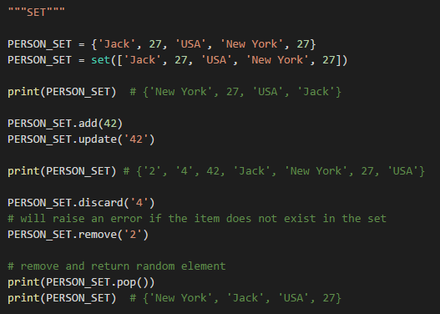
Set

Slide 8
Collections module
This module implements specialized container data types providing alternatives to Python’s general purpose built-in containers, dict, list, set, and tuple.
namedtuple() - factory function for creating tuple subclasses with named fields
deque - list-like container with fast appends and pops on either end
Counter - dict subclass for counting hashable objects
OrderedDict - dict subclass that remembers the order entries were added
defaultdict - dict subclass that calls a factory function to supply missing values

Slide 9
Named tuple
Named tuples assign meaning to each position in a tuple and allow for more readable, self-documenting code.
They can be used wherever regular tuples are used, and they add the ability to access fields by name instead of position index.
Named tuple instances are lightweight and require no more memory than regular tuples.

Slide 10
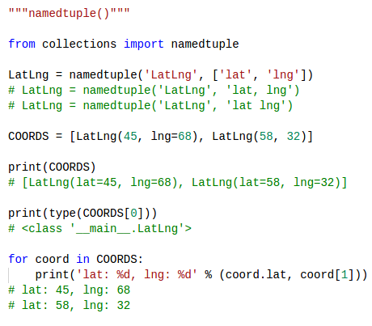
Named tuple

Slide 11
Named tuple
In addition to the methods inherited from tuples, named tuples support three additional methods and two attributes.
To prevent conflicts with field names, the method and attribute names start with an underscore.
_make(iterable) - makes a new instance from an existing sequence or iterable.
_asdict() - return a new OrderedDict which maps field names to their corresponding values.
_replace(**kwargs) - return a new instance of the named tuple replacing specified fields with new values

Slide 12
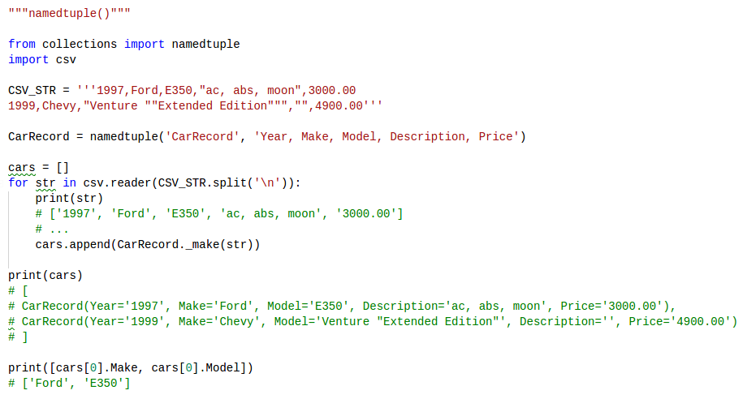
Named tuple

Slide 13
Deque
.deque([iterable[, maxlen]])
A deque is a double-ended queue. It can be used as a stack or queue.
Although lists offer many of the same operations, they are not optimized for variable-length operations.
Deques support memory efficient appends and pops from either side of the deque with approximately the same performance in either direction.
If maxlen is not specified or is None, deques may grow to an arbitrary length. Otherwise, the deque is bounded to the specified maximum length.
Once a bounded length deque is full, when new items are added, a corresponding number of items are discarded from the opposite end.

Slide 14
Deque
Deque has the same interface as a list, but with additional methods
appendleft(x) - add x to the left side of the deque.
extendleft(iterable) - extend the left side of the deque by appending elements from iterable (in reversed order).
popleft() - remove and return an element from the left side of the deque.
rotate(n) - rotate the deque n steps to the right. If n is negative, rotate to the left. Rotating one step to the right is equivalent to: d.appendleft(d.pop())

Slide 15
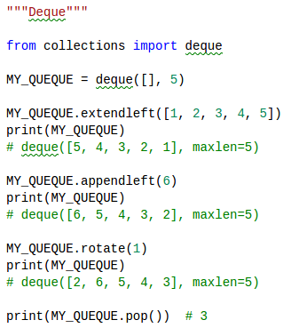
Deque

Slide 16
Counter
A Counter is a dict subclass for counting hashable objects.
It is an unordered collection where elements are stored as dictionary keys and their counts are stored as dictionary values.
Counter objects have a dictionary interface except that they return a zero count for missing items instead of raising a KeyError

Slide 17
Counter
Counter objects support three methods beyond those available for all dictionaries:
elements() - return an iterator over elements repeating each as many times as its count.
most_common([n]) - return a list of the n most common elements and their counts from the most common to the least.
subtract([iterable-or-mapping]) - elements are subtracted from an iterable or from another mapping (or counter). Like dict.update() but subtracts counts instead of replacing them.

Slide 18
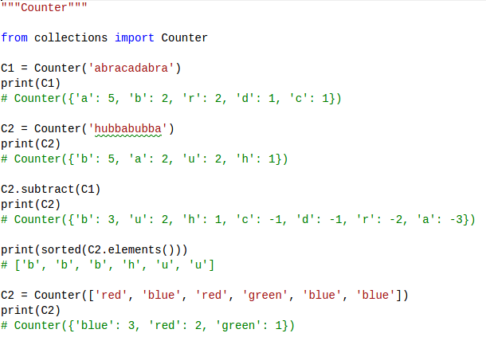
Counter

Slide 19
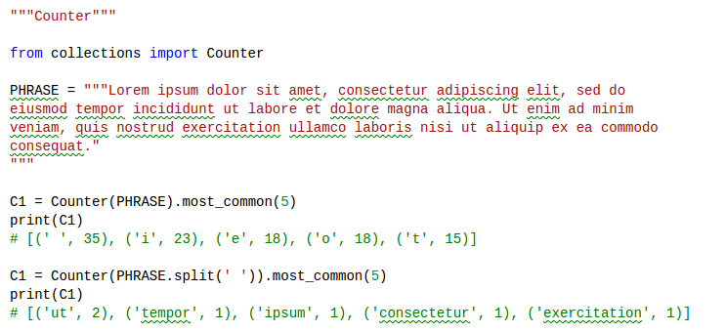
Counter

Slide 20
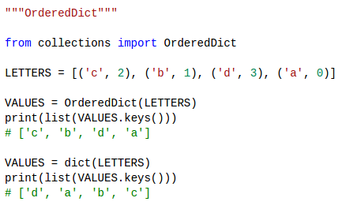
Ordered Dictionary
Ordered dictionaries are just like regular dictionaries but they remember the order that items were inserted.
When iterating over an ordered dictionary, the items are returned in the order their keys were first added.

Slide 21
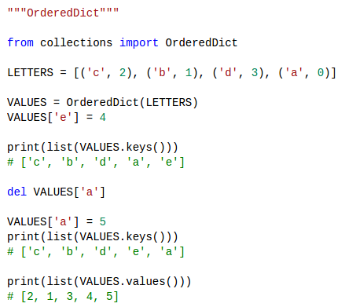
Ordered Dictionary

Slide 22
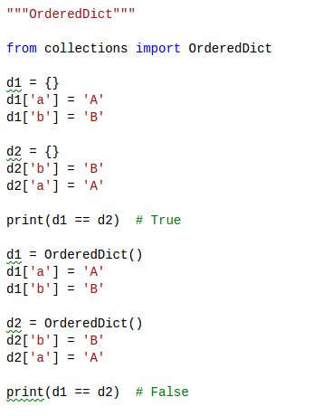
Ordered Dictionary

Slide 23
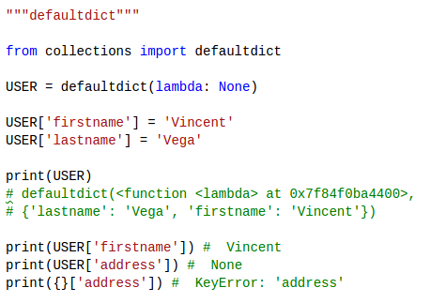
Default Dictionary
A defaultdict works exactly like a normal dict, but it is initialized with a function (“default factory”) that takes no arguments and provides the default value for a nonexistent key.

Slide 24
Built-in function: Map
map(func, seq)
The first argument func is a function or it’s name and the second a sequence (e.g. a list) seq.
map() applies the function func to all the elements of the sequence seq.
The returned value from map() (map object) then can be passed to functions like list() (to create a list), set() (to create a set), etc.

Slide 25
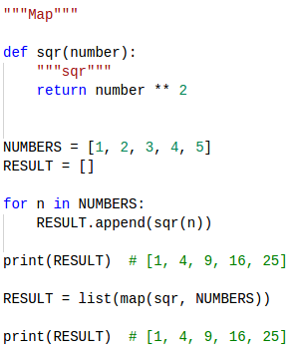
Built-in function: Map

Slide 26
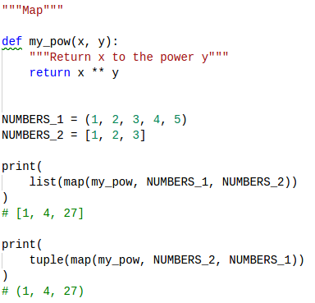
Built-in function: Map

Slide 27
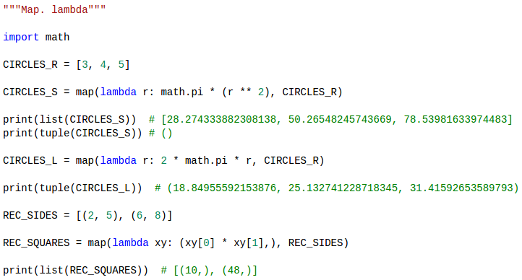
Built-in function: Map

Slide 28
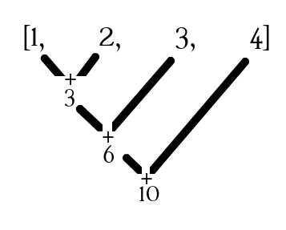
Built-in function: Reduce
functools.reduce(func, seq)
The first argument func is a function or it’s name and the second a sequence (e.g. a list) seq.
reduce() applies a particular function passed in its argument to all of the list elements mentioned in the sequence passed along.

Slide 29
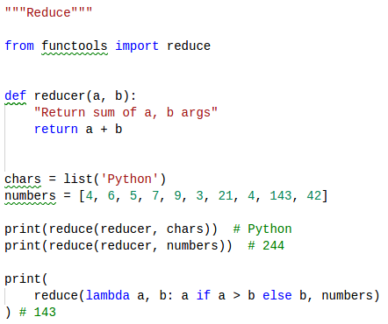
Built-in function: Reduce

Slide 30
Built-in function: Filter
filter() method filters the given iterable with the help of a function that tests each element in the iterable to be true or not
The filter() method takes two parameters:
function - function that tests if elements of an iterable returns true or false
iterable - iterable which is to be filtered, could be sets, lists, tuples, or containers of any iterators

Slide 31
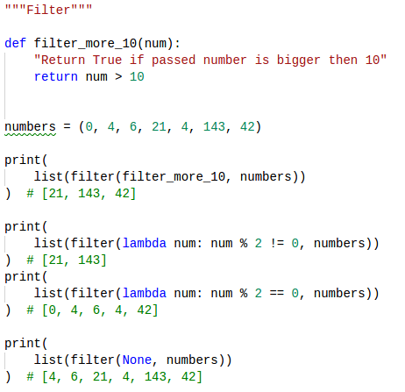
Built-in function: Filter

Slide 32
Algorithms
An algorithm is a step by step recipe for solving an instance of a problem.
Every single procedure that a computer performs is an algorithm
An algorithm is a precise procedure for solving a problem in finite number of steps.
An algorithm states the actions to be executed and the order in which these actions are to be executed.
An algorithm is a well ordered collection of clear and simple instructions of definite and effectively computable operations that when executed produces a result and stops executing at some point in a finite amount of time rather than just going on and on infinitely.

Slide 33
Algorithms. Complexity
Algorithmic complexity is concerned about how fast or slow particular algorithm performs. We define complexity as a numerical function T(n) - time versus the input size n.
We want to define time taken by an algorithm without depending on the implementation details. But you agree that T(n) does depend on the implementation!
A given algorithm will take different amounts of time on the same inputs depending on such factors as: processor speed; instruction set, disk speed, brand of compiler and etc.

Slide 34
Algorithms. Big O notation
Big O notation is used in Computer Science to describe the performance or complexity of an algorithm.
O(T(n)) - T(n): time as the number of elementary "steps" (provided each such step takes constant time. ), where n is an input size
Need to remember what is an log
log2(1024) == 10 (2^10 == 1024)

Slide 35
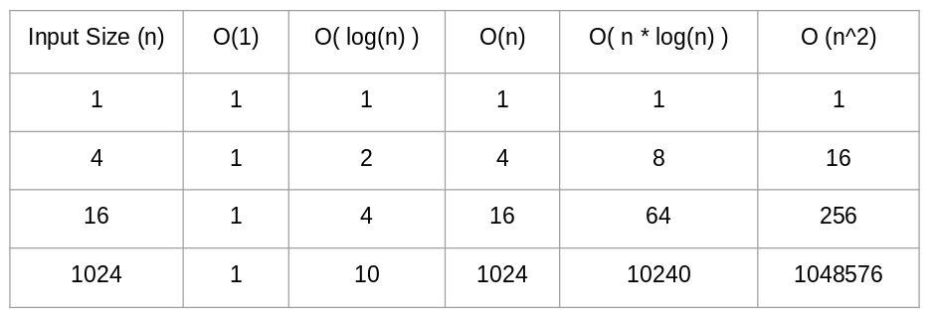
Algorithms. Big O notation

Slide 36
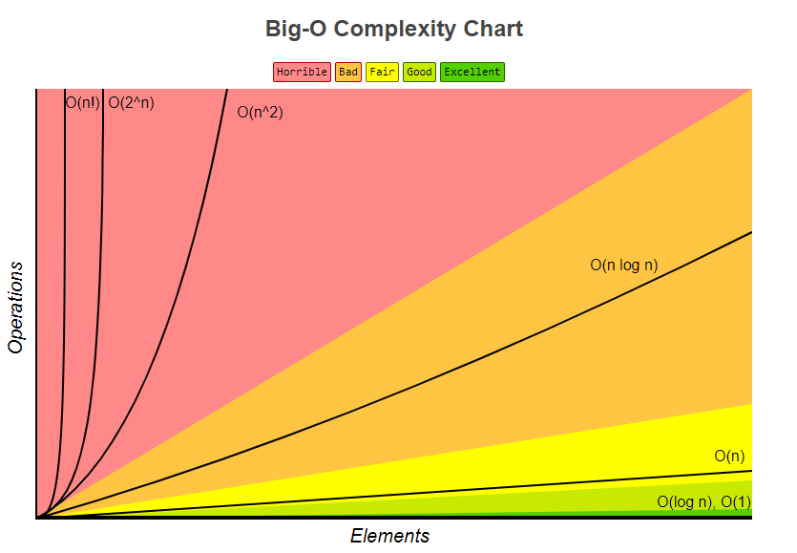
Algorithms. Big O notation

Slide 37
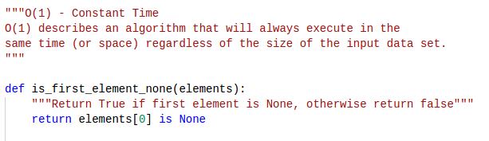
Big O notation. O(1)

Slide 38
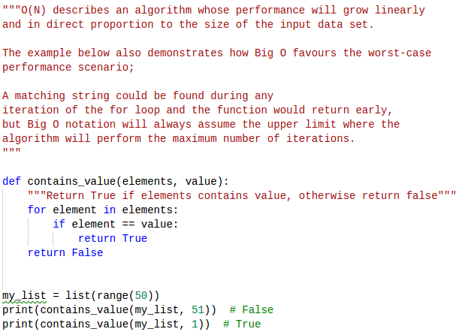
Big O notation. O(N)

Slide 39
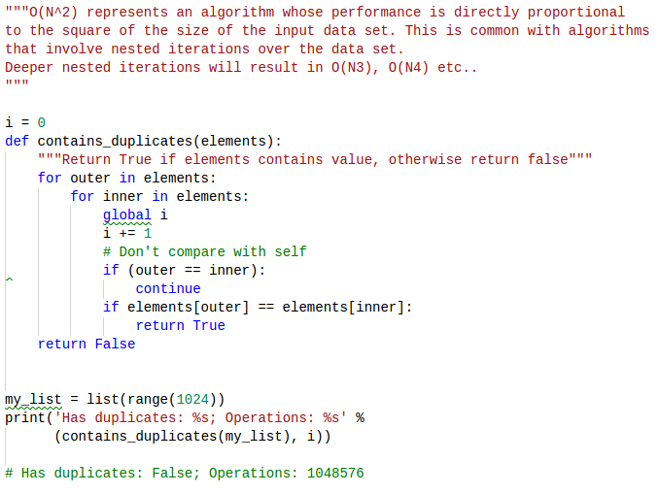
Big O notation. O(N^2)

Slide 40
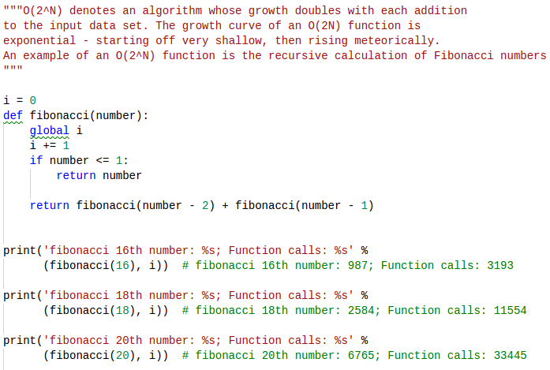
Big O notation. O(2^N)

Slide 41
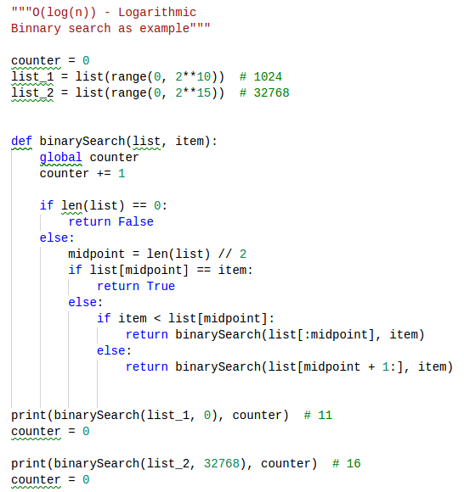
Big O notation. O(log N)

Slide 42
Thanks for watching

