Slide 1

Python Flow
Lecture 2. Iterators. Generators. Decorators.

Slide 2

OVERVIEW
Container
Iterable
Iterator
Generator
Generator expression
Comprehension {list, set, dict}
Decorators

Slide 3
Containers
Containers are data structures holding elements, and that support membership tests. They are data structures that live in memory, and typically hold all their values in memory, too. In Python, some well known examples are:
list, deque, …
set, frozensets, …
dict, defaultdict, OrderedDict, Counter, …
tuple, namedtuple, …
str

Slide 4
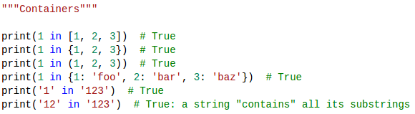
Containers
Containers are easy to grasp, because you can think of them as real life containers: a box, a cupboard, a house, a ship, etc.
Technically, an object is a container when it can be asked whether it contains a certain element. You can perform such membership tests on lists, sets, or tuples alike.
A string does not literally store copies of all of its substrings in memory, but you can certainly use it that way.

Slide 5
Containers
Even though most containers provide a way to produce every element they contain, that ability does not make them a container but an iterable .
Not all containers are necessarily iterable. An example of this is a Bloom filter. Probabilistic data structures like this can be asked whether they contain a certain element, but they are unable to return their individual elements.

Slide 6
Iterables
As was said, most containers are also iterable. But many more things are iterable as well. Examples are open files, open sockets, etc. Where containers are typically finite, an iterable may just as well represent an infinite source of data.
An iterable is an object that has an __iter__ method which returns an iterator, or which defines a __getitem__ method that can take sequential indexes starting from zero (and raises an IndexError when the indexes are no longer valid). So an iterable is an object that you can get an iterator from. (with the purpose of returning all of its elements).

Slide 7
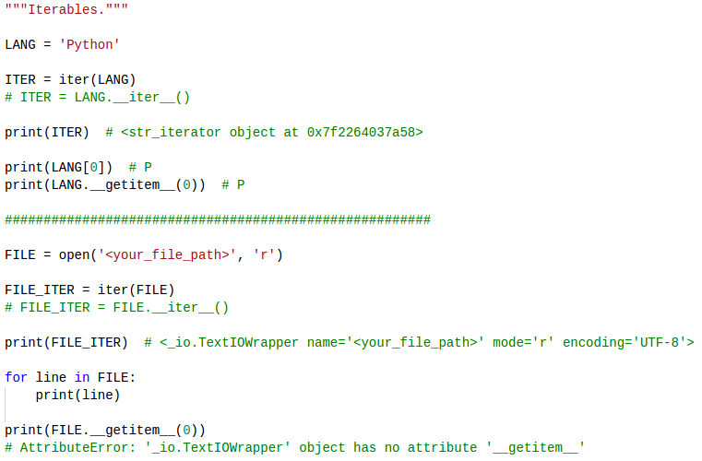
Iterables

Slide 8
Iterators
So what is an iterator then?
It's a stateful helper object that will produce the next value when you call next() on it.
Any object that has a __next__() method is therefore an iterator.
How it produces a value is irrelevant.
So an iterator is a value factory.
Each time you ask it for "the next" value, it knows how to compute it because it holds internal state.

Slide 9
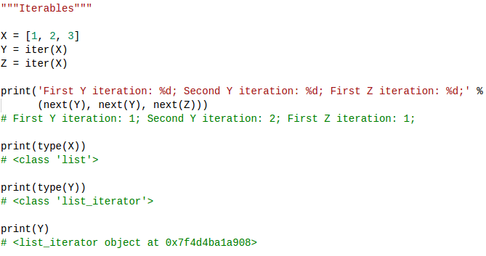
Iterators with iterables
Here, X is the iterable, while Y and Z are two individual instances of an iterator, producing values from the iterable x.
Both Y and Z hold state, as you can see from the example. In this example, x is a data structure (a list), but that is not a requirement.

Slide 10
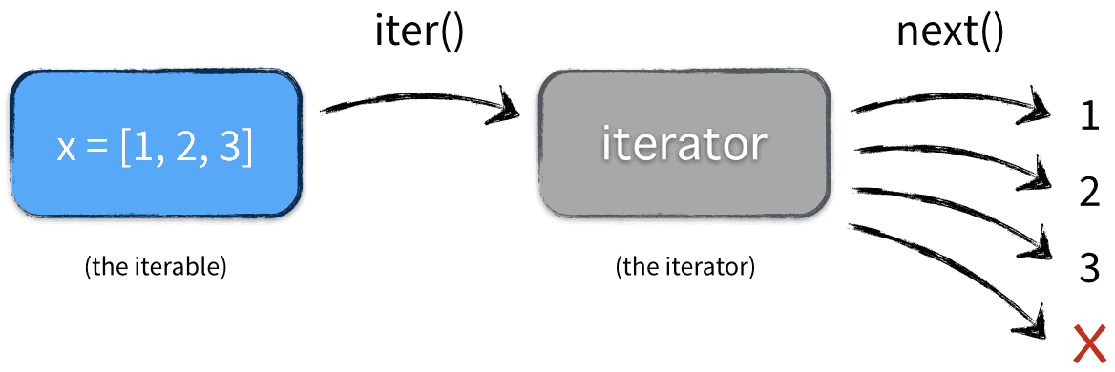
Iterators with iterables
Finally, when you write:
x = [1, 2, 3]
for elem in x: pass
This is what actually happens:

Slide 11
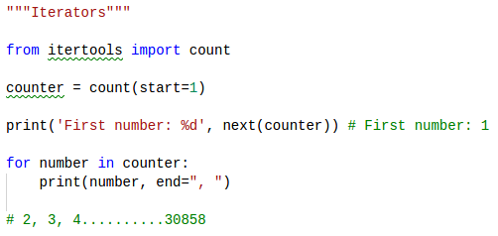
Iterators
There are countless examples of iterators.
All of the itertools functions return iterators.
Some iterators produce infinite sequences

Slide 12
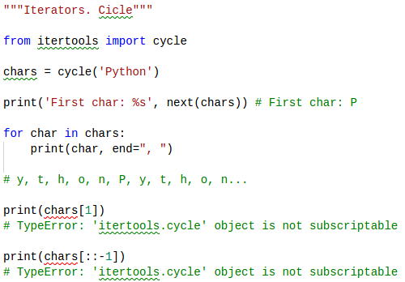
Iterators
Some produce infinite sequences from finite sequences

Slide 13
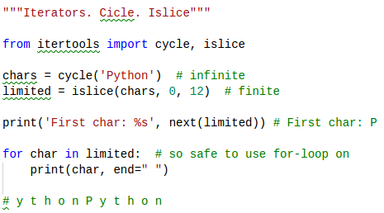
Iterators
Some produce finite sequences from infinite sequences

Slide 14
Iterators. The main idea
From the outside, the iterator is like a lazy factory that is idle until you ask it for a value, which is when it starts to buzz and produce a single value, after which it turns idle again.

Slide 15
Generators
Finally, we've arrived at our destination! The generators are the great Python language feature. A generator is a special kind of iterator—the elegant kind.
The main feature of generator is evaluating the elements on demand.
A generator allows you to write iterators in an elegant succinct syntax that avoids writing classes with __iter__() and __next__() methods.
Let's be explicit:
Any generator also is an iterator (not vice versa!)
Any generator, therefore, is a factory that lazily produces values.

Slide 16
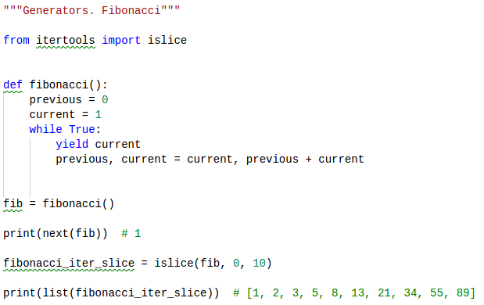
Generators
Here is an example of Fibonacci sequence factory written as a generator:

Slide 17
Generators
Wow, isn't that elegant? Notice the magic keyword that's responsible for the beauty: yield
Let's break down what happened here: first of all, take note that fibonacci is defined as a normal Python function, nothing special.
Notice, however, that there's no return keyword inside the function body. The return value of the function will be a generator (read: an iterator, a factory, a stateful helper object)

Slide 18
Generators
When fib = fibonacci() is called, the generator (the factory) is instantiated and returned.
No code will be executed at this point
The generator starts in an idle state initially. To be explicit: the line previous, current= 0, 1 is not executed yet.

Slide 19
Generators
Once next(fib) was called fibonacci() functions was first time invoked.
But we had only one iteration despite the fact we have “while True” loop.
This because of yield statement.
The “while True” loop is entered, and then it encounters the yield current statement. It produced the value that was in the current variable and become idle again.

Slide 20
Types of Generators
There are two types of generators in Python:
Generator functions - any function in which the keyword yield appears in its body. We just saw an example of that. The appearance of the keyword yield is enough to make the function a generator function.
Generator expressions - the generator equivalent of a list comprehension. Its syntax is really elegant for a limited use case.

Slide 21
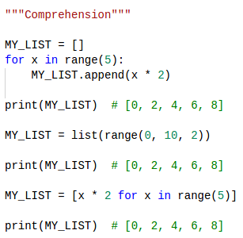
Comprehension {list, set, dict}
List comprehensions allow you to create lists with a for loop with less code.
[ expression for item in list if conditional ]

Slide 22
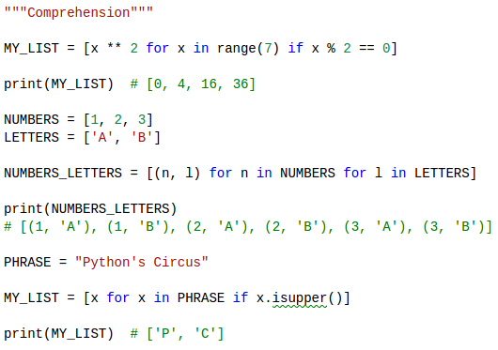
Comprehension {list, set, dict}

Slide 23
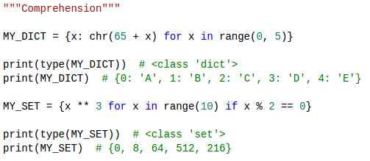
Comprehension {list, set, dict}

Slide 24
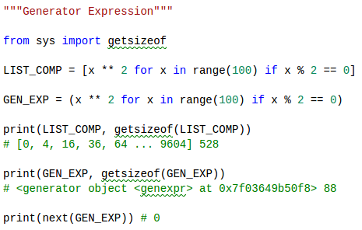
Generator Expression

Slide 25
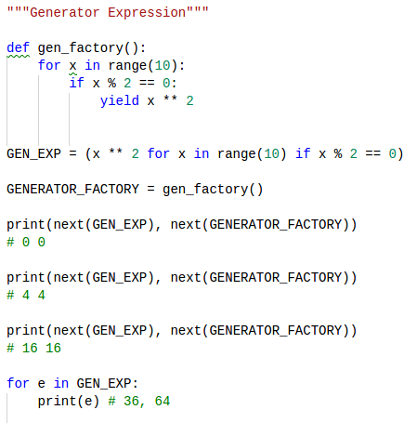
Generator Expression

Slide 26
Decorators
Decorator is way to dynamically add some new behavior to some objects. We achieve the same in Python by using closures.
We will create a simple example which will print some statement before and after the execution of a function.

Slide 27
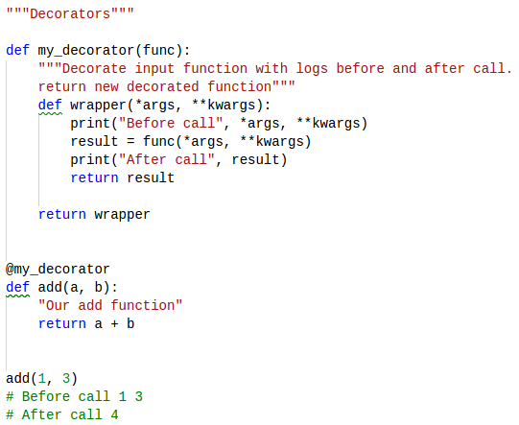
Function Decorators

Slide 28
Thanks for watching

