Slide 1

Python Flow
Lecture 3. Exception handling. Operations with files.

Slide 2

OVERVIEW
Exceptions
Exceptions handling
Exceptions raising
User-Defined Exceptions
Opening and Closing Files
Reading and Writing Files
File Positions
Renaming and Deleting Files
Directories in Python

Slide 3
Exceptions
Exception is an indication of a special event that occurs during program’s execution.
Exception indicates that, although the event can occur, the event occurs infrequently.
When a Python script encounters a situation that it can’t cope with, it raises an Exception.
An Exception is a Python object that represents an error.

Slide 4
Exceptions. Examples
Division by Zero.
Addition of two incompatible types.
Accessing a file that is nonexistent.
Accessing a nonexistent index of a sequence.
Deleting a table in a disconnected database server.
Withdrawing money greater than the available amount.
…
Aborting a program component could leave a file or a network connection in a state in which other programs are not able to acquire the resource.

Slide 5
Exception Handling
Advantages
Handle the error
- catching the exception
- resolving the exception
Continue processing as if no error had occurred
Programs are more clear, robust and more fault-tolerant
When no exceptions occur, exception-handling code incurs little or no performance penalties.

Slide 6
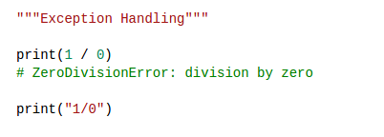
Exception Handling

Slide 7
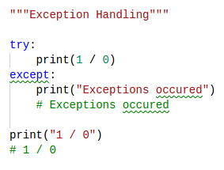
Exception Handling

Slide 8
Exceptions. try-except-else
Python uses try statements to enable exception handling.
The try statement encloses statements that potentially cause exceptions.
A try statement consists of keyword try, followed by a colon (:), followed by a suite of code in which exceptions may occur, followed by one or more clauses.
Immediately following the try suite may be one or more except clauses (also called except handlers).
Each except clause specifies zero or more exception names that represent the type(s) of exceptions the except clause can handle.
After the last except clause, an optional else clause contains code that executes if the code in the try suite raised no exceptions.

Slide 9
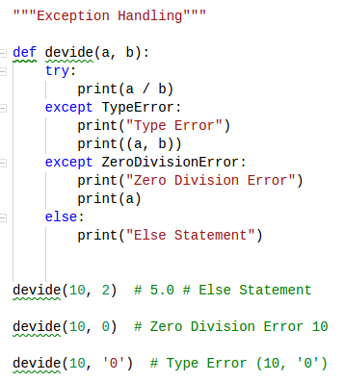
Exceptions. try-except

Slide 10
Exceptions. try-except-finally
A try suite can be followed by zero except clauses.
In that case, it must be followed by a finally clause.
The code in the finally suite always executes, regardless of whether an exception occurs.
Programs frequently request and release resources dynamically.
Programs that obtain certain types of resources (such as files) sometimes must return those resources explicitly to the system to avoid resource leaks.
The finally clause is an ideal location to place resource deallocation code for resources acquired.

Slide 11
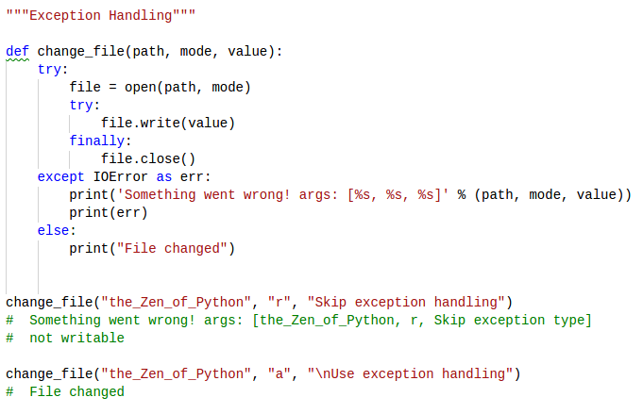
Exceptions. try-except-finally

Slide 12
Exceptions. Inheritance
Exceptions are objects of classes that inherit from class Exception.
Programmer-defined exception classes should derive directly or indirectly from class Exception.
Exception hierarchy: see Python documentation

Slide 13
Exceptions. raise
Raising/Throwing An Exception
raise keyword
Catching and handling exceptions enables a program to know when an error has occurred, then to take actions to minimize the consequences of that error.
The raise statement may specify an argument that initialize the exception object.

Slide 14
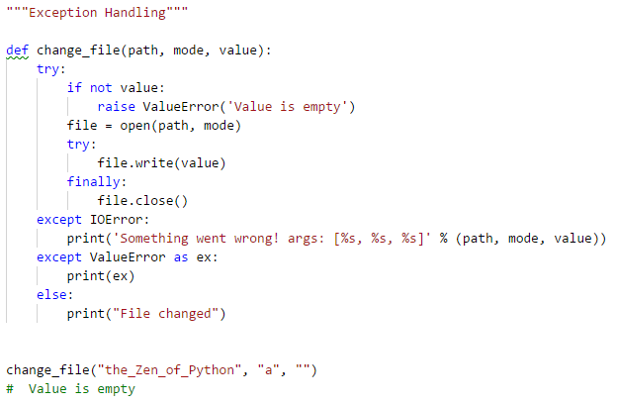
Exceptions. raise

Slide 15
User-defined Exceptions
Python has many built-in exceptions which forces your program to output an error when something in it goes wrong.
However, sometimes you may need to create custom exceptions that serves your purpose.
In Python, users can define such exceptions by creating a new class. This exception class has to be derived, either directly or indirectly, from Exception class. Most of the built-in exceptions are also derived from this class.

Slide 16
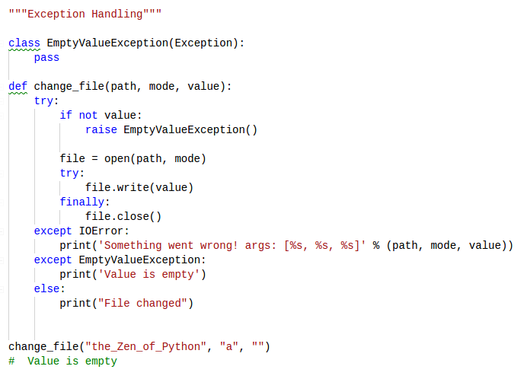
Exceptions. raise

Slide 17
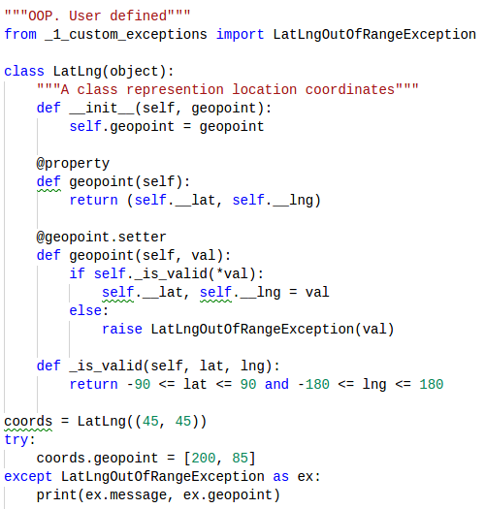
User-defined Exceptions

Slide 18
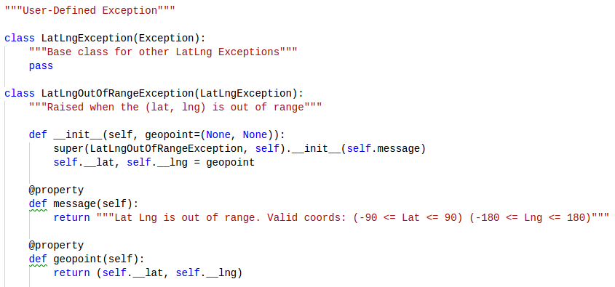
User-defined Exceptions

Slide 19
Exceptions. assert
An assertion is a sanity-check that you can turn on/off when you are done with your testing of the program.
Assertion is like a raise-if statement (or to be more accurate, a raise-if-not statement).
An expression is tested, and if the result comes up false, an exception is raised.
Programmers often place assertions at the start of a function to check for valid input, and after a function call to check for valid output.
Run you program using Python with command line option -O to turn on optimization mode. In this mode assertions are skipped

Slide 20
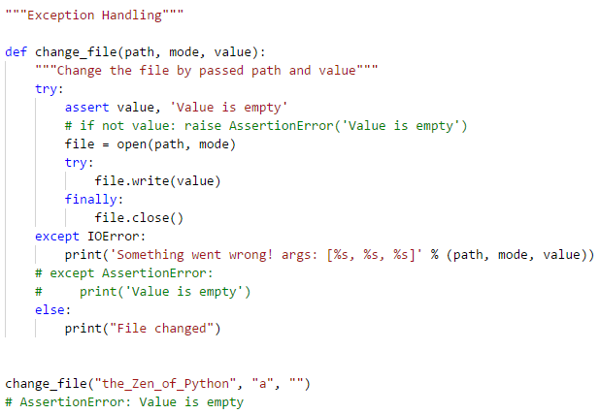
Exceptions. assert

Slide 21
Working with files. Open
Python provides basic functions and methods necessary to manipulate files by default.
You can do most of the file manipulation using a file object.
Before you can read or write a file, you have to open it using Python's built-in open() function.
This function creates a file object, which would be utilized to call other support methods associated with it.

Slide 22
Working with files. Close
After opening a file one should always close the opened file. We use method close() for this.
Python automatically closes a file when the reference object of a file is reassigned to another file.
with statement is often used for reading and writing files.
The advantage is that the file will be automatically closed after the indented block after the witch has finished execution

Slide 23
The file Object Attributes
Once a file is opened and you have one file object, you can get various information related to that file.
file.closed - returns true if file is closed, false otherwise.
file.mode - returns access mode with which file was opened.
file.name - returns name of the file.

Slide 24
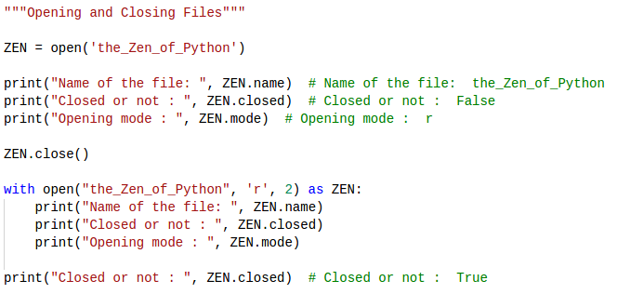
Opening and Closing Files

Slide 25
Opening files
open(file_name [, access_mode][, buffering][, encoding][, errors][, newline])
file_name - string value that contains the name of the file that you want to access.
access_mode - mode in which the file has to be opened, i.e., read, write, append, etc. This is an optional parameter and the default file access mode is read (r).
buffering - If the buffering value is set to 0, no buffering takes place. If the buffering value is 1, line buffering is performed while accessing a file. If you specify the buffering value as an integer greater than 1, then buffering action is performed with the indicated buffer size. If negative, the buffer size is the system default(default behavior).

Slide 26
Opening files
open(file_name [, access_mode][, buffering][, encoding][, errors][, newline])
encoding - name of the encoding used to decode or encode the file. This should only be used in text mode. The default encoding is platform dependent, but any text encoding supported by Python can be used.
errors - errors is an optional string that specifies how encoding and decoding errors are to be handled—this cannot be used in binary mode. Default (None) - 'strict' to raise a ValueError
newline - controls how universal newlines mode works (it only applies to text mode). It can be None, '', '\n', '\r', and '\r\n'. Default - system default line separator

Slide 27
Opening files. Mode
Here is a list of the different modes of opening a file:
r - opens a file for reading only. The file pointer is placed at the beginning of the file. This is the default mode.
rb - opens a file for reading only in binary format. The file pointer is placed at the beginning of the file.
r+ - opens a file for both reading and writing in binary format. The file pointer placed at the beginning of the file.
w - opens a file for writing only. Overwrites the file if the file exists. If the file does not exist, creates a new file for writing.
wb - opens a file for writing only in binary format. Overwrites the file if it exists. If it does not exist, creates a new file for writing.

Slide 28
Opening files. Mode
Here is a list of the different modes of opening a file:
w+ - opens a file for both writing and reading. Overwrites the existing file if the file exists. If the file does not exist, creates a new file for reading and writing.
wb+ - opens a file for both writing and reading in binary format. Overwrites the existing file if the file exists. If the file does not exist, creates a new file for reading and writing.
a - opens a file for appending. The file pointer is at the end of the file if the file exists. That is, the file is in the append mode. If the file does not exist, it creates a new file for writing.

Slide 29
Opening files. Mode
Here is a list of the different modes of opening a file:
ab - opens a file for appending in binary format. The file pointer is at the end of the file if the file exists. That is, the file is in the append mode. If the file does not exist, it creates a new file for writing.
a+ - opens a file for both appending and reading. The file pointer is at the end of the file if the file exists. The file opens in the append mode. If the file does not exist, it creates a new file for reading and writing.
ab+ - opens a file for both appending and reading in binary format. The file pointer is at the end of the file if the file exists. The file opens in the append mode. If the file does not exist, it creates a new file for reading and writing.

Slide 30
Important
Always make sure you explicitly close each open file, once its job is done and you have no reason to keep it open. Because - There is an upper limit to the number of files a program can open. If you exceed that limit, there is no reliable way of recovery, so the program could crash. - Each open file consumes some main-memory for the data-structures associated with it, like file descriptor/handle or file locks etc. So you could essentially end-up wasting lots of memory if you have more files open that are not useful or usable. - Open files always stand a chance of corruption and data loss.

Slide 31
Reading and Writing Files
The file object provides a set of access methods to make our lives easier. We would see how to use read() and write() methods to read and write files.
The write() method writes any string to an open file. It is important to note that Python strings can have binary data and not just text.
The write() method does not add a newline character ('\n') to the end of the string.
The read() method reads a string from an open file. It is important to note that Python strings can have binary data.

Slide 32
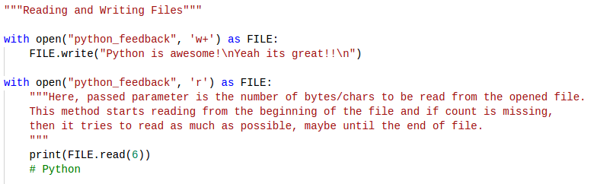
Reading and Writing Files

Slide 33
File Positions
The tell() method tells you the current position within the file; in other words, the next read or write will occur at that many bytes/chars from the beginning of the file.
The seek(offset[, from]) method changes the current file position. The offset argument indicates the number of bytes/chars to be moved. The from argument specifies the reference position from where the bytes/chars are to be moved.
If from is set to 0, the beginning of the file is used as the reference position. If it is set to 1, the current position is used as the reference position. If it is set to 2 then the end of the file would be taken as the reference position.

Slide 34
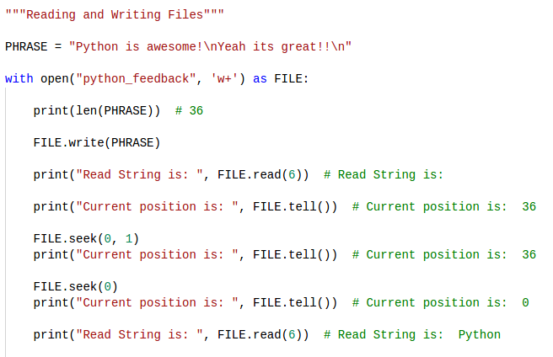
File positions

Slide 35
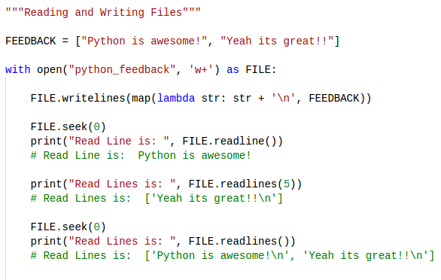
Reading and Writing Files

Slide 36
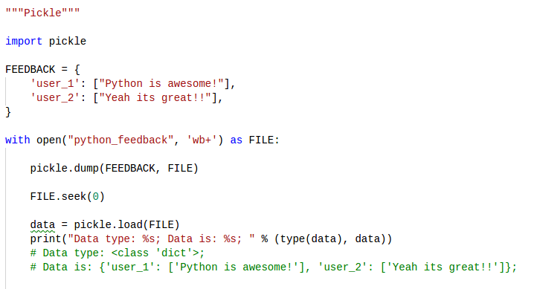
File I/O. Pickle

Slide 37
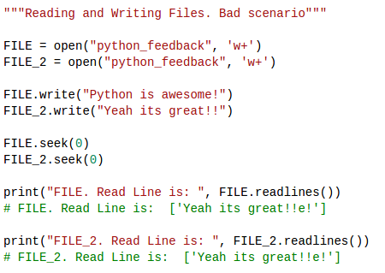
File I/O. Bad scenario

Slide 38
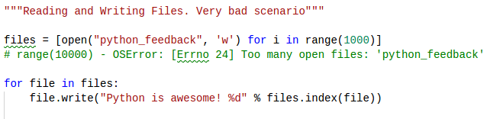
File I/O. Bad scenario

Slide 39
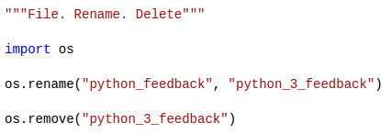
Renaming and Deleting Files
Python os module provides methods that help you perform file-processing operations, such as renaming and deleting files.
The rename() method takes two arguments, the current filename and the new filename.
You can use the remove() method to delete files by supplying the name of the file to be deleted as the argument.

Slide 40
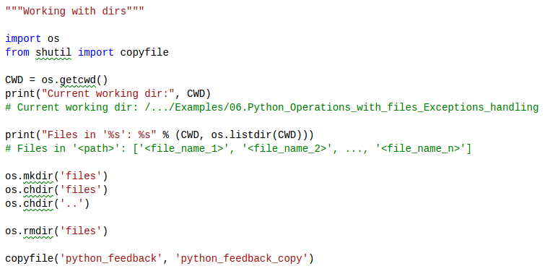
Working with dirs

Slide 41
Thanks for watching

