Slide 1

Python Flow
Lecture 4. OOP and Python

Slide 2

OVERVIEW
OOP basics
Abstract classes
Interfaces
Static & Class method
SOLID Python

Slide 3
OOP
OOP is mainly a program design philosophy.
Everything in OOP is grouped as self sustainable "objects". Hence, you gain reusability by means of four main object-oriented programming concepts.
In OOP programmers define not only the data type of a data structure, but also the types of operations/methods (functions) that can be applied to the data structure.
In this way, the data structure becomes an object that includes both data and functions (methods) in one unit. In addition, programmers can create relationships between one object and another.
For example, objects can inherit characteristics from other objects.

Slide 4
OOP Basic Terminology
Object
Usually a person, place or thing (a noun)
Method
An action performed by an object (a verb)
Property or attribute
Characteristics of certain object
Class
A category of similar objects (such as automobiles), does not hold any values of the object’ s attributes/properties

Slide 5
OOP. Classes and Objects
An object is a computational entity that
Encapsulates some state
Is able to perform actions, or methods, on this state
Communicates with other objects via message passing
Each copy of an object from a particular class is called an instance of the class.
The act of creating a new instance of an class is called instantiation.
Object is a class in “runtime”

Slide 6
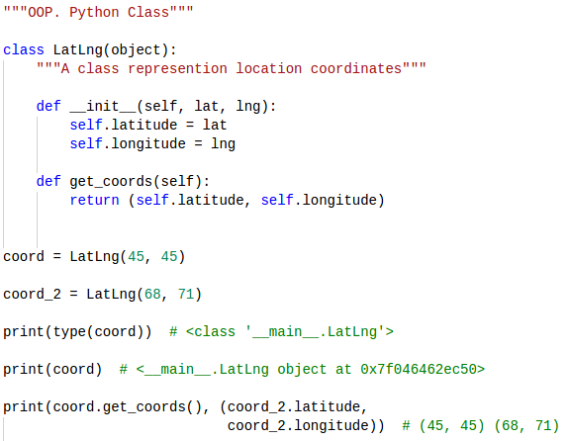
OOP. Python Syntax

Slide 7
OOP Basic Concepts
Encapsulation
Inheritance
Abstraction
Polymorphism

Slide 8
OOP. Encapsulation
Important advantage of OOP consists in the encapsulation of data. We can say that object-oriented programming relies heavily on encapsulation.
Data hiding and encapsulation are the same concept, so it's correct to use them as synonyms
Generally speaking encapsulation is the mechanism for restricting the access to some of an object's components, this means, that the internal representation of an object can't be seen from outside of the object’s definition.

Slide 9
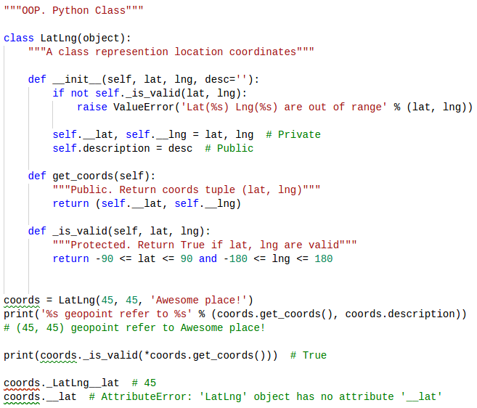
OOP. Access Modifiers

Slide 10
OOP. Inheritance
Inheritance is a powerful feature in object oriented programming.
It refers to defining a new class with little or no modification to an existing class.
The new class is called derived (or child) class and the one from which it inherits is called the base (or parent) class.
Derived class inherits features from the base class, adding new features to it.

Slide 11
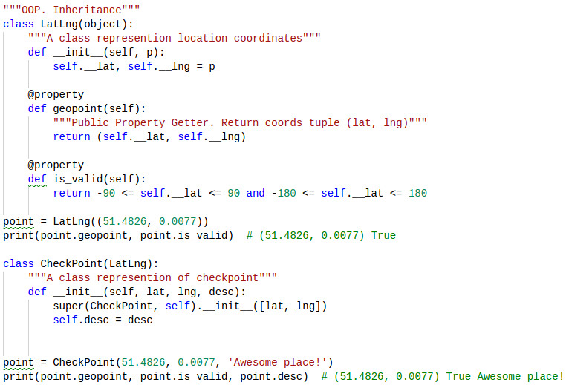
OOP. Inheritance

Slide 12
OOP. Abstraction
Is the process of removing characteristics from something in order to reduce it to a set of essential characteristics.
Abstraction allows programmers to represent complex real world in the simplest manner.
It is a process of identifying the relevant qualities and behaviors an object should possess, in other word represent the necessary features without representing the background details
When we design the abstract classes, we define the framework for later extensions.
An abstract class cannot be instantiated. It can only be used as a super-class for other classes that extend the abstract class.

Slide 13
Abstract class
Is the process of removing characteristics from something in order to reduce it to a set of essential characteristics.
Abstract classes are classes that contain one or more abstract methods or properties.
An abstract method is a method that is marked with @abstractmethod and contains no implementation or contains some limited implementation.
An abstract property is a property that is marked with @abstractproperty and contains no implementation or contains some limited implementation.
Abstract classes may not be instantiated, and require subclasses to provide implementations for the abstract methods and properties.

Slide 14
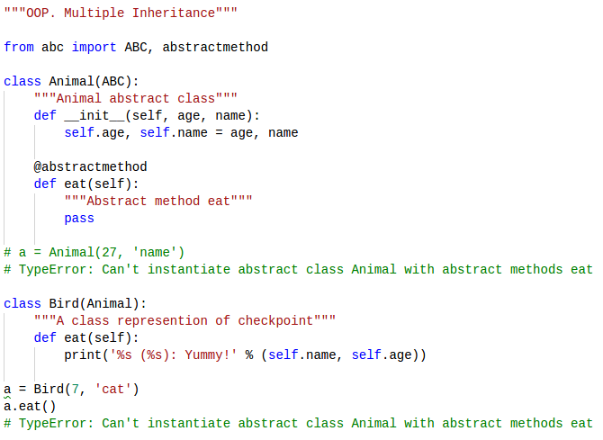
OOP. Abstraction

Slide 15
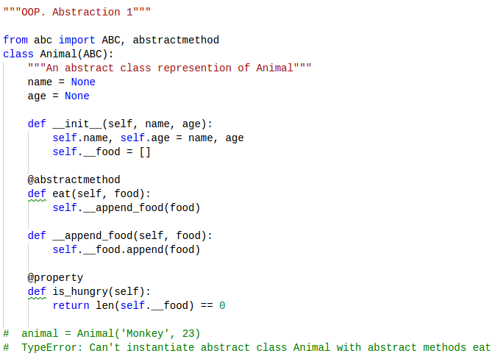
Abstract Method

Slide 16
OOP. Polymorphism
Encapsulation, Inheritance, and Abstraction concepts are very related to Polymorphism.
Polymorphisms is a generic term that means 'many shapes'. More precisely Polymorphisms means the ability to request that the same methods be performed by a wide range of different types of things.
So polymorphism is the ability (in programming) to present the same “interface” for differing underlying forms (data types).

Slide 17
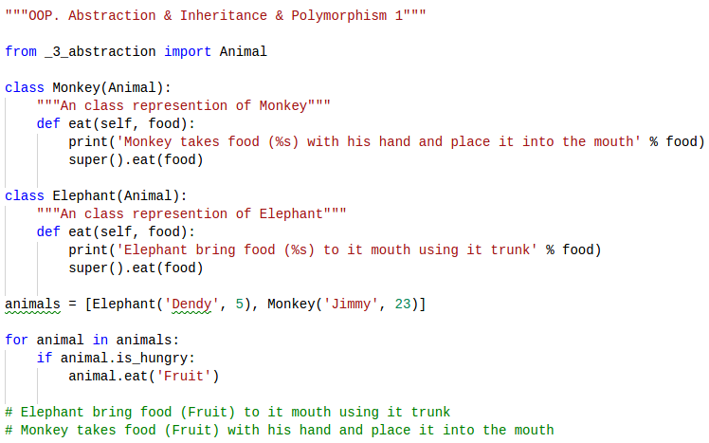
Abstraction. Polymorphism

Slide 18
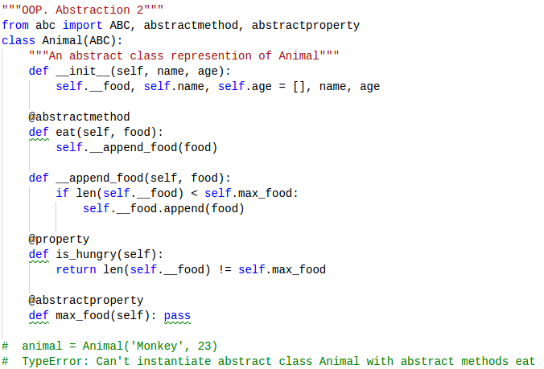
Abstract Property

Slide 19
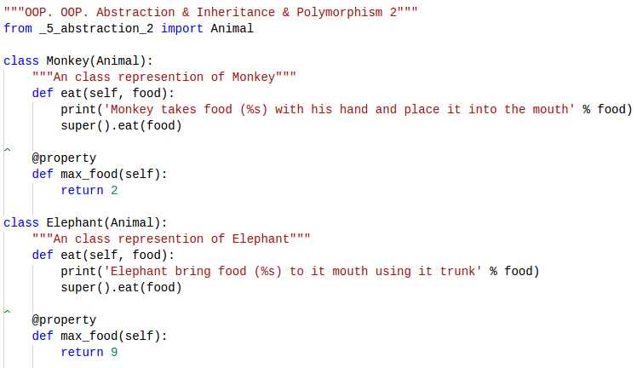
Abstraction. Polymorphism

Slide 20
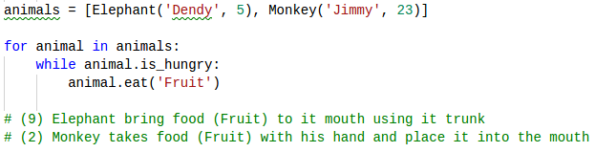
Abstraction. Polymorphism

Slide 21
Abstract Method (private)

Slide 22
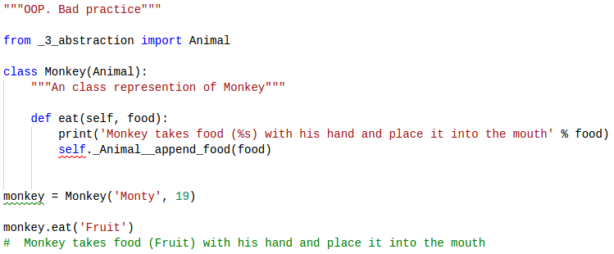
OOP.Bad Practice

Slide 23
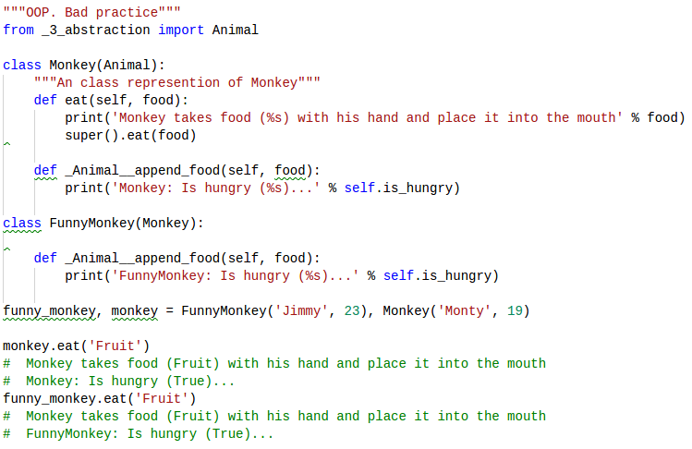
OOP.Bad Practice

Slide 24
Interfaces
Consider the following situation:
You are in the middle of a large, empty room, when a zombie suddenly attacks you.
You have no weapon.
Luckily, a fellow living human is standing in the doorway of the room.
"Quick!" you shout at him. "Throw me something I can hit the zombie with!"
Let’s consider...

Slide 25
Interfaces
You didn't specify (nor do you care) exactly what your friend will choose to toss; ...But it doesn't matter, as long as:
It's something that can be tossed (He can't toss you the sofa)
It's something that you can grab hold of (Let's hope he didn't toss a shuriken)
It's something you can use to bash the zombie's brains out (That rules out pillows and such)
It doesn't matter whether you get a baseball bat or a hammer - as long as it implements your three conditions, you're good.
When you write an interface, you're basically saying: "I need something that..."

Slide 26
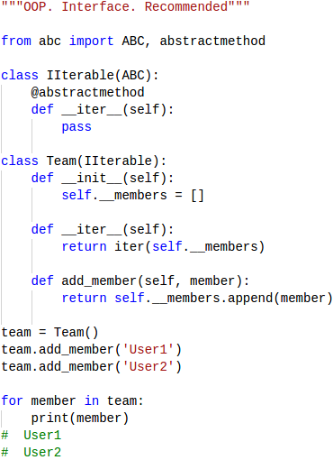
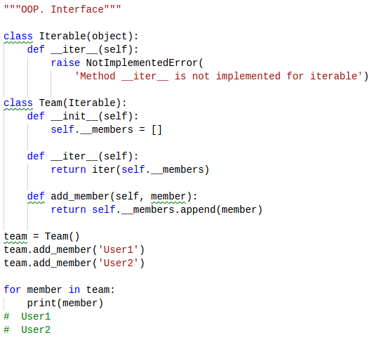
Interfaces
Python doesn’t support interfaces but there are some ways to emulate it

Slide 27
Static Method
Static methods, much like class methods, are methods that are bound to a class rather than its object.
They do not require a class instance creation. So, are not dependent on the state of the object.
Static method knows nothing about the class and just deals with the parameters.

Slide 28
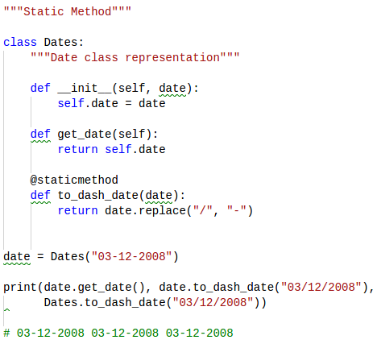
Static Method

Slide 29
Static Method Usage
Grouping utility function to a class
Static methods have very limited use case, because like class methods or any other methods within a class, they cannot access properties of the class itself.
However, when you need a utility function that doesn't access any properties of a class but makes sense that it belongs to the class, we use static functions.
Having a single implementation
Static methods are used when we don't want subclasses of a class change/override a specific implementation of a method.

Slide 30
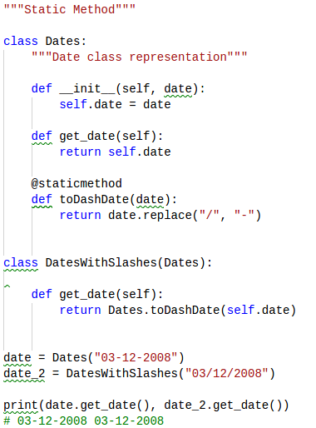
Static Method

Slide 31
Class Method
A class method is a method that is bound to a class rather than its object. It doesn't require creation of a class instance, much like staticmethod.
They do not require a class instance creation. So, are not dependent on the state of the object.
Class method works with the class since its parameter is always the class itself.

Slide 32
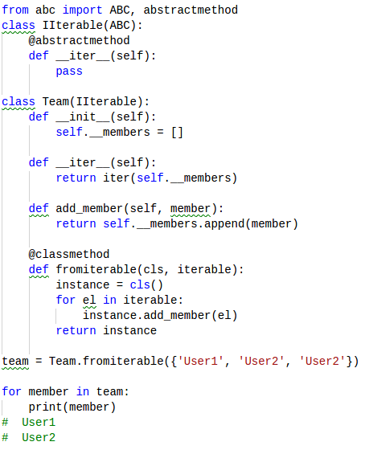
Class Method

Slide 33
Class Method Usage
Factory methods
Factory methods are those methods which return a class object (like constructor) for different use cases.
Correct instance creation in inheritance
Whenever you derive a class from implementing a factory method as a class method, it ensures correct instance creation of the derived class.
You can create a static method for the above example but the object it creates, will always be hardcoded as Base class.
But, when you use a class method, it creates the correct instance of the derived class.

Slide 34
SOLID principles
Five basic principles of OOP
SRP - Single Responsibility Principle
OCP - Open/Closed Principle
LSP - Liskov Substitution Principle
ISP - Interface Segregation Principle
DIP - Dependency Inversion Principle

Slide 35
SOLID goals
Make software entities easy to:
understand
maintain
extend
unit-test
reuse in different context

Slide 36
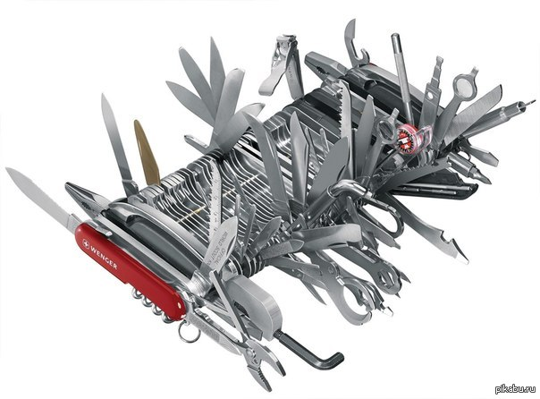
Single Responsibility Principle
Single responsibility is the concept of a Class doing one specific thing (responsibility) and not trying to do more than it should

Slide 37
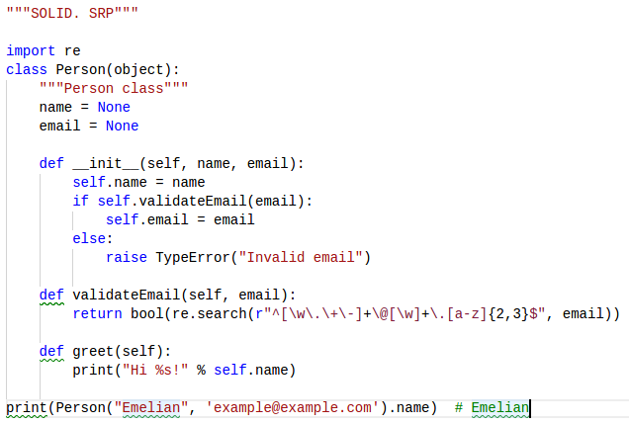
Single Responsibility Principle
Each class should have only one responsibility. Not just to “do only one thing”

Slide 38
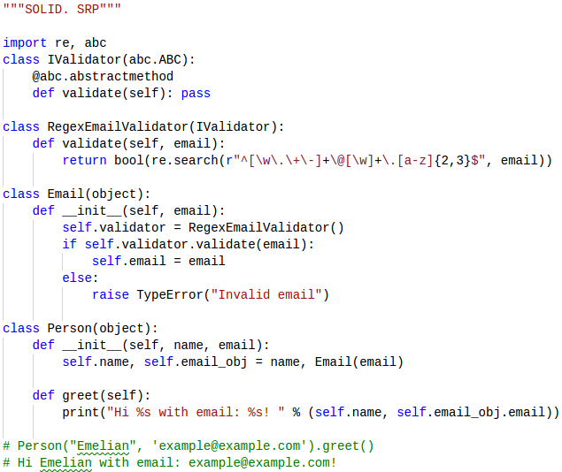
Single Responsibility Principle

Slide 39
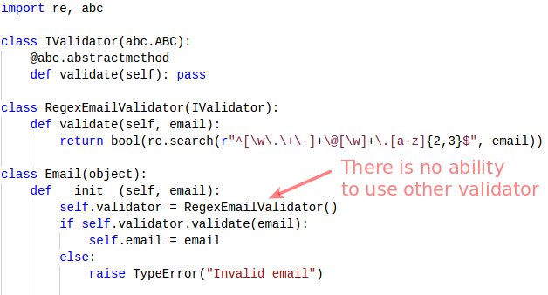
Open/Closed Principle
Software entities (classes, modules, functions, etc.) should be opened for extension, but closed for modification

Slide 40
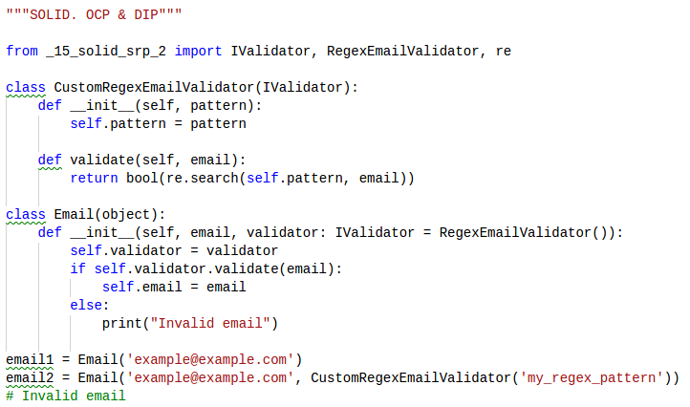
Open/Closed Principle & DI

Slide 41
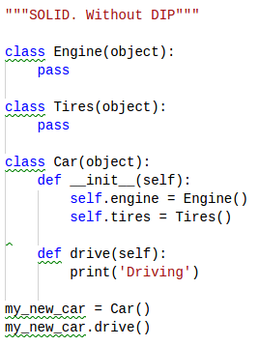
Dependency Inversion

Slide 42
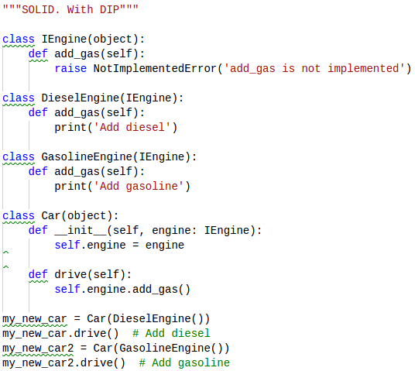
Inversion of Control

Slide 43
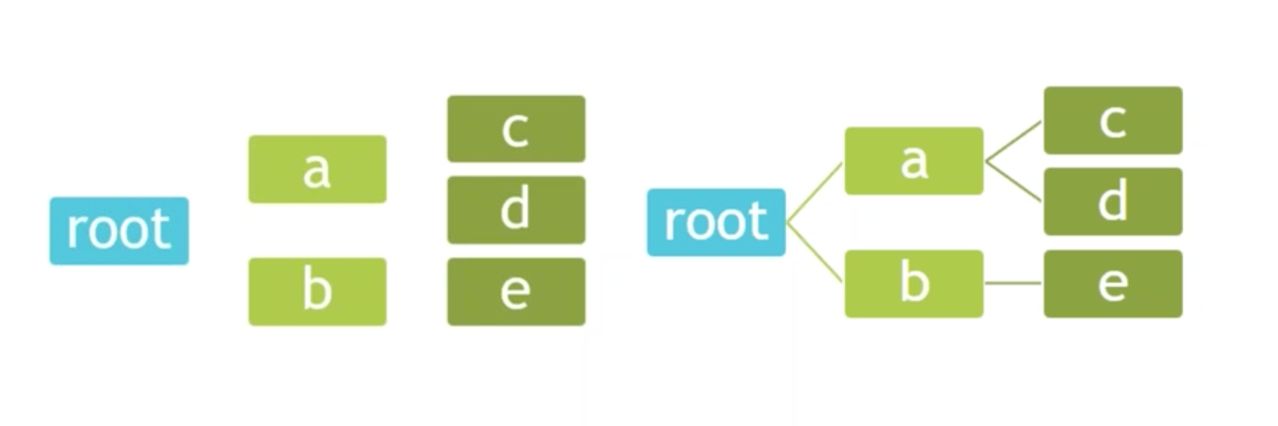
WHY WE NEED DI?

Slide 44
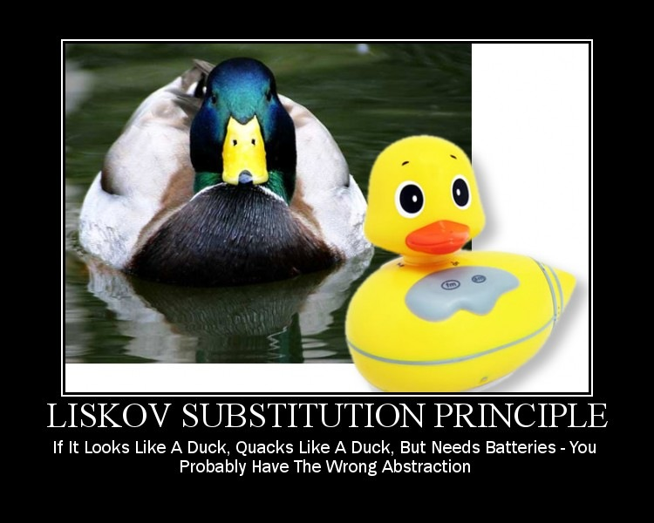
Liskov Substitution Principle

Slide 45
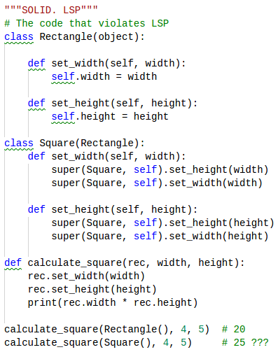
Liskov Substitution Principle

Slide 46
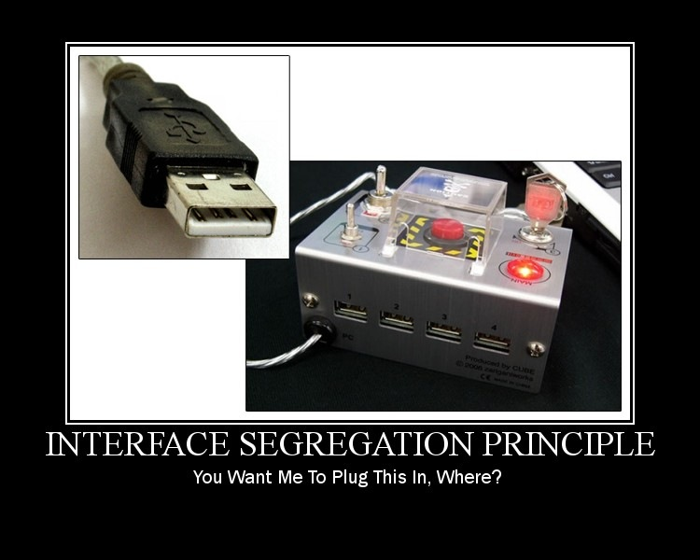
Interface Segregation Principle

Slide 47
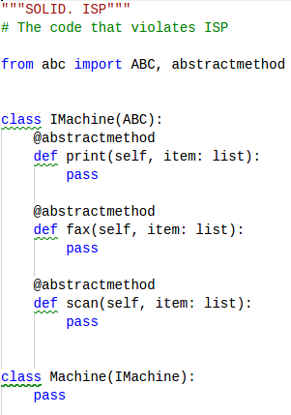
Interface Segregation Principle

Slide 48
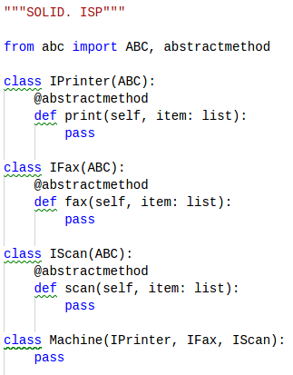
Interface Segregation Principle

Slide 49
Thanks for watching

