Slide 1

Python Flow
Lecture 5. MetaClasses. ContextManager.

Slide 2

OVERVIEW
MetaClasses
ContextManager

Slide 3
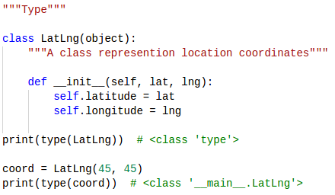
Metaclasses
A class is an object, and just like any other object, it's an instance of something: a metaclass.
The default metaclass is type.
Unfortunately, due to backwards compatibility, type is a bit confusing. It can also be used as a function that return the type of an object

Slide 4
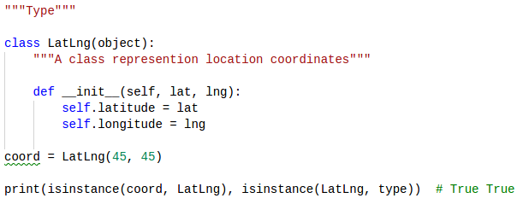
Metaclasses

Slide 5
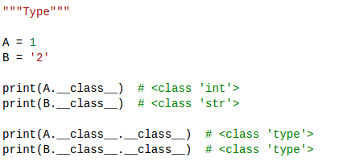
What is Metaclasses
Metaclass is a class which is used to create another class

Slide 6
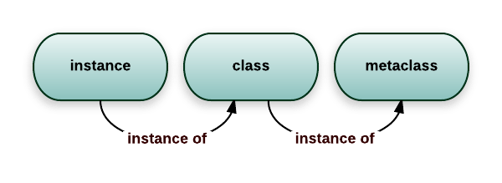
Metaclasses

Slide 7
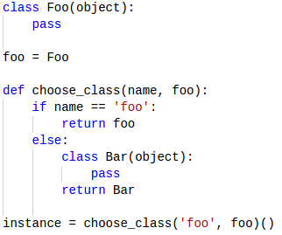
Metaclasses
That’s why
class is object in memory.
we can assign class reference to a variable.
we can add and change attribute in class.
it can passed to function as an argument.

Slide 8
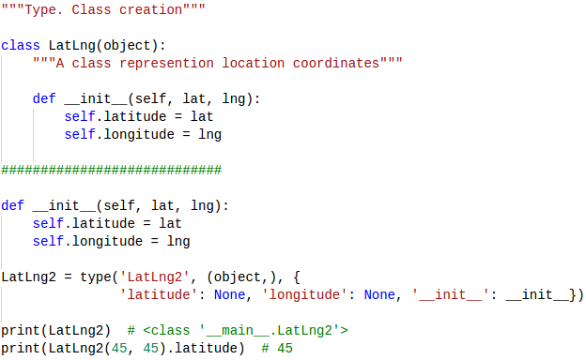
Metaclasses. Type
The class statement isn't just syntactic sugar, it does some extra things, like setting an adequate __qualname__ and __doc__ properties or calling __prepare__.

Slide 9
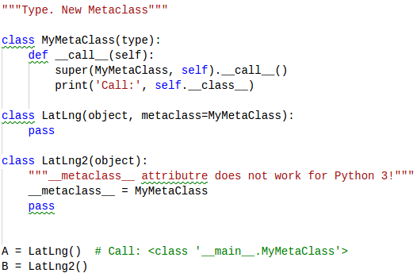
Metaclasses
We can make a custom metaclass. And then we can use it.
The main idea of metaclasses is ability to automatically change class during it creation.

Slide 10
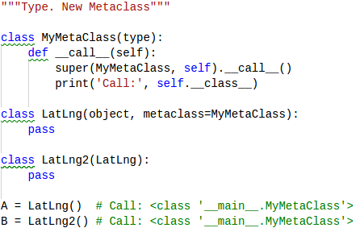
Metaclasses
Python search metaclass on class definition, then on parent class definition.
If nothing found - type metaclass will be used by default.
metaclass may contain any object which could create a class

Slide 11
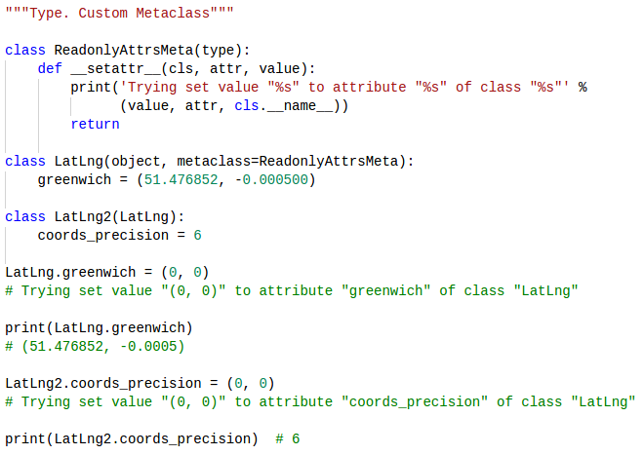
Custom Metaclasses

Slide 12
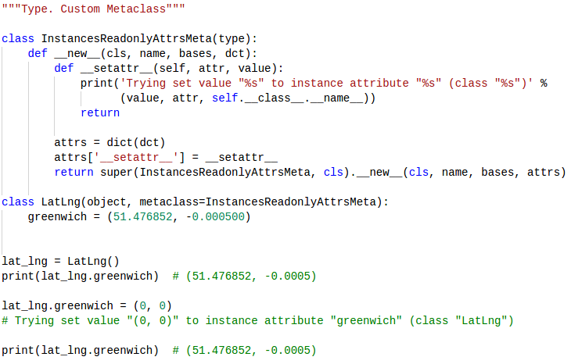
Custom Metaclasses

Slide 13
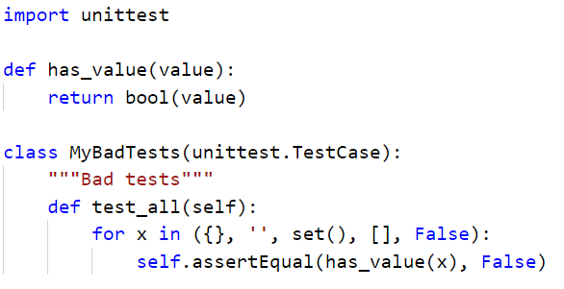
Metaclasses Usage

Slide 14
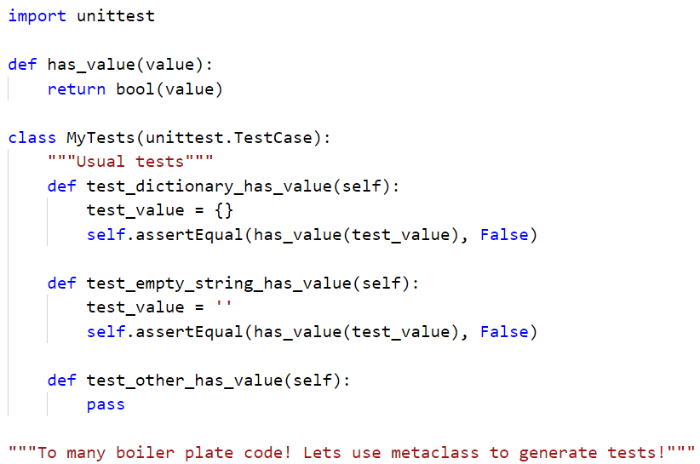
Metaclasses Usage

Slide 15
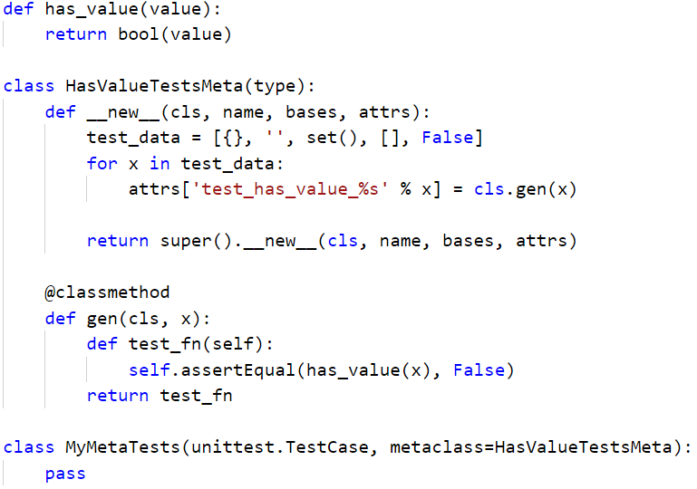
Metaclasses Usage

Slide 16
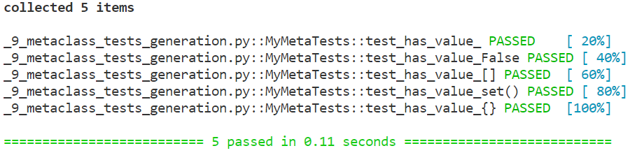
Metaclasses Usage

Slide 17
Managing Resources
In real systems, it's difficult to make sure that close() is called on every file opened, especially if the file is in a function that may raise an exception or has multiple return paths.
In other languages, developers are forced to use try...except...finally every time they work with a file (or any other type of resource that needs to be closed, like sockets or database connections)
Luckily, Python loves us and gives us a simple way to make sure all resources we use are properly cleaned up, regardless of if the code returns or an exception is thrown: context managers.

Slide 18
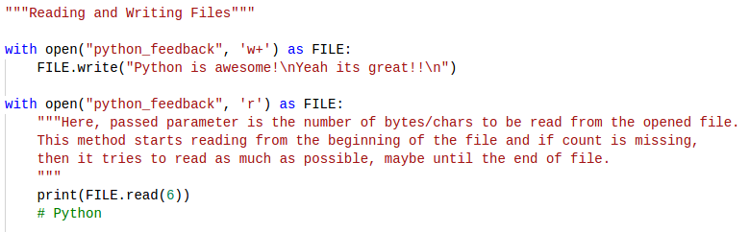
Managing Resources
That's it! Using with, we can call anything that returns a context manager (like the built-in open() function).
The FILE variable exists after the indented block below the with statement, but after the with block file will be closed.

Slide 19
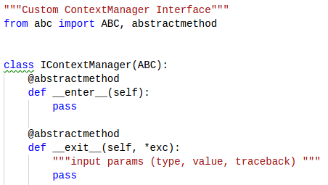
What is Context Manager?
A Context Manager is an object that has an __enter__, __exit__ methods implemented.

Slide 20
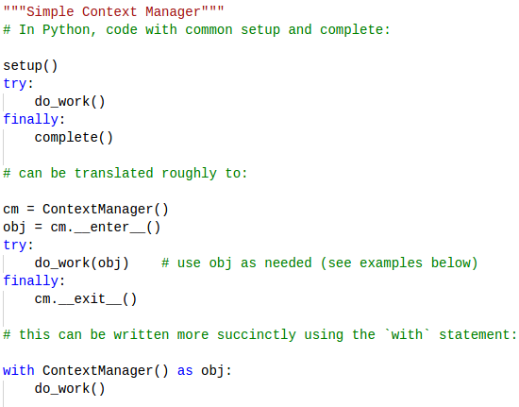
What is Context Manager?

Slide 21
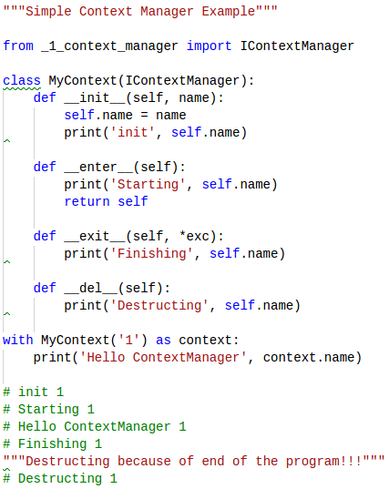
ContextManager Example

Slide 22
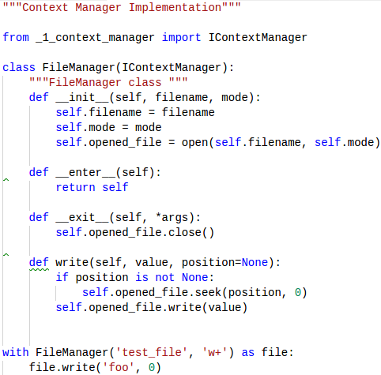
ContextManager Example

Slide 23
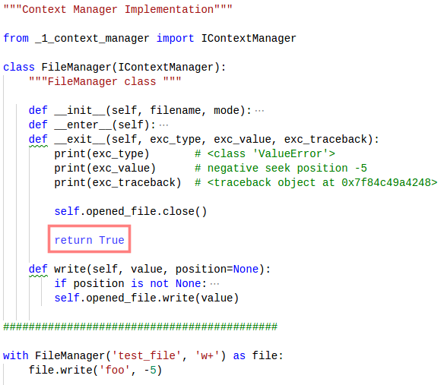
CM Exception Handling

Slide 24
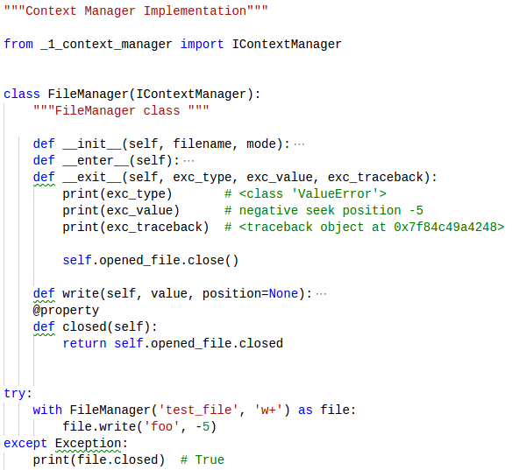
CM Exception Handling

Slide 25
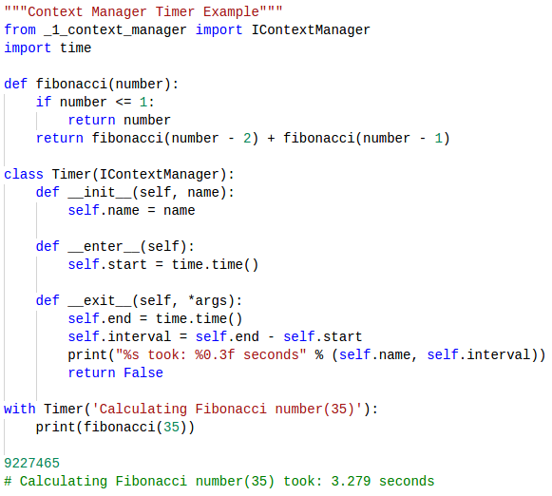
CM Timer Example

Slide 26
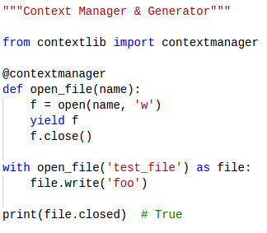
CM With contextlib

Slide 27
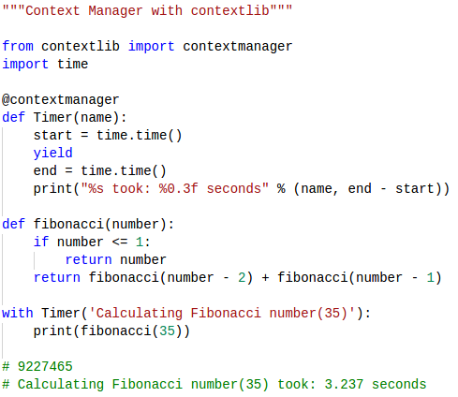
CM With contextlib

Slide 28
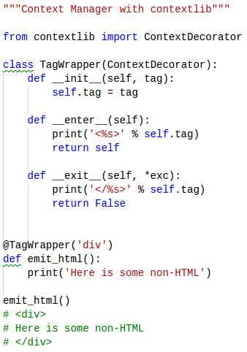
CM With contextlib

Slide 29
Thanks for watching

